Slide 1
Kara Whitely – Logo & Website
Possible book cover
World’s worst computer design.
Gorge
By Kara Whitely

Slide 2
In the Works
Gorge
Spring 2015
Documentary
TLC ,Weather Channel
Or Outside Magazine
Online series
Gorge-ous.
Plus-size Active Clothing Line
By Junonia in REI Stores
Speaking Engagements
Wilderness Writers Conference
Tour /National Parks(125 REIs)
Media
Seal Press provides publicist
- Wow-factor
Millions
List 400K
Millions
Millions

Slide 3
Current Website
Fat Woman on the Mountain off the market
Not really excited about FWOTM label any more.
Will shut down when new website is up, w/redirect.
No allegiance to the colors or logo. But would like a natural edge/feeling (ie Trickle Up) invoking feeling of outdoors and possibilities.

Slide 4
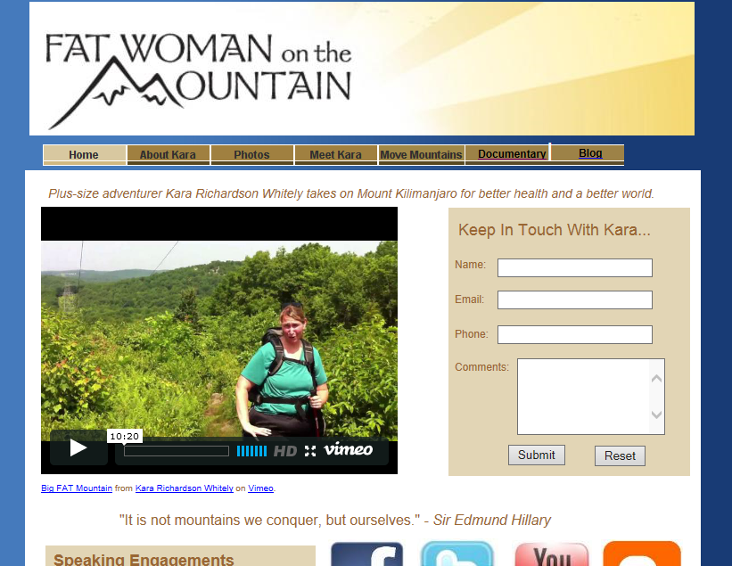

Slide 5












My logo will probably just be
“Kara Whitely” typeset – but here are some logos/Images loved by my audience

Slide 6
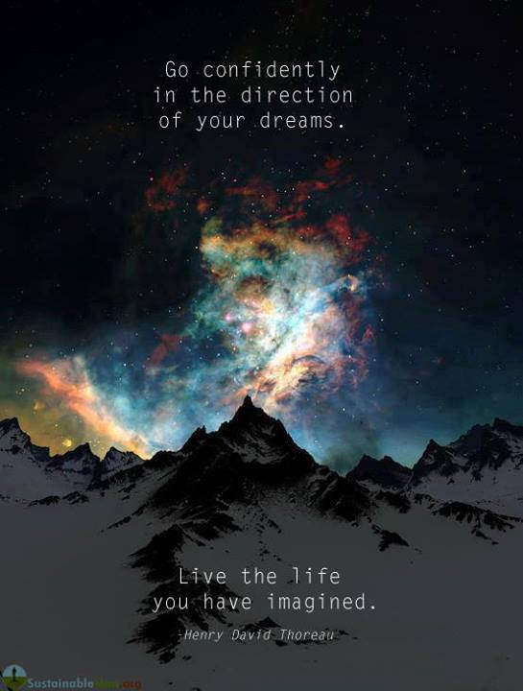
Inspiration: Websites I Like & Why
Logo just typeset (though Shankman uses his autograph, which makes you assume he’s famous)
Photo focused
Emphasis on events/news

Slide 7
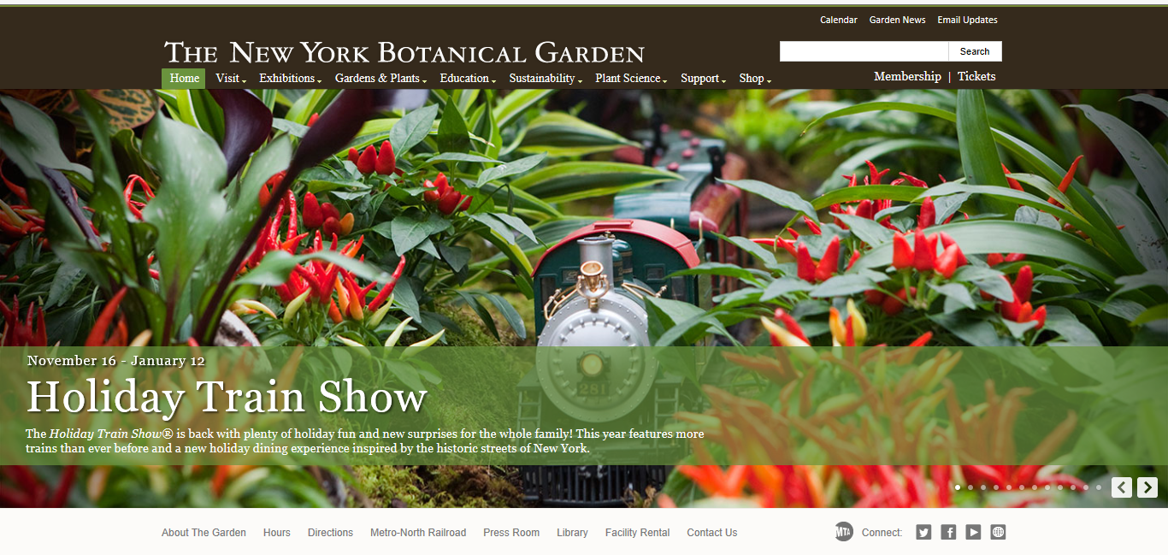
Notes:
Love the photo-centric look of this site. Very simple but amazing.

Slide 8
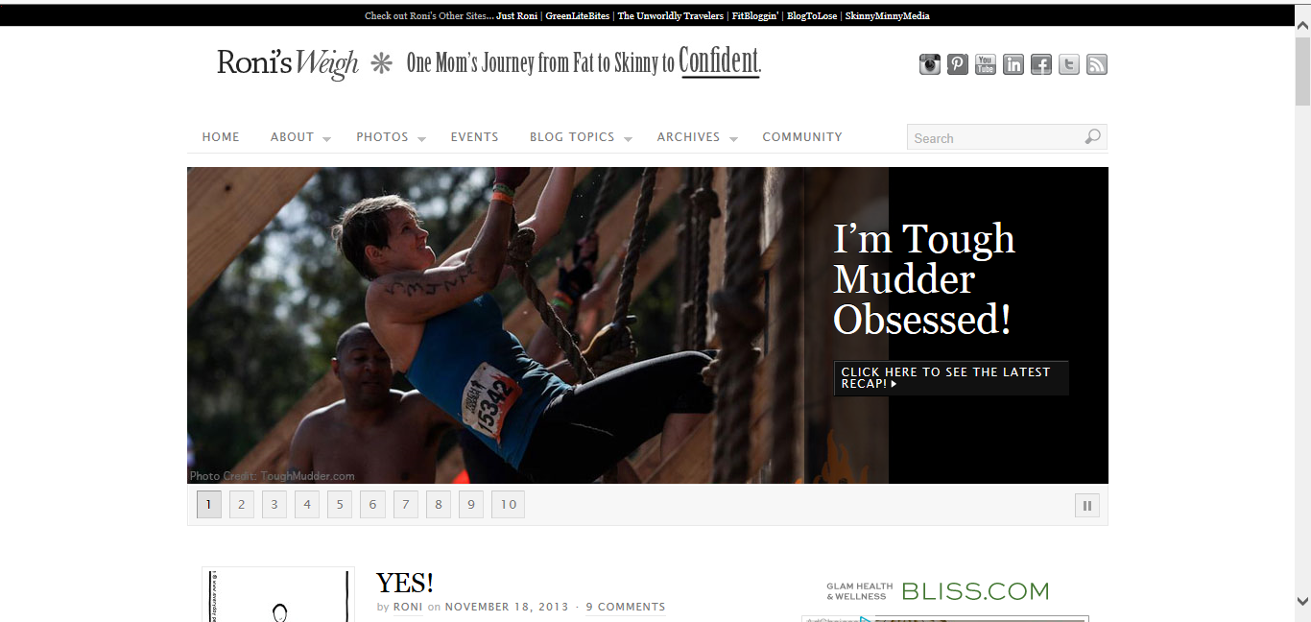
Notes:
My friend Roni’s blog. Love the action shot.

Slide 9
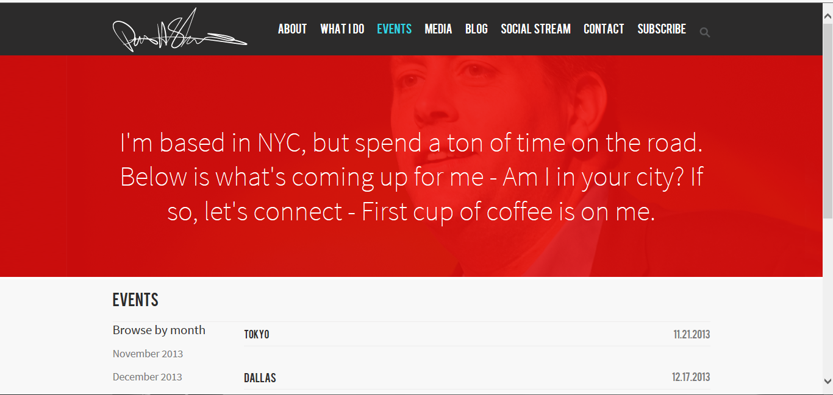
Notes:
He has great emphasis on events. Probably bse he gets paid $15,000 for a keynote. Love his copy. (In line w/his customer service bent) Kind of like his autograph logo… makes you automatically think he’s famous.

Slide 10
Typical Best-Selling Author Websites
Events
Bio
Books
Social Media or Newsletter Engagement
Contact

Slide 11
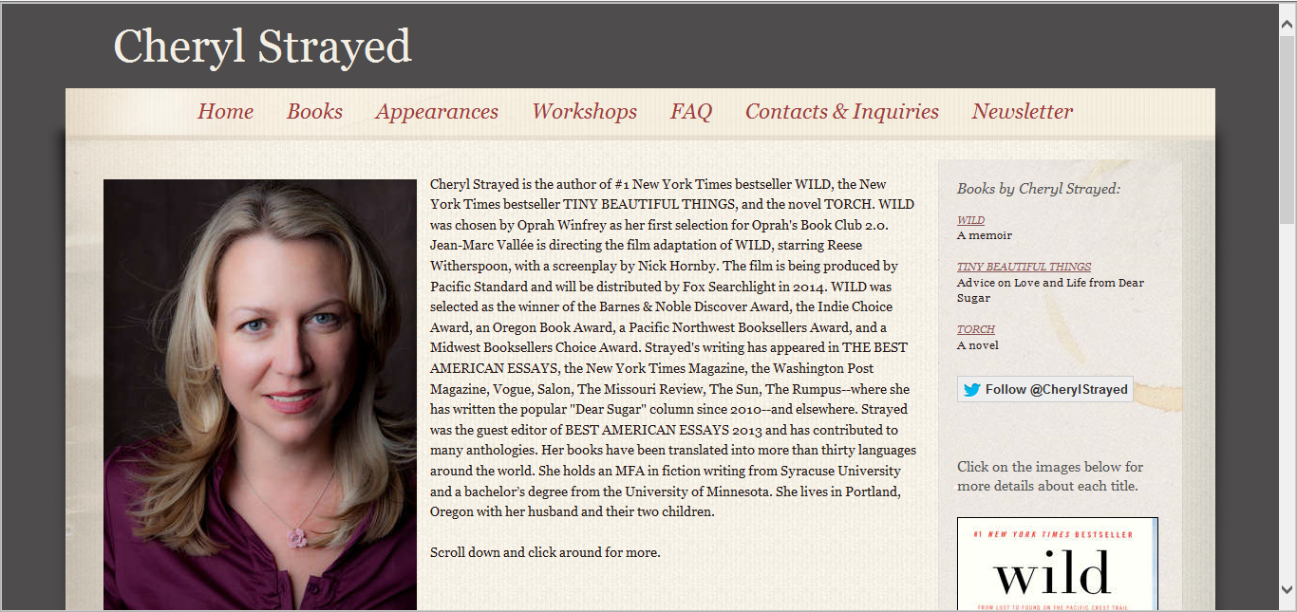
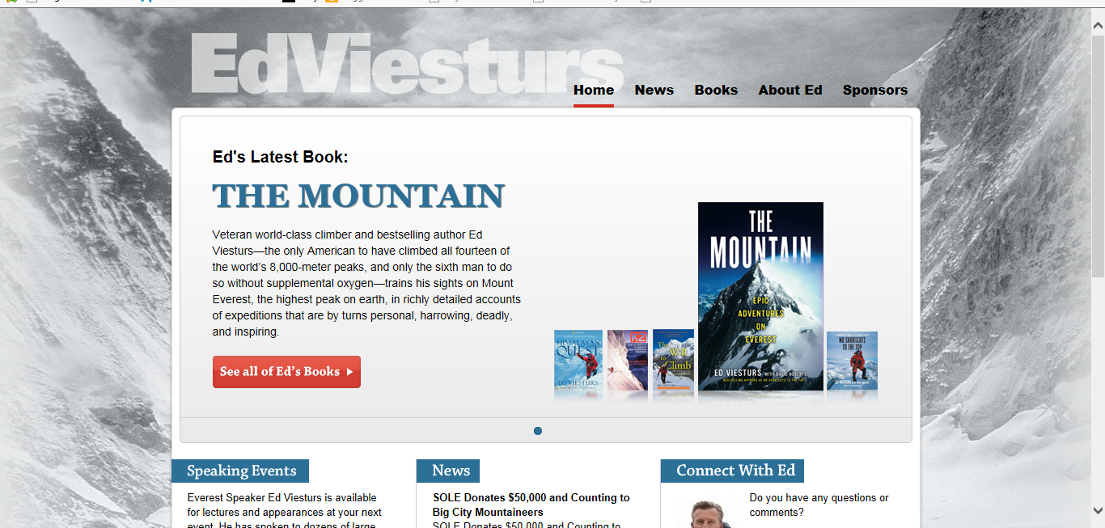
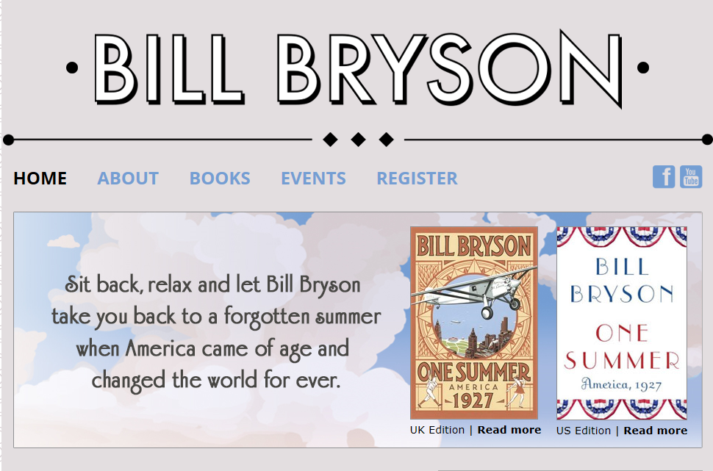
Notes:
This is the author who I’m compared to most. (Gorge is called a plus-size Wild)

Slide 12
Possible New Website Architecture
Home
Bio/
Media
Book
Doc
Speaking/
Contact
Tour/
Speaking
Same nav bar on each page
Social media engagement on each page
Secondary pages can have static hero images.
Very simple and clean look/navigation

Slide 13
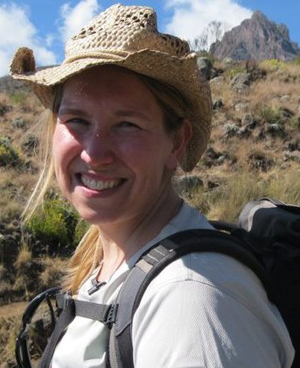
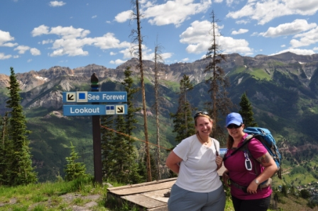
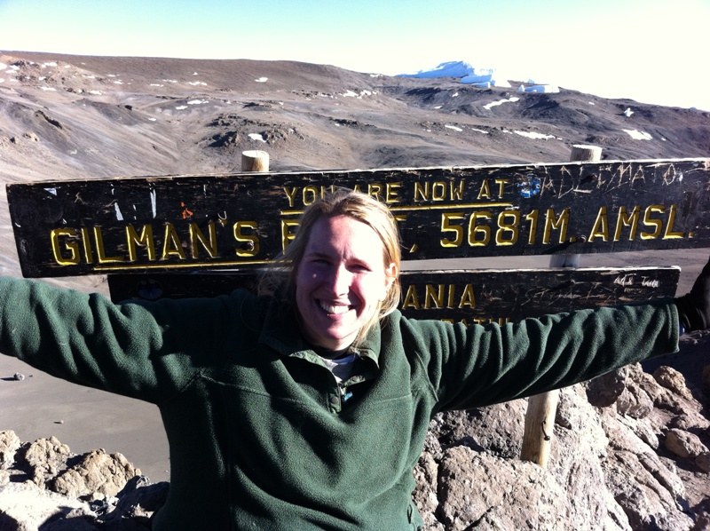
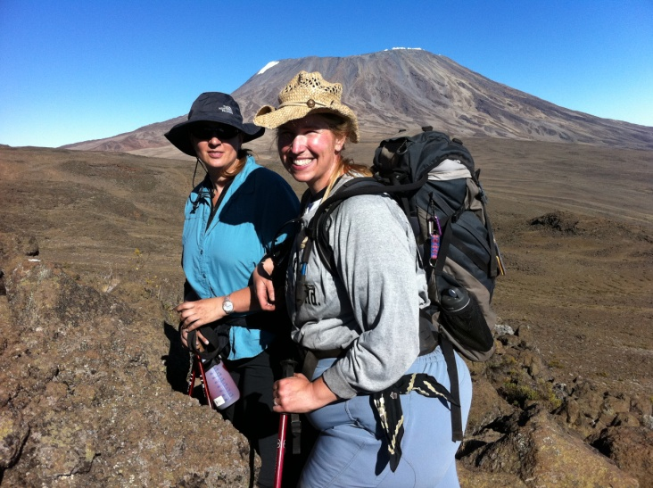
Can Use Many of My Images/Video Stills

Slide 14

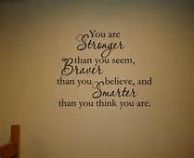


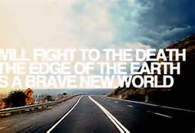





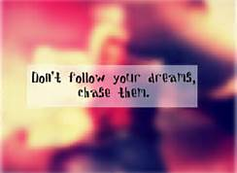
Brave, Inspiring, Compelling & Healing
Favorite

Slide 15

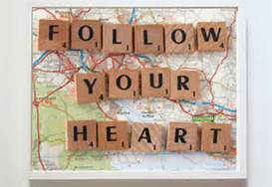


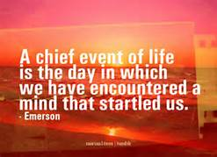
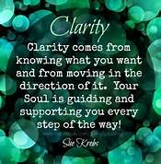
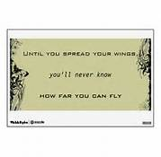


Brave, Inspiring, Compelling & Healing

Slide 16




Sunrise/Sunset Images

Slide 17


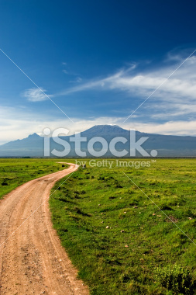


Slide 18
KARA WHITELY
About
Projects
Events
Contact
Gorge
By Kara Whitely

Slide 19
Kara Whitely
About
Projects
Events
Contact
Bio
Blah, blah, blah.
New Headshot coming 12/26

Slide 20
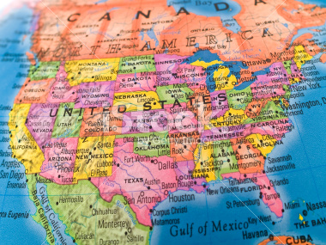
Kara Whitely
About
Projects
Events
Contact
Find Kara on tour….
XXXXX
XXXX
XXXXX
XXXXX
/xxxxxx
Notes:
Kind of like the hand writing because it conveys that honesty.

