Slide 1



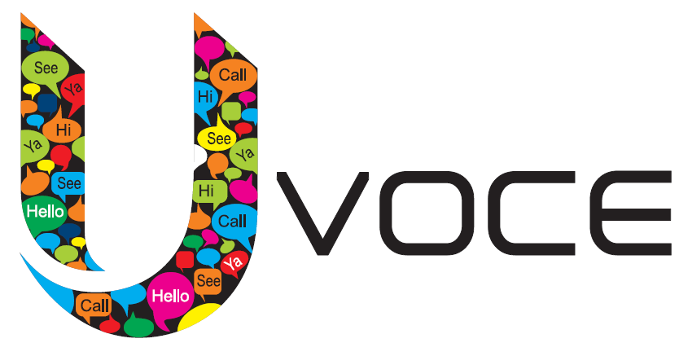
Hosted PBX from UVOCE Page 1 of 2
Hosted PBX: Key Differentiators
UVOCE Hosted PBX is an enterprise-grade VoIP phone system. It’s delivered from the cloud to small and medium-sized businesses.
Communicate more effectively
Simplify management and scaling via your Control Panel
Cut capital, maintenance and long distance costs
High reliability
Free onboarding & migration (keep your phone numbers)
Superior 24/7/365 support .
Encrypted Voice calls
The Marketplace
SMBS are rapidly embracing VoIP. According to Frost & Sullivan, the number of hosted VoIP lines will increase by 45% in 2014—and reach 14.7 million lines by 2016.
The competition and their weakness
vs on-premise PBX or Key System:
Hosted PBX offers more features
Easier to manage and support
Easy upgrade path for new features and scalability
Cut costs: CAPEX, maintenance, licenses & telco costs
vs other Hosted PBX providers:
UVOCE offers a full suite of cloud services (email, cloud servers & more) (please check web site:- uvoce.com)
UVOCE provides 24x7 support .
Consumer-grade VoIP service:
(Skype, Google Voice)
Hosted PBX offers business-grade features designed with SMBs in mind, not consumers
Hosted PBX
Free Desk Phone Promo!
Free Polycom/Cisco for each new user
Requires 12-month contract • Through Oct 30, 2013
SELECT FEATURES
Encrypted Voice Calls , Account - Authorization Codes, Alternate Numbers, Anonymous Call Rejection, Authentication by Digest (user's web browser), Authentication by ANI (users Phone number),◦ Auto Attendants,◦ Personal Auto Attendants and scheduled Auto Attendant, Chained Auto Attendants,◦ Barge In / Barge-in Exempt, Busy Lamp Field, Call Forwarding, Call Forwarding Always, Call Forwarding Busy◦ Call Forwarding No Answer◦ Call Forwarding Not Reachable◦ Find Me (multiple numbers)◦ Call Logs (Inbound and Outbound)◦ Call Park◦ Call Pick Up◦ Call Pick Up Group◦ Directed Call Pickup◦ Call Queues◦ Call Recording◦ Call Return◦ ◦ Call Status (Real-time in User Portal)◦ Call Transfer◦ Attended Transfer◦ Blind Transfer◦ Intercom Transfer◦ Transfer to Voicemail◦ Call Waiting◦ Calling Line ID Delivery Blocking, ◦ Calling Name Retrieval◦ Calling Party Category◦ CDRs◦ Client Call Control (API and User Portal)◦ Conferencing (Multi-Way Calling)◦ Scheduled/Instant Conference◦ Web-based Setup◦ Account Codes◦ Monitor Add, Drop, Hold, Mute◦ Conference Recording◦ Direct Inward Dialing◦ Extension Dialing◦ External Calling Line ID Delivery◦ Hunt Groups◦ In-Call Service Activation◦ Intercom◦ Internal Calling Line ID Delivery◦ Last Number Redial◦ Malicious Call Trace◦ Message Waiting Indicator◦ Music-On-Hold◦ System Default Music-on-Hold◦ Personalized Music-on-Hold…contd…
Hosted PBX: $19.95/user Taxes not included in price
Each user receives: 1 direct dial phone number and 1 extension 1 conference dial-in (unique passcode) Find Me/Follow Me Voicemail and voicemail-to-email Caller ID, call waiting, 3-way calling, call transfer, call recording Unlimited calling in the US and Canada Each account includes: 1 automated attendant (multi-level) 10 hunt groups On-hold music which you can customize Online administration of your portal Free onboarding and migration, including number porting, user & phone setup, and more We offer you free vigilant 24/7/365 support | Available add-ons: Additional phone number Toll-free numbers Hunt groups (additional) Auto attendants (additional) Click-to-Call: Order pre-configured phones Visit website for phones/pricing

Slide 2






Hosted PBX from UVOCE Page 2 of 2
Five points of differentiation for Hosted PBX:
SELECT FEATURES..contd..
◦ N-way Call◦ Phone Status◦ Selective Call Acceptance◦ Selective Call Rejection◦ Sequential Ring,◦ Shared Call Appearance◦ Simultaneous Ring Personal◦ Video Telephony◦ Voicemail◦ Default Greetings◦ Customizable Greetings◦ Name Recording◦ Email Notification◦ Voicemail Forwarding◦ Forwarding to Email◦ User Portal (View, Save Delete)◦ Voice Messaging Group◦ Voice Messaging Call Back◦ Web User Console◦ Contact List◦ Dial by Contact Name◦ Inbound Call Handling Rules◦ Screen Pop for CRM support , Group Features◦ Authorization Group Codes◦ Auto Attendants◦ Personal Auto Attendants,◦ Attendant Console,◦ Detailed reports ◦ International calls blocking, Calling Plans (Incoming, Outgoing)◦ Configurable Extension Dialing◦ Configurable Feature Codes◦ Device Inventory◦ Group Announcements,◦ Hunt Groups◦ Instant Group Call◦ Office Manager Portal (Web portal)◦ Printable Group Directory ◦ Simultaneous Ring (group)◦ Video Conference (external MCU).
1. Communicate more effectively | 2. Simplify management & scaling | 3. Lower your costs
Rich, Fortune 500-grade features help you operate more effectively. Automated attendant (multi-level)answers and routes every call Hunt groups ring multiple people at once or sequentially Click-to-Call connects phones Find Me/Follow Me forwards calls to your mobile and other numbers Conferencing dial-in numbers connect up to 20 people And much more | Our powerful and intuitive web-based control panel dramatically simplifies moves, adds, and changes. Easily manage upgrades, feature introductions, migration and scaling Retain granular control to configure your phone system to match your exact needs | Preserve you capital, reduce system expenses, and cut operating costs. No need to invest capital in rapidly depreciating on-premise phone systems Slash operating expenses by eliminating maintenance, upgrades, software license and telco costs Cut costs with unlimited local and long distance calling to US and Canada
4. Free migration and 24/7 support | 5. Integrate with our other services and business tools
Keep your attention on growing your business. Our Cloud Concierge™ team ports over your phone numbers and sets up users, ensuring a smooth transition Our 24/7/365 support is standard just in case you need it Enterprise-grade datacenters, providers, software & high availability hardware | Hosted PBX integrates directly with UVOCE full suite of business applications. Unlock productivity benefits of Click-to-Call and more Every element is fully managed & delivered from the cloud Impeccable security and reliability, broad ease-of use, 24/7 access to onboarding and support... all from a single vendor
UVOCE:
Fewer than 25 phones: spotlight cost savings/ROI Cost effectiveness of service and ease of management Keep your existing phone numbers No technicians or wiring necessary UVOCE continuously updates service with newest features | Above 25 phones: spotlight on control Ability to configure all features, set up users, manage every aspect of your phone service Easy to grow, scale, move employees and change settings Manage multiple offices with no additional complexity
www.uvoce.com

