Slide 1

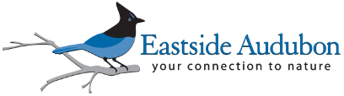
Creating Bird Friendly Communities

Slide 2
Messaging Points – Keep it Simple with What, Why, and How
More than Just a Yard
You can turn your backyard into wonderful habitat that helps support many different kinds of birds. And, and if you do this, and your neighbors do this, and their neighbors do this, pretty soon we have an entire bird friendly community! There are several things you can do to make your yard bird friendly. Take our pledge and commit to doing at least three things on this list:
Provide protective cover to nest and rest.
Offer a source of water to drink and bathe.
Plant native plants that offer seeds and berries.
Reduce or eliminate pesticide use in your yard.
Keep your cats indoors.
Become a member of Eastside Audubon Society and spread the word.
Where did this bird come from?
Many of the birds you see in your yard migrate along the Pacific Flyway. They travel thousands of miles, from the tip of the northern hemisphere down to the bottom of the southern hemisphere. For example, the Rufous Hummingbird is only three inches long but will travel over 2,000 miles to reach their summer and winter homes. They need your help. Your newly created bird friendly yard can be a great place for them to nest, rest, and feed.

Slide 3
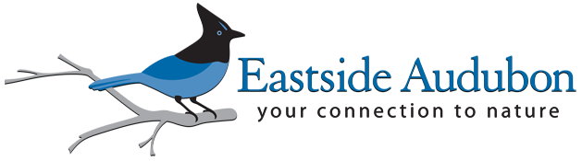

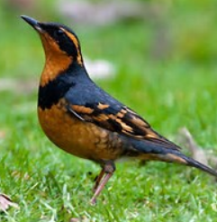

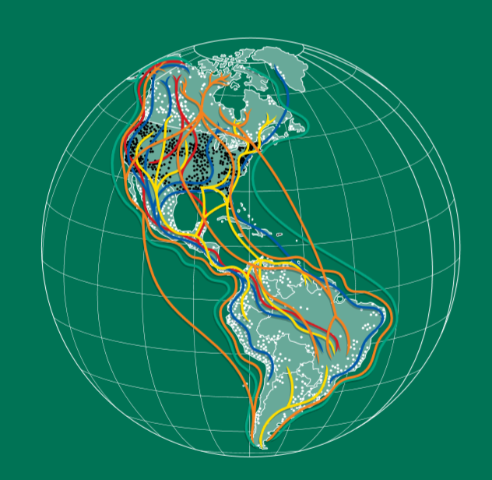
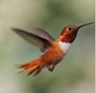
Eastside Audubon, P.O. Box 3115, Kirkland, WA 98083-3115 • 425-576-8805
http://eastsideaudubon.org

