Slide 1
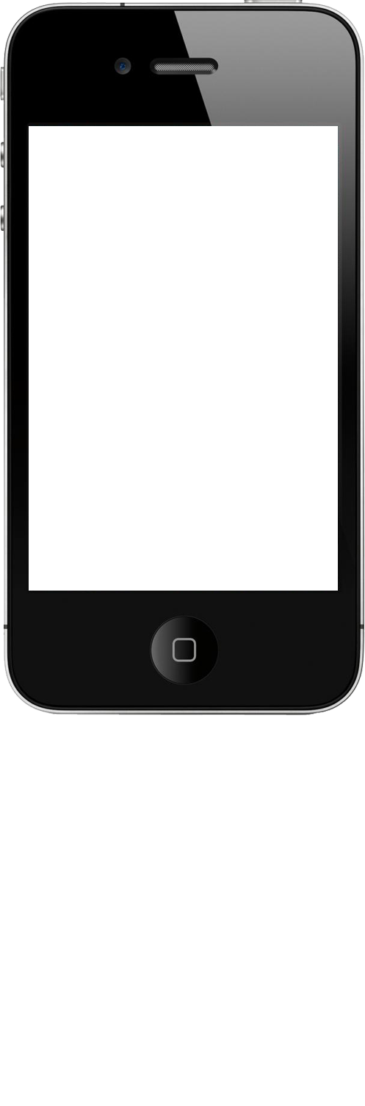

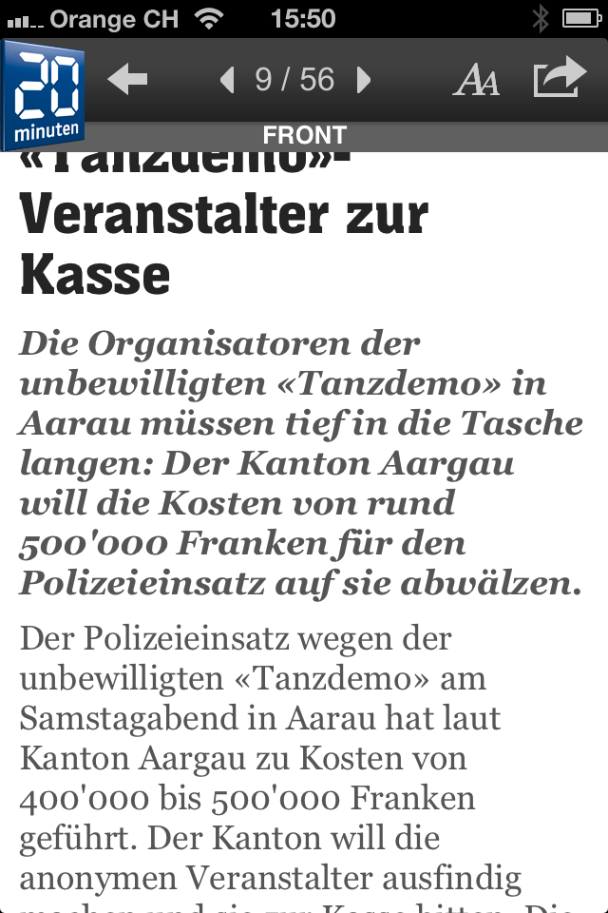
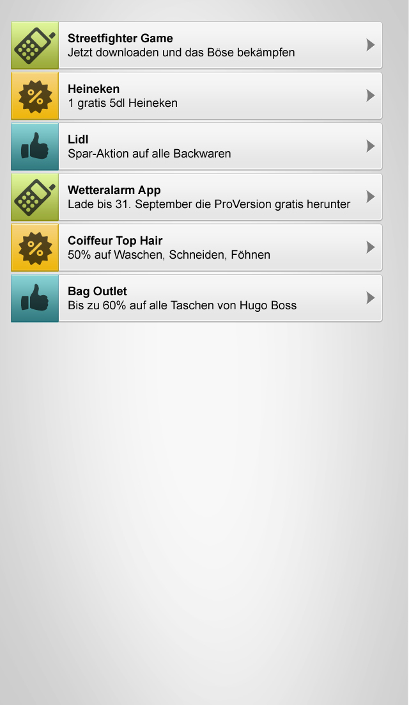
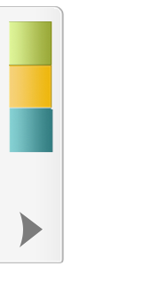
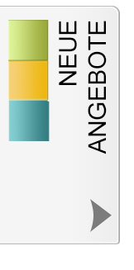
General: The Target is to design a UI for our SDK, that will fit to several 3rd party apps as a layer. The elements should not conflict the design of the 3rd party apps. All samples/Screenshots are showing the UI Elements of our SDK in the sample App „20min“ which is a news app available in the app store. The header in our sample belongs always to the 3rd party app. Note: Our first mockups are not to meant to be adopted. They are to colorful and do not fit the ios 7. Even the icons are not a must. Maybe you choose to leave them away.

Slide 2
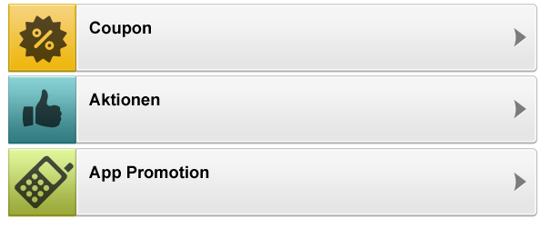
General-Information:
Our SDK will provide 3 categories of offerings to list in the offering library. This is just for information only.
Reflecting the categories with icons in the UI design is not a must.
“Coupons”
Single Offerings which are time limited and give a direct reduction on a particular product or service.
Contains 2d barcodes for redeeming
“General reduction”
Offerings which contain a bunch of products or a promotion over a long term period. Such as
giving 20% reduction on all French wines or a test drive with the newest car model.
“App Promotions”
App-Boost campaigns to increase downloads of a particular application.
E.g. Allows downloading paid apps for free by using the apple promo codes.

Slide 3
1. Navigation Element
Function:
The Navigation Element does inform the user of the3rd party app, that he has received new offerings.
A click o this element brings him to the offering-listing page (offering library)
Behavior:
If our backend has new offerings available, the navigation element changes its style.
Inactive-Text:
none. Just an graphical icon like an arrow, to
indicate, that there is more behind that tap.
Active-Text:
NEUE ANGEBOTE
> Check this slide in Presentation mode to see animations
> Note: its crucial not to get in conflict with the UI Design of the 3rd p App. E.g. slim and placed vertically
3rd Party
app header
3rd Party
app content

Slide 4
2. The Listing (Offering library)
Function:
The library shows al offerings which have been send to the
3rd party apps. The order from top to bottom will be in the order
“newest to oldest”.
Behavior:
A tap on an offering brings the user to the
detail page of the particular offer.
UI Requirements:
- close button to close library list
- loading icon (appears while the app loads the offerings from our server)
- “delete all offerings” button at the end of the list
- deleting a single item from list
(evtl. Using ios function “swipe”?)

Slide 5
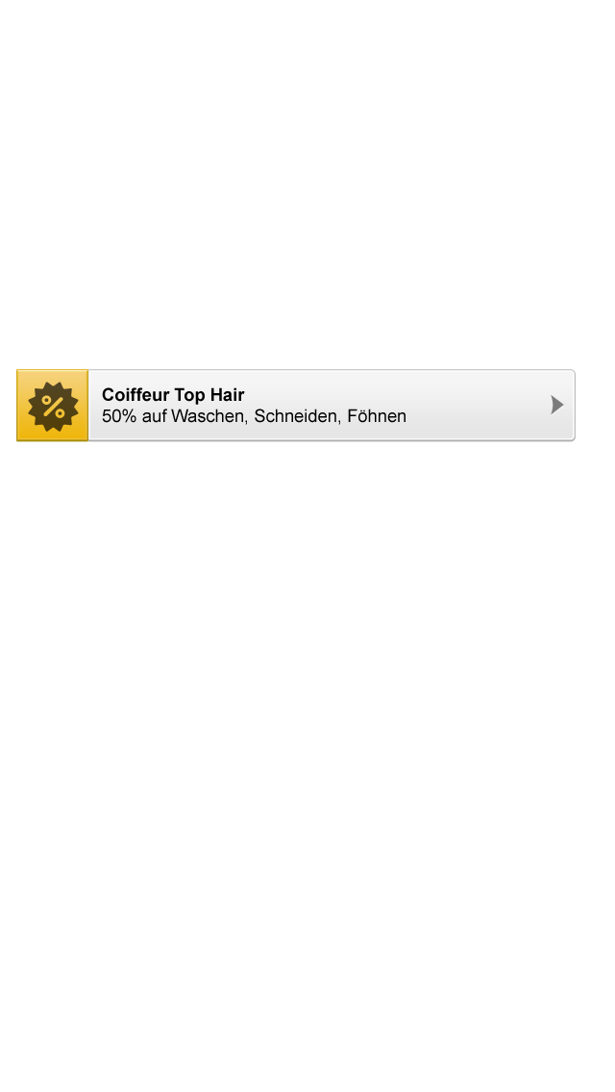
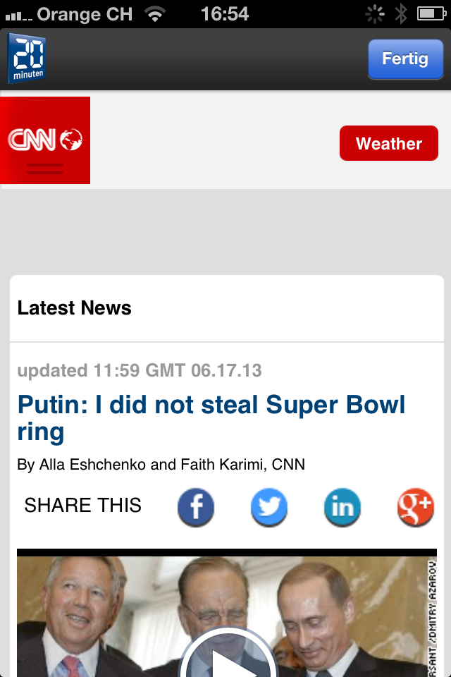
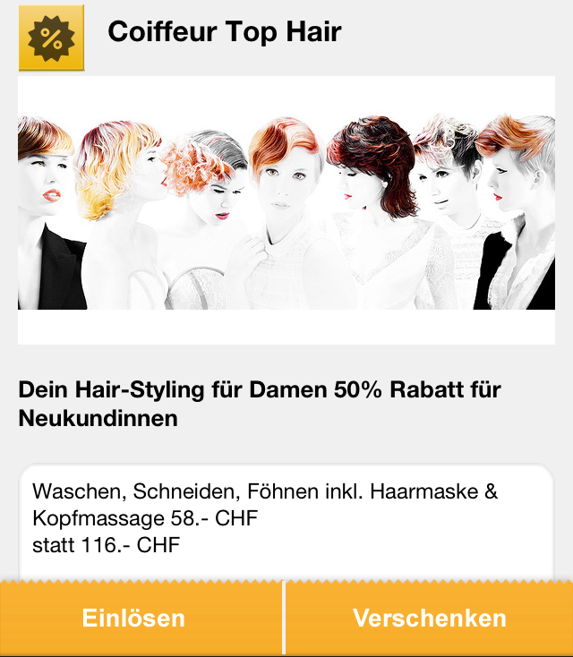
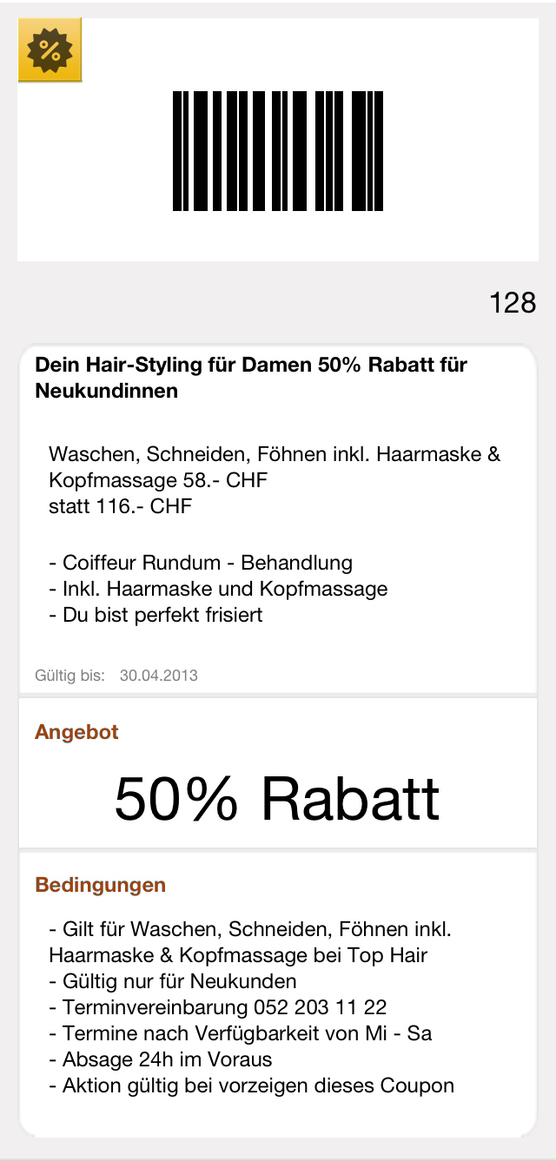

3. Coupon Detail
A click on an offer listing item, opens the in-app-browser with the
Details of the particular offering.
Function:
First page: Offer overview, redeem, share, add to passbook
Second page: (appears, when clicked on “redeem”:
Offer overview, 2d Barcode, Terms of use, add to passbook
UI Requirements:
- back button to go back to library list
- Image section (for Logo or Picture)
- Text sections (see mock ups)
In-App-Browser
In App browser

Slide 6
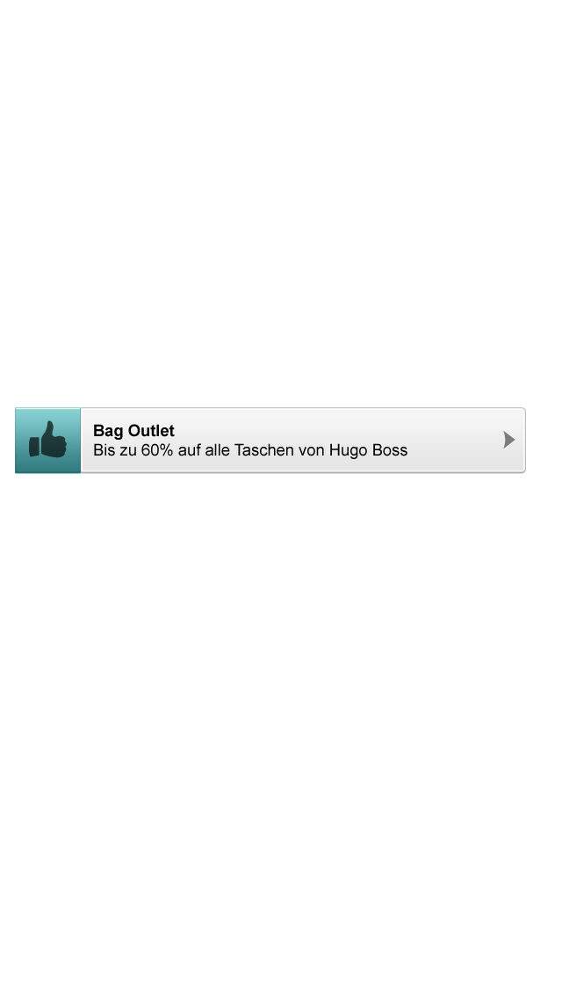
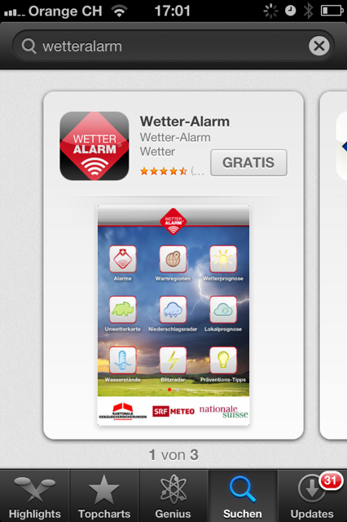
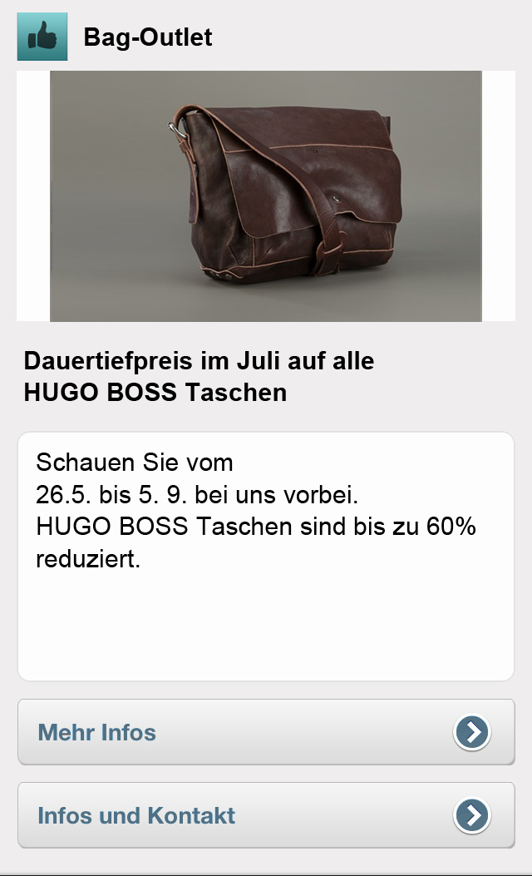
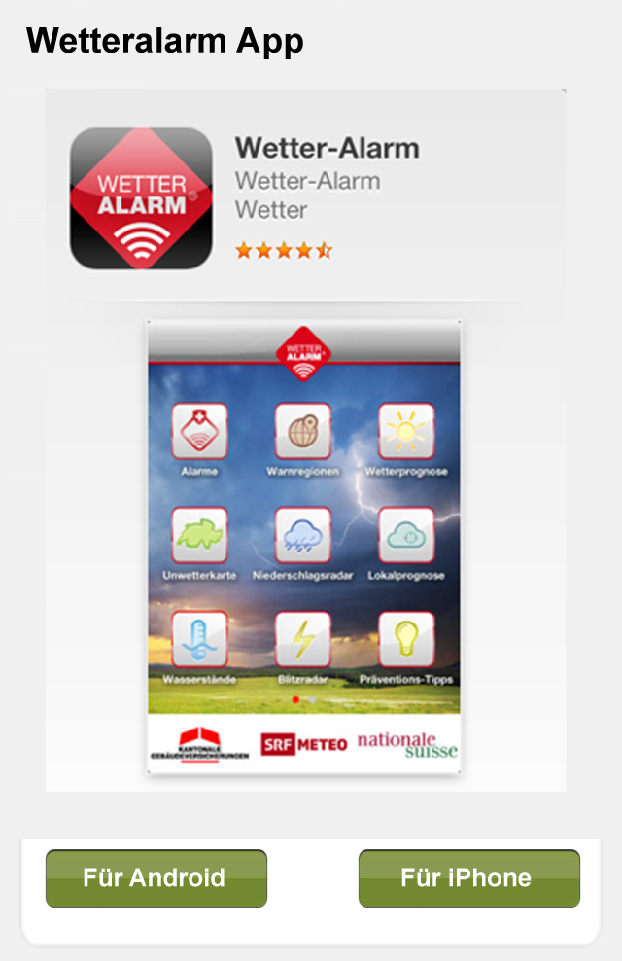
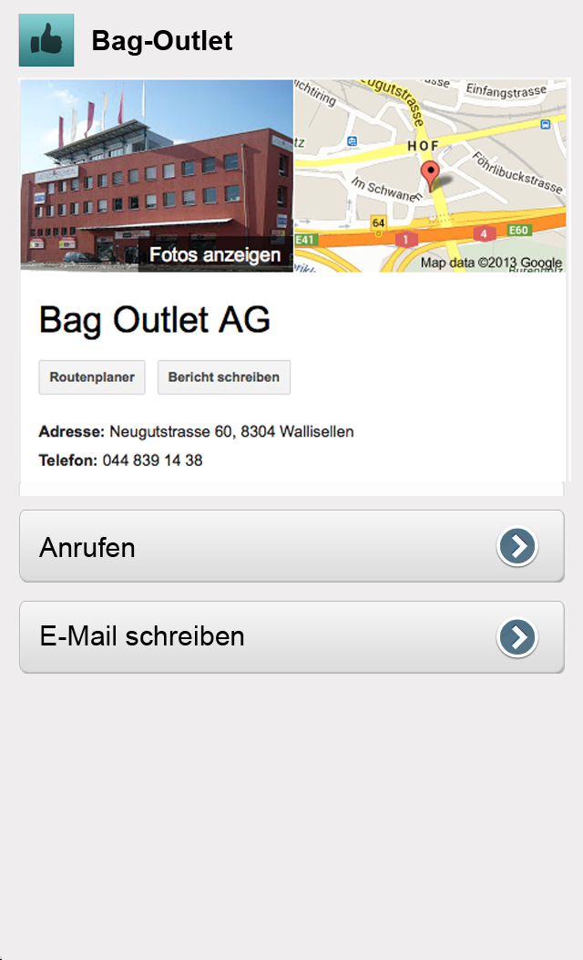
4. General reductions
A click on an offer listing item, opens the in-app-browser with the
Details of the particular offering.
Function:
First page: Offer overview, More Info, Click to call
Second page: Company details, Location, Contact Form
UI Requirements:
- back button to go back to library list
- Info section (see mock ups)
- “Order button”
In-App-Browser
In-App-Browser
Location Details

Slide 7

5. App Promotion Detail
A click on an offer listing item, opens the in-app-browser with the
Details of the particular offering.
Function:
First page: App Details on a html preview page (running on our server)
Choose os (android or iphone)
Second page: Official App detail page from iTunes
UI Requirements:
- back button to go back to library list
- Info section (for App icon and Screenshot)
- Android Download button
- ios Download button
In-App-Browser
iTunes store

