Slide 1

A Cloud Based
Carrier Grade Communications and
Solutions Provider

Slide 2
ABOUT US
UVOCE is a cloud based Communication Service Provider primarily offering Cloud – Communication Solutions for the Mid-Market and Hospitality Industry.
The goals of cloud-based solutions are to lower your costs, while increasing your business agility. After all, the cloud is where your customers spend more and more of their time, and the cloud is where you may already be getting services such as email, instant messaging and a growing list of business applications (e.g. salesforce.com) and of course mobile connectivity.
Our Guarantee – 100% satisfaction and 30% cost savings

Slide 3
Top Reasons for Switching To UVOCE
Lower telecommunications costs 66%
Desire to merge voice and data networks 43%
Obtain a platform for one-stop communications
in 2+ areas 41%
Increase collaboration benefits in 2+ areas 36%
Ease of management 31%
Scalability 24%

Slide 4
WHY UVOCE?
Five 9 Guaranteed Service Level Agreement (99.999%)
Over 100+ Features included in Hosted IP PBX
24/7 /365 days - Technical Support
Unlimited Calling to anywhere in US& Canada
Lowest International Rates
No Hidden Taxes or Fees
Up to 30% savings on your existing tele-com monthly expenses
Plug and Play Hosted IP PBX
Use your existing PBX, Phones, and Network
Ease of Use / Management

Slide 5
PRODUCTS AND SERVICES
Voice Products and Services
TELEWORKER/HOME OFFICE PHONE SERVICE​
SMALL BUSINESS PHONE SERVICE​
LARGE BUSINESS WITH MULTIPLE LOCATIONS​
VOIP SOLUTIONS FOR THE HOSPITALITY INDUSTRY
VOIP using SIP Trunks
VOIP for hospital environment
VOIP for banking (secure and encrypted)
Network Security Solutions
MPLS
UVOCE offer consulting and advisory services
Commercial grade Bandwidth and firewalls​
IT NETWORK DESIGN Services

Slide 6
Hosted IP PBX Phone System
Hosted IP PBX
A hosted IP-PBX is a private branch exchange that is hosted by a telephony provider and delivered over an IP network.
A hosted IP PBX enables businesses to have multiple phones in use at one time, with the use of extensions rather than multiple phone lines. A hosted IP PBX is much more cost effective than an on premise PBX because hardware updates and IT support are supplied by the telephony provider.
Why Hosted ?
Less Expensive , Cloud Telephony, Ideal for Small Business , Automated Value Added Services Data Transfer Capabilities , Easy to Install and Operate , Multiple Location Handling .

Slide 7
UVOCE SIP TRUNKING( VoIP Lines)
Maximize flexibility and capacity. Using UVOCE SIP trunks allows you to run voice, video and data traffic over the same IP network connection, and that enables you to consolidate WAN connections and make the most of the bandwidth you are buying. With UVOCE SIP, you pay a Flat fee since the Trunks are on a Unlimited Calling Plan basis ( both local and long distance to US & Canada)
Reduce communications costs. Organizations that adopted UVOCE SIP Trunking saved an average of 30 – 40 percent a month on telecom costs.

Slide 8
Full Feature List
Account - Authorization Codes, Alternate Numbers, Anonymous Call Rejection, Authentication by Digest (user's web browser), Authentication by ANI (users Phone number),◦ Auto Attendants,◦ Personal Auto Attendants and scheduled Auto Attendant, Chained Auto Attendants,◦ Barge In / Barge-in Exempt, Busy Lamp Field, Call Forwarding, Call Forwarding Always, Call Forwarding Busy◦ Call Forwarding No Answer◦ Call Forwarding Not Reachable◦ Find Me (multiple numbers)◦ Call Logs (Inbound and Outbound)◦ Call Monitoring◦ Automatic Monitoring◦ Supervising Mode◦ Silent Monitoring◦ Call Notify◦ Call Park◦ Call Pick Up◦ Call Pick Up Group◦ Directed Call Pickup◦ Call Queues◦ Call Recording◦ Call Return◦ Call Schedule◦ Call Status (Real-time in User Portal)◦ Call Transfer◦ Attended Transfer◦ Blind Transfer◦ Intercom Transfer◦ Transfer to Voicemail◦ Call Waiting◦ Calling Line ID Delivery Blocking, ◦ Calling Name Retrieval◦ Calling Party Category◦ CDRs◦ Charge Number◦ Client Call Control (API and User Portal)◦ Conferencing (Multi-Way Calling)◦ Convene Conference◦, Invite Attendees◦ Multiple Conference Rooms,◦ Scheduled/Instant Conference◦ Web-based Setup◦ Account Codes◦ Monitor Add, Drop, Hold, Mute◦ Conference Recording◦ Device Auto Provisioning◦ Direct Inward Dialing◦ Directed Call Park◦ Directed Call Pickup◦ Diversion Inhibitor◦ Do Not Disturb◦ Enhanced Privacy on Hold◦ Extension Dialing◦ External Calling Line ID Delivery◦ Hunt Groups◦ In-Call Service Activation◦ Instant Messaging (via SIP SIMPLE)◦ Intercom◦ Internal Calling Line ID Delivery◦ Last Number Redial◦ Malicious Call Trace◦ Message Waiting Indicator◦ Music-On-Hold◦ System Default Music-on-Hold◦ Personalized Music-on-Hold◦ N-way Call◦ Phone Status◦ Pre-paid Calling (PIN or ANI)◦ Presence ◦ Privacy◦ Selective Call Acceptance◦ Selective Call Rejection◦ Sequential Ring,◦ Shared Call Appearance◦ Simultaneous Ring Personal◦ Three-Way Call◦ Two-Stage Dialing◦ Video Telephony◦ Voicemail◦ Default Greetings◦ Customizable Greetings◦ Name Recording◦ Email Notification◦ Voicemail Forwarding◦ Forwarding to Email◦ User Portal (View, Save Delete)◦ Voice Messaging Group◦ Voice Messaging Call Back◦ Web User Console◦ Contact List◦ Dial by Contact Name◦ Inbound Call Handling Rules◦ Screen Pop for CRM support , Group Features◦ Authorization Group Codes◦ Auto Attendants◦ Personal Auto Attendants,◦ Scheduled Auto Attendants◦ Chained Auto Attendants◦ Barge In / Barge-in Exempt◦ Attendant Console,◦ Business Trunking◦ Call Center / Contact Center◦ ACD◦ Detailed reports◦ Skill based routing,◦ Call Intercept◦ Calling Group ID Deliver◦ Calling Plans (Incoming, Outgoing)◦ Configurable Extension Dialing◦ Configurable Feature Codes◦ Device Inventory◦ Department Support◦ Group Announcements,◦ Group Custom Ringback◦ Hunt Groups◦ Instant Group Call◦ Instant Messaging (via SIP SIMPLE),◦ Office Manager Portal (Web portal)◦ Pre-paid Calling (PIN or ANI)◦ Printable Group Directory,◦ Series Completion◦ Simultaneous Ring (group)◦ Video Conference (external MCU).
​​General◦ Integrated Session Border Controller◦ Multi-tiered with delegated administration◦ Brandable web portals for all user levels◦ Comprehensive reseller support◦ Flexible partitioning for wholesale and retail,◦ Customizable IVR and system prompts◦ Comprehensive NOC support tool◦ SIP trace with ladder diagram on every call◦ API for integration with existing OSS/BSS◦ Codec Agnostic with Pass-Thru◦ Integrated Billing and Accounting◦ Prepaid or post paid accounts, Fault Tolerance◦ Geo-distributed for network redundancy,◦ Active-Active server configuration◦ Supports rolling, hitless Upgrades,Routing Management,◦ Least Cost Routing,◦ Percentage Routing,◦ Granular Carrier Capacity Controls,◦ DID Grooming/Normalization,◦ e.164 Support,◦ Route based on User Calling Plan,◦ White list/Black List, Security and Fraud Detection,◦ Velocity Filter for bad calls,◦ Auto Block on failed registrations,◦ Auto Block SIP port scanning◦ Auto Block promiscuous SIP user agents,◦ Remotely triggered updates,◦ Support all major brands, Device Provisioning,◦ Zero touch device configuration,◦ Remotely triggered updates,◦ Customized directories,◦ Geography based provisioning,◦ Support all major SIP device brands, Regulatory,◦ 911 Emergency Calling,◦ CALEA compliance (lawful intercept).​​

Slide 9
Partner + Program
Deliver a purpose-built communication solution for small to enterprise –level business
•Reduce their monthly communications cost up to 40% over legacy solutions
•Gain up to half a day of productivity per employee just by adding UC presence, chat, and call management.
•Reduce Total Cost of Ownership up to 40% vs. market leaders

Slide 10
Partner + Program cont.
•UVOCE channel manager and sales engineers are extensions of your team
•Marketing resources and programs to assist in market development and lead generation programs
•Trusted expert on UVOCE solutions
•Insight into product roadmaps
•Access to the UVOCE Partner Portal

Slide 11
Choose the Level that Fits Your Business
Authorized
No Sales Commitment
Annually
Access to Marketing Resources
Up to 10% in product discounts
Certified
Sales Commitment
$50K Annually
Sales Certification Partner
Access to Marketing Resources
Up to 20% in product discounts
Premium
Sales Commitment $100K Annually
Sales and Technical Certified Partner
PAC Member
Marketing Resources
Up to 30% in product discounts

Slide 12
Want to know more about becoming a Partner?
Interested in learning more about what the UVOCE Partner + Program can do for you Contact Your Channel Manager
Manager of Channel Development: Matthew Clark
Find out more information – info@UVOCE.com

Slide 13
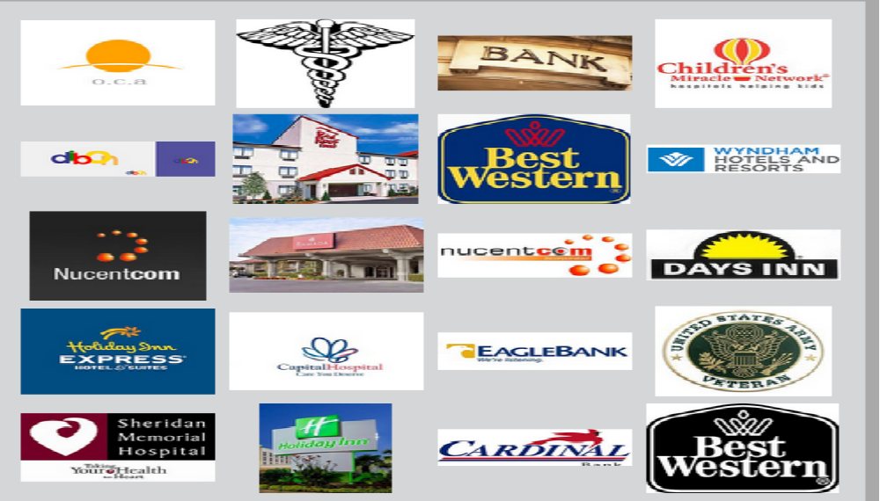
FEATURED CUSTOMERS

Slide 14
Contact us :- Get in touch….
UVOCE HQ
8001 LBJ Freeway, 4th Floor, DALLAS
TEXAS 75251.
Phone -972-447-2160 (main)
Fax - 469-424-2200 info@UVOCE.com

