Slide 1
Covington Maine
Value Curation
The Truth About Value In Business
Purpose Mastery Autonomy

Slide 2
Covington Maine
The Truth About Value In Business
The pace of change today makes it difficult for organisations to stay relevant let alone prosper and create value. Every garage start-up, every dorm-room project, is tomorrow’s potential world-beater. It is very difficult to pick them, let alone work out what makes them valuable and keeps them valuable.
At Covington Maine we are concerned with endurance: how we can keep our organisations relevant, viable and valuable in this fast changing world, a world where the veteran and the start-up are both a threat? This has been the domain of ‘strategy and change’ and the trend has been to change more, faster to remain competitive.
Most change interventions are hard work, are disruptive, cost a lot, and do not add value to the enterprise in the long term. Put simply change fails because change is not a manageable attribute of any human system, it’s connected to the belief system of every individual in the system and cannot be controlled through some central process. Rather, there is an evolutionary capacity we need in our organisations that we call Value Curation -­ the deliberate nurturing of brand value and the development of a culture that suits the unique purpose of every organisation.
Studies of enduring organisations, from the oldest religions to Apple today reveal three endurance literacies, things they inherently know and do and which are key to their existence. The first endurance literacy is Brand Resonance, which describes the extent to which followers; customers, employees and investors believe in their cause, their reason for existence. Second is the concept of Leveraged Value, the extent to which the vision and the results of the organisation amplify one another in determining value. And third is a Viability Culture, which describes its ability to continually choose the most appropriate behaviours for the organisation to thrive.
Where the traditional formulaic ‘best practice’ approaches eliminate competitive advantage by embedding it in process and systems that are easily copied, Value Curation builds a viability culture as the foundation of a valuable brand that resonates with its followers. And when brand resonates with culture, vision and results amplify value.

Slide 3
Covington Maine
Value Curation for Enduring Organisations
Covington Maine is an organisation of masters of the competencies of Value Curation. An organisation of Corporate Curators if you will, each selected for their domain experience and its applicability to the specific engagement. We approach our work with the mindset of the curator, masters at understanding how to grow our clients’ capacity for endurance, developing competencies they already have, eliminating the redundant and building those they need.
Ultimately the Value Curation competencies are evolved within the organisation, for the organisation with the minimum of external consulting, to keep answering the 3 questions of endurance literacy.
  Brand Resonance: What do we want our followers to believe about us and about our organisation?
  Leveraged Value: What would it be worth to our followers if our results reflected our vision?
  Viability Culture: What must change to keep getting more of the behaviours we want from our followers?
The answers to these questions may change over time but the questions themselves remain. Leaders of enduring organisations know this and Covington Maine exists to keep delivering the answers for our clients.

Slide 4
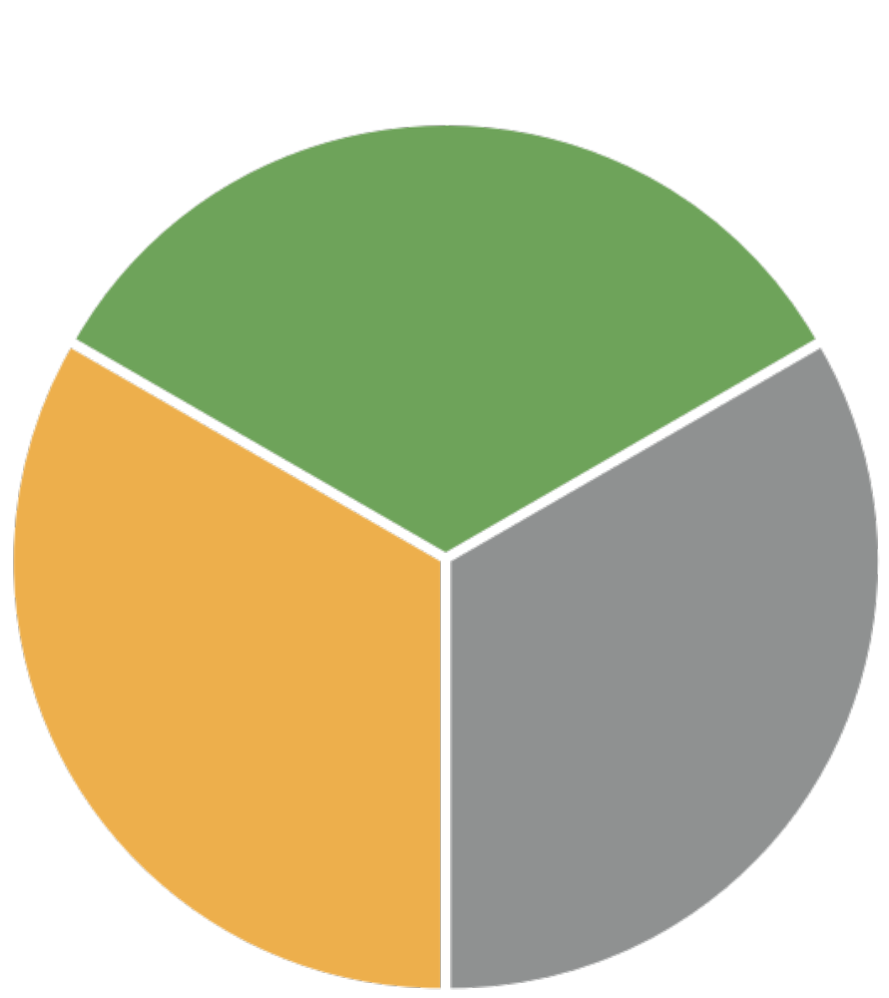
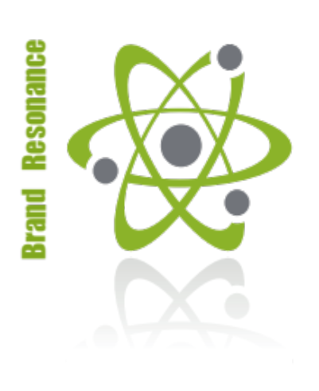

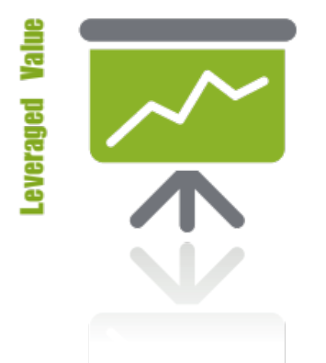
Value Curation
3 Literacies of Enduring Organisations
Literacies are the important things you know and practice to your advantage.
1. Brand Resonance
Stakeholders believe in their cause.
Employees
Customers
Investors
2. Viability Culture
It’s seen as their key competitive advantage.
‘Belief shows up in behaviour.’
3. Leveraged Value
Both Value Levers are exercised.
Vision x Results = Value

Slide 5




Value Curation
3 Literacies of Enduring Organisations
2. Leveraged Value
Value is the product of our Vision and our Results.
1. Brand Resonance
People don’t buy ‘what’ you do, they buy ‘why’ you do it.
3. Viability Culture
Belief shows up in behaviour through the mechanism of choice.
‘Some things need to be believed to be seen’

Slide 6



Covington Maine
Covington Maine is an organisation of Corporate Curators that help our clients define their role in their chosen cause and develop the capacity for endurance in its pursuit.
Our mission is to curate the endurance literacies of brand resonance, leveraged value and a viability culture with our clients and our people.
It is our vision to have our followers find purpose through choice, mastery of their domain literacies and autonomy in their execution.

