Slide 1
Piraya Mobile
Who are we?
  We are a company which publishes games for mobile devices such as smartphones and tablets
  Our games will be free to play with users having the option of purchasing in-game items to help them
  We will be aiming at acquiring users worldwide
What do we need?
  We need a logo which reflects the values of our brand (see next slide) and which also will represent us as a company
  We need a logo which works well on small screens, that sits will in multiple backgrounds and with different kinds of consumers
  We need a logo with an identifiable symbol or element which can be used without the full name in situations where we do not have a lot of space.

Slide 2
Logo Brief
Style
  Our games are fun, challenging and competitive
  We love games and gamers. Our games should appeal to them as we are gamers ourselves.
  Our logo should represent us and also our brand which will offer free games playable by millions of players online
Target audience
  60:40 male/female split
  15-35 are our core ages
  Logo should look modern and clean to appeal to our core audience
Use of logo
  Will be used in games as main and secondary logo (beside game logo)
  Will feature on consumer branded website which is a portal for gamers and games
  Logo should work in both small and larger sizes, i.e. it should be easily scalable but still recognizable
  Logo needs a strong individual identifier so that it can be used within game, menus and to denote that a game belongs to our brand
  Logo should be adaptable so that not many colours are needed to display it but that sub-brands can be made later for specific genres of games (think EA’s multiple logo treatments)
  Logo should also represent the company as well as our brand
Iterations
  We need a full logo including the name “Piraya Mobile” as well as a version with only the identifier

Slide 3






Our Competitors
We notice that we like the simplicity of Kabam and Zynga but are not a fan of the Supercell or Storm 8 logos. In general most of these logo emply very few colours and feature (except for Supercell) an identifying symbol (bomb, dog, etc).

Slide 4
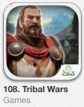
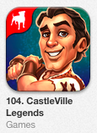
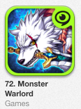
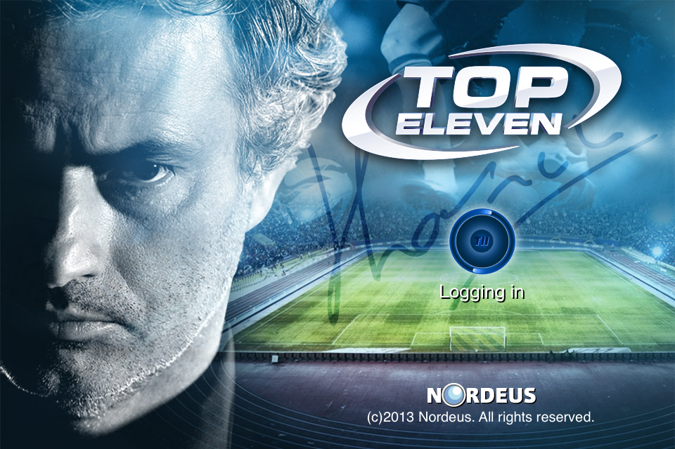
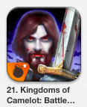
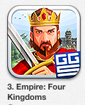
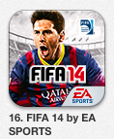
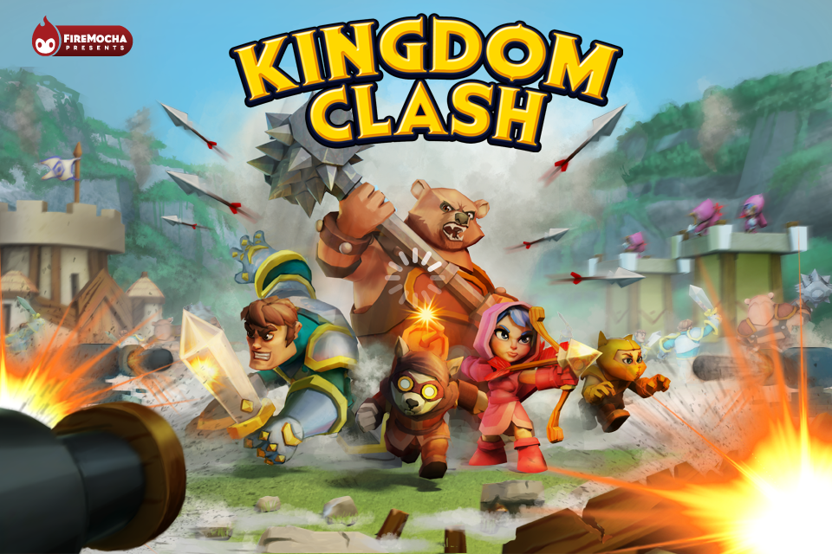
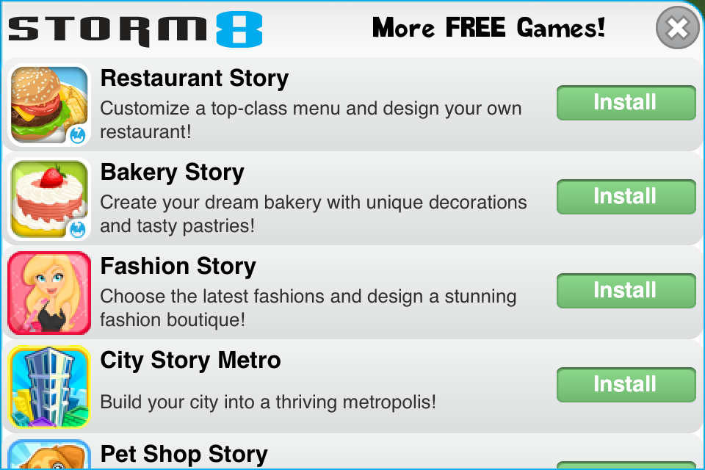
Examples Logo use
As an identifier on App covers
As a secondary logo in games
As main publisher logo

Slide 5


Structure examples (logo including identifier)
1. Lettermark options
2. Icon / Symbol option
identifier
Notes:
These are simple logos used to display different types of logos which we might prefer

