Slide 1
Sugarbush Flowers site design
Please take inspiration from the sites captured in this presentation
A beautifully designed header is required
Clean unique icons or elements designed specifically for Sugarbush flowers should be incorporated
Design should look bespoke/specially made – not like a standard wordpress template

Slide 2
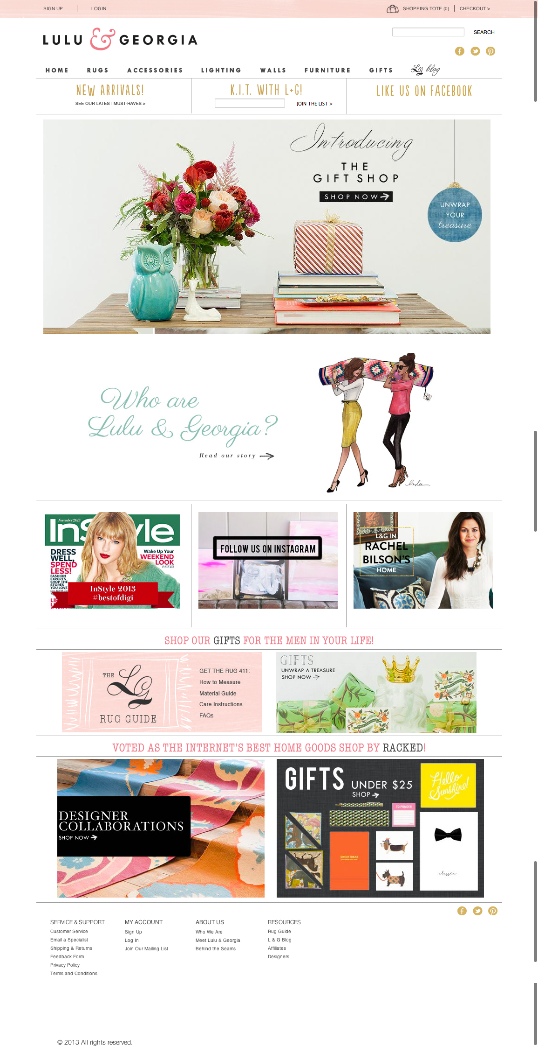
Overall great layout. Fresh, clean colourful and has very nice subtle design features that make it look original not like a standard template

Slide 3
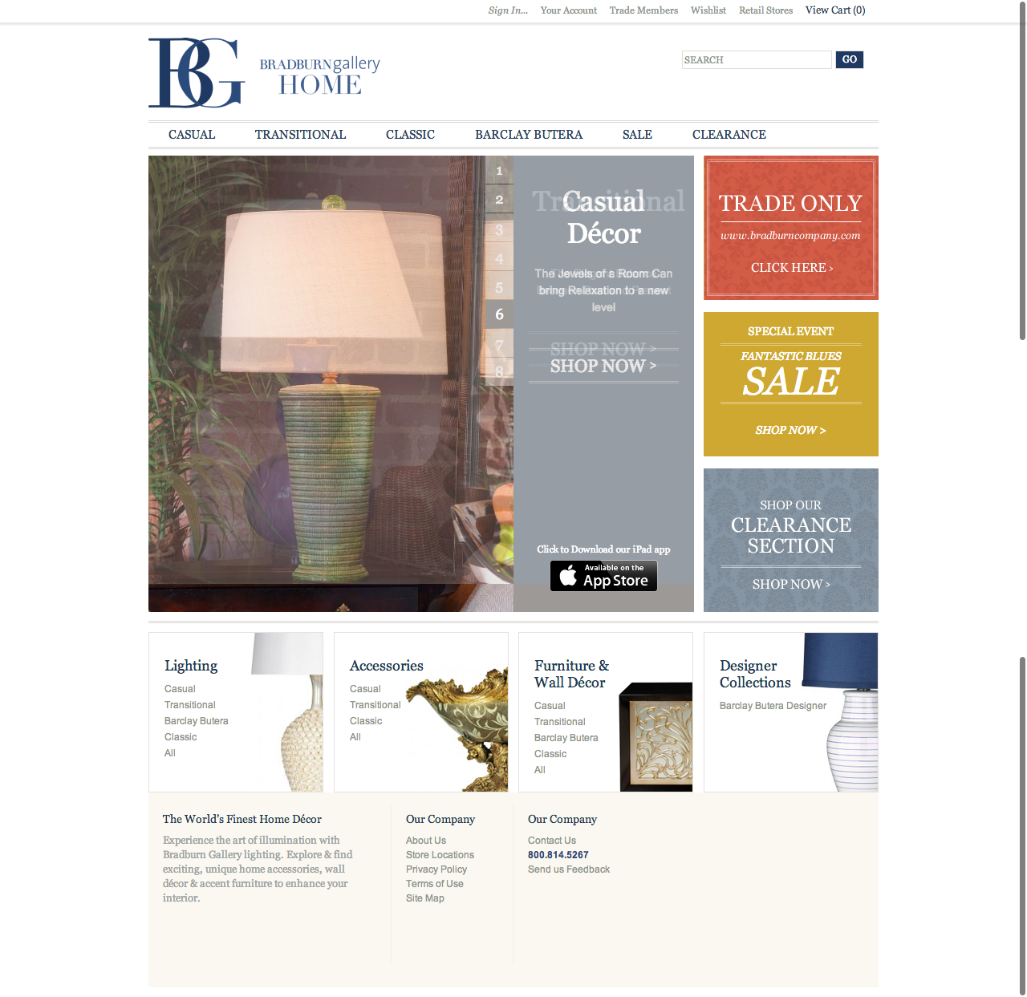
Nice layout – allows for many product feature areas. Nicely designed section typographics that look specially made for this site – not standard

Slide 4
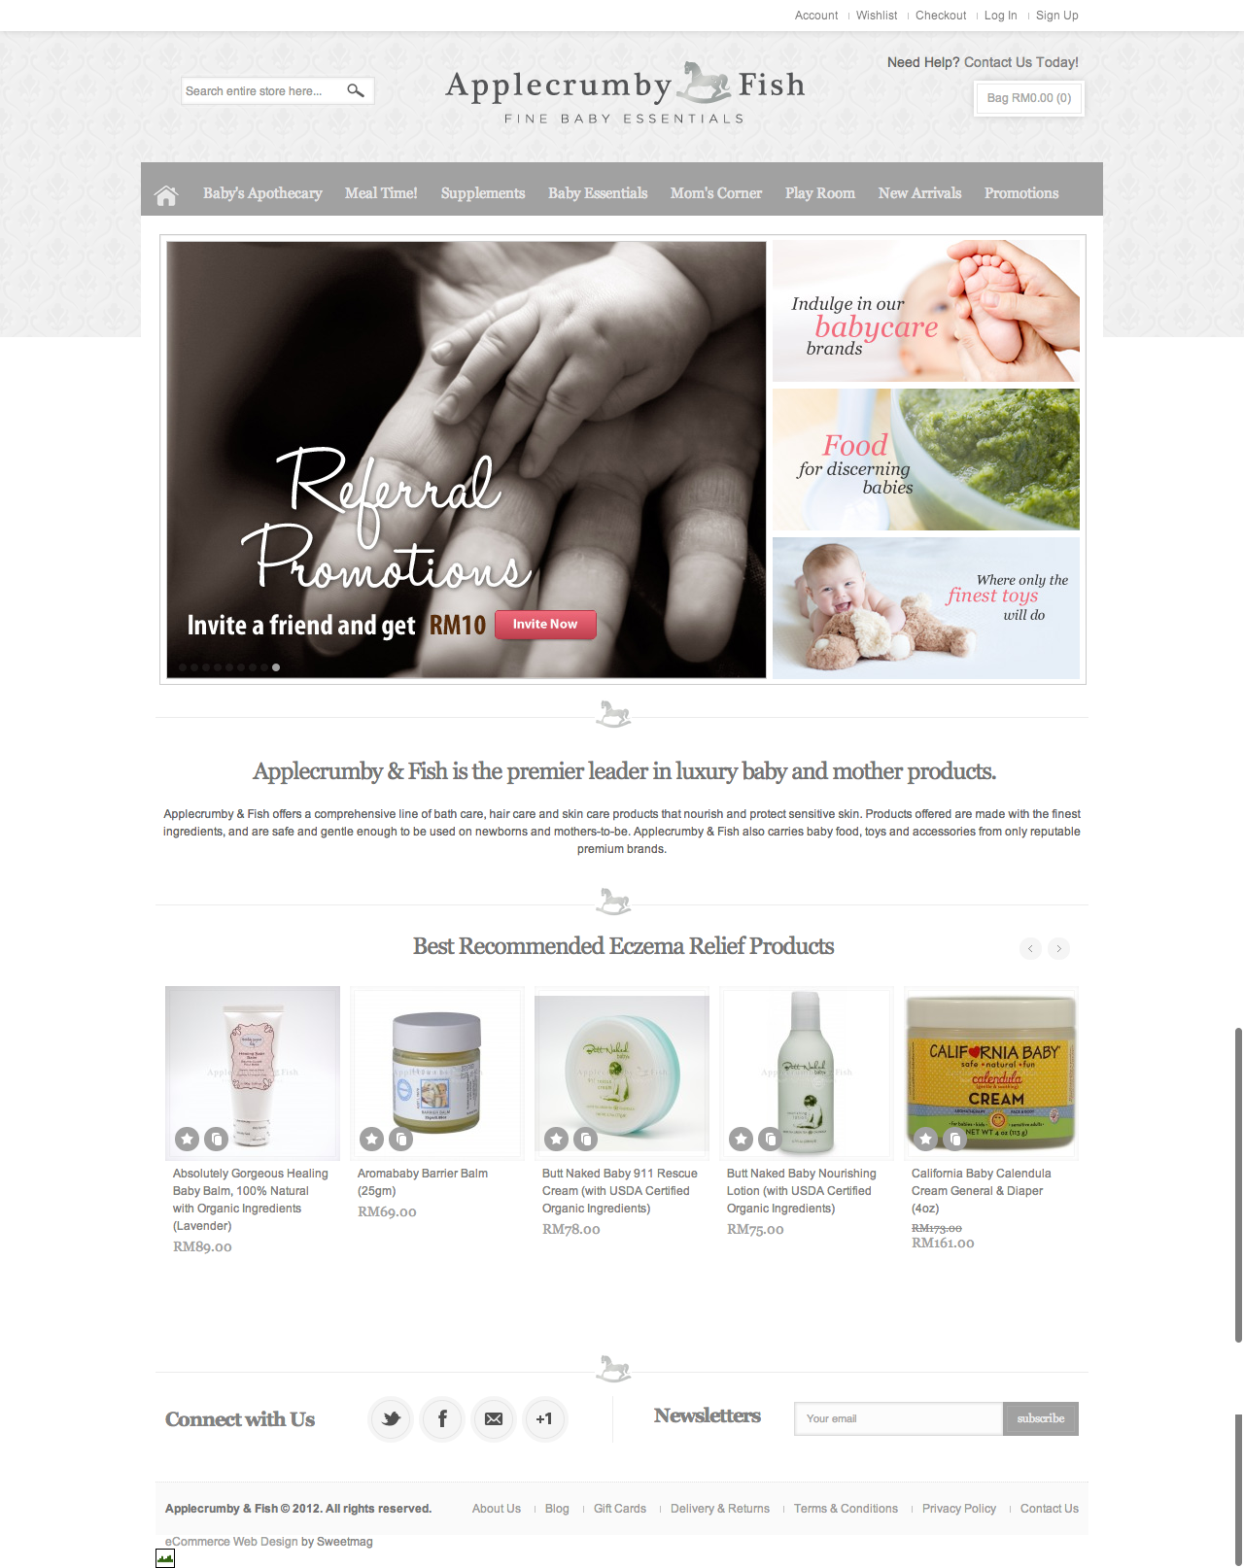
Good use of logo icon within the site design – please consider for our site design. Nicely designed header – not too wild but still makes a statement

Slide 5
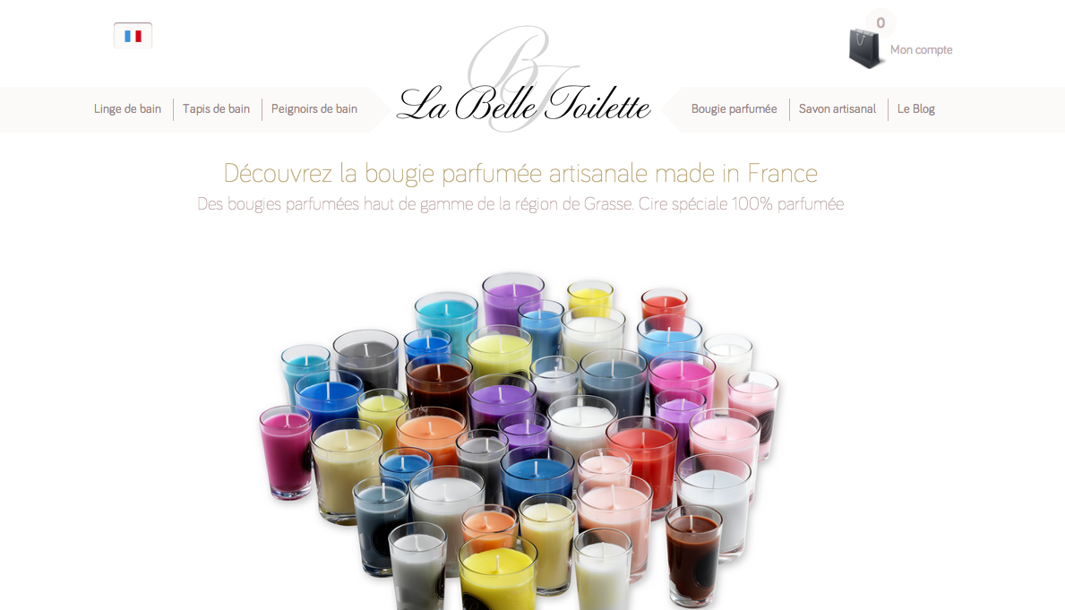
Nice navigation header and use of shopping bag icon

Slide 6

Good use of multiple feature boxes for items and shopping tabs. The colour is too dull but the layout and icons look good

Slide 7
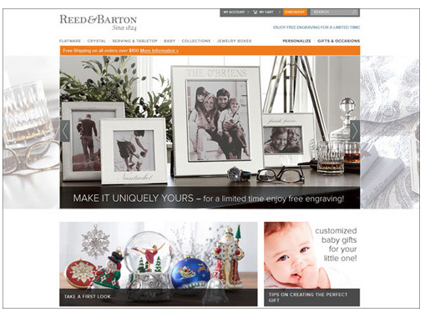
Good use of text on image with transparent background

Slide 8
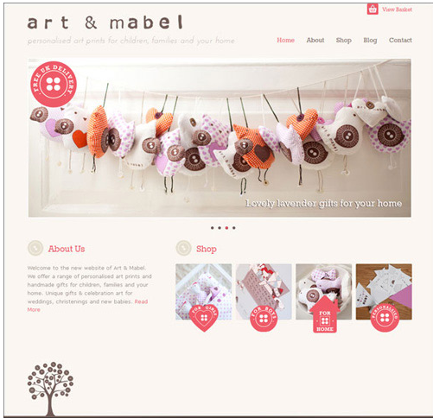
Beautiful icons and very nice clean layout

Slide 9
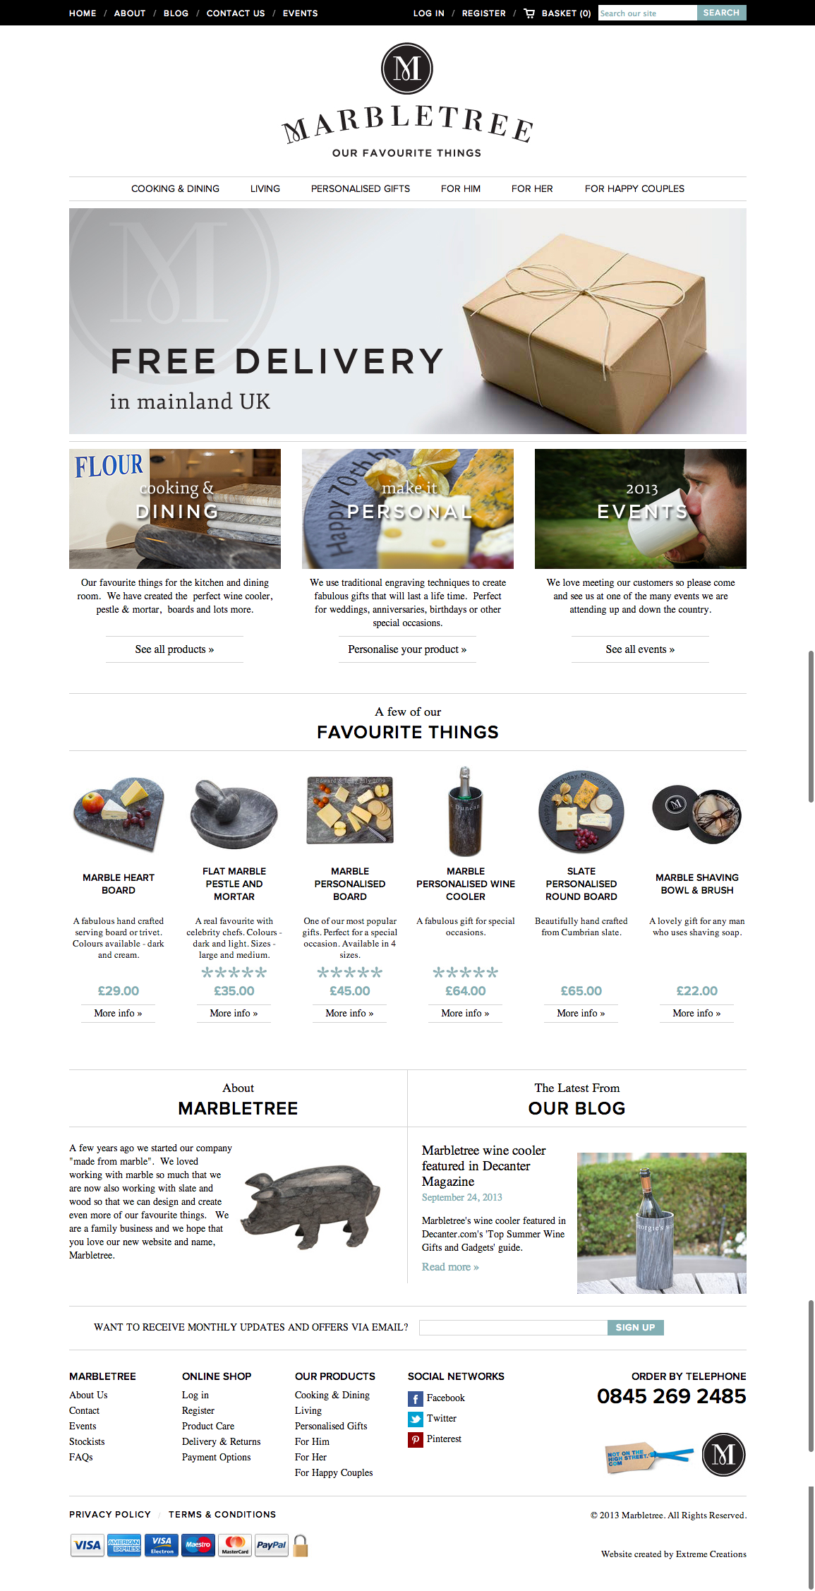
Good looking header and image and text layout

Slide 10
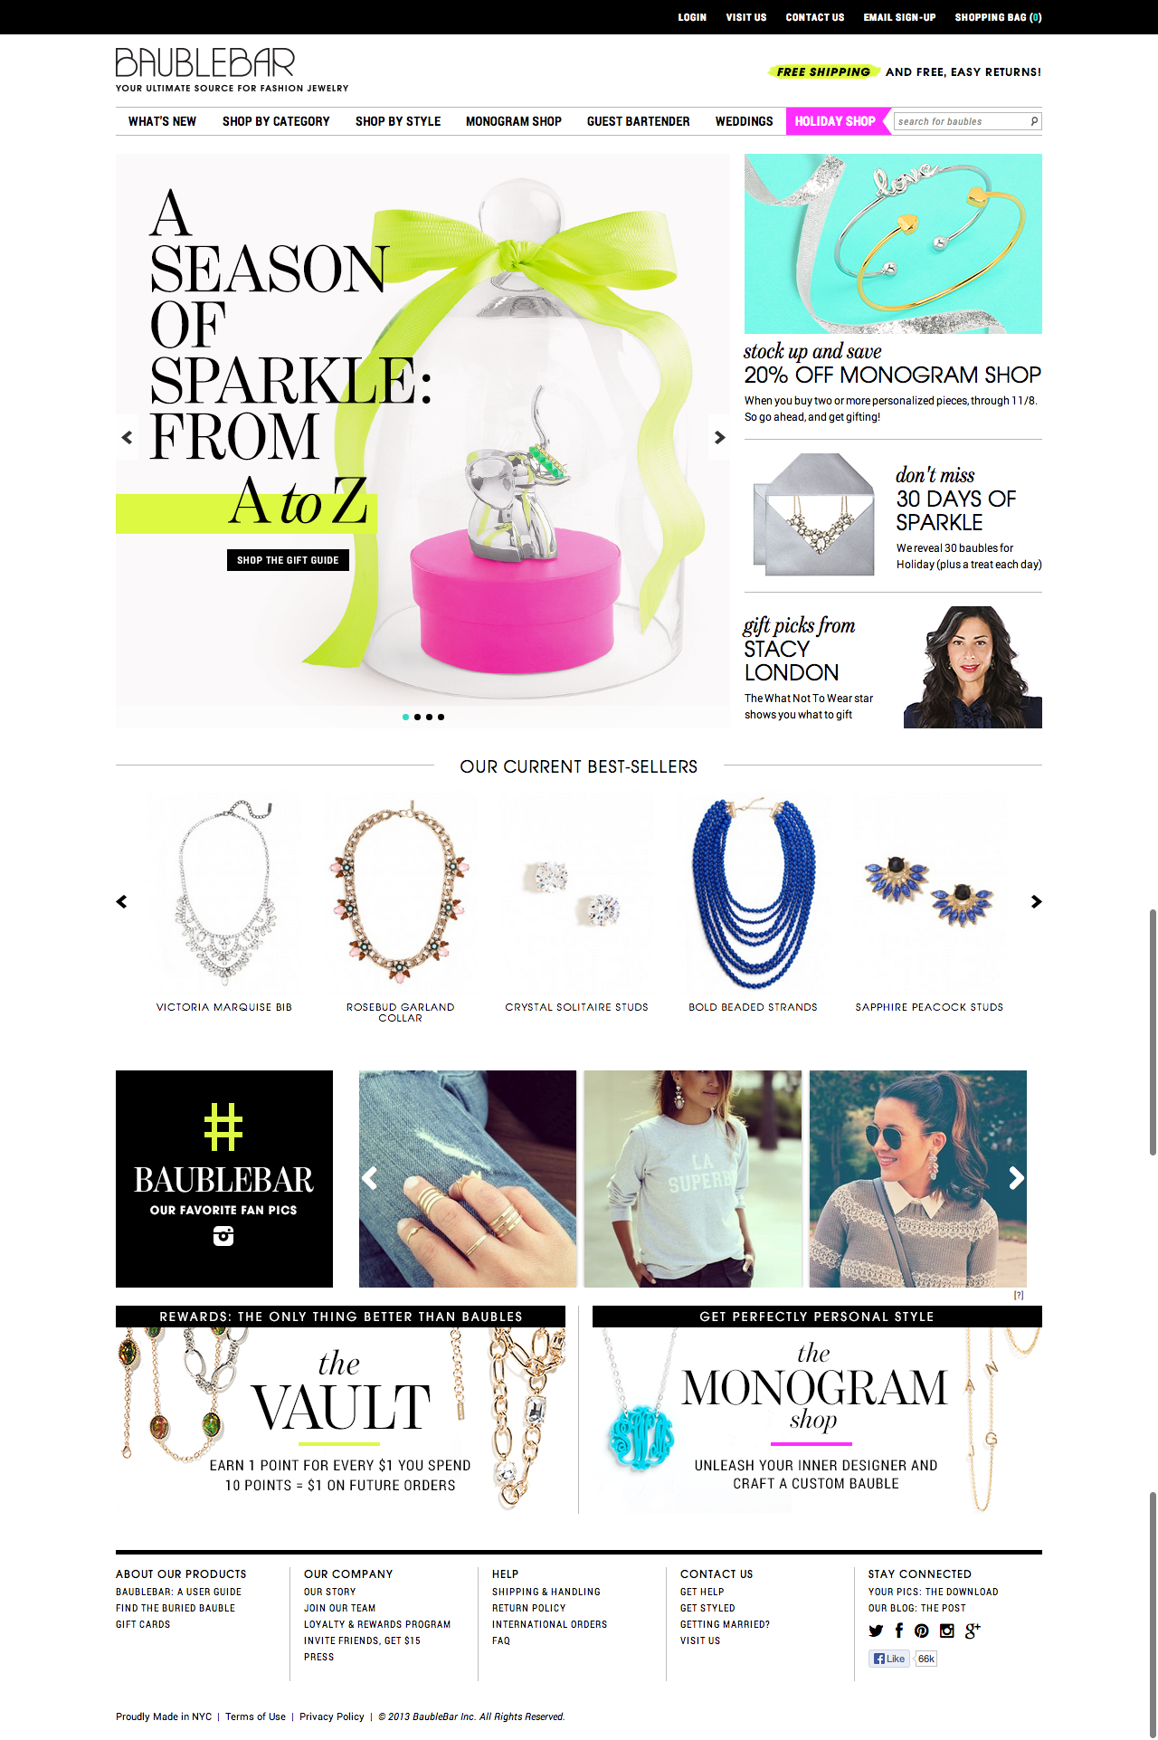
Nice layout which is friendly and functional- easy and nice navigation headers

