Slide 1
Requirements for the website:
Current website can be found at www.prep4gmat.com, but don’t try to use the structure or the design of those pages. We want a new/different website.
Screen resolution of 1024x768 for website
Following slides are meant to be a wireframe with sample copy (as close as possible to the final copy).

Slide 2




logo
English | Chinese
“I increased my GMAT score by 130 points after one month... I made it into MIT.” – Alba Med
“It’s almost like you have a coach in your pocket” – Boston Herald
homepage
Slideshow of our appscreens/video
(see slide 4)
English iPhone version:
English iPad version:
Leave your e-mail address and we’ll send you a download link:
submit
We have created Prep4 GMAT as the most comprehensive GMAT preparation system. It’s a full course in a mobile app.
Carousel with 3 reasons to download our app
(see slide 3)
Follow us:
About | Blog | Jobs | FAQ | Forum | Contact Us| Terms |Privacy

Slide 3

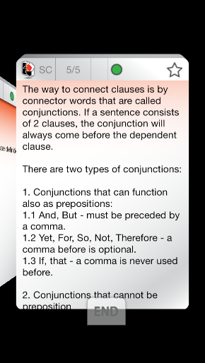
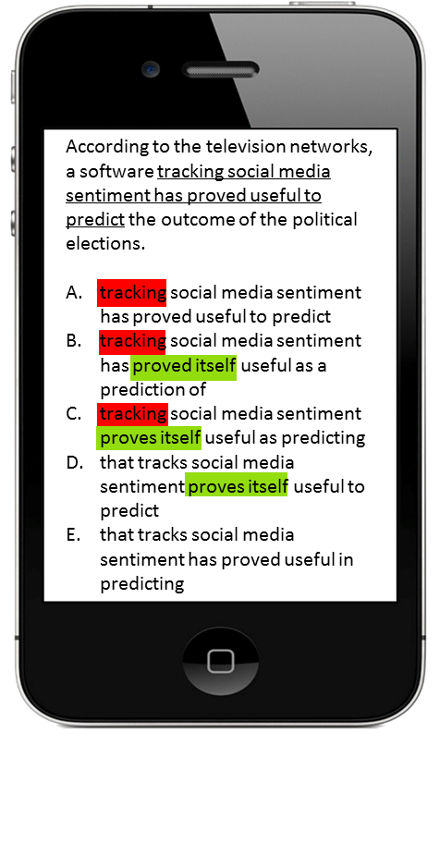
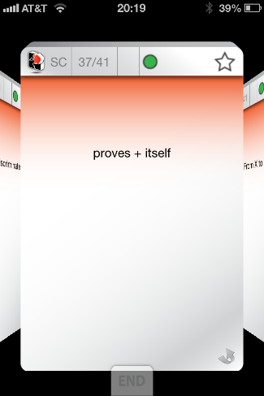
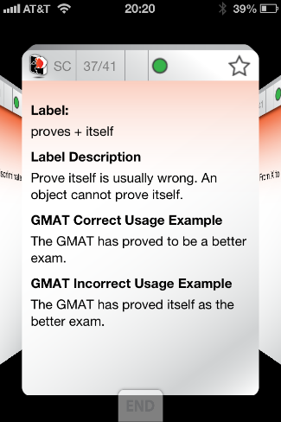
carousel
Study the concepts using hundreds of flashcards
The Label Studying MethodTM helps you identify the concepts that will be tested in the GMAT. It acts like an X-ray for the GMAT questions. By learning to identify the concepts that are being tested, you will be able to find the right answer faster.
Study on the move! The Prep4 GMAT mobile app works offline, so lets you study for the GMAT whenever and wherever you want. Whether you are on a plane or in a train or have some time to spare during your break.

Slide 4
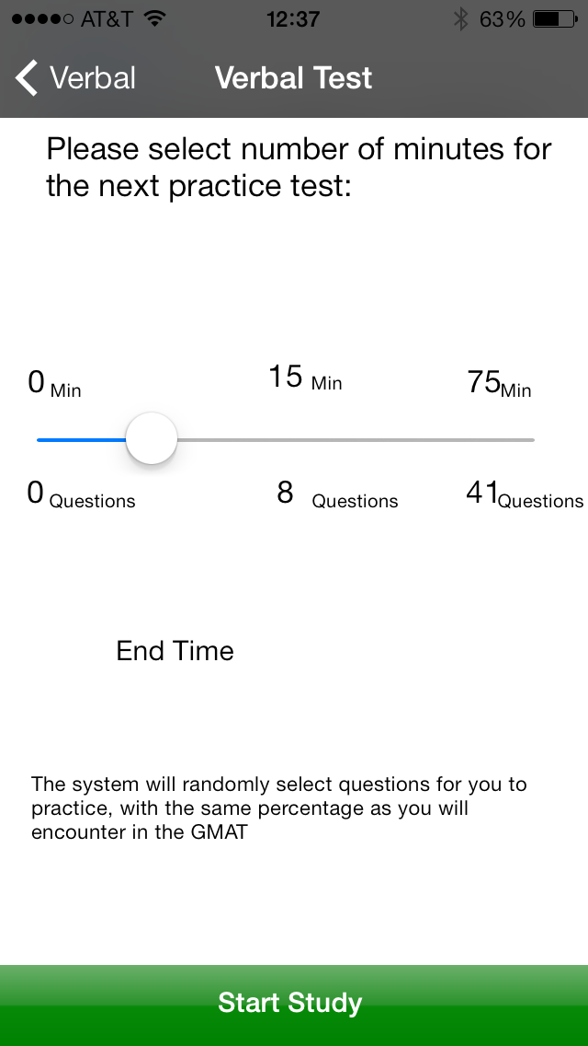
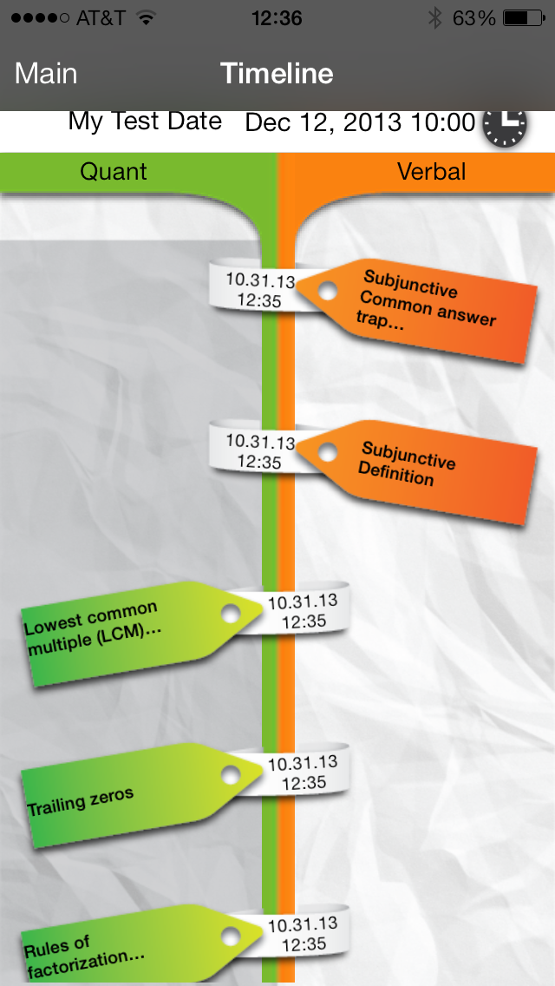
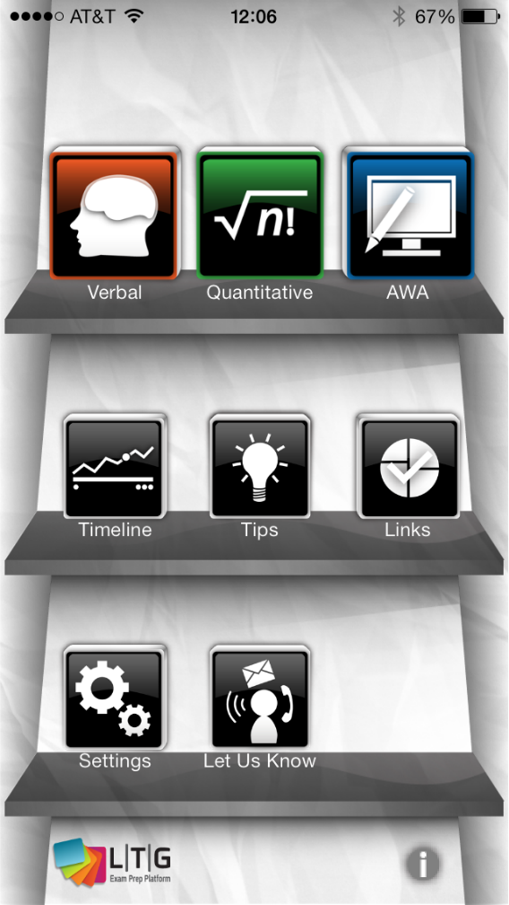
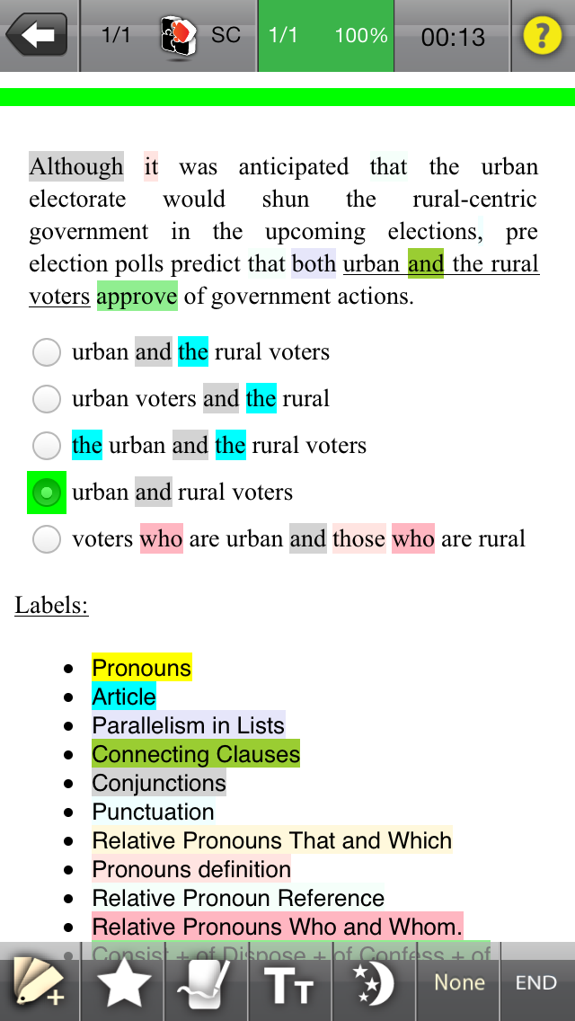
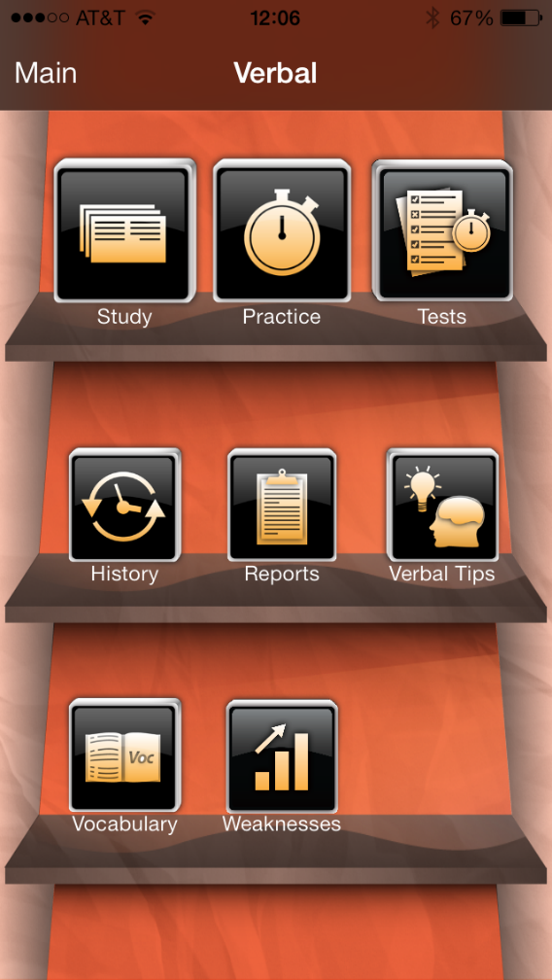
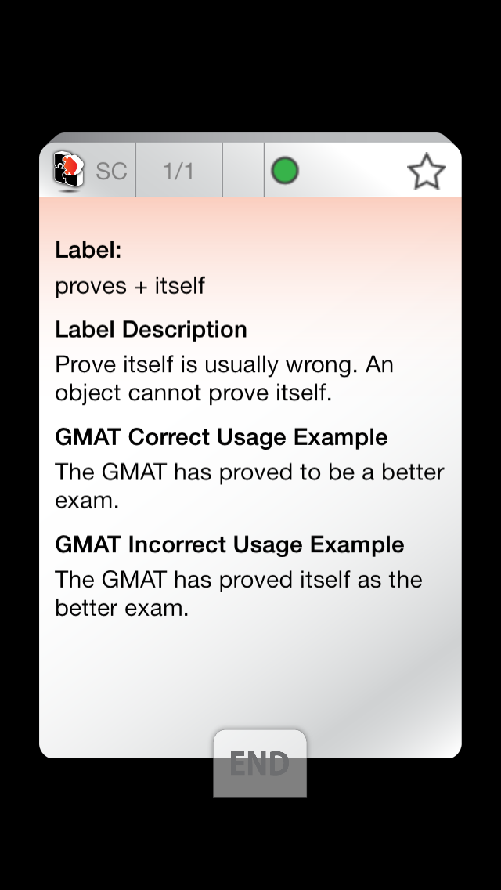
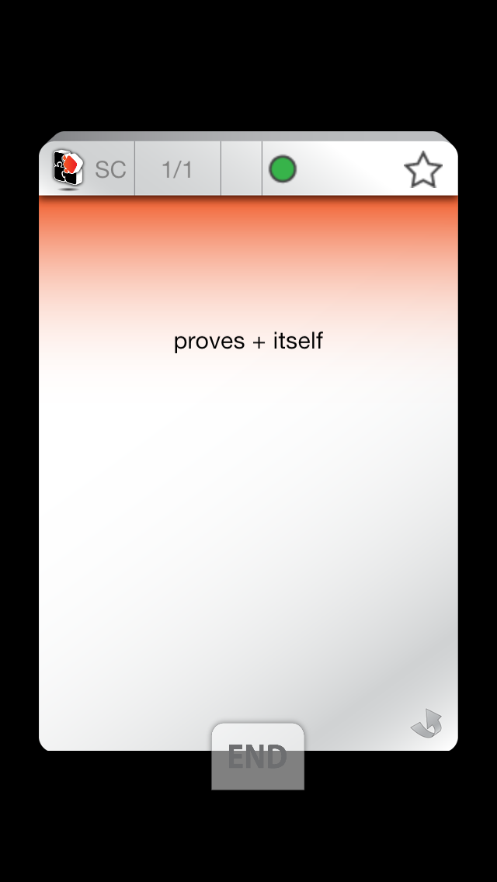
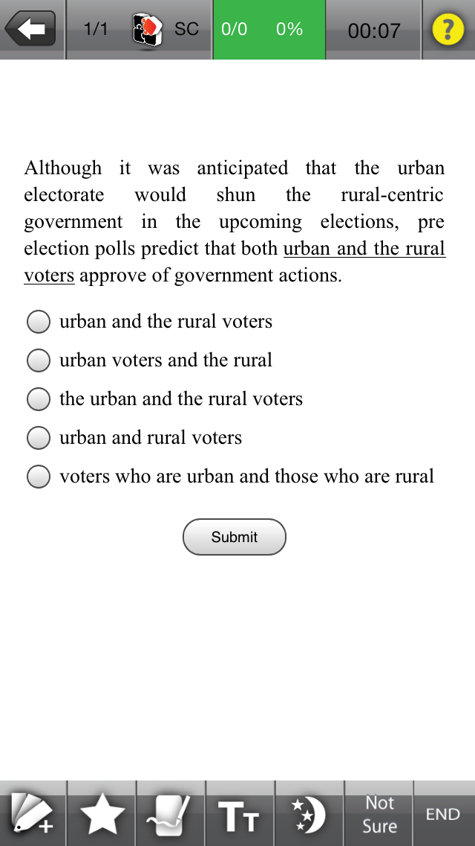
Slideshow in the phone: you can use these screenshots
Homepage slideshow in the phone

Slide 5
Samples of design elements & logo: the following 3 slides contain some ideas for colors used in our style guide. Use them for inspiration, not as a rule.

Slide 6


Heading
Notes:
My name is Elad Shoushan and I am the founder & CEO of LTG Exam Prep Platform.

Slide 7





Existing study tools are a pain.
Ineffective
Expensive
No detailed & actionable analytics
No serious mobile solution
Notes:
I took the GMAT few times and I learned that in order to get high score on the GMAT you need to have verbal, quantitative, and writings skills.
I invested my time in ineffective and generic online courses that are not convenient and not user friendly.
I paid tons of money but got CRAPPY Textbooks that assume all students are the same.
And there was no comprehensive mobile solution that is easy to use that shows testers their weaknesses, and enables learning on the go.

Slide 8

logo

