Slide 1
Design Brief

Slide 2
About Us
We are specialized in Utility/Light Applications such as Battery Saver, Signal Booster, Diet Diary, Alarm, Mirror, Reversi, Othello etc…..
We have launched more than 20+ Applications in such categories.
We are ranked as No.3 Developer in Japan (except Game categories)
What’s Unique About us?
Main Target : Light Smartphone Users ( esp.Women, Kids)
Concept : Simplify Utility Tools that is way to difficult for light users
Fun-to-Use : Along with localized characters navigating how-to-use,
users can enjoy using Utility apps

Slide 3
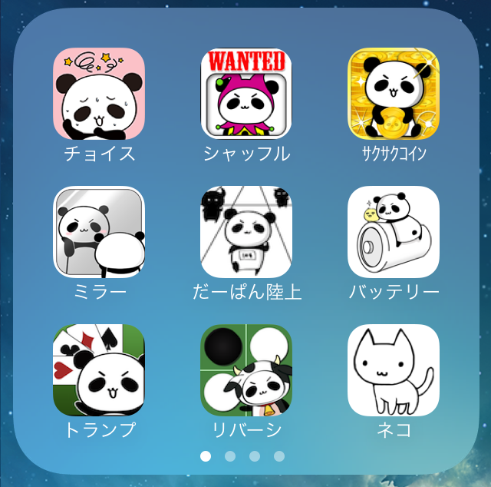
What we’re seeking…
Seeking to localize characters used in Utility Application so that smartphone light users will be fond of our utility applications.
JAPAN
USA
?
?
?
?
?
?
?
?
?

Slide 4
Target
Main Target : 18-35 years old Woman
Sub Target : 18-35 years old Man not really familiar with Phone Settings
Familiar with :
Apps : FACEBOOK, ANGRY BIRDS, CANDY CRUSH SAGA…
Not Familiar with :
Apps : BATTERY SAVER, TASK KILLER, SIGNAL BOOSTER….
Words : RAM, MB, GB, HARD DISK, SYSTEM UPDATE, all those geeky words.

Slide 5
Design Requirements
MUST
Characters that women in USA will really like.
Characters that men in USA will not dislike.
NICE TO HAVE
Unisex Character (i.e.Women will like, men will not dislike)
Easy-to-modify
Simple story along with characters
DON’T
No childish characters that only children in USA will like
100% COPY. We don’t want to violate the copyright.
Use human as character

Slide 6
We want….
1. TIM-BURTON LIKE CHARACTER ×2
2. SOMETHING FROM YOU! ×1 (Be sure about Target&Requirements)
Design sample details follow….

Slide 7
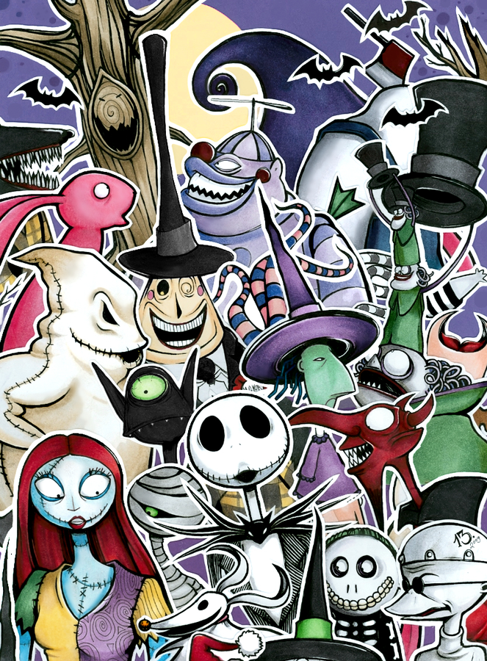
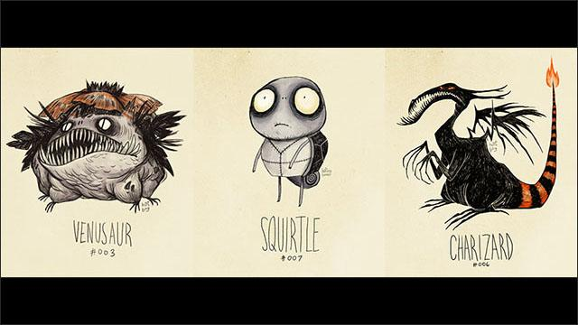
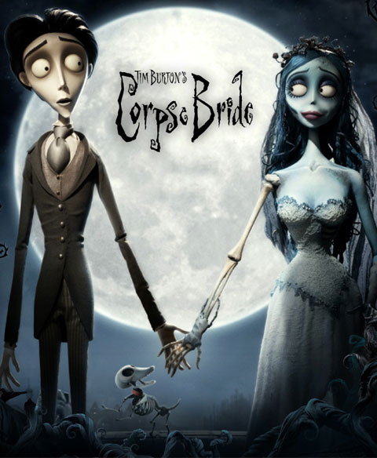
Tim Burton Like Character ×2
We like this one ! http://dailynewsagency.com/2012/08/25/pokemon-if-they-were-created-by-tim-7mv/

Slide 8
Something from you! ×1
MUST : Character that fits into USA Culture
Inspiration : Zombie vs Plants, Alien, South Park, Simpsons, Sponge Bob….
?

