Slide 1
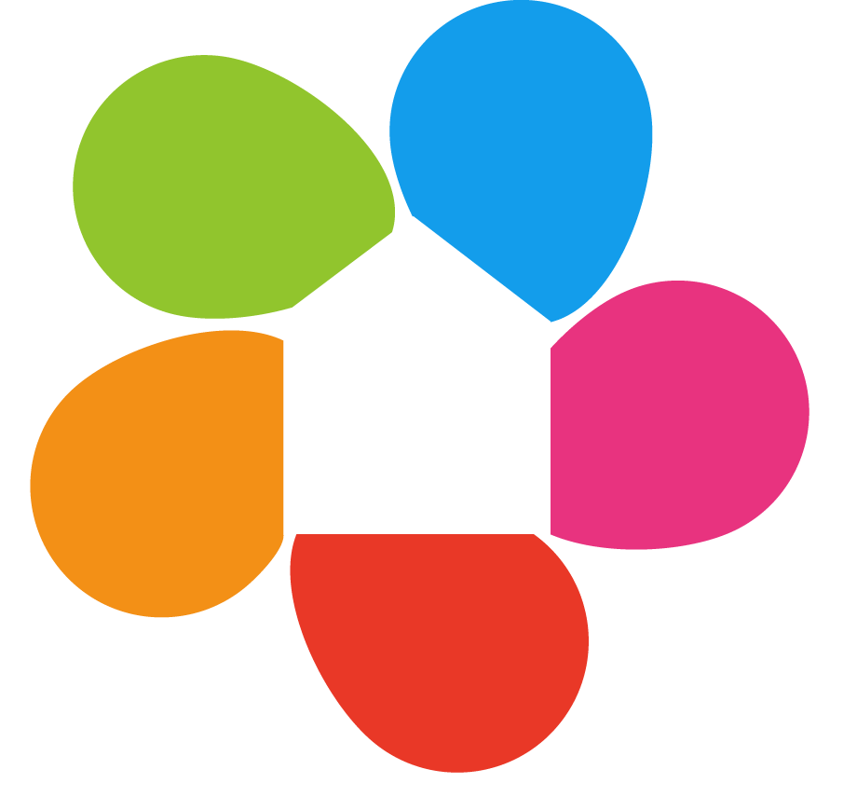
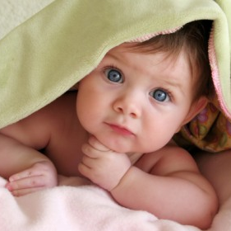
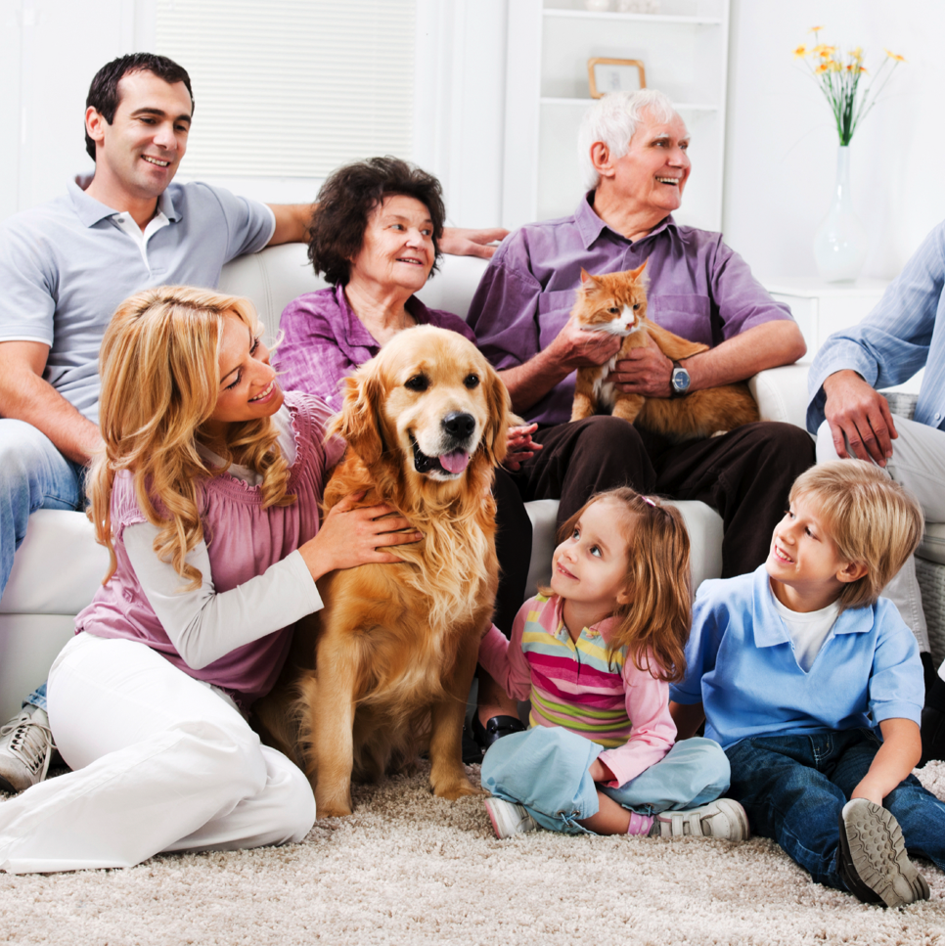
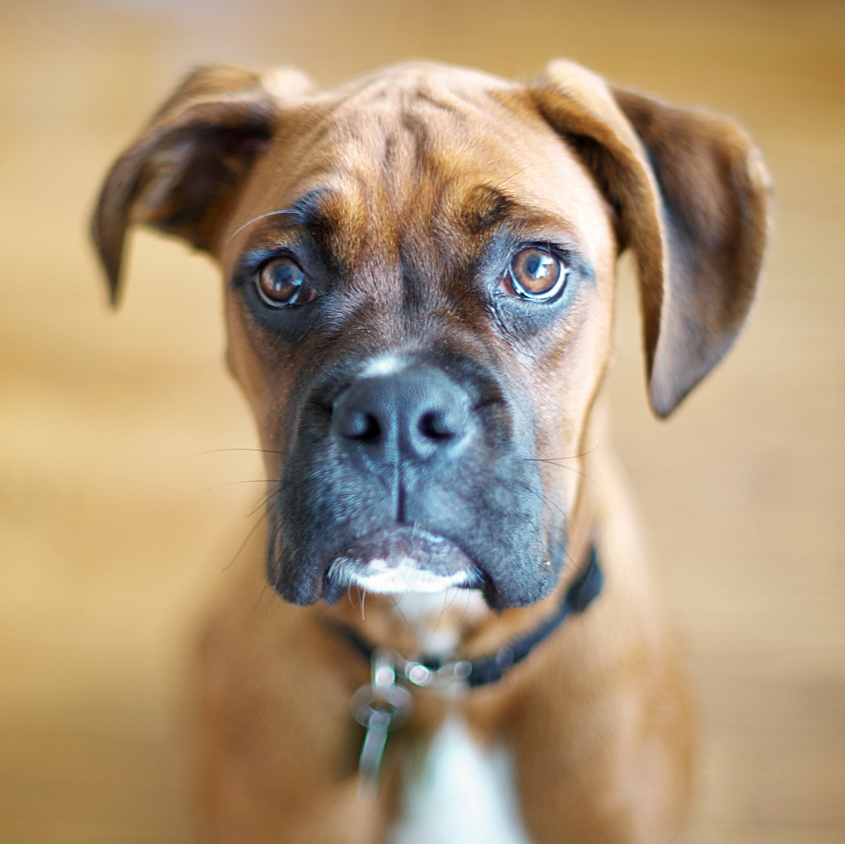
Hubble App Design Competition
Tom Barltrop
October 2013

Slide 2
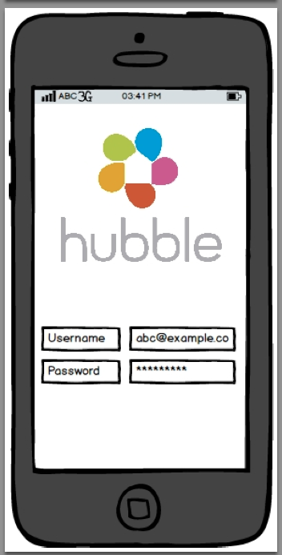
Hubble App Design – Home Page
Updated logo to be attached
Please use Hubble flower to also show page is loading
Also add: Forgotten Something? (for username/password)

Slide 3
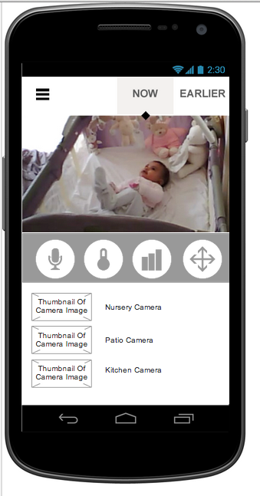
Hubble App Design – Monitoring Camera
1. Camera Home Page
Please feel free to use own images
Icons are as follows (left-right) a) speak function b) see temperature c) view temperature and sound data d) use pan, tilt and zoom controls
These are other cameras that the user can see and can select by tapping on. Please use images.
Baby (main)
Front Door
Garden
Pet (ie in laundry room)

Slide 4
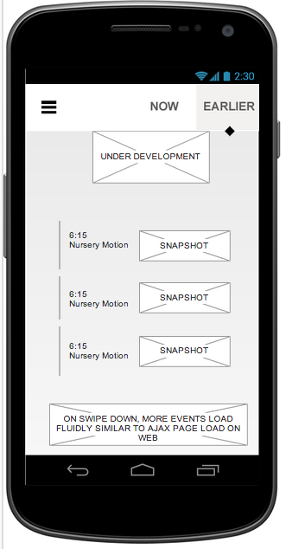
2. Notifications/Timeline Page
Top of page should give current state of room: all is quiet/there’s a lot of movement/the room is a bit too cold
Below is a timeline of notifications. These will include videos (when movement has been detected) as well as sound and any changes in temperature:
7:15am There’s a lot of movement and noise
6:07am all is calm
5:32am There’s some loud noise
4:49am The room temperature has just dropped to 16 degrees
4:11am There’s a lot of movement
Each notification should have an icon on the left such as a petal or something to signify the type of alert (audio/motion/temperature)
Each notification for motion will be accompanied by a video the user can choose to play

Slide 5
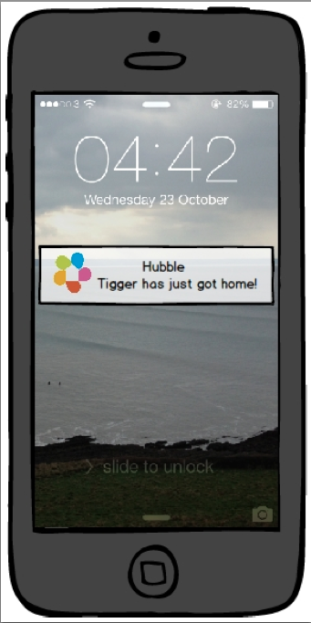
Hubble App Design – Pet Flap
Very simple screen to show alert user will receive when their pet gets home

Slide 6
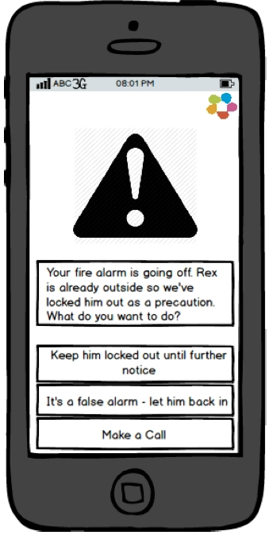
Hubble App Design – Pet Flap
Flexible on choice of icon – could be icon for fire, fire alarm or standard warning icon (as shown)
Change text to: Your fire alarm is going off. Rex has just gone outside so we’ve locked him out as a precaution.

Slide 7
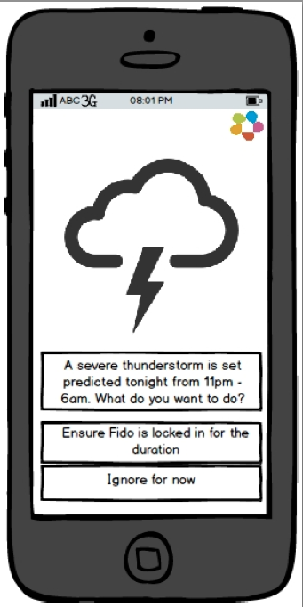
Hubble App Design – Pet Flap
Can either use simple icon as shown or more modern weather design like Yahoo Weather app
Add button: Edit Pet Flap access times

Slide 8
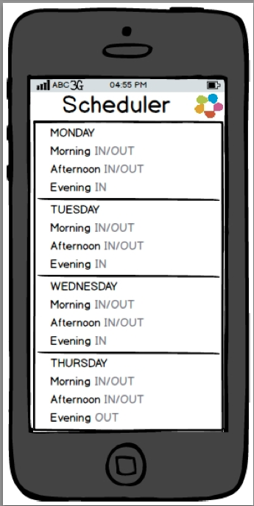
Hubble App Design – Pet Flap
Ultimately the user needs to be able to select the exact timeframe (say down to 15 minutes that the pet can/can’t go outside).
We are flexible on how this is illustrated but usability is key
See the app ‘Sunrise’ for inspiration

