Slide 1
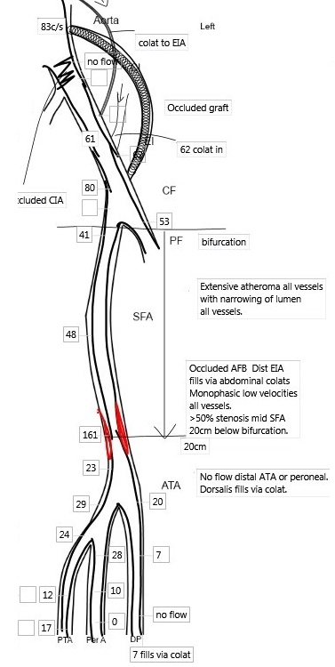
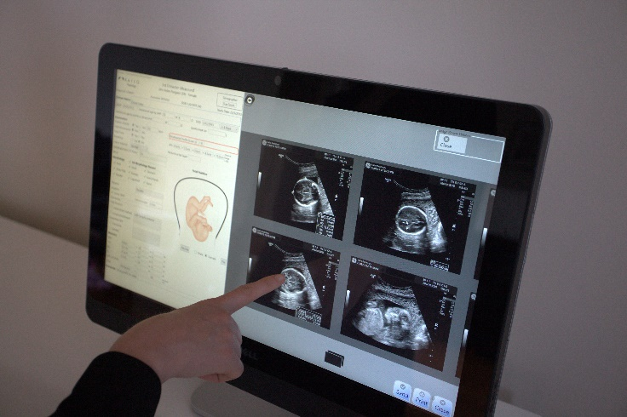
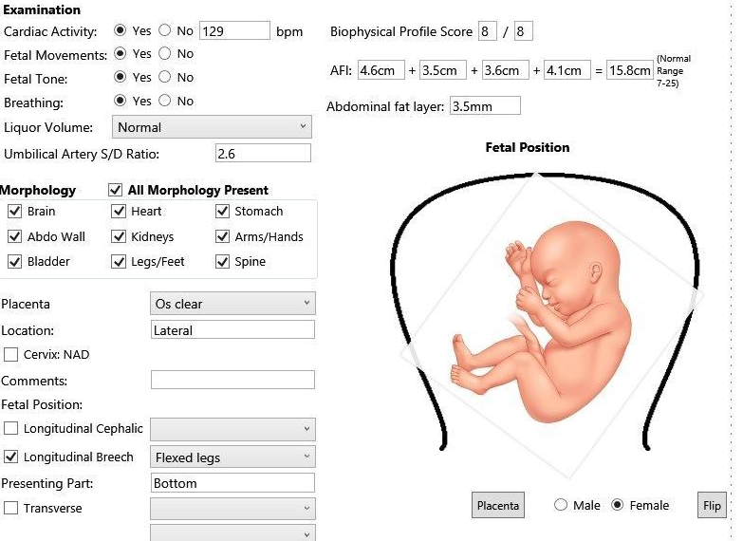

Kailo Medical - SonoReview
Prepared by Kailo Medical
2013 ©
www.sonoreview.com.au

Slide 2
Features
Link to fetal medicine package
Automated Cardiac ejection fraction history
Automated Clinical Markers
Vascular markup by touch
Measurements direct from modality
Active directory integration
Ability to start and stop examinations from workstation
Integrates with an HL7 compliant RIS, and DICOM PACS

Slide 3
Benefits
Clinical Benefits
  Clear
  Concise
  Consistent
Business Benefits
  Time saving
    Sonographer – upwards of 40% increase
    Radiologist
    Typist
Technical Benefits
  No scanner required
  Seamless integration with RIS & PACS
  Single login

