Slide 1


ChoiceLocal
Insert Any
Prospect Logo Here, to Personalize Presentation
Local Marketing Solution to
Deliver New Patients & ROI
May look nice as a background image
That blends into the background in color.

Slide 2

Today’s
Agenda
About ChoiceLocal
Your Goals
Our Strategy for You
Investments and Projections
Summary and Next Steps

Slide 3
We Believe
All Marketing Investments Should Be Held Accountable!
• Built on a belief system that all marketing investments should be held highly accountable •
Integrity In All Things
Amazing Customer Service
Candor With Goodwill
Everyone A Leader
Family
Giving

Slide 4
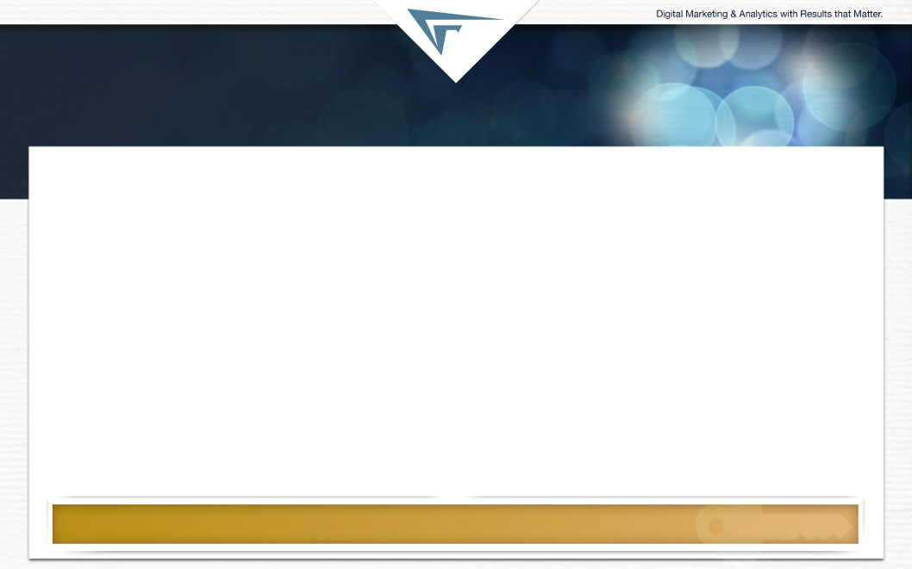
ChoiceLocal
Our Mission: Help Others
At ChoiceLocal our mission is to be a purpose-driven business that helps kids in need by helping others succeed. The common mantra that we say at ChoiceLocal is, “Help Others.”
Help our clients succeed
Help our ChoiceLocal teammate’s succeed
Help Kids – Donate 10% of our Profits to Kids in Need
Our Big, Hairy, Audacious Goal: Help 10,000 Kids Per Year
To accomplish this we must deliver YOU meaningful results!

Slide 5
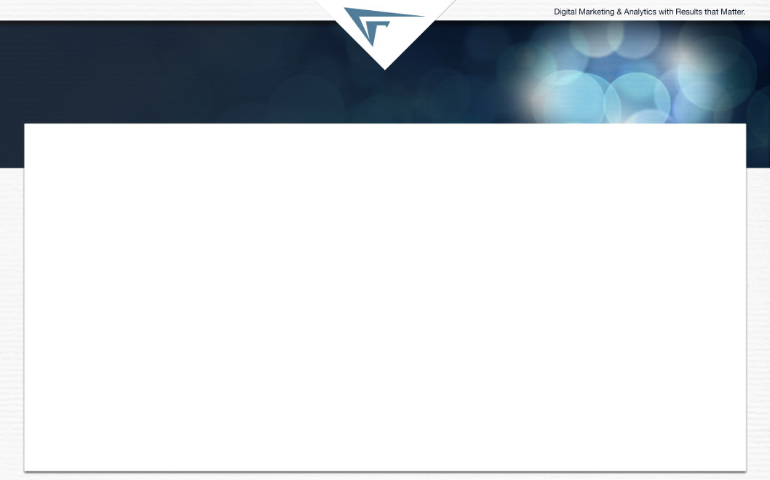
Why ChoiceLocal
••• Helping Guide Potential Customers into Customers & Promoters •••
Top 3 Reasons:
We Are Our Client’s Best Return on Investment in Marketing
We Project Your Revenue & Return on Investment Before You Start
We Specialize in Marketing Local Business Just Like Yours!

Slide 6





ChoiceLocal
What We Do
Build Your Website
Drive Leads & Calls
Help You Close Business
Track Performance
Make It Simple

Slide 7

Your
Goals
GOAL #1: Increase Student Enrollment
Drive
500
More New Patients in 2014 With
Positive ROI

Slide 8
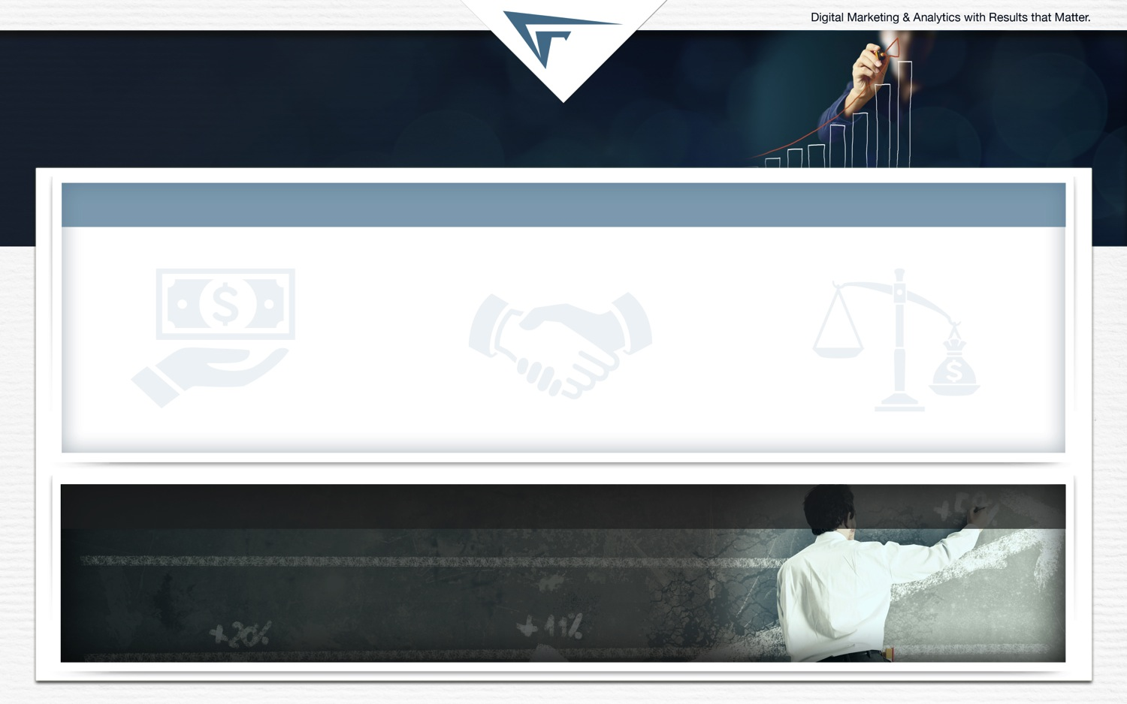
Target
Outcomes
Target Outcomes
Revenue & ROI
Appointment Requests / Month
80
New Patients/ Month
65
Average Patient Revenue
$1,200
Revenue/Month
$78,000
ROI/Month
$10.00:$1.00
••• 1 Year Annualized Run Rate •••
960 Appointment Requests
780 New Patients
$936,000 in New Revenue
For every $1 Invested Project $10.00 in Return

Slide 9

OUR STRATEGY
FOR YOU
Local Online Marketing
Focused on Revenue Generation
(May look nice as a background image
That blends into the background in color.)

Slide 10
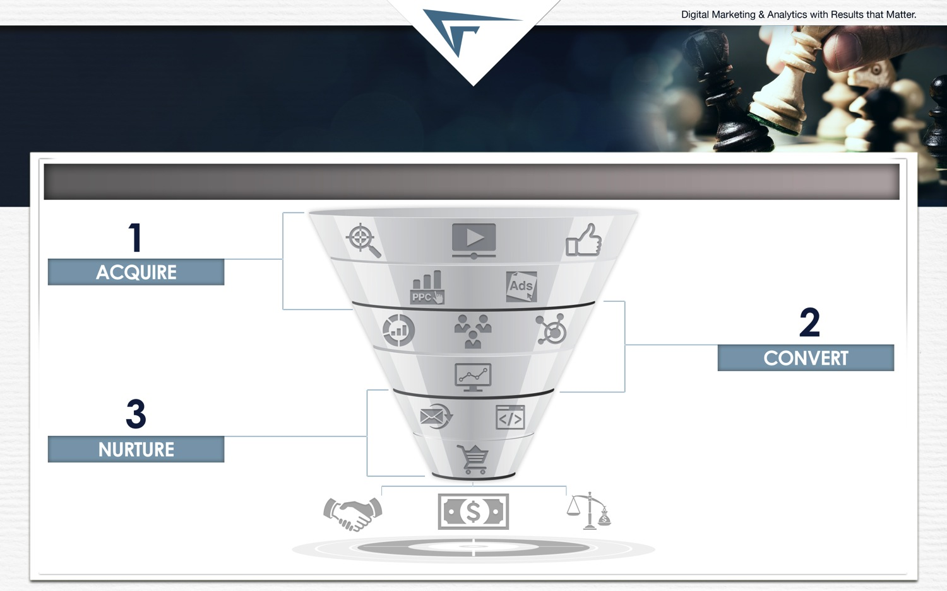
Local Online Marketing
Focused on Revenue Generation
••• Helping Guide Your Prospective Patients to Appointment & Referrals •••
(Insert an image that shows a Flow broken down as follows, Communicate as much as possible with pictures & icons:
Drive Leads & Calls
Search Engine Optimization
Local Listings
Online Reviews
Blog, Facebook, Linked In & Twitter
Pay Per Click
Help You Close Business
Email Newsletter
Automated 1:1 Email
Revenue
New Customers
Strong ROI
->
->

Slide 11
Our Findings
Build Your Website
(May look nice as a background image
That blends into the background in color.)

Slide 12
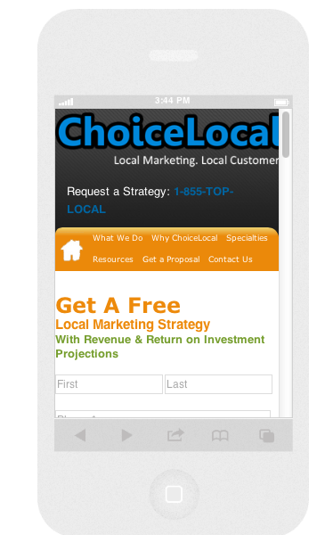
Our Findings:
Build Your Website
“4 out of 5 consumers use smartphones
to make purchasing decisions.”*
Insert Mobile Rendering Here
Website Assessment | Rating (1-5)
Mobile Friendly | 2
Local Search Friendly | 2
Lead Generation Friendly | 2
Clearly Differentiates You | 3
Builds Trust | 4
Integrated Into Social Media | 1
Deficiency | -53%
Page Traffic [mo.]: 2 million
Bounce Rate: 7.5%
Conversion Rate: 3.50%
Page Traffic [mo.]: 2 million
Bounce Rate: 7.5%
Conversion Rate: 1.50%
*SlideShare.net – 150 Smart Stats
Key Finding:
You are missing substantial opportunity. We can work with you over the
course of your program to upgrade your website to meet these criteria.

Slide 13

OUR
FINDINGS
Drive Leads & Calls

Slide 14
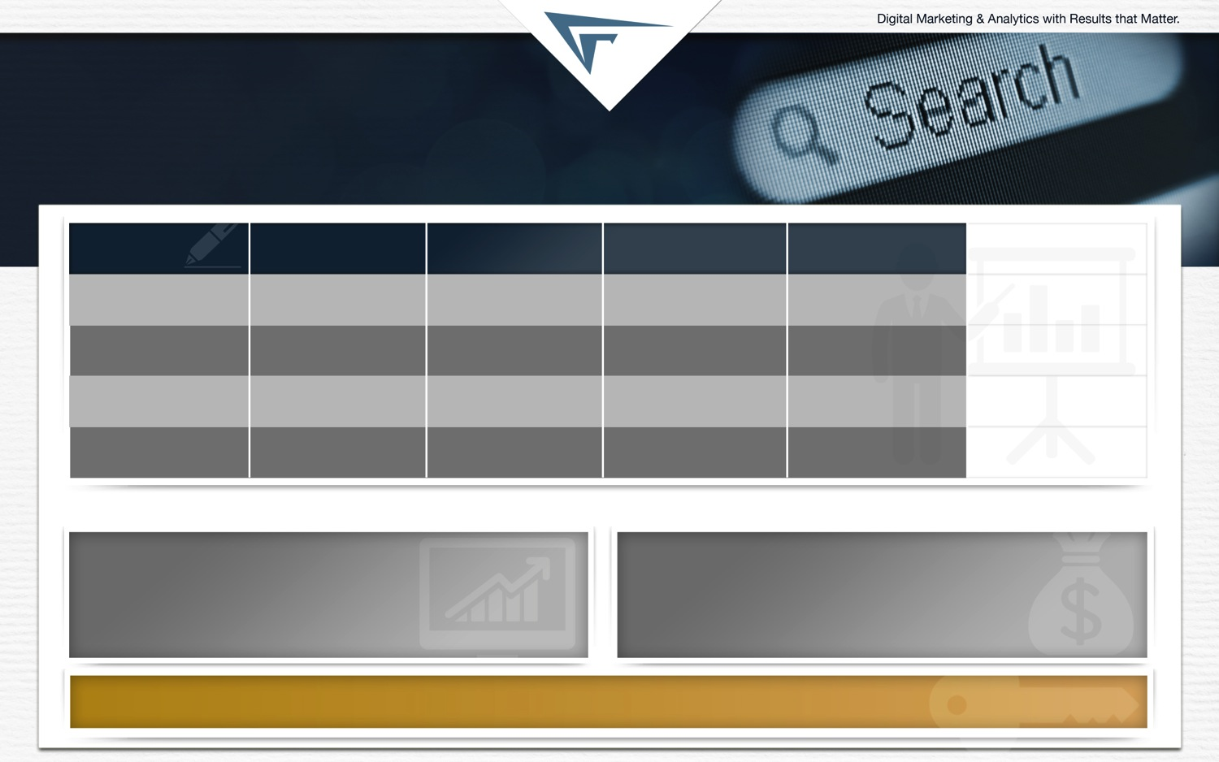



Our Findings:
Search Engine Optimization
Competitor Analysis
Keyword Reach
Onsite
Offsite
Technical
Overall Score
[Out of 20]
CSU.edu
3
2
3
3
11
Kent.edu
5
2
5
3
15
Akron.edu
4
4
4
3
16
Deficiency
-67%
-60%
-25%
0%
-27%
Annual SEO Market Opportunity
Local Search Volume: 360,000
Traffic : 7,200
Appointment Capture Rate: 3.5%
Leads:
Avg. Show Rate: 70%
Avg. Patient Value: $1,200
# of Enrollments: 193
SEO Rev. Opp.:
277
$997K
Key Finding:
You can capture large market share by making your onsite a 5, making important local seo changes on your website and expanding your keyword roster.

Slide 15
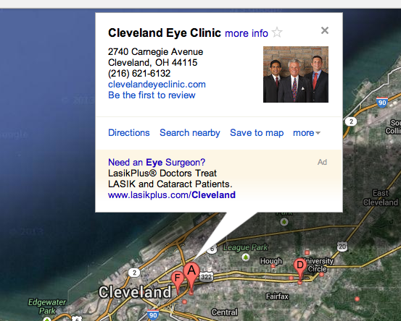
Our Findings:
Local Listings
 | Rank | Ratings (1-5) | Accuracy (1-5)
Google Maps | 2 | 2 | 3
Yahoo Local | 3 | 3 | 5
Bing Maps | 4 | 5 | 3
SuperPages | 5 | 3 | 2
YP.com | 3 | 2 | 5
YellowBook.com | 2 | 3 | 3
Angie's List | 1 | 5 | 2
Review Sites | 4 | 3 | 1
ChoiceLocal Directory Network | 2 | 2 | 1
Deficency | -58% | -62% | -56%
• PREMIUM CONTENT | FINDINGS •
List of Sites We Will Optimize Your Rank, Ratings & Keep Accurate: Facebook, Amazon.com, Groupon.com, HotFrog, MojoPages, YellowBot, WhitePages, BestoftheWeb, TripAdvisor, Fave, KadZue, Bing, Judy’s Book, ThumbTack.com, nSphere, Travidia, Twitter, FourSquare, wCities, Manta, Dunn & Bradstreet, Angie’s List, InsiderPages, Tupalio, MerchantCircle.com, Ask.com, CitySearch, SuperPages.com, DexKnows, TomTom, YellowPages.com, YahooLocal, DiscoverOurTown.com, MapQuest, Local.com, YellowBook.com, Yelp, Google Map Maker, & Google Places.
Key Finding:
You are missing 90% of the local listings leads and calls you could be receiving.

Slide 16
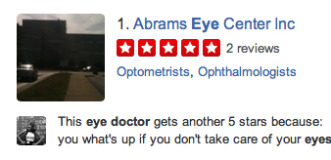
Our Findings:
Online Reviews
“7 out of 10 consumers said they trust online reviews as much as a personal recommendation.”*
• PREMIUM CONTENT | FINDINGS •
Online Reviews
Average Rating | 4/5
# of Positive Reviews | 6
# of Negative Reviews | 2
*SlideShare.net – 150 Smart Stats
Key Finding:
We can improve your new customer flow & local rankings by encouraging more
positive reviews and push down negative reviews by optimizing your social profiles.

Slide 17
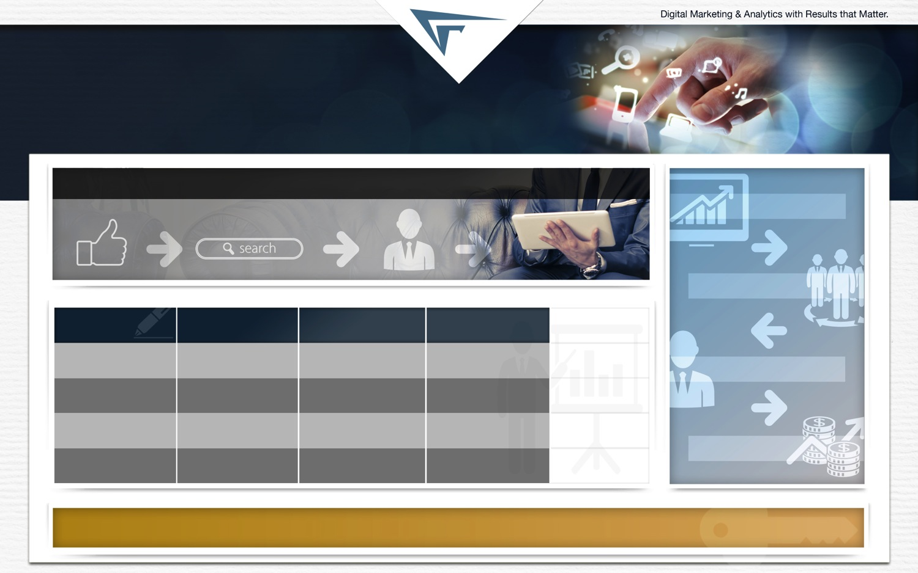


Our Findings:
Social Media & Simple Blog Posts
Likes/Shares | Traffic, Rankings & Referrals | Provable Leads | Provable Patients
(Insert An Image About Blogging, or Blog Content, Getting Syndicated Through Social And Generating Customers)
Improved Local Rank
More Leads
Competitor Analysis
Social Setup
Social Followers
Engagement
Overall Score
[Out of 20]
You.com
2.7
2.0
1.7
6.3
More Customers
Kent.edu
3.0
3.0
2.3
8.3
Akron.edu
3.0
2.0
3.0
8.0
More Revenue
Deficiency
-13%
-50%
-80%
-26%
Key Finding:
A simple social strategy focused on a weekly blog post on the topics of X, Y & Z, and posting that content to your Facebook, Twitter & LinkedIn will drive referrals, more patient visits, and improved local rankings.

Slide 18
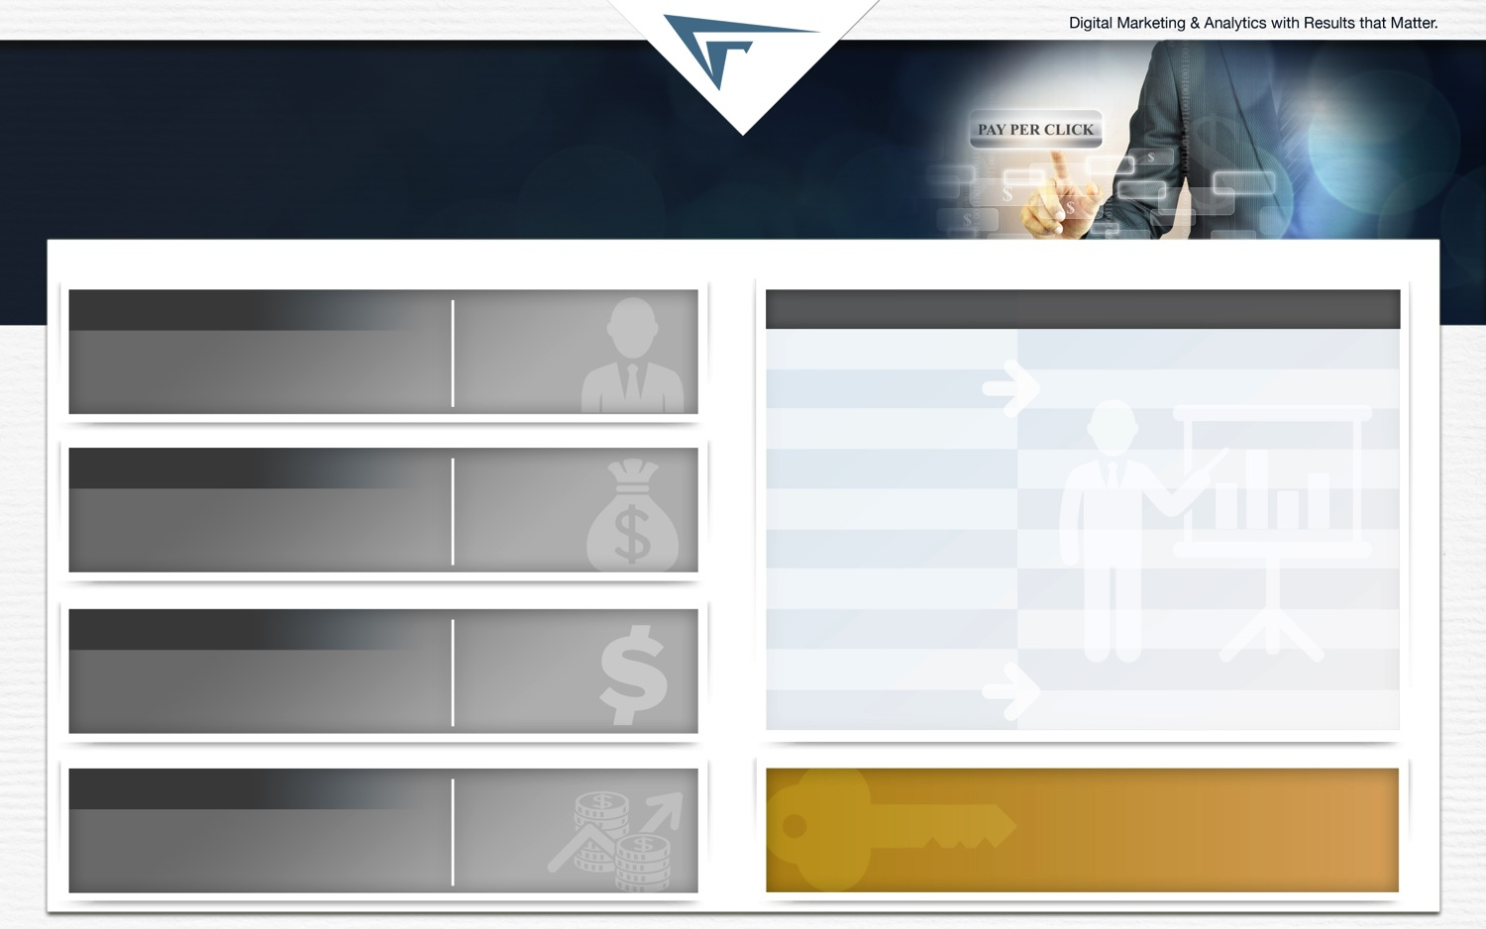
Our Findings:
Pay-Per-Click
Monthly Advertising Opportunities
Leads
Improvement:
Keywords
| Insights
Current: 32
Future Target: 470
438
Keyword Reach
X relevant keywords
Remarketing Reach
Enhance display and text remarketing X%
Display Reach
Expand with X, Y, & Z targeting
New Patients
Improvement:
CTR
More robust ad copy testing to lower cost
Current: 2
Future Target: 24
22
Campaign Structure
More targeted per product line
Ad Extensions
Missing opportunities in X, Y & Z targeting
Branded Search
More brand variations and ad extensions
ROI
Improvement:
Wasteful Spend
$XXXX.XX wasted/mo. not meeting goals
Current: $12.80
Future Target: $18.63
45%
Bid Management
Too many ads in high position at high CPC
Match Type Use
Experiment with long-tail phrase & BMM
Revenue
Improvement:
Key Finding:
Current: $144,000
Future Target: $1,728,000
$1.58M
Our target is to drive a X% improvement in ROI
and $X in new revenue through X new enrollments.

Slide 19

OUR
FINDINGS
HELP YOU CLOSE BUSINESS

Slide 20

Our Findings:
Monthly eNewsletters
Email Program Insights
(Insert a screenshot here
that shows an example of a eNewsletter in the Healthcare Space)
Current | Target | Improvement
Send Volume
Per month
5K
5K
N/A
Open Rate
18%
25%
35%
CTR
8%
17%
190%
Conversion
Rate
3%
5%
40%
# of Leads
54
8.5
30%
% of Leads
That Close*
70%
70%
Avg. Closed
Deal Value
$1.2K
$1.2K
Key Finding: We can utilize your database of current customers by giving them free content that will drive them to come see you, buy more from you, and refer new patients to you.
Monthly
Revenue
$1.8K
$7.1K
+$5.3K

Slide 21

Our Findings:
Automated 1:1 Email
1:1 Email Program Insights
Email Marketing Automation|
# of New Leads/Mo. |
% Deals Won Back |
Close Rate |
Enrolls/Mo. |
Avg. Deal Value |
Monthly Revenue
No Marketing Automation:
5,000
N/A
5.0%
250
$72,000
$18,000,000
Target w/ Marketing Automation:
5,000
20%
6.0%
299
$72,000
$21,500,000
Improvement:
N/A
20%
20%
49
N/A
+$3,358,000
••• 1:1 EMAIL MARKETING •••
Activity
• Email Activity | Open Rate
• Site Behavior
• Remarketing Activity
• Social Profiles & Activity
• Video Activity
Personal Information
• Degree of Interest
• Personal Characteristics
• Name/Address
• Motivations
• Objections
• Survey Data
Key Finding:
We expect that we can improve your close rate on leads by 20%.

Slide 22

OUR
FINDINGS
TRACK PERFORMANCE

Slide 23
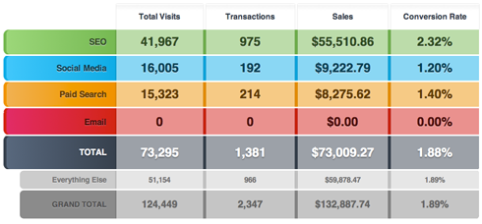
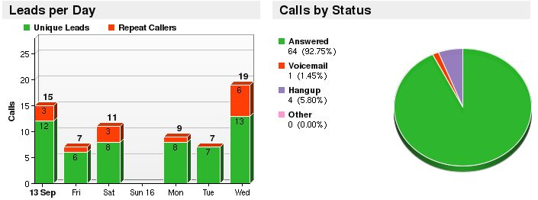
Track Performance
Marketing Performance Dashboards
Call Tracking Performance Dashboards
Key Fact:
We give you clear reporting on leads, calls, revenue, and web performance.

Slide 24

INVESTMENT &
PROJECTIONS
Local Marketing Solution

Slide 25
Investment
& Projections
Investment
Leads & Enrollment Rate
Revenue & ROI
ChoiceLocal Fees/Month
$3,000.00
Media Spend/Month
$7,500.00
Total Investment/Month
$10,500
Leads/Month
80
Show Rate
70.00%
# of New Customers/Month
65
Average Enrollment Revenue
$1,200.00
Revenue/Month
$75,000
ROI/Month
10:1
••• 1 Year Annualized Run Rate •••
960 Appointment Requests
780 Patients
$936,00 in New Revenue
For every $1 Invested Project $10.00 in Return

Slide 26

SUMMARY &
NEXT STEPS

Slide 27

Summary &
Next Steps
Solution
Account Expertiese
Performance Targets
Drive Leads & Calls
Search Engine Optimization
Local Listing Management
Online Review Strategy
Blog & Social Strategy
Pay Per Click Advertising
Help You Close Business
Monthly eNewsletter
Account Executive
Search Engine Optimization
Pay Per Click
Display
Conversion
Analytics
Content
Email Marketing
Strategist
Designer
Developer
Leads
960
Patients
780
New Revenue
$936,000
Return on Investment
$1 to $10.00
Track Performance
Program Reporting
  Calls
  Leads
  Web Performance
  Financial Performance
Monthly Investment
Next Steps
• Fathom: $3,000.00
• Media Spend: $7,500.00
• Total: $10,500.00
Complete Activation Paperwork
Schedule Onboarding Call
Begin Campaign Development

