Slide 1

Preferred design/style

Slide 2


Slide 3


Slide 4
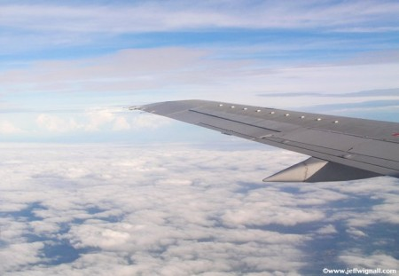

Slide 5
Capital and lower case letters
WannaTravel

Slide 6
Lower case letters only
wannatravel

Slide 7
Capital and lower case letters
WannaTravel

Slide 8
Lower case letters only
wannatravel

Slide 9
Capital and lower case letters
WannaTravel

Slide 10
Lower case letters only
wannatravel

Slide 11









Gate 17
wannatravel
annatravel

