Slide 1


Squooshi’s Famous “Little Green Monster”
This blend is packed with vitamins, minerals, protein and healthy fat. It blends up a beautiful bright green and is just delicious. Sweet and creamy without a hint of spinach grit.
Ingredients:
1/2 banana
1/4 avocado
1 handful chopped fresh spinach
1 scoop Greek yogurt
3/4 c fresh or frozen mango
Puree all ingredients together in a food processor or blender. Pour into your favourite Squooshi. Enjoy now or freeze for later.
Apple, Carrot, Sweet Potato & Broccoli Squooshi
Ingredients:
2 small apples
2 medium carrots
1 1/2 cup sweet potato, cubed
1 cup broccoli, chopped
Steam carrots, sweet potato and broccoli together until tender, adding apple at the very end. Save the steaming water. Puree using your wand, blender, mixer of choice using the steaming water to achieve desired consistency.
Show full product range
Reusable Food Pack
“Extremely easy for me to pack my home cooked mashed food for my baby. A great concept and he loves the animal designs. “
Melissa Ann Tan, Malaysia
Give your children wholesome, home made food on-the-go
Great for baby food, yogurt, oatmeal, smoothies and more
Freeze, store and serve from same container
Award winning & eco-friendly
Portes Sdn Bhd
mimijumi@asia.com
www.portes.my

Slide 2
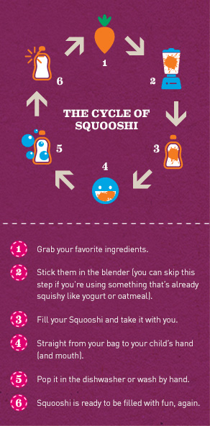
WHAT CAN I PUT IN A SQUOOSHI?
Squooshi refillable pouches are perfect for any squishy food. We fill them with applesauce, smoothies, fruit, grain and veggie purees, homemade baby food, yogurts, oatmeal – anything of a squishy consistency.
WHERE CAN SQUOOSHI POUCHES GO?
Squooshis are easy to fill and take with you wherever you go. School.The park. For homemade baby food, Squooshi reusable squeeze packs mean no more frozen cubes or fussing around with freezer trays, no extra bowls and spoons, and no breakable jars or double-dipping. They can go straight from filling, to the freezer, to your bag, to your child's hand (and mouth) with no fuss (and less mess!).
HOW DO I FILL MY SQUOOSHI?
Squooshi pouches can be filled through an extra sturdy zipper located on the bottom of the pouch. Simply turn the pouch over, pull apart the zipper, make sure your cap is on and pour or spoon in your favorite squishy food. For optimal use, Squooshi pouches should be filled about ¾ full depending on the content. Wipe away any seeds or food bits from the zipper, and make sure the bottom is sealed completely after filling.
Avoid the microwave, boiling liquids, and anything with a consistency thinner than applesauce.
HOW DO I CLEAN MY SQUOOSHI?
Our pouches were designed specifically for ease of cleaning. Every section of the interior of our pouch is easily rinsed with a direct stream of water. Just pop them in the top rack of your dishwasher or wash them by hand with warm soapy water.
ABOUT THE POUCH SAFETY & MATERIALS
As eco-minded parents, we made sure Squooshi reusable food pouches are made with the greatest of care. This product is has gone through very stringent test and is US FDA approved. Squooshi are BPA-free, PVC-free, Lead-free, Phthalate-free, puncture resistant plastic, to provide convenience and durability without unnecessary chemicals. ISO 9001 certified and BRC rated, meaning the company meets international standards for quality and safety protocols as pertains to ingredients, allergens, hygiene, humane trade practices, and foreign ingredient exposures.
Extra sturdy zip-lock bottom, prevent spills
Easy-to-clean convenience
Compatible with spoon attachments
Easy to fill

