Slide 1

DESIGN INSPIRATIONS
<

Slide 2
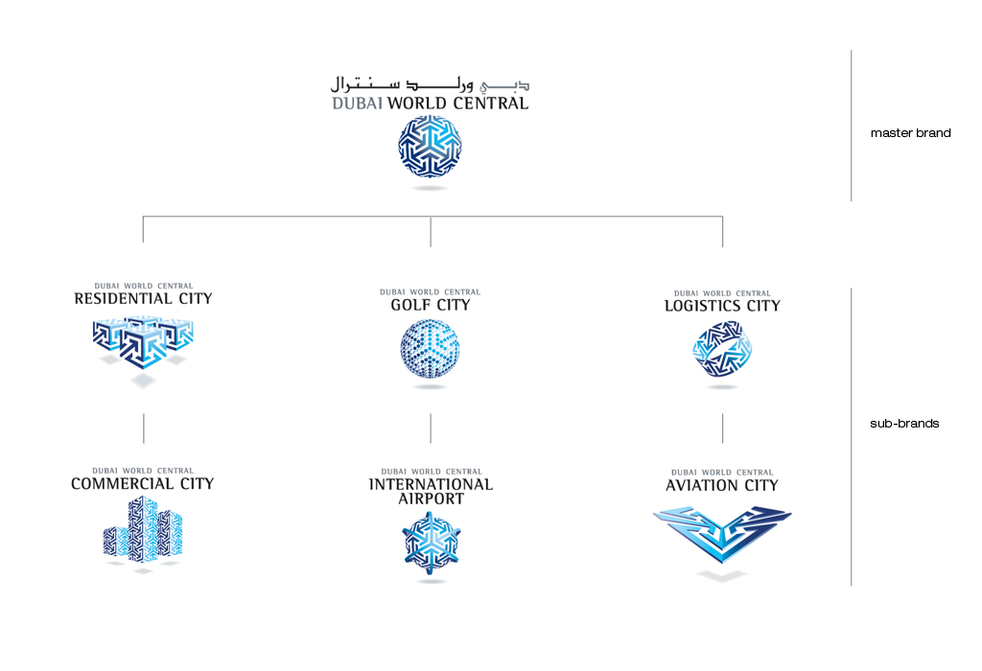

DESIGN INSPIRATIONS
<

Slide 3


DESIGN INSPIRATIONS
<

Slide 4

DESIGN INSPIRATIONS

