Slide 1



Slide 2
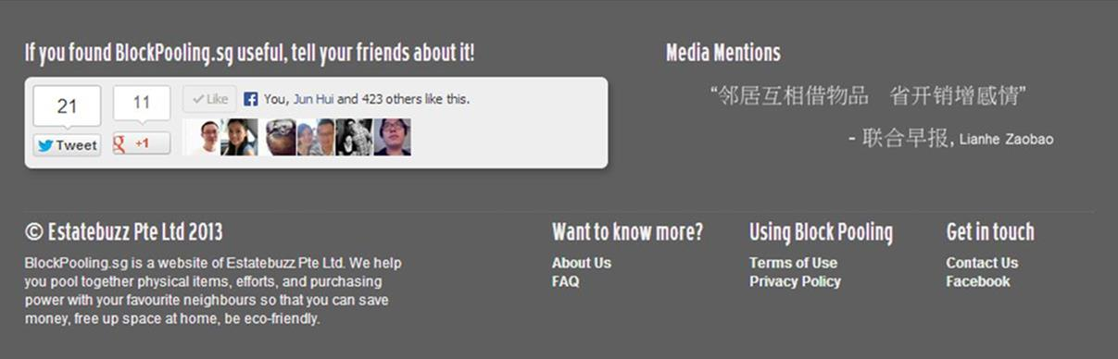

Slide 3


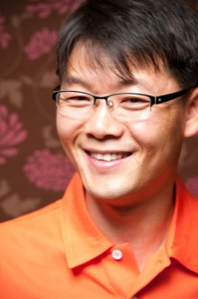

Slide 4
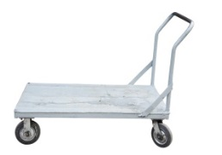

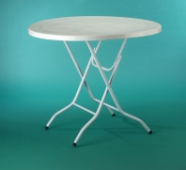





There are 2400 DVDs, 10 electric drills, 200 children items and more in your block. Why buy when you can borrow?

Slide 5



Mag is offering professional home-call beauty services at low rates
Angela is offering hourly housekeeping at $13 per hour

Slide 6



Noor, a non-professional guitar enthusiast, will teach beginner guitar for only $5 per lesson
Siew Fong, an architecture undergraduate, will design your home from only $200

Slide 7
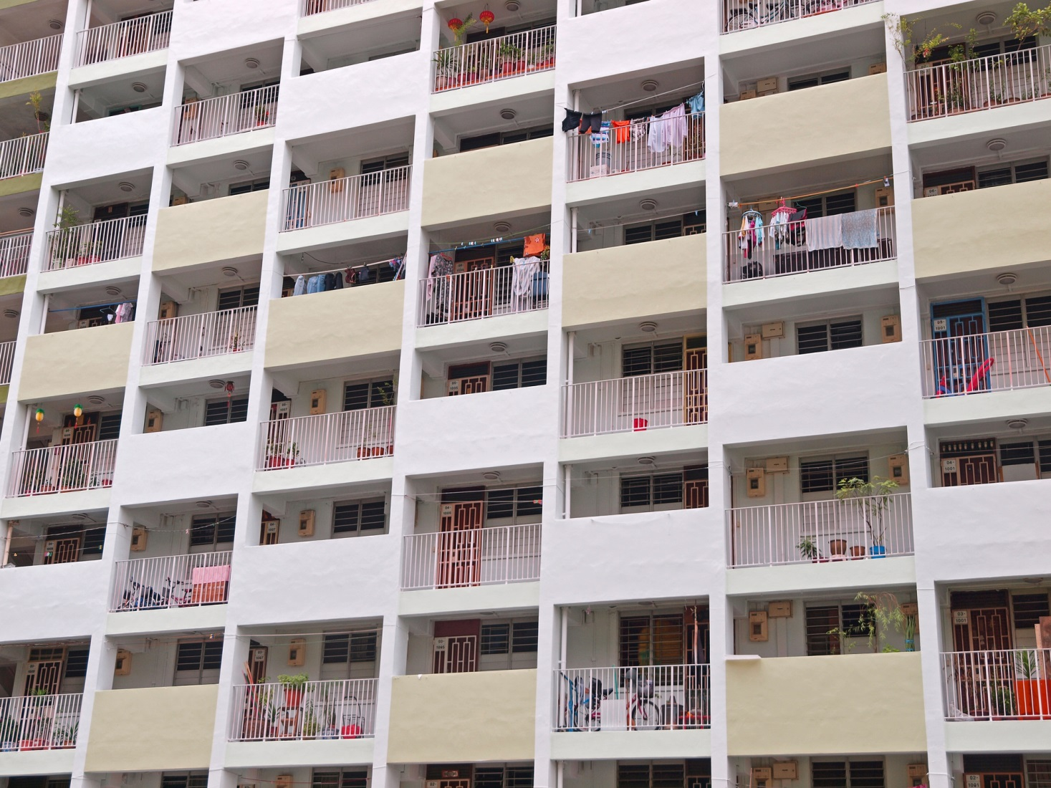


Jo is offering dog walking at $10 per hour
Jill will assemble IKEA furniture for $20 per piece

Slide 8


Slide 11


Slide 12


Slide 13


Slide 14


