Slide 1
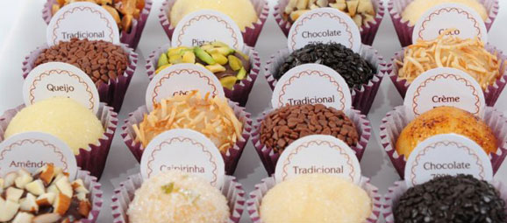
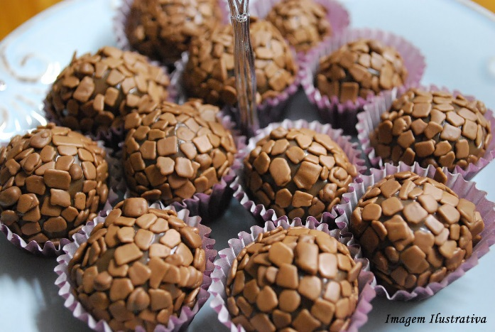
What does “Galeria do Brigadeiro” mean?
Galeria do Brigadeiro = Brigadeiro Gallery (inspired in Retro Syle Art Galleries)
What does “Brigadeiro” mean?
- It is a Brazilian traditional sweet. It started as a child´s birthday treat and it is now a national icon. Made mainly with condensed milk, butter and chocolate, it has now reached new horizons and is served as a luxury sweet in many flavours and packagings.
Different Flavour Brigadeiros
Traditional Chocolate Brigadeiro

Slide 2
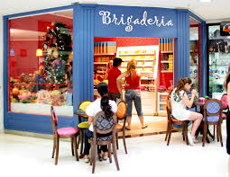
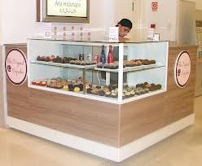
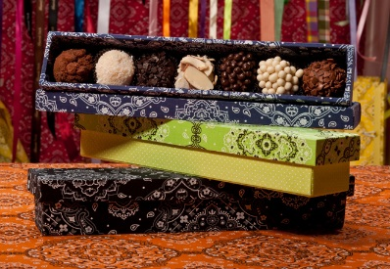
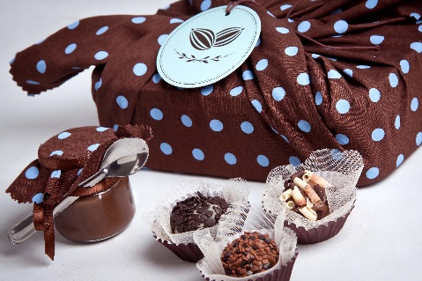
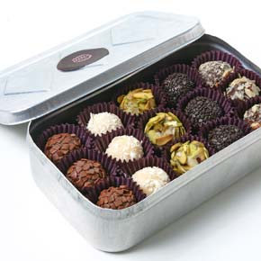




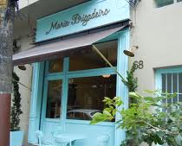
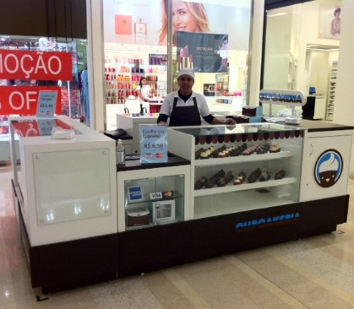
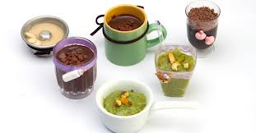
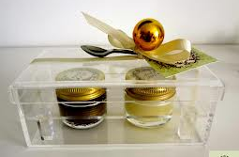


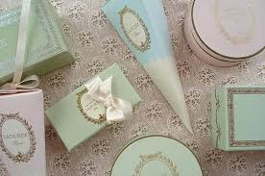
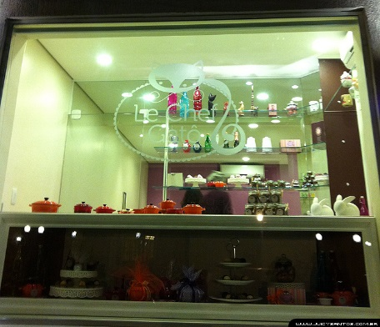
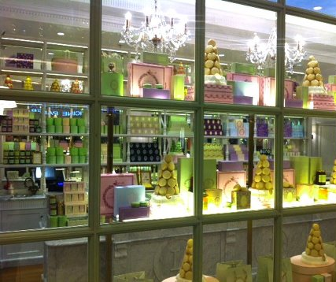
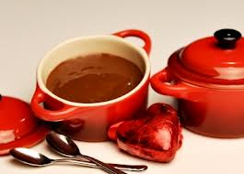
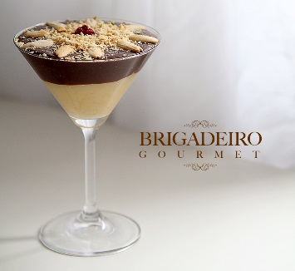
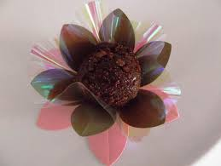

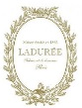
The Gourmet Sweets Market
Existing Gourmet Sweet Stores
Differentiated packaging

Slide 3
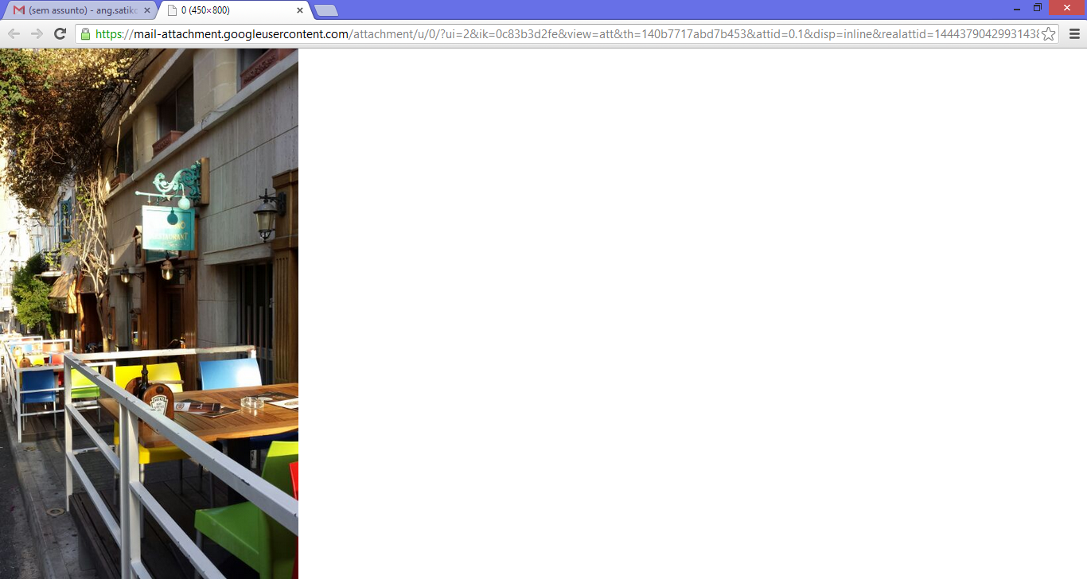









About the Logo for “Galeria do Brigadeiro”
Inspired in retro style mirrors and signs
Colors: Mainly Red, Purple or Blue

