Slide 1
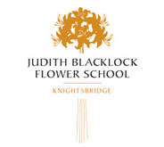
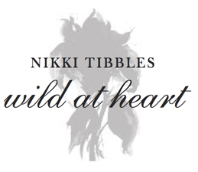
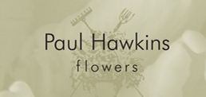
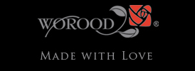
Logos we like

Slide 2
Background/requirement
Sugarbush Flowers is a florist for individuals who are drawn to the luxurious things in life. We cater to individuals and corporate clients who don't want the standard arrangement with ordinary template designs. The ideal customer for Sugarbush Flowers is an individual who is not satisfied with the ordinary, they have reached a certain level of success in their life and they like to make their choices reflect this standard. We speak to their needs and provide flowers and gifts that impress. Our customer comes to us because they know that we will make them look good to the people that receive their flowers on a personal level or people that see the arrangements in a corportate setting. We are all about making an impression.Our product line consists of bespoke floral designs for all special occasions, specialising in handtied bouquets. We also carry giftware and flower accessories such as vases.As a sidenote - Sugarbush is another name for the Protea flower. This flower can be incorporated into the design but is not a must although a flower element would probably reinforce the business type within the logo.A winning logo will be one that is striking and has a lasting impression. The design should include the name of the business "Sugarbush Flowers" . Our tagline is "Delivering sweet bunches of joy" which will not necessarily always be used with the logo but should be considered because there may be some instances where a lockup is used (logo & tagline).We would like to see designs with a premium feel to them. A classy, tasteful logo with any combination of any of the following colours (not all the colours need to be used, this is just the preferred palatte) - grey, slate, black, white, pink, gold, lime green/turquoise (please feel free to suggest any other colours that speak to the brief)

Slide 3
Target Market
The ideal Sugarbush Flowers customer is in their mid 30's to 50's, has achieved success in their professional and personal lives and likes to enjoy the finer things in life. Because they have built a reputation for themselves, they have to uphold a certain standard in everything they do. This is the kind of person that you want to have as a friend because they give the best gifts. They have exquisite taste so when they are choosing flowers to send to someone, they see this as an extension of themselves and will not settle for a manky little bouquet that says "i've just picked this up from the petrol station on my way to your house" The response that they are looking for when someone receives their flowers is "wow!"we want to appeal to both males and females who are internet savvy as we are going to develop a lush website where we will showcase our products and services so the logo needs to carry the same highend appeal to audiences who may come accross the ICONIC logo online.

