Slide 1

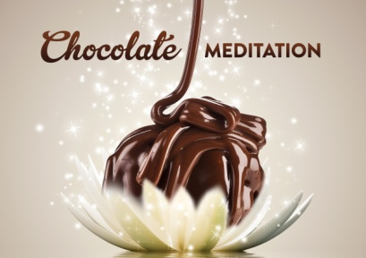
Meditation
Meditation is the process of sitting still and concentrating on the breath.
Not about clearing your mind but being aware of the thoughts.

Slide 2
Mindfulness
Being fully present with the present moment with all the senses.
Mindful eating is being fully aware of what you are putting into your mouth.

Slide 3
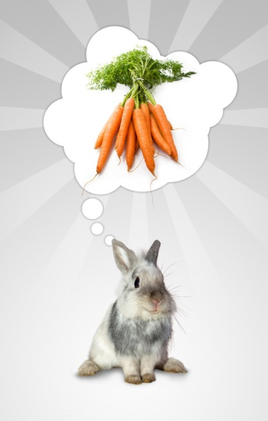
Eating Mindfully
Really sensing what you are eating:
    Where it came from
    All the processes it went through to get to you
No distractions like TV, computers or telephones. Just be with the food.
Gives us an opportunity to really taste the food and appreciate it.

Slide 4
Food Reflection
With wise reflection I eat this food.
Not for play, not for intoxication.
Not for fattening, not for beatification.
Only to maintain this body.
To stay alive and healthy.
To support this way of life.
Thus I let go of unpleasant feelings,
And do not stir up new ones.
There by the process of life goes on,
Blameless, at ease and in peace.

