Slide 1
iQ Consult
iQ Consult is a Proud Sponsor of the Mawson’s Huts Foundation www.mawsons-huts.org.au

Slide 2
About iQ Consult
Offering IT infrastructure monitoring and analysis tools
Helping companies avoid infrastructure failure
Optimising the health & performance of all infrastructure elements
  any device, any platform, anywhere
Privately held Australian software and services company
  Sydney and Melbourne, Australia
As a company of scientists and engineers,
  we proudly support the Mawson’s Huts Foundation as a Corporate Sponsor
  we ascribe to achievement through scientific endeavour, as epitomised by explorer/scientist/engineer, Douglas Mawson and his Antarctica expedition team (1911-1914)

Slide 3


































Slide 4
Some recent experiences
Local
International
Dept of Foreign Affairs & Trade – implement the largest instance of VMware vCloud Director in Australia
Infoplex/NextGen – design and implement Cloud Delivery Platform (EMC Smarts & W4N, integrated with BMC Remedy and Cisco Portal)
Bpay – root cause analysis and service level management (EMC Smarts & W4N)
UGL – integrate Huawei mobile network with Smarts & W4N
Prime Minister & Cabinet – operational framework for network management solution
Macquarie Telecom – design Government Department hosted cloud monitoring service
CSIRO – remediate and upgrade EMC Smarts monitoring and infrastructure performance reporting (W4N) platform;
AEMO – EMC Smarts ~ operational support services
Gilbert+Tobin – Disaster Recovery solution (VMware SRM)
Jordan Telecom – large scale, complex implementation of Watch4Net as a customer portal to display all of their connections
Investec Bank (S.Africa) – design and implement network monitoring and performance analysis (W4N) giving true end to end storage view of all storage layers
Dimension Data (UK) – advise on design of their global Managed Service for Microsoft Lync (MSML) network; part of Global Services Operational Architecture (GSOA)
First Data (Greece) – custom network monitoring reporting (EMC W4N) ; custom VMAX reporting
NZ Telecom – Network Configuration management (EMC NCM)

Slide 5
Our emc partnership
iQ Consult are dedicated champions for EMC Advanced Software Division (ASD) solutions, using:
EMC Smarts Suite:
Service Assurance Manager (SAM)
Network Configuration Manager (NCM)
IT Orchestrator
Business Impact Manager (BIM)
Availability and Performance Manager (AM-PM)
Watch4Net
End to end view of performance and capacity across all technology stacks
Topology
Custom metric collection and report packs
Custom portal
EMC Storage Resource Management (SRM) Suite:
Watch4Net (including iQC custom Report Packs)
Prosphere
Storage Configuration Advisor (SCA)
EMC Certified Training Partner
Certified Trainers for Smarts & Watch4Net
Globally acknowledged Smarts and Watch4Net experts

Slide 6
Our approach
Remediation – enhance the existing solution set (whether this is configuration, upgrade or customisation) to a standard where a demonstrable business benefit may be realised;
Licensing - applying the right mix of software licensing to the actual business and technical needs of businesses
  Promotion of EMC ELA as appropriate licensing vehicle
Operational Support – take on the 1st, 2nd and 3rd level support for the environment as well as the engagement structures within the customer’s business units;
Extended Support – additional professional services for project-based work and new solution development based on the development of reference architectures.

Slide 7
iQ Consult Offerings
m.Reports (W4N)
m.Events (Smarts)
E2E for Storage (W4N)
vCloud Director – Solution Pack (W4N)
Storage Assessment Service

Slide 8

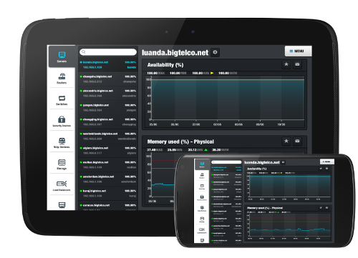
m.Reports
Device monitoring and
Service Level Agreement (SLA) reporting

Slide 9



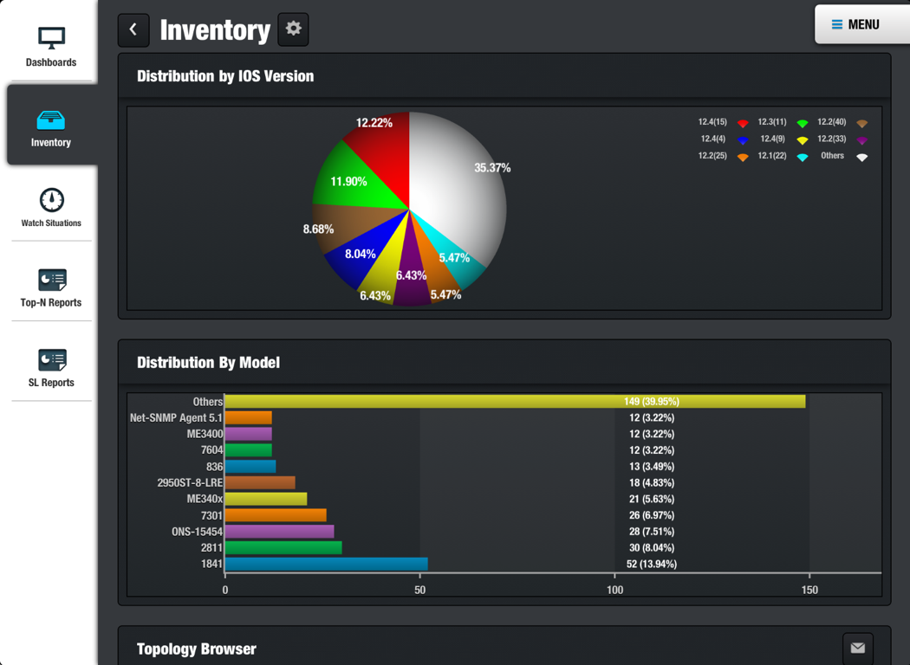
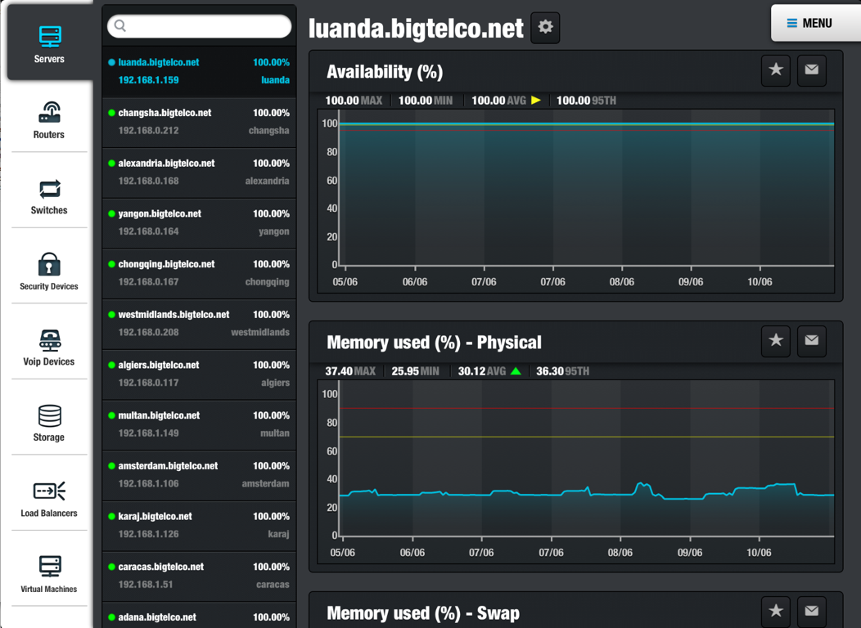

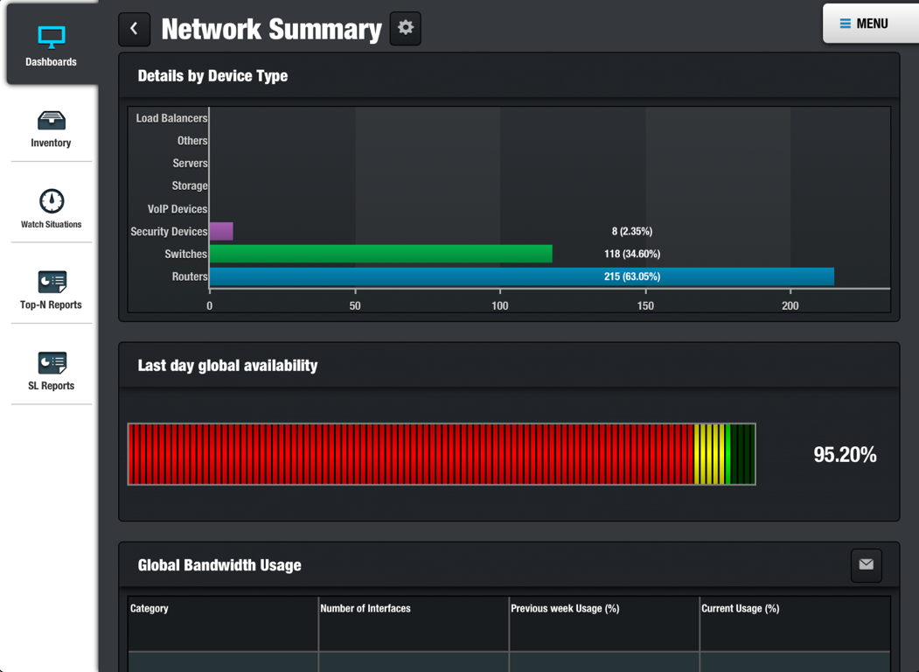

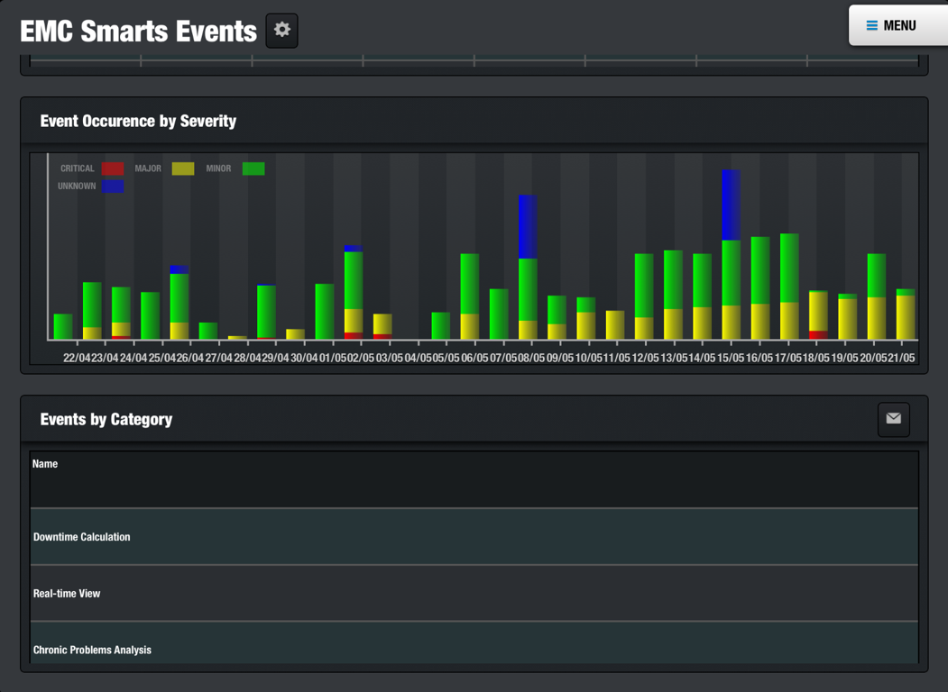

m.Reports = W4N reports on any iOS device
Graphical reports
+
Alerts
Sharing
Easy to use

Slide 10




  Monitor any device on any platform

Slide 11
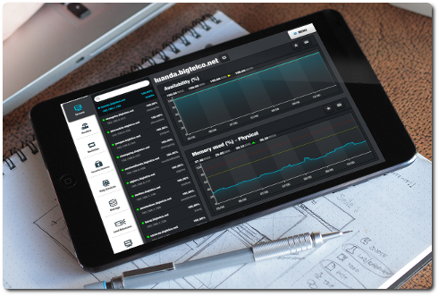

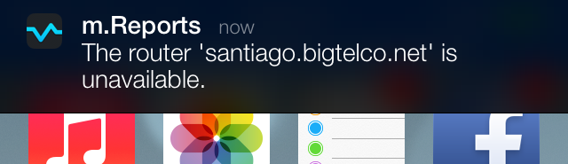
Alerts
Monitor your system anywhere, anytime
Customisable PUSH notifications

Slide 12
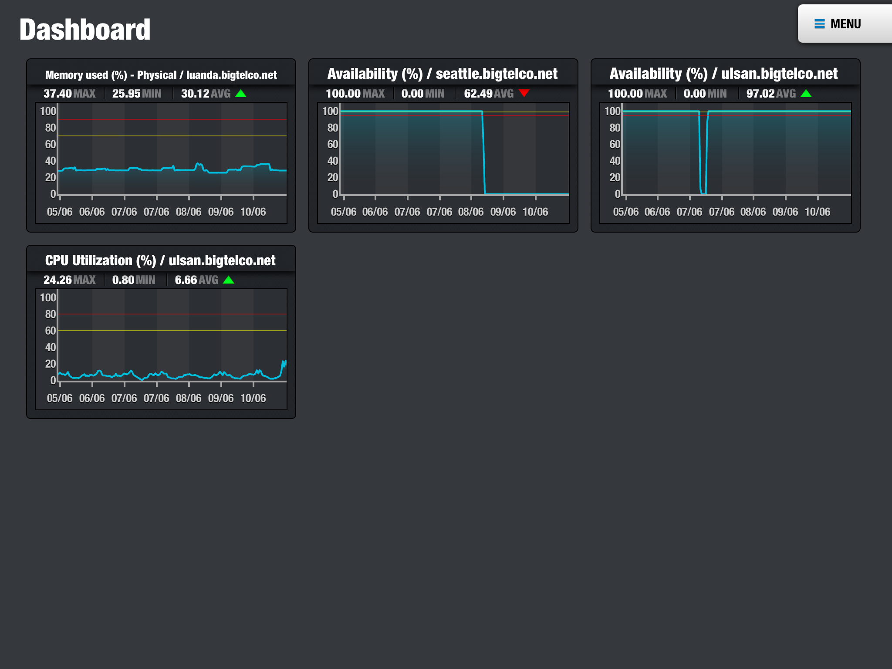
Flexible & User Friendly
Customisable Dashboard
  choose any graph ~ follow any device

Slide 13
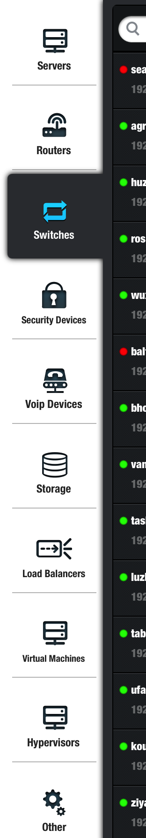
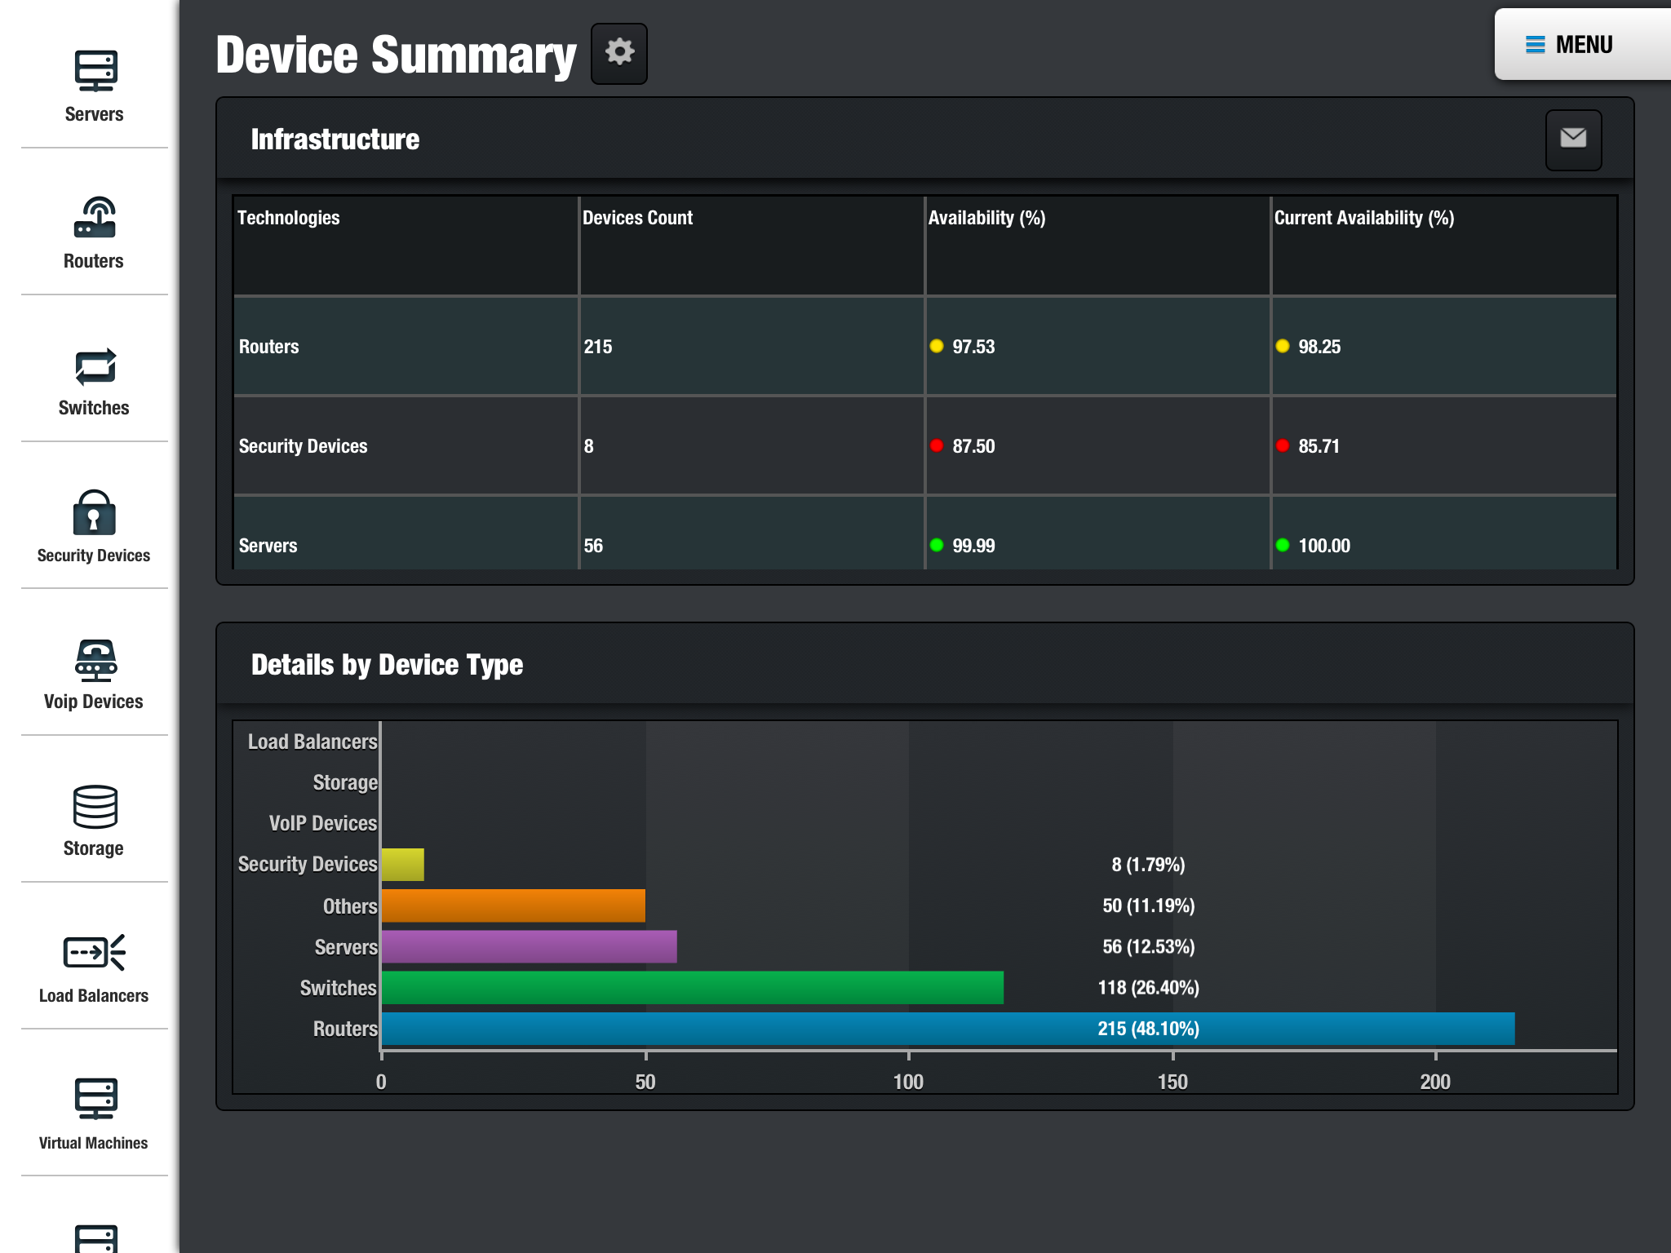
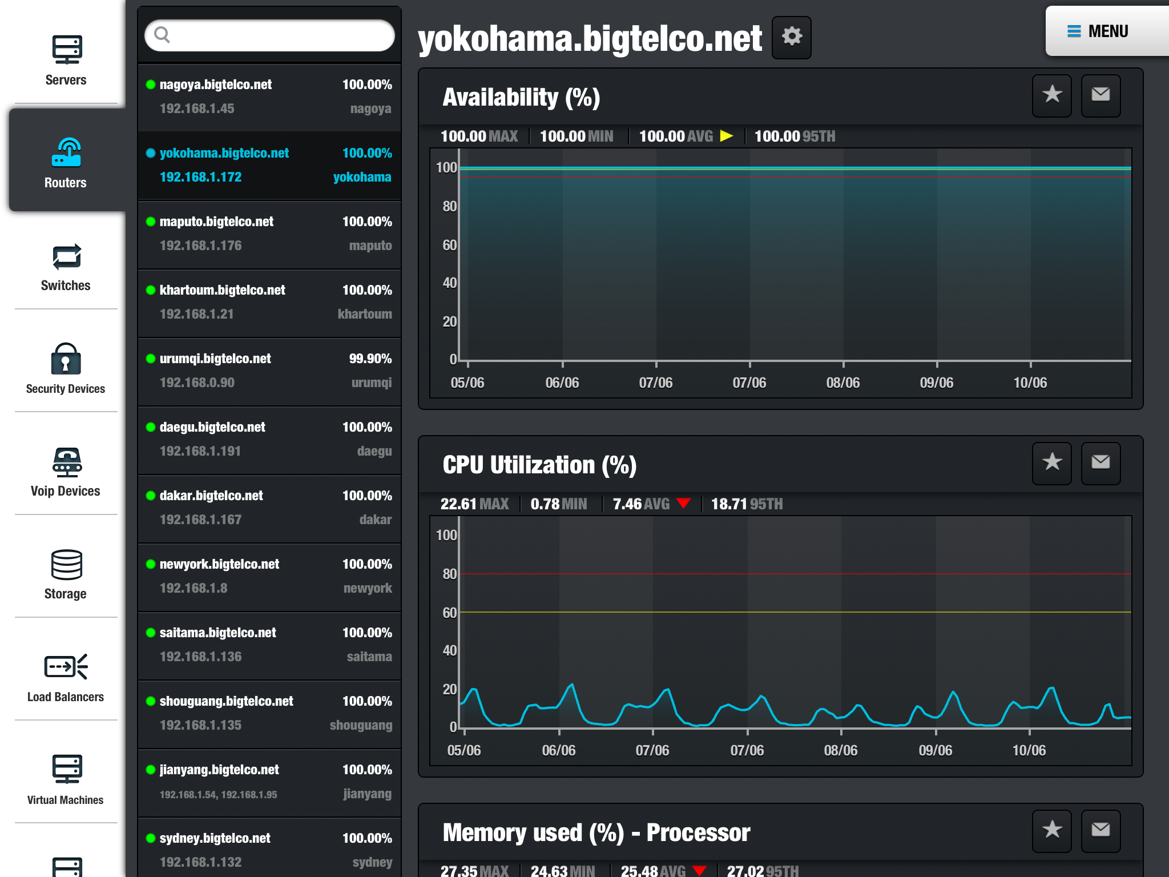
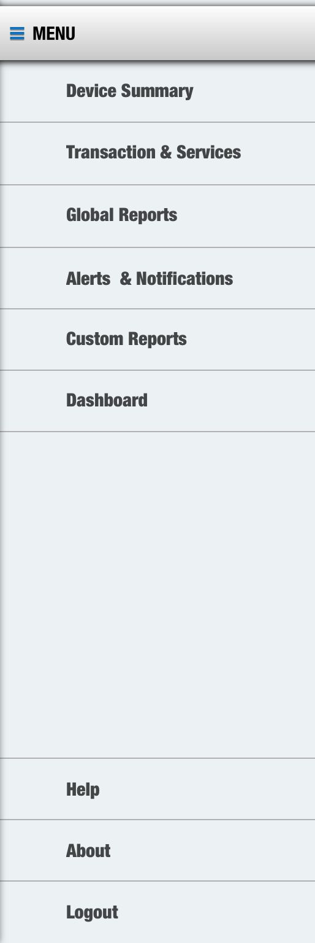
Flexible & User Friendly
Easy, natural navigation
Infrastructure Stack

Slide 14
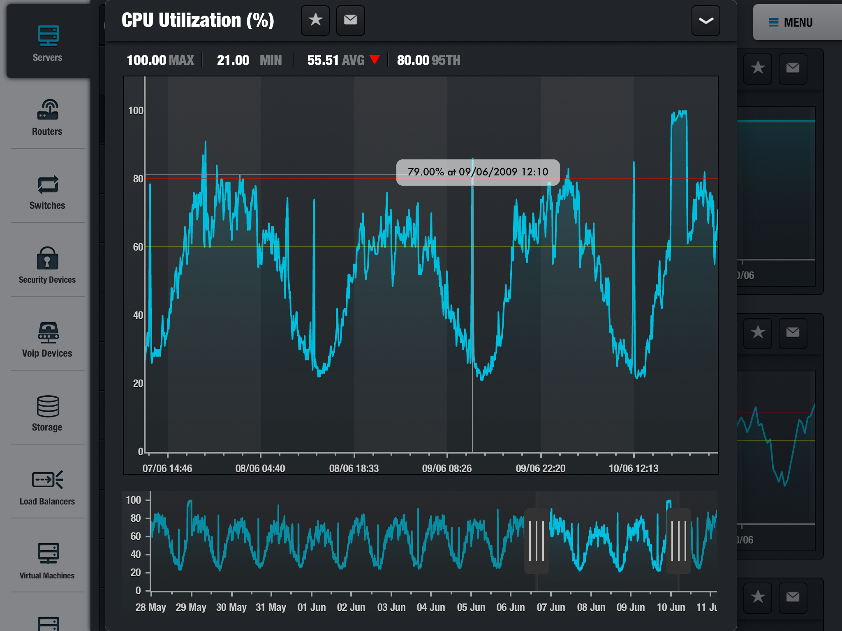
Flexible & User Friendly
Zoom & crop graphs with pin-point accuracy

Slide 15
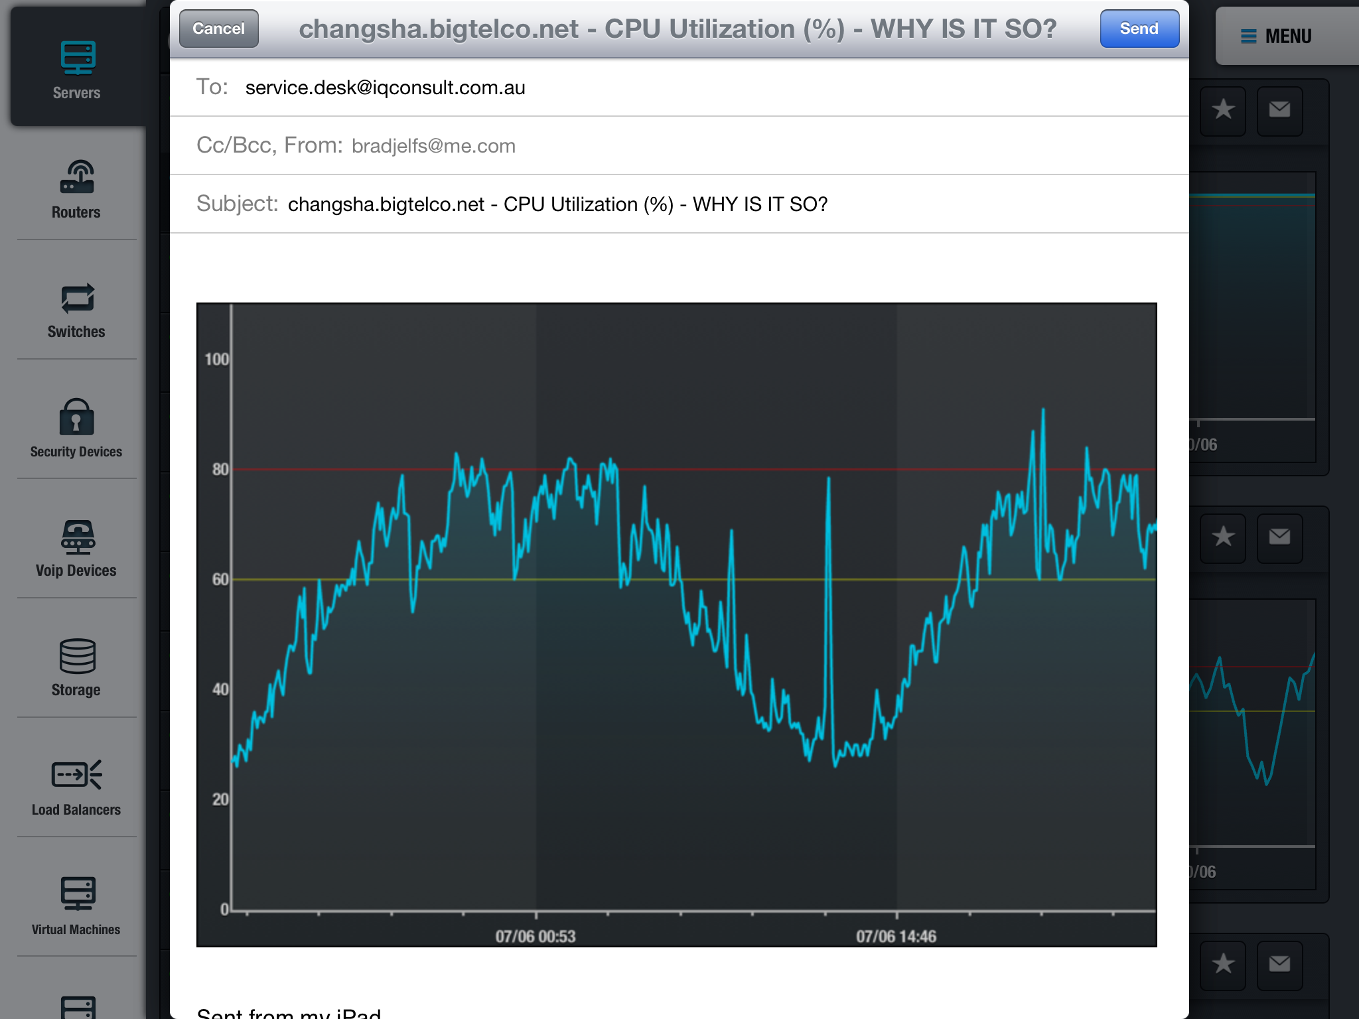
Shared Intelligence
Email a query directly to your Service Desk
Email graphs or tables immediately from your mobile device

Slide 16


Secure
yet requires Low Bandwidth
m.Reports supports Watch4net authentication
  no additional user management
Communication is secured by SSL
Caching achieves a more responsive user experience
Low data usage .. on your mobile device

Slide 17
What’s involved?
Install virtual appliance in your DMZ
  requires direct access to W4N server
Configuration by iQ Consult
Deploy apps via App-Store to your devices
  point app to virtual appliance
  log on and monitor your infrastructure
All potentially within 2-3 days

Slide 18
Cost (AUD excluding GST)
On premise server software $30,000
  includes up to 10 users (up to 2 devices per user)
  annual support and maintenance $6,000
Device software application
  *Free from AppStore
Setup - 2-3 days $3,200-$4,800
About $40,000
Additional 10 users (up to 2 devices per user) $5,000
  site licensing available
  annual support and maintenance $1,000
Customised Reports (scoped and quoted separately)
Customise to your branding $5,000

Slide 19

iQ Consult
visit: www.iqconsult.com.au
call: 1300 725 925

Slide 20
m.Events
Event monitoring and reporting
Enhancing the experience of EMC’s Smarts

Slide 21
In Beta
Release date expected in August, 2013

Slide 22
E2E Storage
Watch4net SolutionPack for End-to-End Storage
Storage reporting across the technology stack

Slide 23
E2E Storage
Solution Pack = Collector + Reports
Collects information from:
  File systems
  Partitions
  Logical devices
  Physical devices
  Storage Arrays
Consolidated Storage Report
Notes:
-
-
- Fully configurable collection engine, integrated as a native application with the Watch4net (W4N) Collector Managers, allowing use of standard W4N filters and connectors

Slide 24
E2E Storage
Current supported technologies
  Windows, Linux (CentOS, RHEL,Ubuntu), Solaris and HPUX
  VMware
  Logical devices
  Physical devices
  Storage Arrays (all arrays supported by SRM)
Consolidated Storage Report
Notes:
-
-
- Fully configurable collection engine, integrated as a native application with the Watch4net (W4N) Collector Managers, allowing use of standard W4N filters and connectors

Slide 25
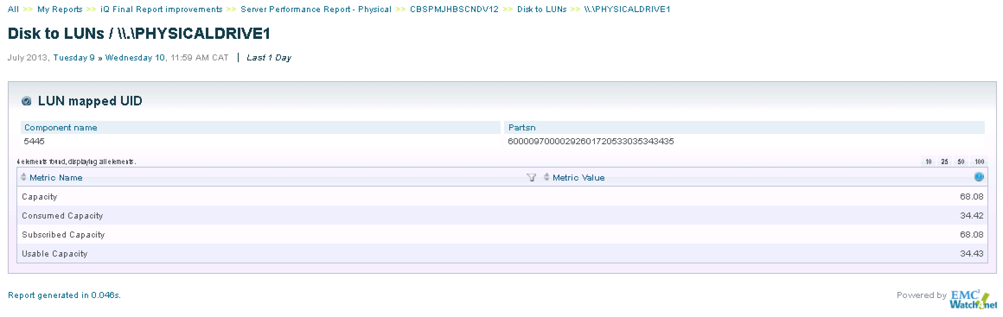
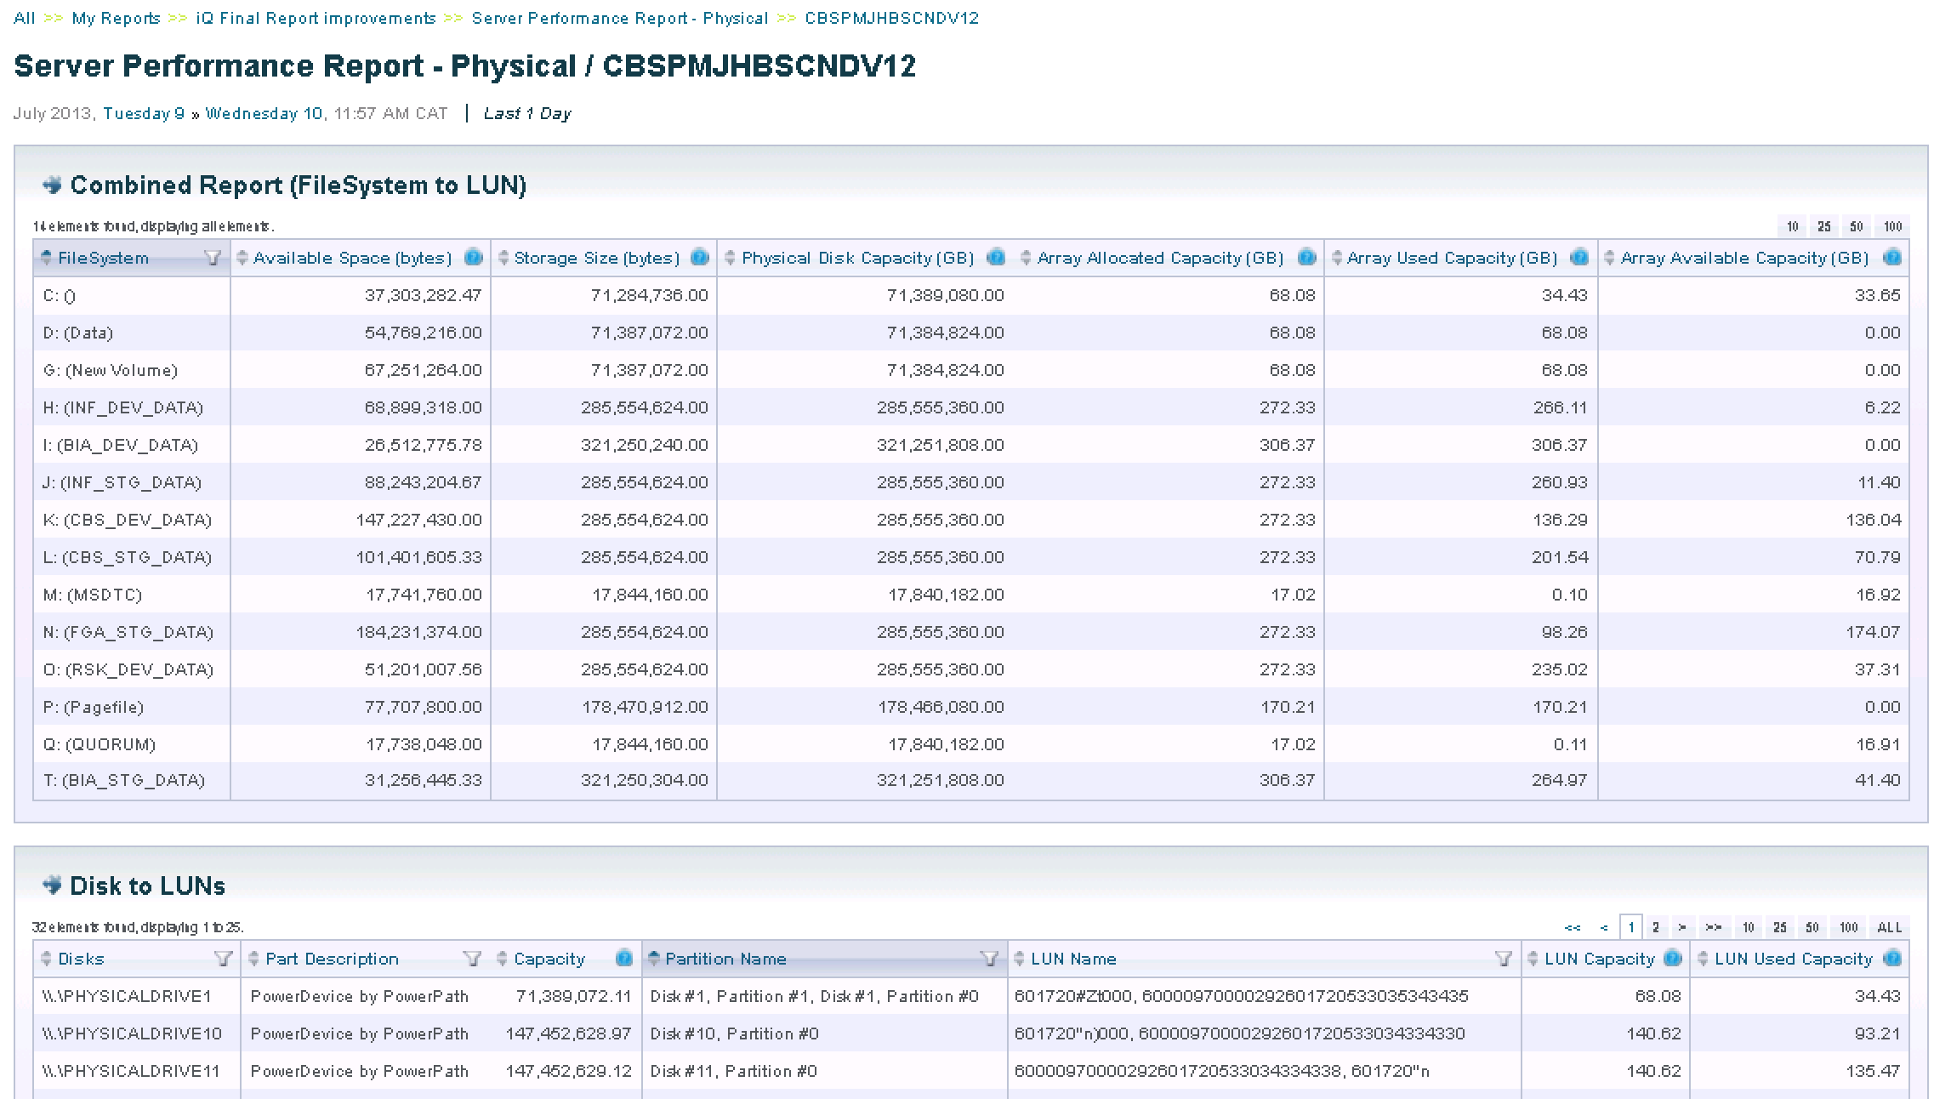
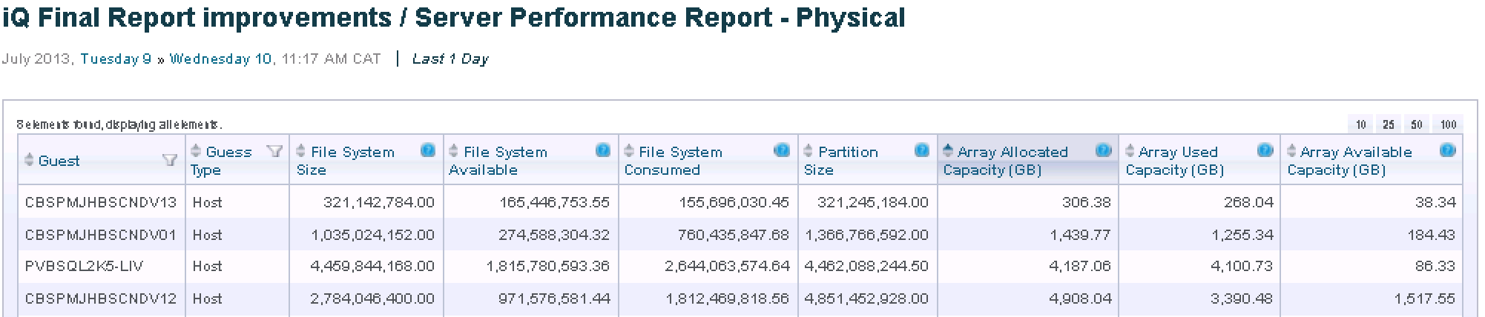
Reports (physical)

Slide 26
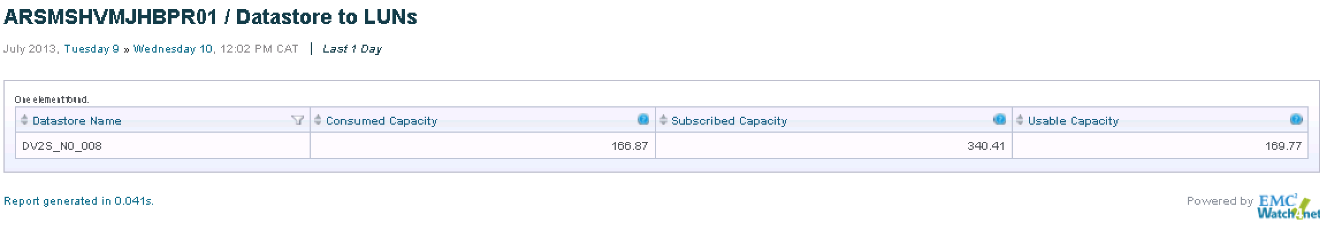
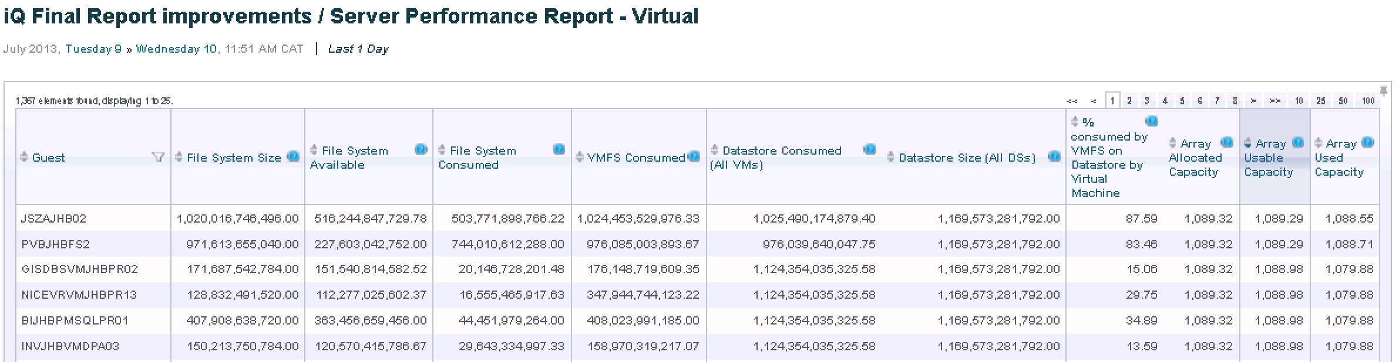
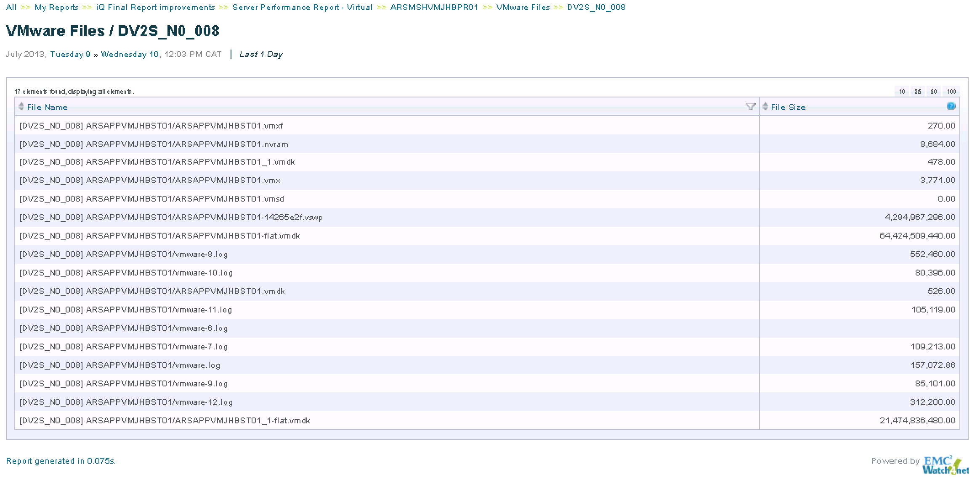
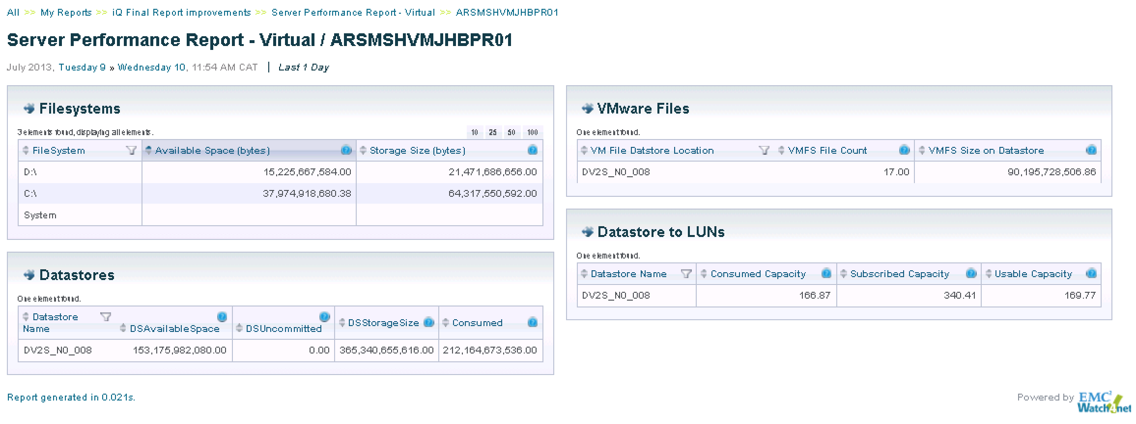
Reports (virtual)

Slide 27
Storage Assessment Service
When storage goes down you have significant problems to resolve

Slide 28
Why Perform a Storage Assessment?
Arm yourself against storage failure
Find the root cause of storage system issues
Discover non-compliant, non-supported storage configurations; satisfy audit requirements
Consolidated & Detailed inventory of all storage system components
View current capacity and storage consumption trends (health of storage)
Notes:
Storage environment may have grown organically in response to project and department demands without overall master plan - need to be able to gain a view of the entire storage environment in order to plan for the future.
Respond to audit requirements and ensure that the storage environment is in a vendor supported configuration
Address immediate issues with storage performance, capacity, configuration
Current toolset may not support this kind of analysis across the entire storage architecture – focusing only a smaller areas (SAN only, switch only, Virtualisation)

Slide 29
Storage Assessment process
Conduct workshops ~ scope storage environment
Install the Storage Assessment components:
  EMC Prosphere and Storage Configuration Advisor (SCA)
  Preconfigured virtual appliances (VMware)
  Agentless operation
Data is collected for ~30 days
Report back with recommendations
About 10 days in duration
Remediation if required
Notes:
10 day offering for up to mid sized organisations limited size to storage environment 4 storage systems and associated switches, hosts.
Prosphere and SCA only – these products are meant to be used long term - little benefit for installing W4N given the timeframe
30 day period for data collection – could be shorter or longer depending on customer requirements

Slide 30
Storage Assessment report
Immediate storage issues
  Configuration, capacity, performance
Validation, comparison against EMC Support Matrix and EMC’s and iQ Consult’s Best Practice
Capacity and Performance (including trends if available)
  Advice on remediation of issues
Configuration detailed report, including models, versions, highlighting issues
  Include diagrams where appropriate
Notes:
Executive summary contains immediate recommendations depending
Support Matrix and Best Practice
Capacity and performance will be somewhat of a snapshot with trending limited to the data collection phase
Detailed configuration report – describe all components of storage system.

Slide 31
Scope of SAS
4 storage systems
2 physical sites
2 vSphere environments
larger will be scoped and costed

Slide 32
Potential licensing revenue to EMC
Prosphere $40,000
Storage Configuration Advisor (SCA) $24,000
or
Storage Resource Manager (SRM) $75,000
(includes W4N for storage)
+
Additional storage $??
+
Watch4Net + Smarts $75,000 - $400,000

Slide 33
VCD-SP
Watch4net SolutionPack for vCloud Director supports both VMware vCloud Director v1.5 and v5.1
Fully integrated into m.Reports
(mobile reporting app)

Slide 34
VCD-SP
Solution Pack = Collector + Reports
Native collector application, leveraging W4N filters and connectors
Consolidated performance report on the virtual datacenter constructs and performance statistics (for vCloud Director)
Multi-tenant support
Notes:
-
-
- Fully configurable collection engine, integrated as a native application with the Watch4net (W4N) Collector Managers, allowing use of standard W4N filters and connectors

Slide 35


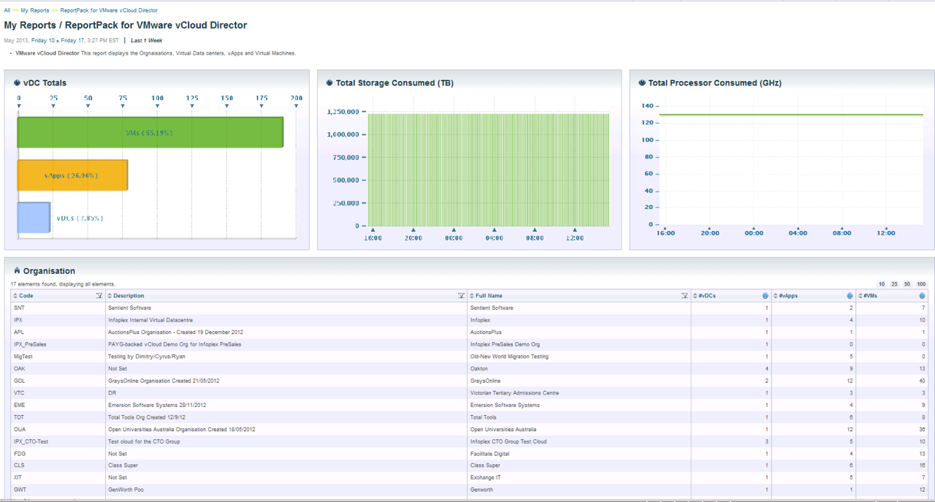





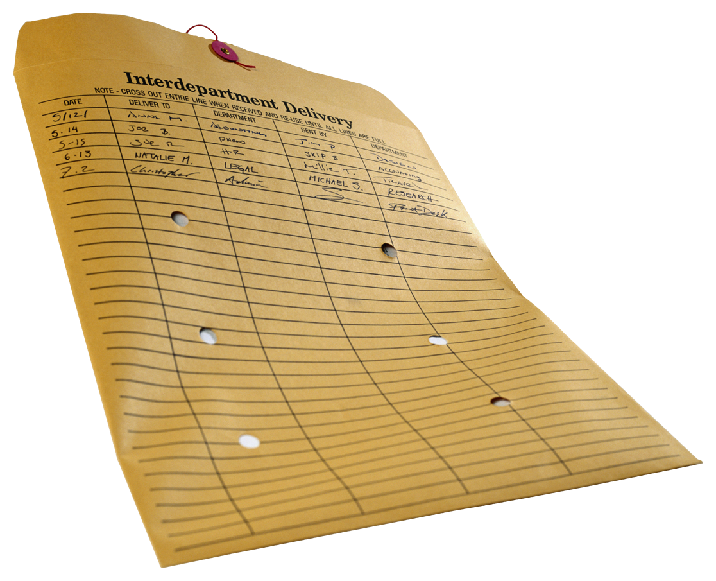
Information Collected
Compatible with m.Reports
provider Virtual Data Centers (pVDC’s)
Virtual Data Centers (VDC’s)
vApps
Individual Virtual Machines (VM’s)
Watch4Net
VCD/SP
vCloud Director

Slide 36
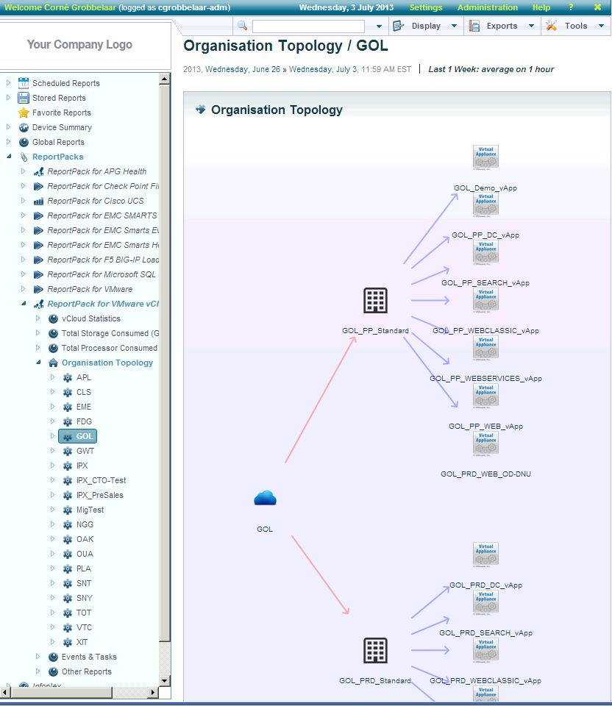
vCloud Director – Solution Pack for W4N
In-depth VM drill-down capability for metrics and performance reporting
Based on the VMware vCenter API collection

Slide 37

VCD-Solution Pack at NextGen Cloud Services
“Having a clear understanding of the logical constructs of our vCloud environment, and how these map to our underlying infrastructure and VMware environments has been essential in delivering our customer IaaS solutions ...”
Aakash Gandhi, Head of Nextgen Cloud Services

Slide 38
Cost (excluding GST)
VCD-SP is loadable on the W4N server
Software licence $30,000
Annual Support and Maintenance $6,000
Installation & configuration services $3,200

Slide 39
iQ Consult is committed to making our customer’s investment in EMC Advanced Software solutions exceed expectations

Slide 40


