Slide 1
S.P.Q.R
Stone Preservation Quality Restoration

Slide 2
0 Our promise
Our aim in pitching our product is not only to benefit us but to add value to your properties . As we all know when it comes to real estate or selling any product for that matter it usually all comes down to image and quality.
The simple cleaning and maintenance of property may raise its potential value by thousands especially when considering aesthetics.
That's why we are here to provide you with unbeatable quality and packages on all our stone work.
0 S.P.Q.R
Stone Preservation Quality Restoration

Slide 3
0
0 Our Service
We at S.P.Q.R are here to provide you with an extensive service on all your property stone work maintenance needs.
Being a fifth Generation stonemason myself I have been able to provide many services and contributions to major Sydney buildings such as the Australian Queen Victoria building, Newcastle town hall and even St. Mary’s Cathedral.
A few things we specialise in are Heritage, Restoration, cleaning and maintenance of all stone works and even other odd bits and pieces such as pavers concrete.
0 S.P.Q.R
Stone Preservation Quality Restoration

Slide 4
Work and Packages
On the following page there are some images that will be able to provide you with more assistance on the kind of works our team carries out.
Our Packages for repointing and cleaning of the stone consist of chopping out the original damaged parts. Refilling them with a sand and cement based mortar cleaning and washing the stone back down to it’s original state without damaging the original works.
This package starts from $150 per square metre for regular coursed walls. As shown in the pictures.
For replacement of stones and indents our package starts from $350 per stone which includes supply and installation of materials.
0 S.P.Q.R
Stone Preservation Quality Restoration

Slide 5
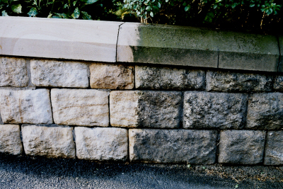
Before and after

Slide 6
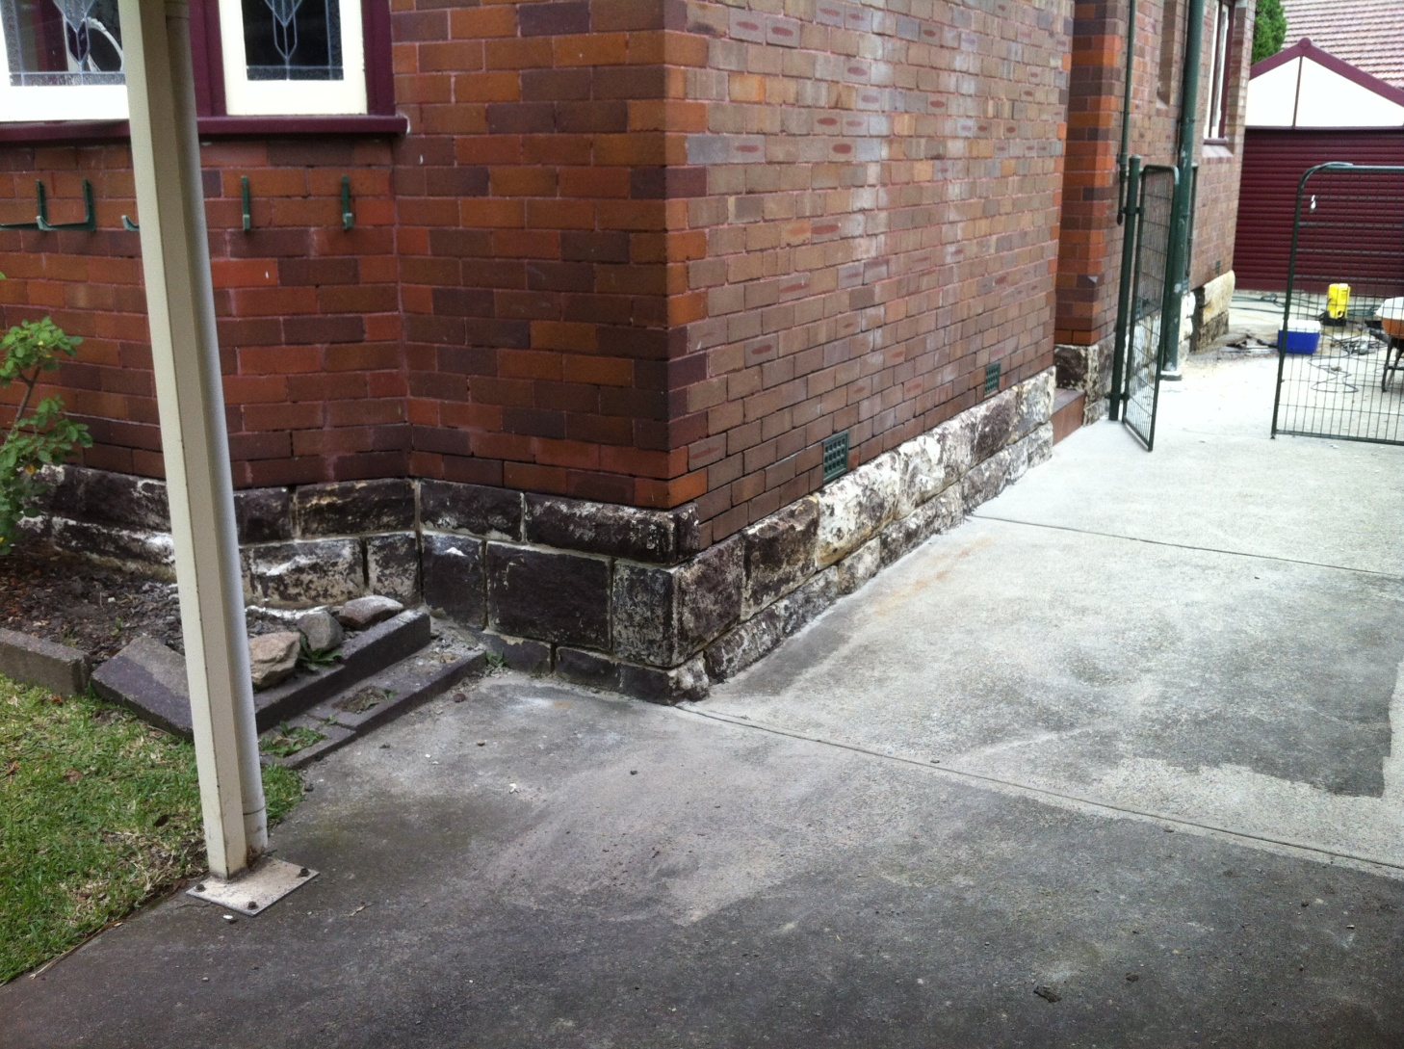

Slide 7
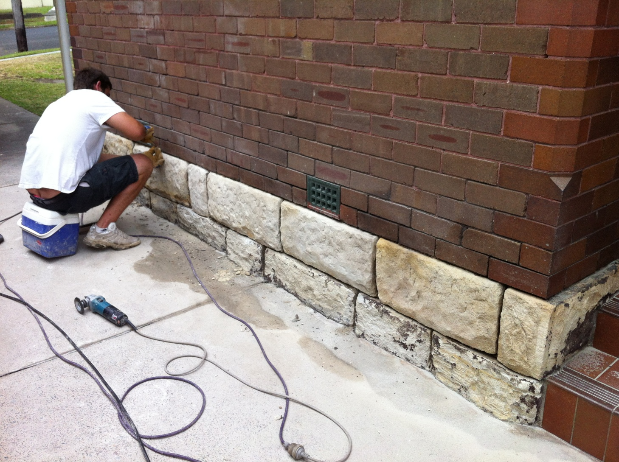

Slide 8
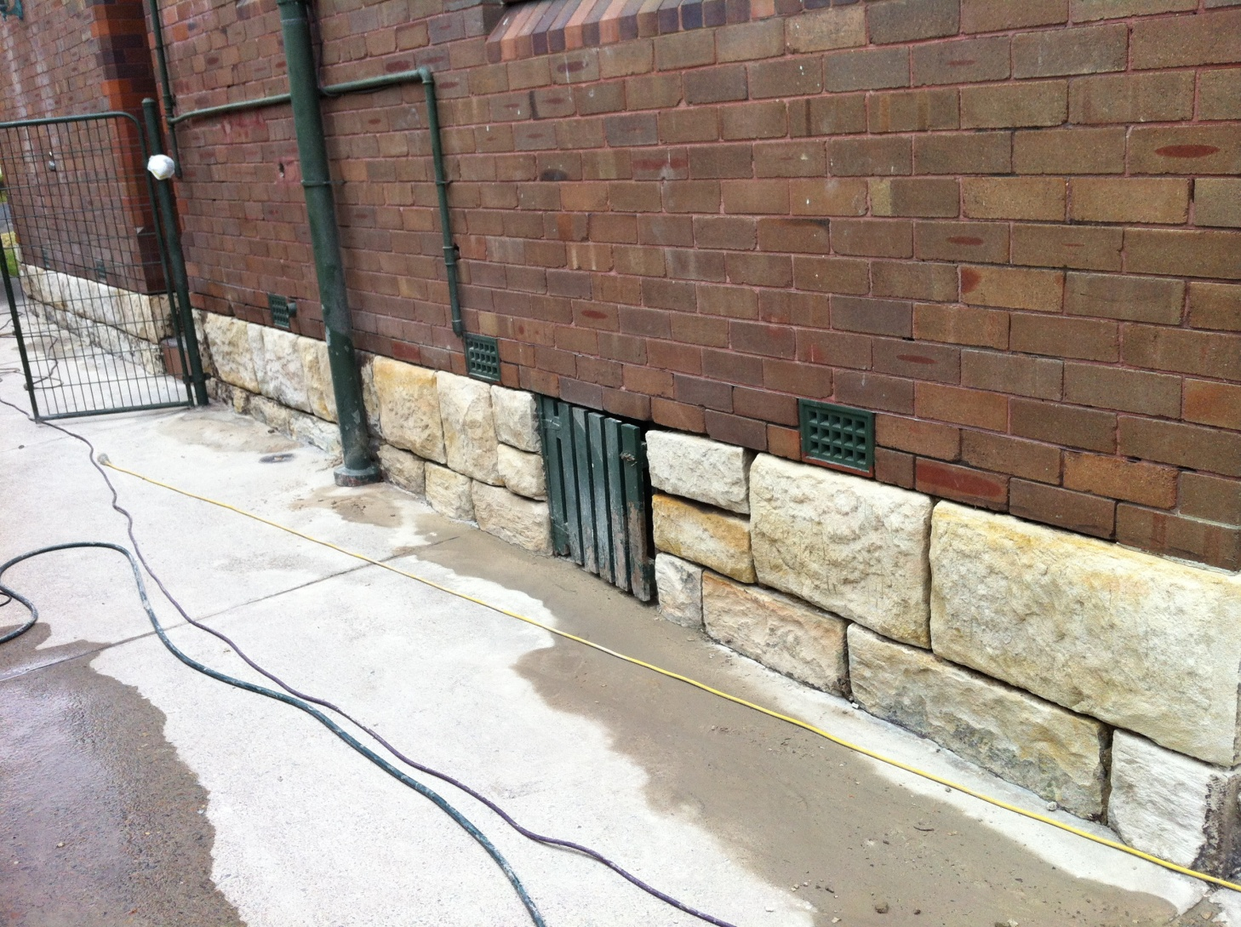

Slide 9
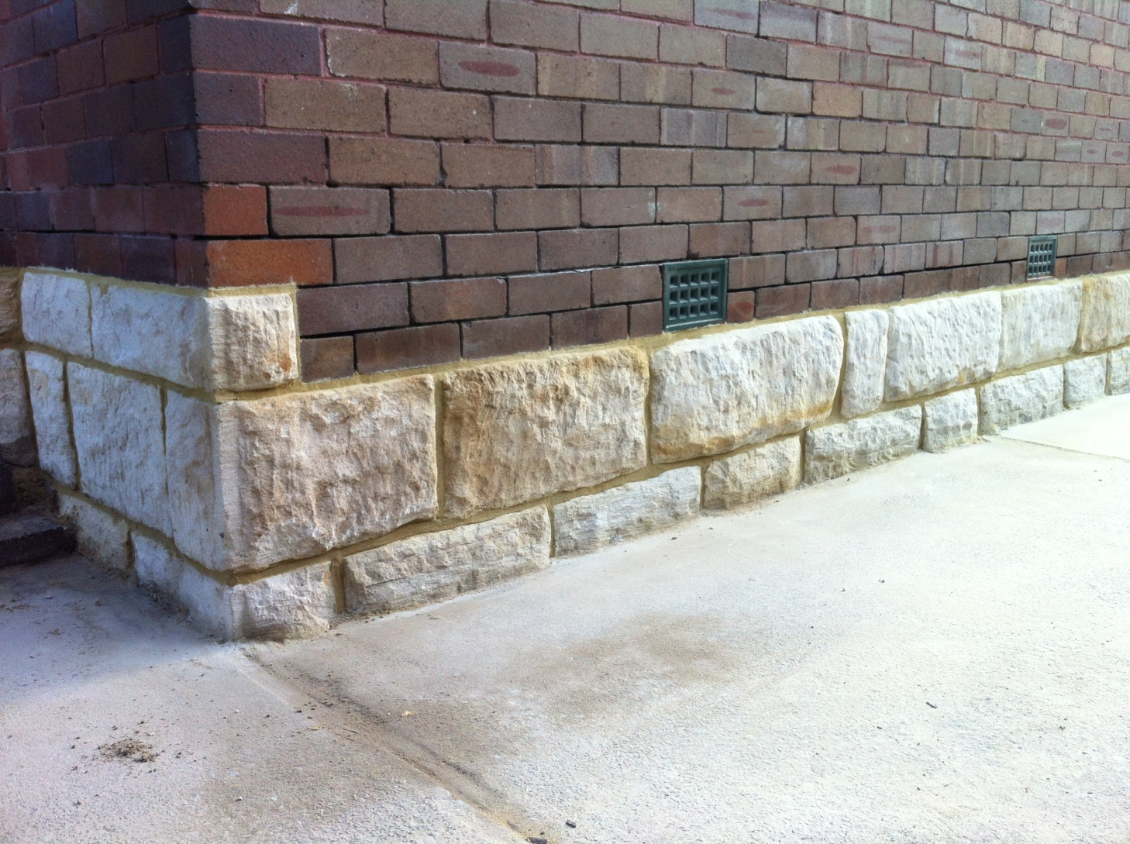

Slide 10
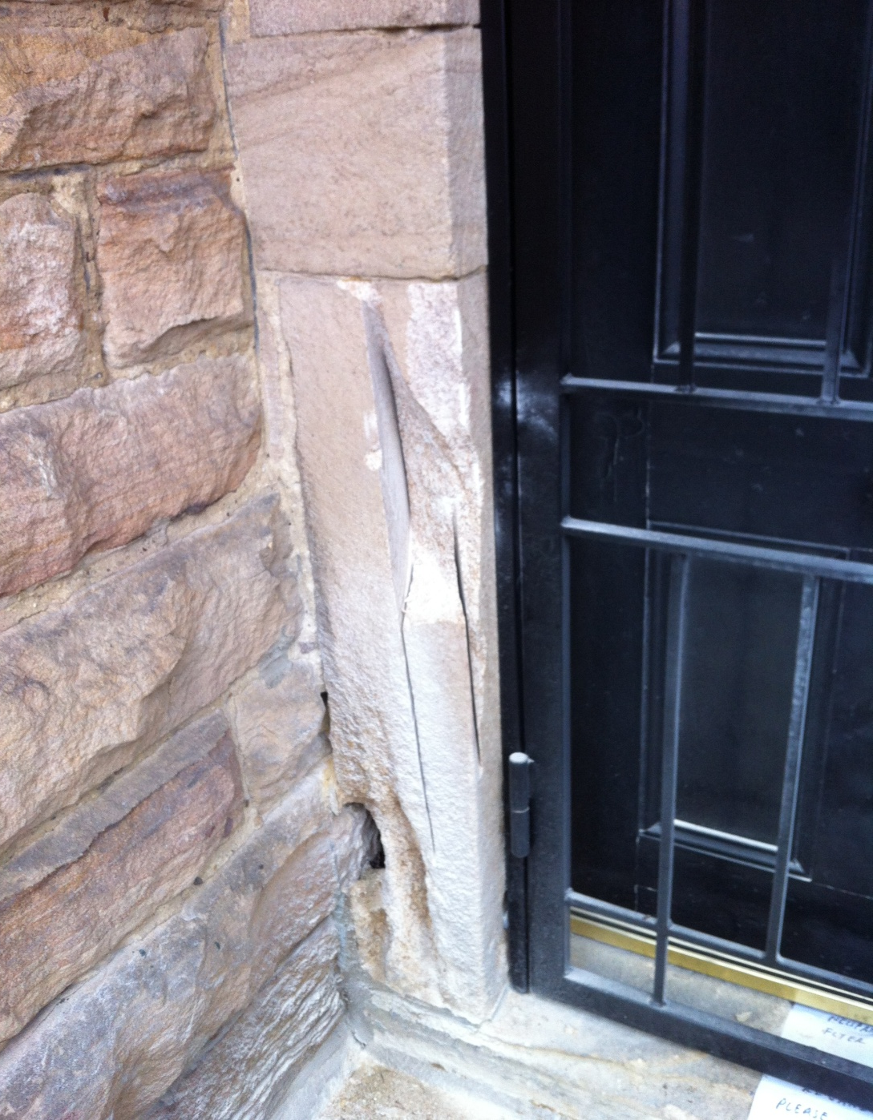

Slide 11
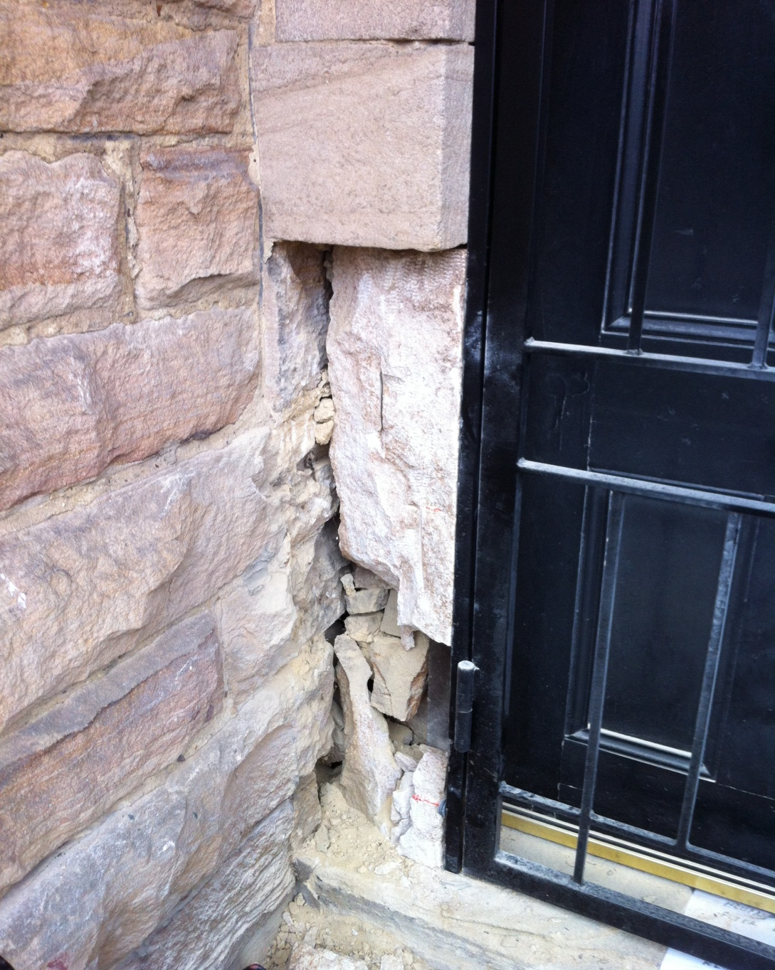

Slide 12
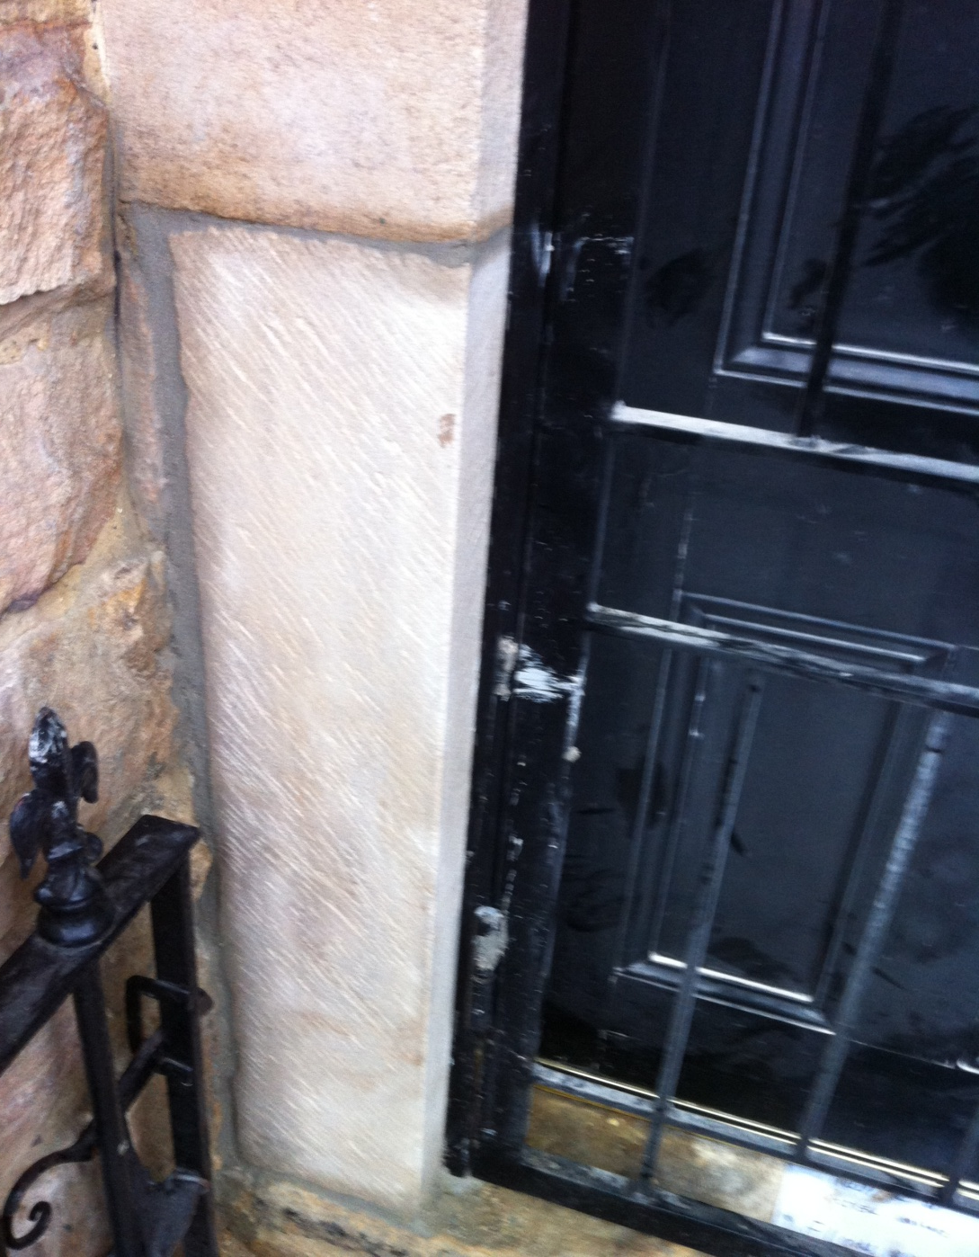

Slide 13
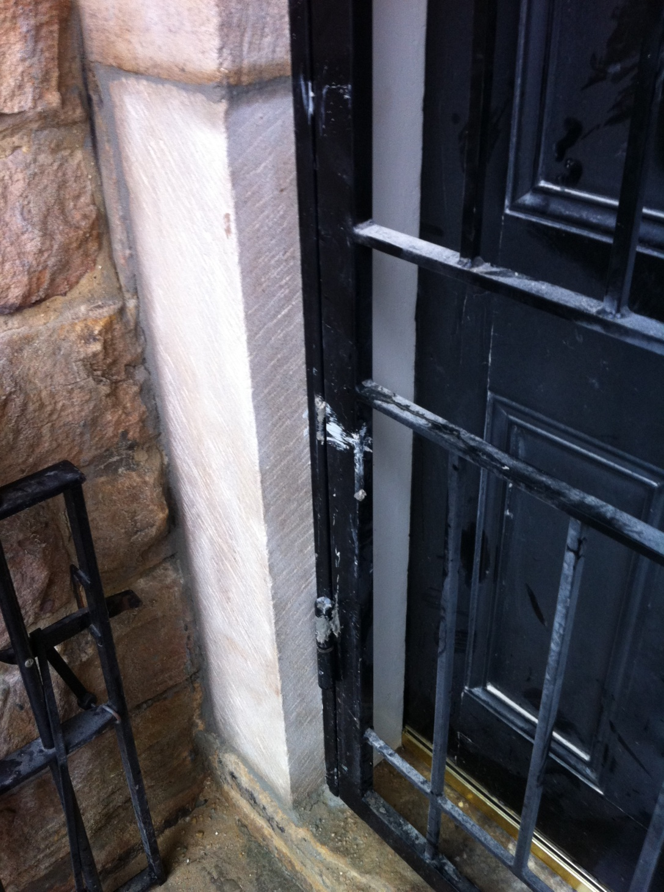

Slide 14
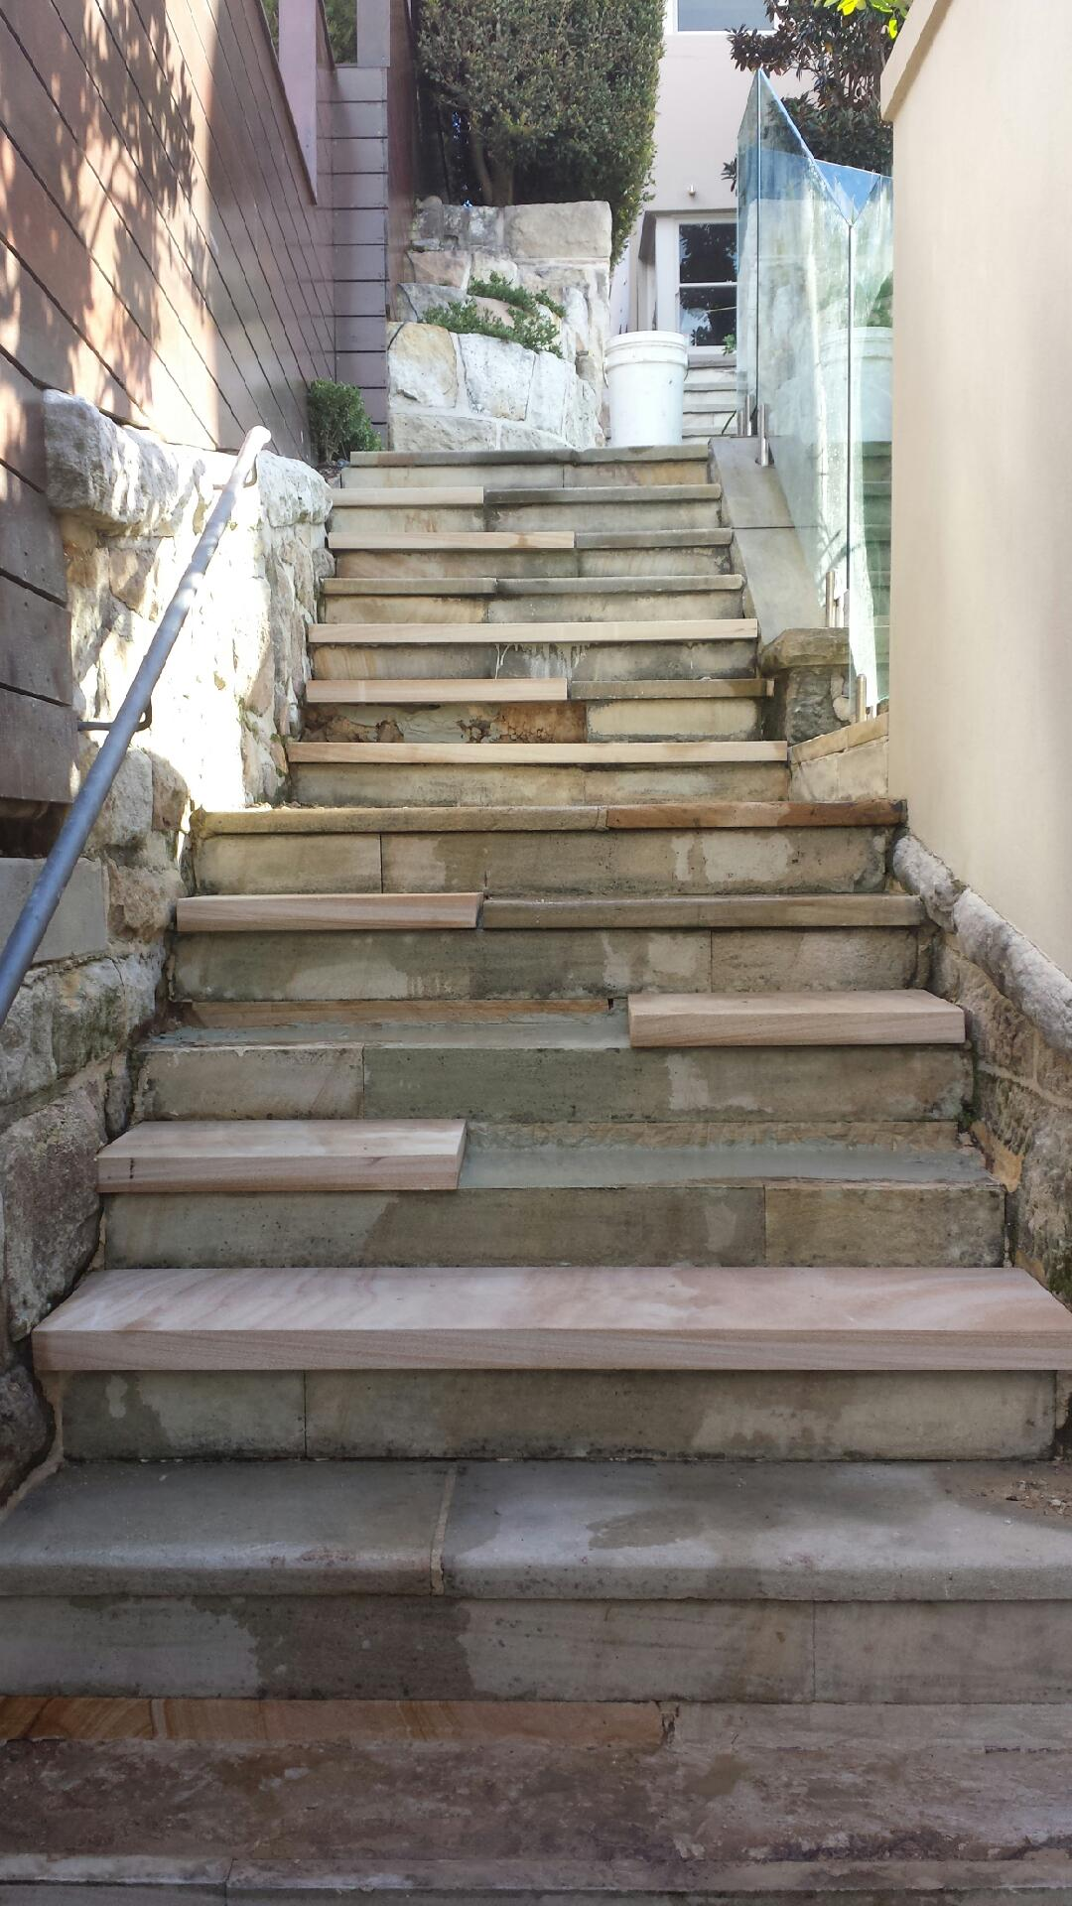
Staircase packages
Our staircase packages vary pending on the size and type of step and the riser. A more straight forward staircase as seen from the images below .
Start from $300 for the tread and riser included . Supply and install.
0 S.P.Q.R
Stone Preservation Quality Restoration

Slide 16
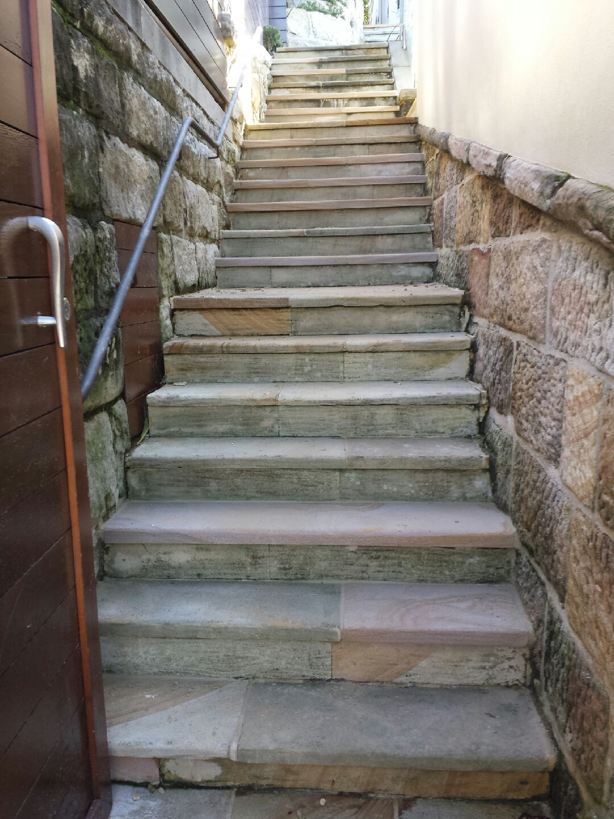

Slide 17
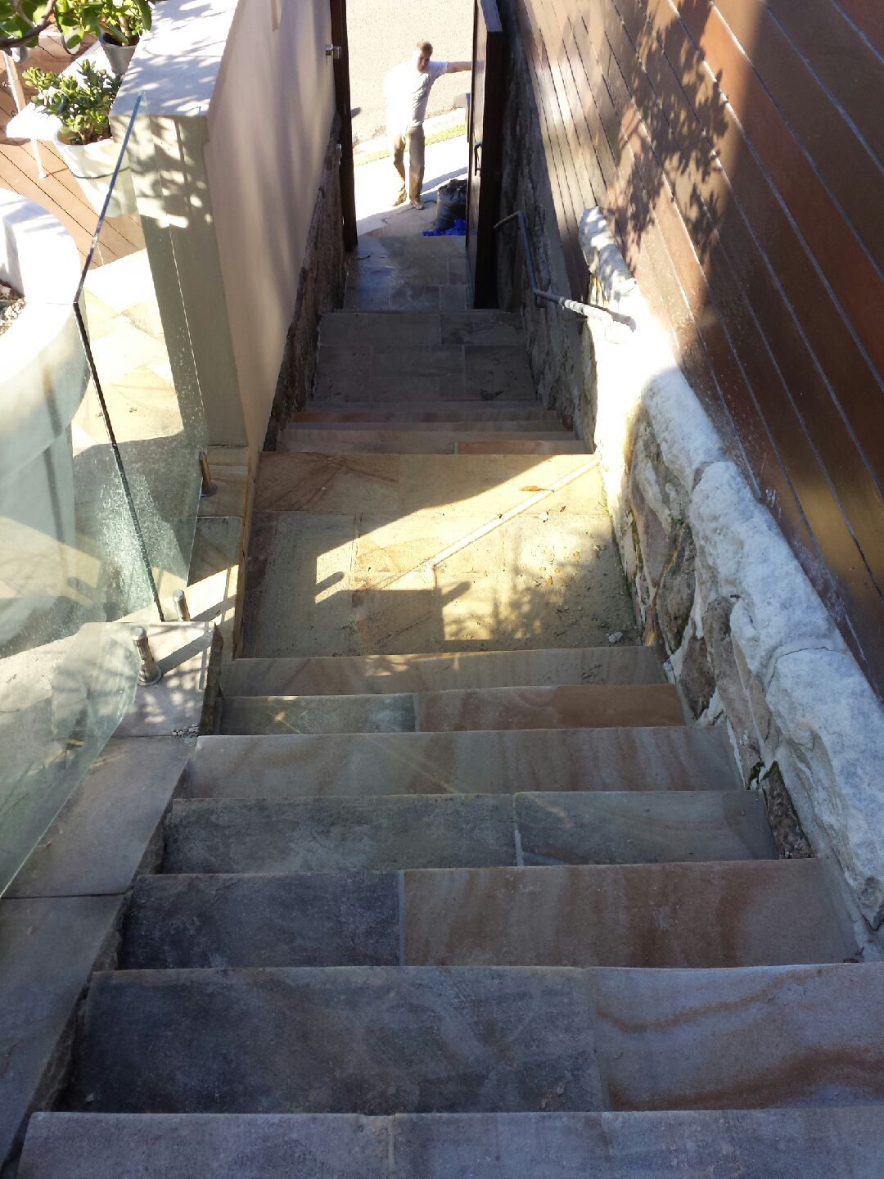

Slide 18
The difference
As I have showed you clearly in the photo’s above there is an outstanding difference from simply maintaining and preserving the stones natural beauty.
I assure you that me and my team of stonemasons will be able to provide with uncompromising quality on all of your stone work needs.
So if you think that our service may establish your properties and have the potential to raise the value you can reach S.P.Q.R on : 0405 261 298

