Slide 1
Title this document is an example of layout and formating

Slide 2

Our Goal
Thank you for the opportunity to present to the team at for the rebranding to .............
This presentation aims to demonstrates how Custom Gear can provide an overall solution for the implementation, management and distribution of Merchandise, Stationery & Uniforms to the group and its associates. We have also covered all your assessment criteria
We have taken the time to learn, understand your brand position, culture, values & direction.
It will be a pleasure to partner with an organisation, that although a distance apart in headcount is very similar in its ambition and approach.
Where you are an International organisation working closely with & supporting SME’s
- We are an established SME who is in direct partnership & responsible for supporting fortune 500 brands daily.
We are also “right sized” - The team you meet and gain confidence in, will be the team you work with throughout the engagement.
Proven to be capable of delivering, yet flexible enough to adapt rapidly and always improve (we don’t let perfect get in the way of better)
Through our proposed engagement we guarantee to achieve:
Consistency of brand identity across the Group – Through unique supply of high quality products
Accurate brand representation and delivery of products that are accurate & in line with brand guidelines
A unique fresh wardrobe selection that will represent the quality of the brand whilst serving its purpose
Dedicated online & offline ordering channels that demonstrate – function / features of all products available to acquire
Competitive item pricing which is in line or better than market comparisons
Assigned account managers who will provide a level of service that is outstanding & accommodating at all times (24/7)
Offer payment options and terms that are acceptable and comfortable for all.
Provide a streamlined, simple ordering system that saves time, effort & cost for all parties,
Whilst providing clear statistics & analytics of stock, history on request.
We look forward to your thoughts & hope that the information provided is in line with your expectations.
Giancarlo Savoca

Slide 3
Business Stationery

Slide 4
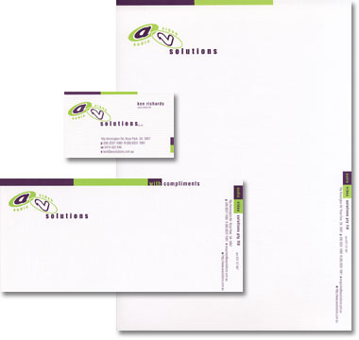
Business Cards
350GSM Gloss Artboard, Matt Celloglazed.
Double-sided. 90mm x 54mm
Estimate Cost
250 units = $65.00 + GST
Letterheads
100GSM Splendorgel Uncoated. Printed in 2 PMS colours,
One side only. Trimmed to A4.
Estimate Cost
500 units = $275 + GST
1,000 units = $335 + GST
5,000 units = $695 + GST
10,000 units = $1185 + GST
With Comps – Plain or Boxes
100GSM Splendorgel Uncoated. Printed in 2 PMS colours,
One side only. Trimmed to 100 x 210mm.
Estimate Cost
500 units = $215 + GST
1,000 units = $245 + GST
5,000 units = $385 + GST
10,000 units = $565 + GST
Standard
Stationery

Slide 5
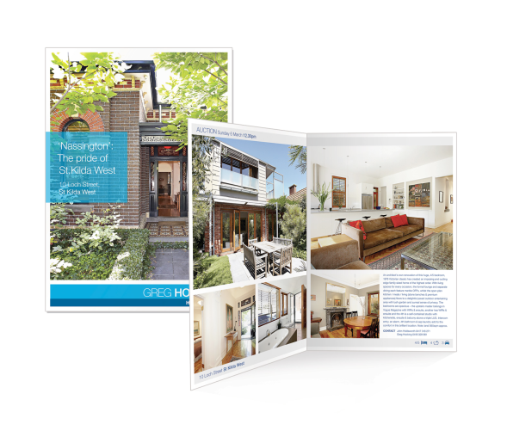
Brochure - Firm Profile
12pp + 4pp cover w/ spot UV & spot varnish.
4pp covers: 300GSM matt artboard
12pp text: 170GSM Matte artpaper
CMYK & Spot Gloss throughout.
Collate, fold & stitch to A4 portrait size.
Estimate Cost
Firm Specific – Price TBA on receipt of artwork & qty.
No quantity was provided – please suggest
Flyers
Preferred stock & size to be supplied.
Estimate Cost
Firm Specific – Price TBA on receipt of artwork & qty.
Other Product Fact Sheets & Brochures
Specs to be supplied.
Estimate Cost
Price TBA on receipt of artwork & qty.
Brochures/
Other

Slide 6
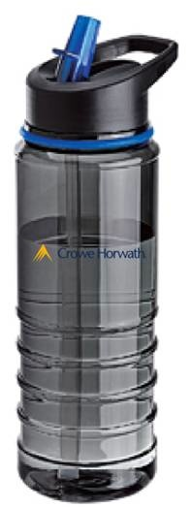
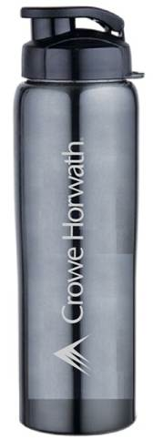
Milano Drink Bottle
BPA Free, 750ml Capacity, Translucent body with coloured silicon band, Flip up drinking spout, Carry handle, Ribbed grip area, Supplied in white box, Hand wash only.
Estimate Cost
2,000 units @ $4.88 + GST
3,000 units @ $4.25 + GST
5,000 units @ $3.98 + GST
Price includes 2 Colour / 1 Position Print
Suarez Stainless Drink Bottle
750ml, Stainless steel, Single wall with carabineer, BPA free
Estimate Cost
2,000 units @ $4.48 + GST
3,000 units @ $4.15 + GST
5,000 units @ $3.88 + GST
Price includes1 Position Laser Engraving or 2 colour print
Standard
Merchandise
______________
DRINK BOTTLES

Slide 7

IMPRESS YOUR BRAND
Impress - To press, stamp, or print something in or upon ; To touch the sensibilities, or affect the conscience ; To fix deeply in the mind
Custom Gear are leaders in Branded Merchandise, Digital Printing and Promotional Concepts.
From Strategy engagement & Concept development through to market deployment Custom Gear will deliver a personalised, hands on approach to every project.
We work side by side with our clientele to ensure that marketing objectives are met, in line with your business direction and corporate identity.
Using our Local & Global network of suppliers, we are able to extend the largest range, whilst guaranteeing the most cost effective solution every time.
From items of the highest quality that will be within reach of your audience every day, to completely custom personal concepts, Custom Gear will deliver.
Whether it is out of the warehouse or off the drawing board, Custom Gear have what your business requires & your market desires.

Slide 8
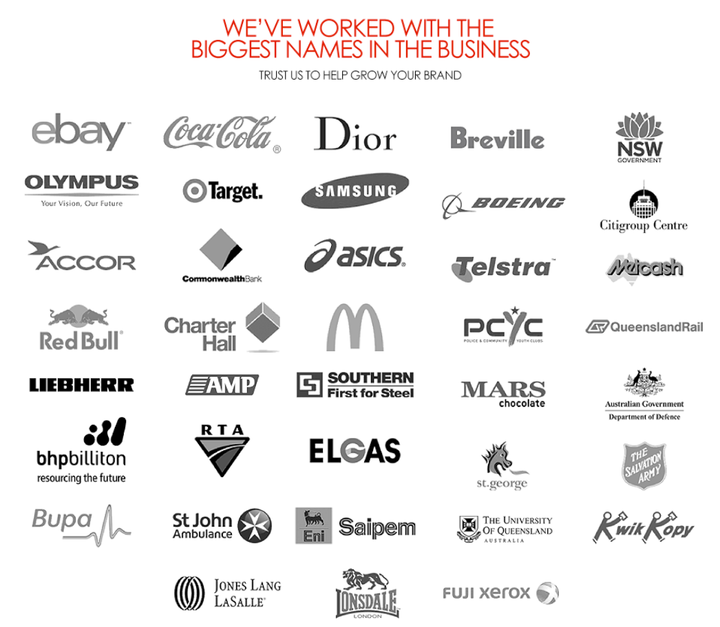
Our
Partners

Slide 9
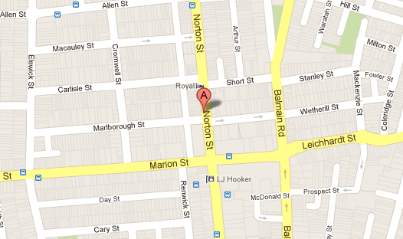
Any Questions?
Contact us if you would like to learn more. get in touch
Due to our volumes and strong business relationships with leading suppliers, Custom Gear is driven to save our partners time, effort and money.
We encourage all our customers to speak with us openly & feel able to compare us on all of the factors that are important to them.
Custom Gear have earned the trust of many Fortune 500 and government bodies Australia wide. We work every day to earn your repeat business and trust.
Your personal account manager is an experienced professional who understands promotions, tradeshow giveaways, corporate gifts, customised products, logo imprinting, and the marketing tactics that will bring you the best return on your investment.
where. 128 Norton St, Leichhardt, NSW 2040 Australia
phone. 1300 CG PROMO | 02 9090 2030| 0416 844 777
email. enquiries@customgear.com.au
web. www.customgear.com.au
Return On PTY LTD 36 137 697 146
/CUSTOMGEAR.COM.AU
@CUSTOM_GEAR

Slide 10
Thank You

