Slide 1
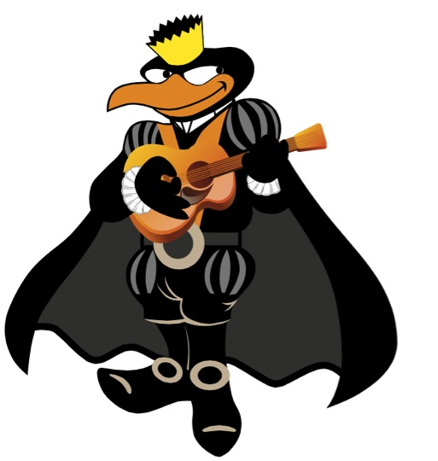
Our mascot, with a dress that is used in our group
Our main symbol, called “Beca” (in spanish),
we use it on the chest
Logos Ideas
TUL
TUL
TUL

Slide 2

Logos Ideas
TUL

Slide 3
Logos Ideas
TUL
TUL
TUL
TUL
TUL
TUL
TUL

Slide 4
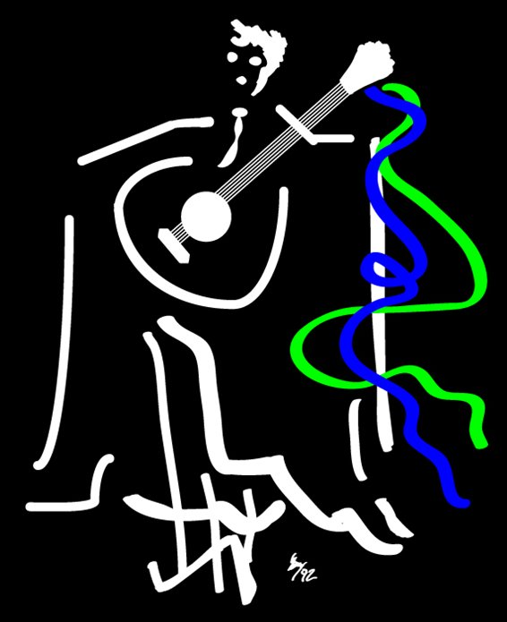
Other Logos that I like
This is from a group similar to us,
they are from Portugal:
http://antunia.fct.unl.pt/

Slide 5





Other Logos that I like

Slide 6

Additional Information
Logo from our University:
www.ulima.edu.pe
Maybe we can use something like the crown or the bird
Our colors are black and orange
You can find us in www.facebook.com/TunaULima
If you search in Youtube “Tuna Universidad Lima” you can see our videos too

