Slide 1





Sample of logos izakaya
This one it’s my favorite one

Slide 2
The name of the Restaurant it's ’’Saikō'’
At the bottom please add ‘’ Comptoir Japonais or Bar Japonais”
The meaning Comptoir it's a ''pub'' in french.
最高 saikō
さいこう
1. The highest; the best; supreme
最 (sai-, “most”) +‎ 高 (kō, “high”)
We would like to bring the concept of Izakaya (Japanese pub) to Montréal.
Izakayas are essentially Japanese taverns – drinking houses with a menu of small dishes for snacking while drinking. It literally means “stay sake shop” so traditionally this was a place where you could sit and drink on the premises. In today’s izakayas you can order food and drink and hang out with friends for an evening. Many also offer bottle keep where your unfinished bottle of shochu is waiting for you when you return.
‘i' from izakaya「居心地」(igokochi), meaning ‘place of comfort.'
"sakaya" (sake shop),

Slide 3
About the Restaurant:
The restaurant will serve Japanese Appertizers similar to ‘’tapas’’ with alcohol (Multi-type of
Sake).
http://en.wikipedia.org/wiki/Izakaya
For inspiration you can take a look at the link below. There are pictures of izakayas in japan and in USA
https://www.google.com/search?q=izakaya+pictures&tbm=isch&tbo=u&source=univ&sa=X&ei=L8PaUdIbjP7gA4PVgcAI&ved=0CCwQsAQ&biw=1309&bih=708
Picture of the restaurant (Please disregard the purple color we will change it to red)
https://www.facebook.com/pages/Restaurant-Le-Marly-Montr%C3%A9al/109339362436655

Slide 4

Specifications:
The logo should be saikō
If you want you can add this japanese Kanji ----
L'izakaya = Japanese Pub
The theme colors are Red, Gold, Wood, Black.
Maybe we could add ‘’Comptoir Japonais’’ at the bottom in small

Slide 5
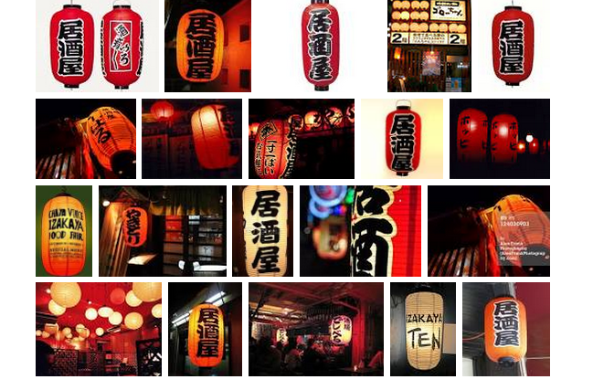
What I would like to see in the logos ( there are only ideas )
You can add lantern images

Slide 6
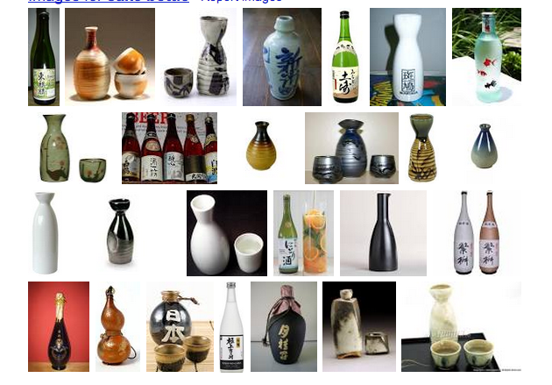
You can add bottle sake as image

