Slide 1
Park & Pier Media Group
Website Wire Frame & Content

Slide 2
I want the page to function seamlessly and collect content from all of my athletes (IE: Collect all Twitter, FB, Instagram, Photo’s, Etc and put it in 1 place
Easy/Updatable “Stories”, “News”, Etc
The main page should have an easily updatable photo and key news/stories comes to the top. This is a portal for sponsors to get information on the athletes(news, media info, etc and for me to post press releases)
Great Reference as to how this could be done easily for all aspects of the site. You might have a better solution: www.wattieink.com
Clean & Simple is the goal

Slide 3
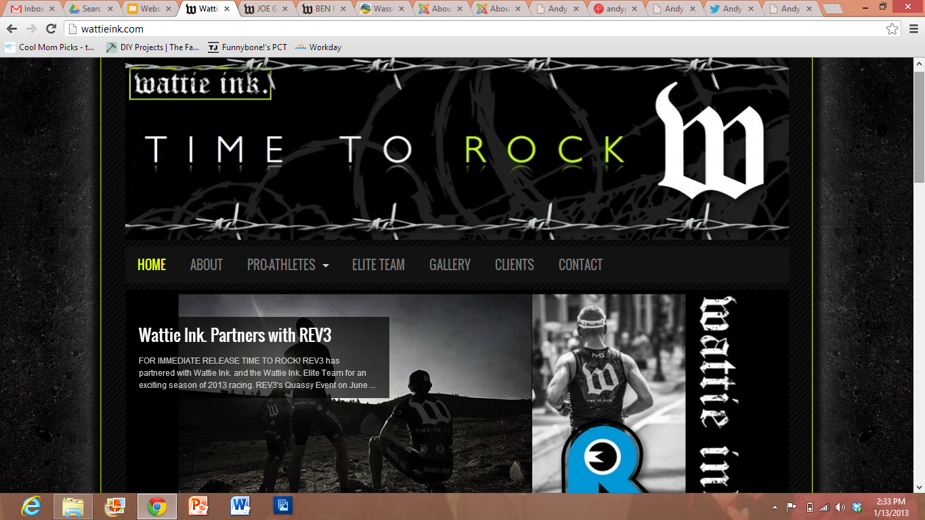
SAMPLE

Slide 4
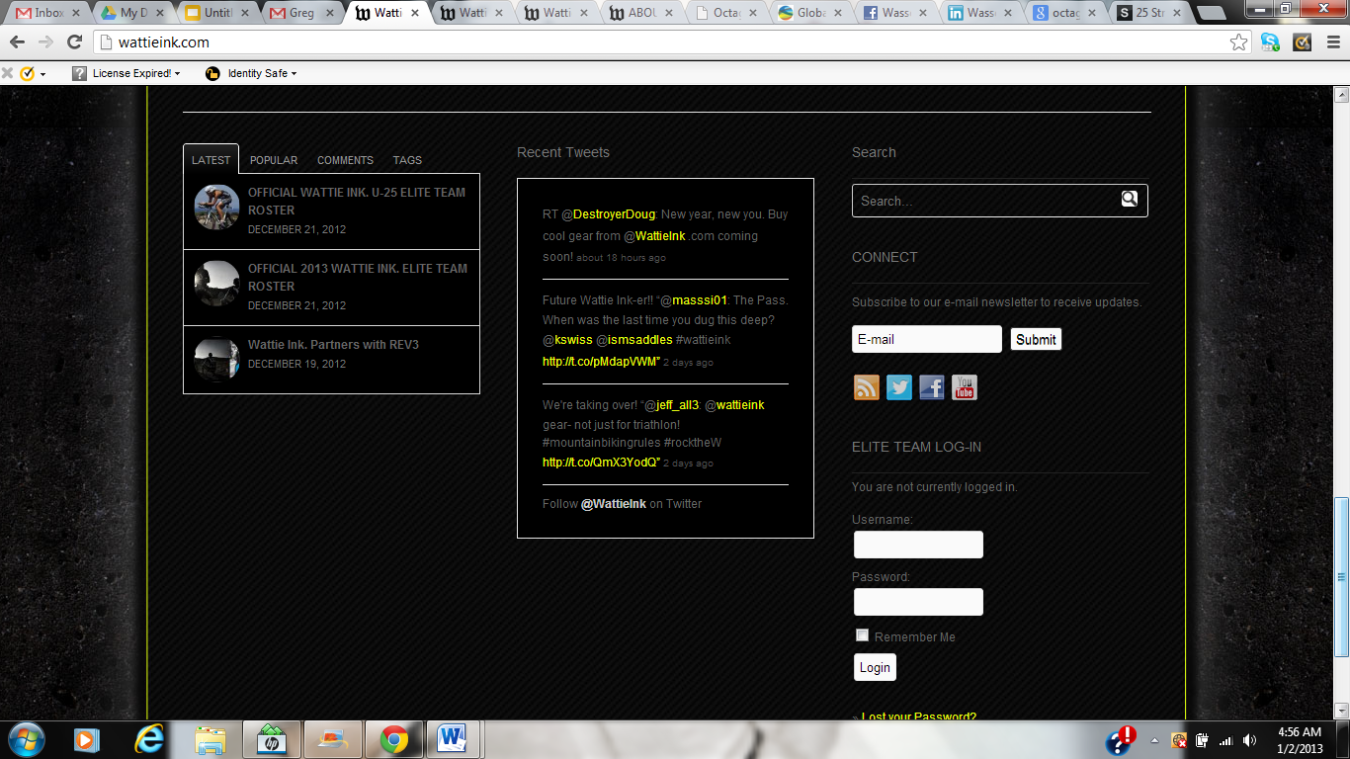
SAMPLE
Home Page
Home
What We Do
Athletes
Gallery
Contact Us
Should Be on Every Page; collects from all athletes & P/P key business info

Slide 5
Home Page
Home
What We Do
Athletes
News
Previous Clients
Find Us
Park and Pier Media Group is the agency of the 21st century. Combining critical thought, industry expertise, strategic thinking and a results driven process, P&P is emerging as a leading full service agency for consulting, strategic partnerships, business development, lifestyle marketing, media planning, athlete representation, event sponsorship and more. From Park Avenue to Pier Avenue, P&P is a credible voice and thought leader that can move any brand forward.
ABOUT / What We Do

Slide 6
Home Page
http://struck.com/about#capabilities
What We Do
For a while, we asked ourselves, what do we do? The list was long and the expertise that we brought to the table was even longer. In the end, the common thread throughout it all was an unwavering passion to combine critical thought, in depth analysis, flawless execution and fully encompassing solutions to build really cool stuff.
We build brands, create experiences, connect people with their passions and create links between what each of us do everyday.
Whether it is athlete management, media planning, building a new sales channel, product launches or business development, we take our work very personally- Just like we tell our children:
Be Passionate, Be Calculated, Be Bold and Leave things better then when we started with them.
Brand Strategy
Business Development
Sponsorship (Valuation, Pitching, Sales)
Events
Product Strategy / Launch
Athlete Representation
Lifestyle Marketing
Sales
Social Media Marketing
Retail Marketing
RFP Writing
Media Planning

Slide 7
Maybe not necessary
Home Page
http://struck.com/about#capabilities
What We Do
Brand Strategy:
Making your brand familiar, contagious, and integrated into your audiences life using analysis to take a brand from abstract to tangible
Business Development:
We determine areas for improvement and expansion as well as determining the market atoshpere to bring your product to the front by entering new sales and product channels.
Events:
Our team will increase the value of your events through productin management best racties we've developed that fuses athlete, brand, and media
Product Strategy Launch:
Launch new and existing products using traditional and non-traditional channels
RFP Writing & Sales
Need to win a new account or have an important proposal to write. We can do everything from copywriting to creative direction to simply ‘playing client’ and letting you know what we think.
Athlete Management:
Athletes are like brands and products adn therefore need to be developed the same way by integrating whole person and whole market concepts using media, technology, events and personality tofull advantage.
Sponsorship:
Event Business:
-Creating sponsor proposals, activation plans and so forth
-Selling sponsorship (media and event)
-Fulfilling sponsored commitments and continuously improving value
Sponsor Business:
-Sponsorship evaluation and recommendations
-Syncing sponsorship and strategic partnerships to build brands and marketing campaigns
-Sponsorhip and event marleting campaigns

Slide 8
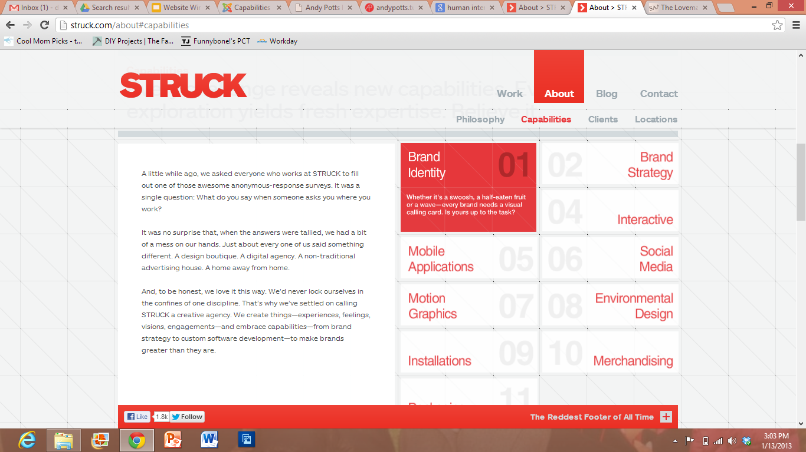
SAMPLE
Home Page
What We Do
"The World has been flat' for a while now, the way we do business has changed and organizations need to be nimble, experienced and actionable. P&P
Business Development
http://struck.com/about#capabilities
Brand Strategy
Events
Sponsorship
Product Strategy / Launch
Athlete Representation
Sponsorship Fulfillment
Sales
Lifestyle Marketing
Social Media Marketing
Retail Marketing

Slide 9
Home Page
http://struck.com/about#capabilities
What We Do
Sales:
Full evaluation of current sales to create and implement plan to improve or grow saless in a product line or geographic region
Lifestyle management:

Slide 10
Home Page
Athletes
Andy Potts
Cameron Dye
Sarah Haskins
Ben Collins
Greg Billington
Jenna Parker
Matt Russell
Jackie Arendt
Ian Mikelson
Maik Twelsiek
This should be a tiled page with a picture of each. When you click on the picture, it gives you the option to download a media packet or go to their website.

Slide 11
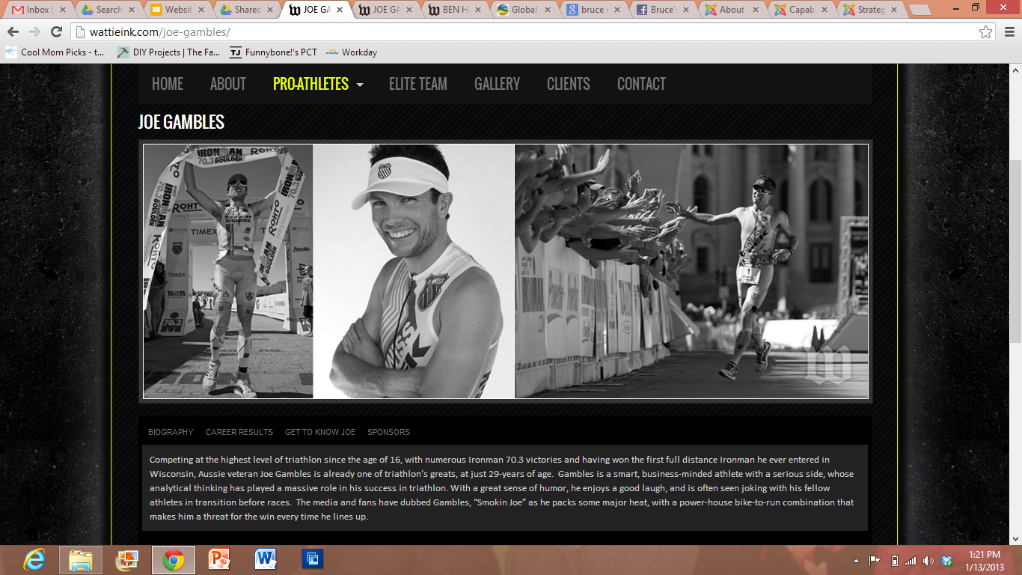
Home Page
http://wattieink.com/heather-jackson/
- USE THIS URL AS A REFERENCE UNLESS YOU HAVE A BETTER DESIGN IDEA THAT”S SIMPLER AND COOLER
Athletes
Andy Potts
Bio
Schedule/Results
Sponsors
Connect w/Andy
Sponsor Packet

Slide 12











KEY CLIENTS

