Slide 1





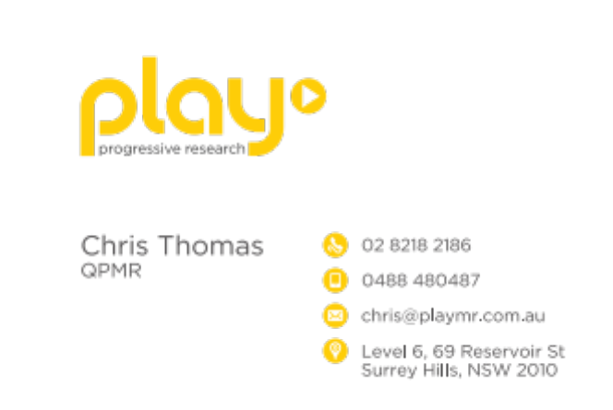

Business Card
Front
Back

Slide 2

One of the pics that has already been used in a promotional card
Draft Website

Slide 3

Another design I quite like – has people, and nice bold friendly fonts

