Slide 1
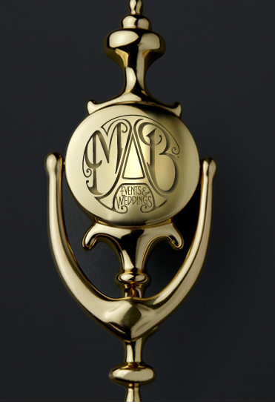
Option 1 – URL Landing Page
Logo pictured to be replaced by our logo

Slide 2
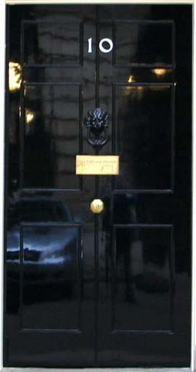
Option 2 – URL Landing Page
Number 10 to be removed and replaced maybe by company logo
The ‘luxury wedding and event Consultants’ tag to maybe be put on the mail box flap’
These are just suggestions. Do not use this exact imagery as its blurred etc. The picture is just to give you an idea of what we were thinking.

Slide 3
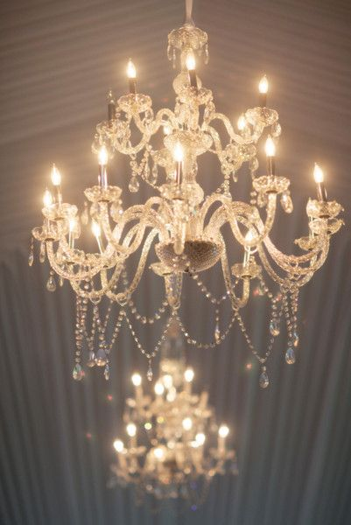
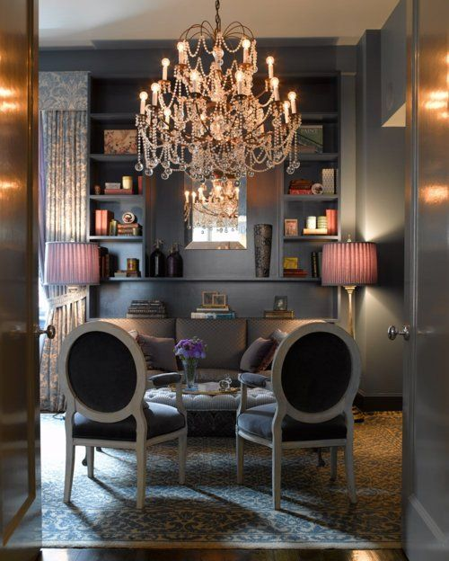
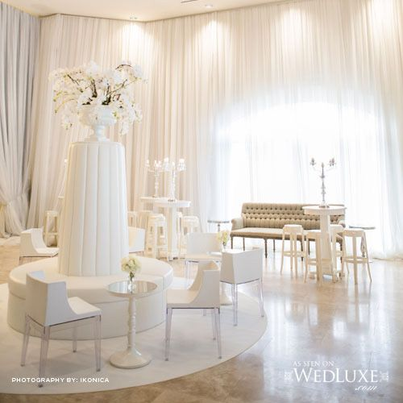
The Home Page should be white background, and have a warm, modern luxury and elegant feel.
The images above is not what we want. Please just refer to it for the colour tones and feel that we want for the Home Page/
The image above is not what we want. Please just refer to it for the style/ concept only. We do not like the colours or furniture used.

