Slide 1
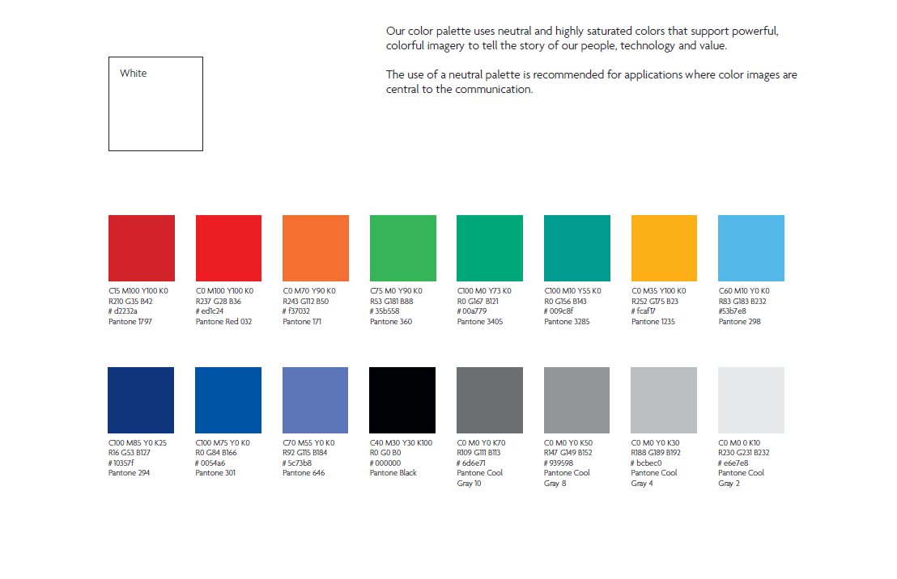





C0 M50 Y90 K0
R247 B148 B51
#F79433
Pantone 716

