Slide 1

Gel Type Facial Mask
(OEM/PL Cream Modeling Mask)

Slide 2
Contents
What is CREAM MODELING MASK?
  Concept
  History of Modeling Masks
  Features of CREAM MODELING MASK
  Standard Modeling vs. CREAM MODELING MASK
  Key Effects of CREAM MODELING MASK
Product
  Product Configuration
  Key Ingredients
  Powder Kinds and Features
How to use
Inquiry

Slide 3
CONCEPT
  “Never dried out modeling mask”
  “No water at mixture”
  “Endless water supply and retention”
  “Perfect adhesion without any gap”
  “Easy and simple removal”

Slide 4
History of Modeling mask
Standard
Modeling Mask
Cream
Modeling Mask
Aqua
Modeling Mask
1st Generation
2nd Generation
3rd Generation

Slide 5
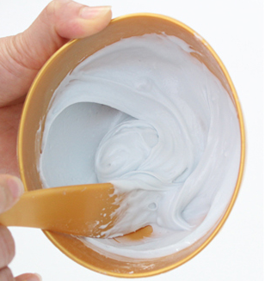
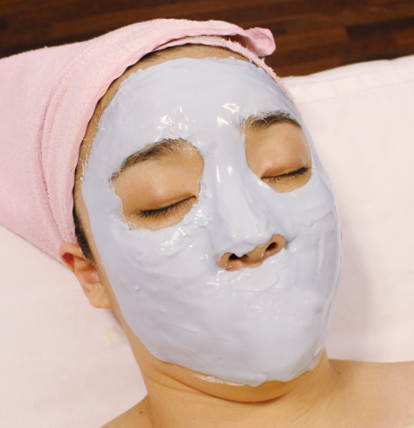
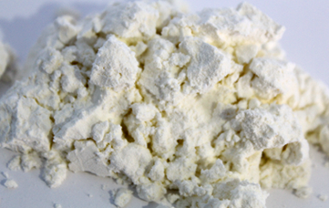
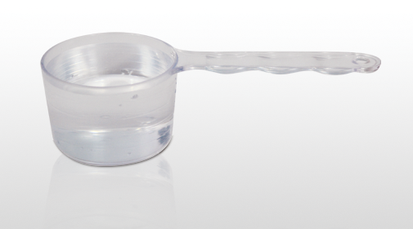




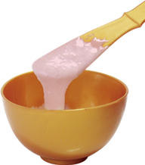
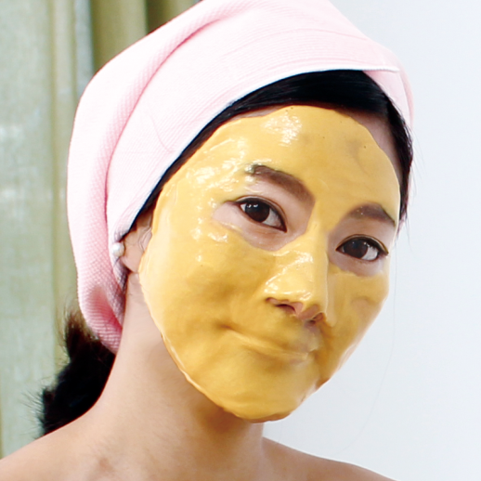
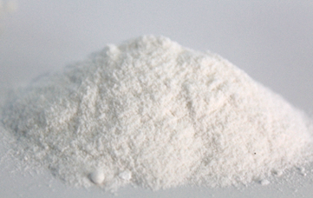

History of Modeling mask
1. Modeling mask
+
2. Aqua Modeling mask
+

Slide 6
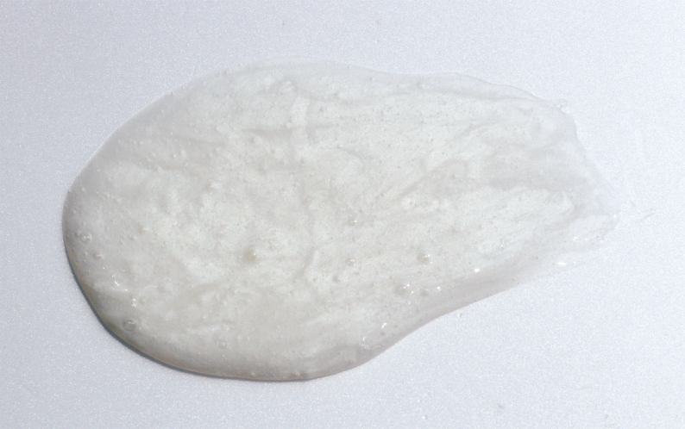
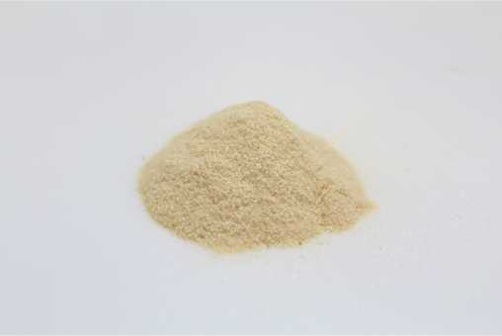
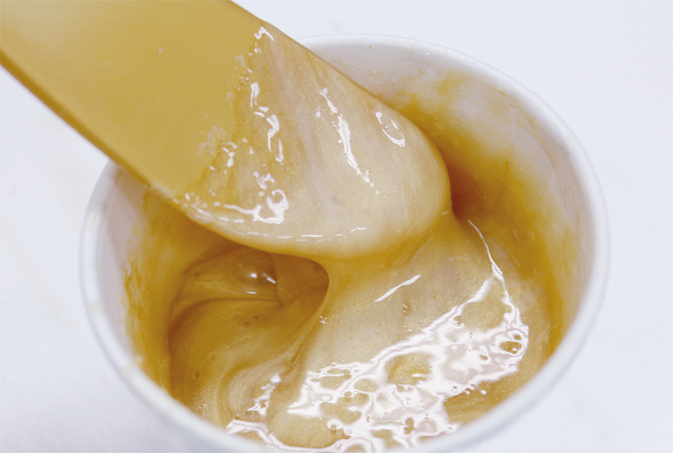


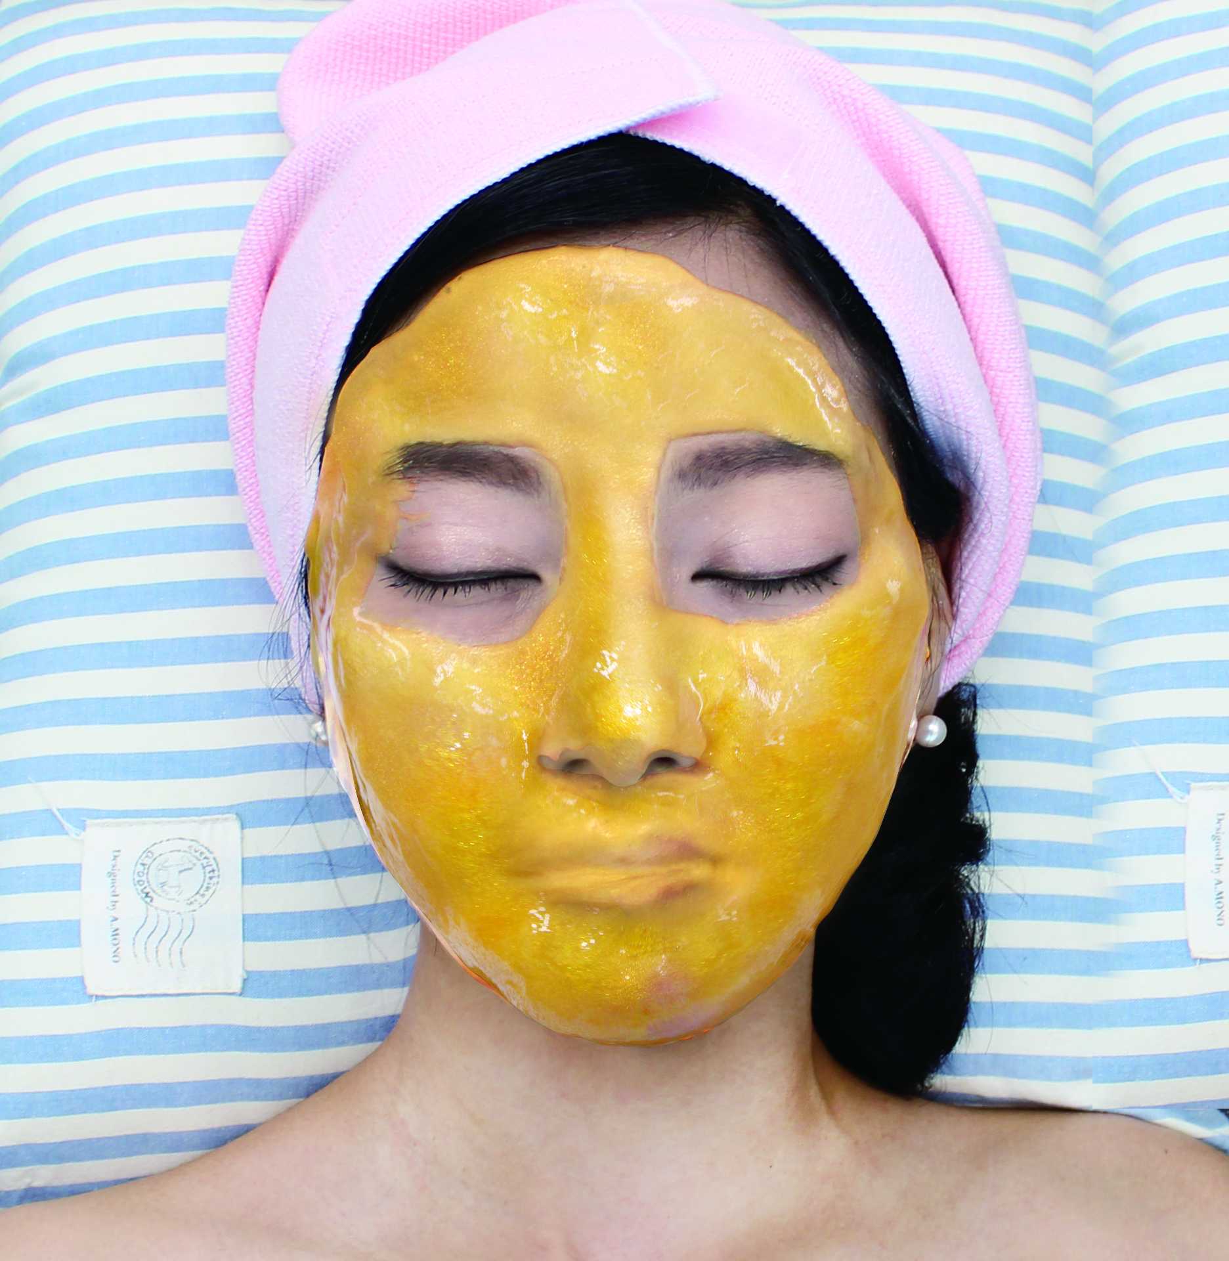

History of Modeling mask
3. Cream Modeling mask
+
Base Cream
Active Powder
Cream Modeling
Content : 50g
Content : 4.5g
Content : 54.5g

Slide 7
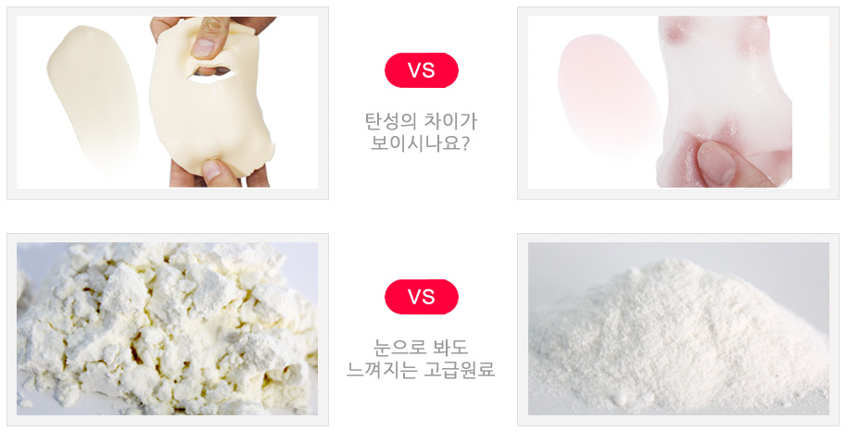
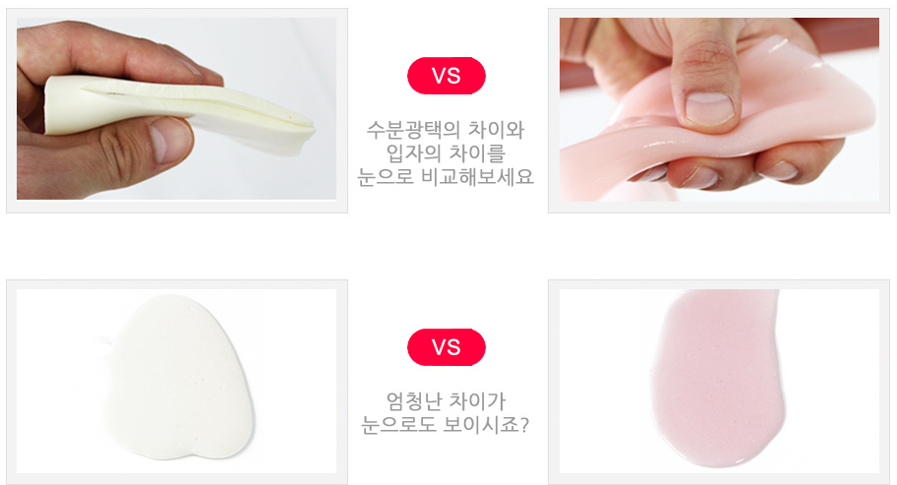
FEATURES OF CREAM MODELING MASK
Epoch-making change
  Powder -> Cream Formula
  NO WATER needed
NO residues, perfect and easy removal
Strong lifting effect (V-line form)
  Long moisturizing effect(72 hours lasted)
Better delivery and perfect adhesion
Various configuration possible
Available any seasons.
  COOL in refrigerator(summer)
  HOT in warmer(winter)
파우더 타입과
크림 제형

Slide 8
STANDARD MODELING vs. CREAM MODELING MASK
Types | Standard Modeling | Cream Modeling
Solvent | Water | No water
Tool set | Bowl, spatula | Bowl, spatula or brush
Removal | Left residues after removal sometimes. Difficult | No residues, no water wash. Very easy
Hydration | Lasting 30 min. or 1 h after removal. | Much longer and strong hydration
Elasticity | Weak | Strong
Feeling after use | Partly dry | Moist
Effects | Less moisture | Cooling/High moisture

Slide 9
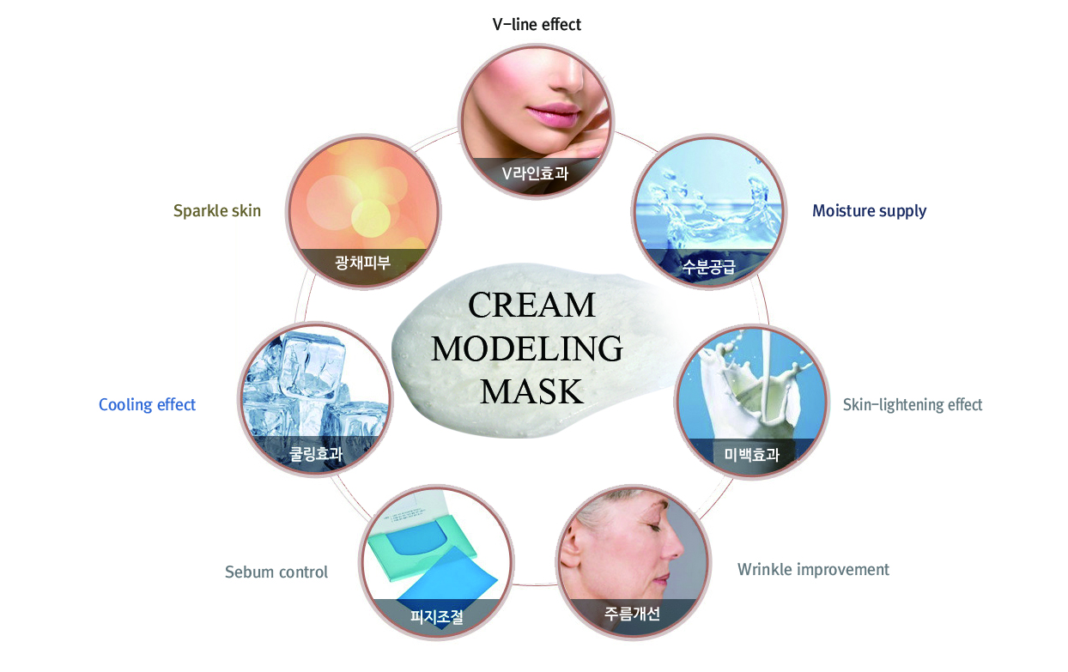
Key effects of Cream Modeling Mask

Slide 10
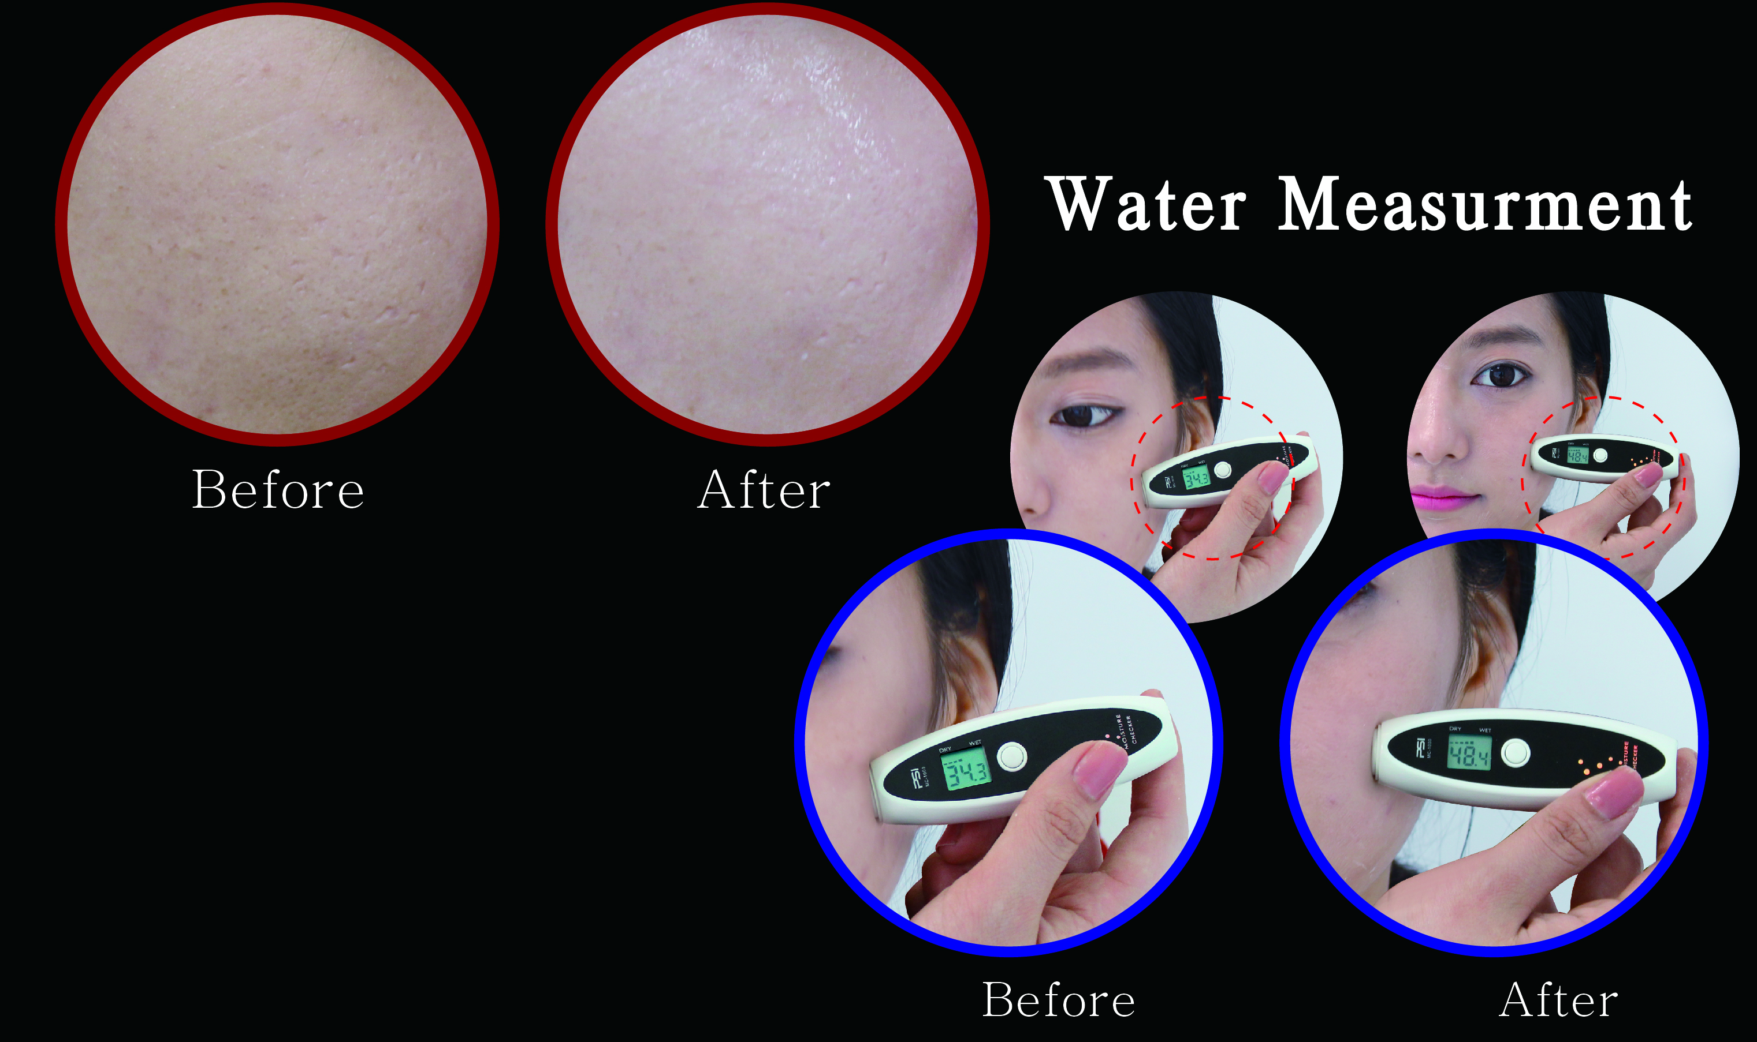
Strong Moisturizing Effect

Slide 11
HOW TO USE
1 way
Cleansing
2 way
Apply solutions & ampoules
3 way
Apply Cream Mask (20~40 minutes)
4 way
Remove Cream Mask and trim with serum or cream

Slide 12
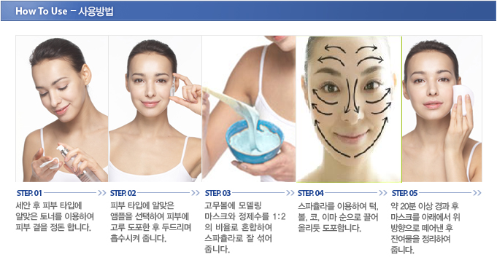
Step 1- CLEANSING
HOW TO USE
Clean and wash your face with toner after cleansing your face.

Slide 13
HOW TO USE
Step 2- Solution & Ample Apply
Rub enough ampoules or functional products to your face and neck in advance.

Slide 14
HOW TO USE
Step 3- Cream Modeling Apply
Put powder and cream mask in the rubber bowl and mix evenly and quickly using spatula. If cream pack is ready, apply them to chin, forehead, cheeks and neck except eyes and nostils.

Slide 15
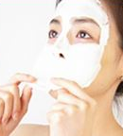
HOW TO USE
Step 4- Remove Cream Modeling and Trim
Approximately 20~40 minutes after application, remove cream pack from your face. No need to wash, just rub with skin toner and finish your skin care. Now you can feel the differences.

Slide 16
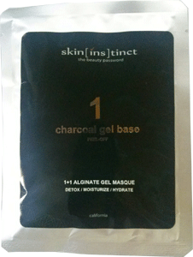
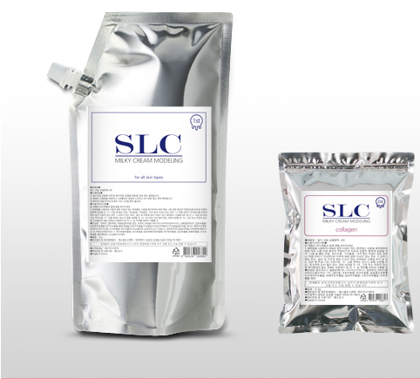

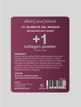
PRODUCT CONFIGURATION
Disposable Pack
1st Solution(50g)
2nd Powder(4.5g)
Bulk Pack(20 times use)
1st Solution(1kg)
2nd Powder(100g) + Measuring Cup(5g)
1st Cream : 50g
2nd Powder : 4.5g
1st Cream : 1 Kg
2nd Powder : 100g

Slide 17
INGREDIENTS
1st (Solution)
Aqua, Glycerin, Butylene Glycol, Algin, Diatomaceous Earth, Sodium Chloride, Glycyrrhiza Glabra Root Extract, Salvia Miltiorrhiza Root Extract, Schizandra Chinesis Fruit Extract, Coptis Japonica Root Extract, Rhus Semialata Gall Extract, Caprylhydroxamic acid, Caprylyl glycol, PEG-60 Hydrogenated Castor Oil, Hydrolyzed Pearl, Hydrolyzed collagen, Titanium Dioxide, Mica, Tin Oxide, Silk Amino Acids, Adenosine, Galactomyces Ferment Filtrate, Acetyl Hexapeptide-8, Copper Tripeptide-1, Hamamelis Virginiana (Witch Hazel) Extract, Cucumis Sativus (Cucumber) Fruit Extract, Aloe Barbadensis Leaf Extract, Portulaca Oleracea Extract, Algae Extract, Centella Asiatica Extract, Cornus Officinalis Fruit Extract, Chlorphenesin,Disodium EDTA
2st (Powder)
  10 Types
Glucose, Calcium Sulfate, Niacinamide, Allantoin, Hydrolyzed Collagen, Sorbitol, Punica Granatum Fruit Extract, Cnidium Officinale Root Extract, Brassica Oleracea Italica (Broccoli) Extract, Medicago Sativa(Alfalfa) Extract, Brassica Oleracea Capitata (Cabbage) Leaf Extract, Triticum Vulgare (Wheat) Germ Extract, Brassica Campestris (Rapeseed) Extract, Raphanus Sativus (Radish) Seed Extract, Fragrance

Slide 18
2nd Powder(10 types) & FEATURES
1. COLLAGEN
A vegetable elasticity factor. It contains proteins, polysaccharides, increase skin elasticity and robustness.
2. NUTRITION
Vitamin C and other ingredients cleanse the skin, make clear skin and supply nutrition to healthy skin.
3. OILY
This will help to remove wastes from the pores and keep skin clean in addition alleviating the trouble. For oily skin only.
4. BRIGHTENING
This will keep dark and dull skin clear and brighten the skin.
5. ICE COOL
This will make skin elastic with tightening the pores, make the trouble and stimulated skin cool down and refresh.
Anti-wrinkle
Lifting
Sebum Control
Whihtening
Soothing

Slide 19
2nd Powder(10 types) & FEATURES
6. GREEN TEA
This will keep your skin shiny and healthy and protect from stress.
7. CHARCOAL
Charcoal will adsorb sebum in the pores of the skin and help to eliminate waste and keeps the skin clean.
8. CHLORELLA
Nutrients in Chlorella and vitamins maintain your skin healthy and protect your skin from contamination.
9. MOISTURE
Moisturizes dry skin and keeps the skin moist and smooth.
10. SNAIL
Mucine of snail mucus will help to protect the skin and maintain the moisture of the skin tissue.
Refreshing
Pore Tightening
Revitalizing
Deep Hydration
Regeneration

Slide 20
INQUIRY
Jandy Brands Inc
2535 West, 237th Street, Suite 127, Torrance, CA 90505
Contact
  Joseph Cho (Jandy Brands Inc)
  Tel : 1-310-534-0300
  Mobile : 1-323-351-6976
  E-mail : joseph.c@jandybrands.net

