Slide 1


Slide 2

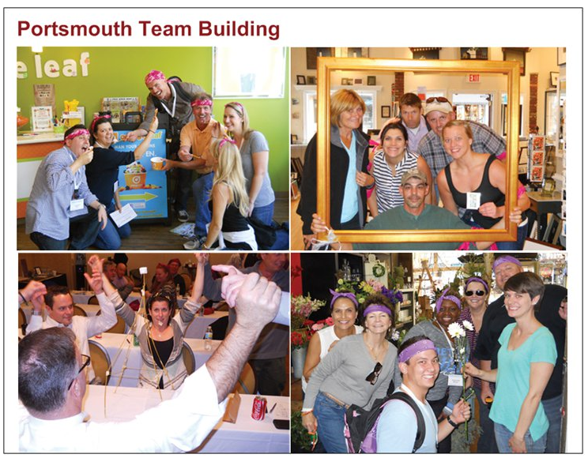
Last Rule

