Slide 1
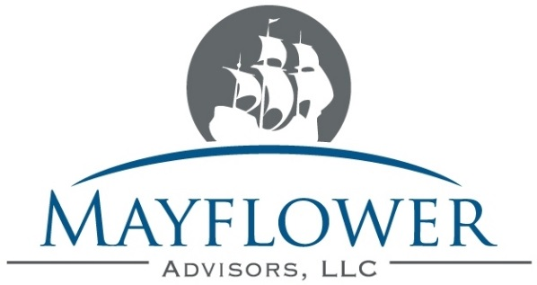
UPDATE DATE by:
Presentation of
Advisory Services
for
PROSPECT LOGO HERE

Slide 2
Presentation Overview
Mayflower Advisors Background
Employer Solutions
  Fiduciary Support
  Plan Design & Testing Support
  Vendor Benchmarking & Search
Employee Communications
  Education for Groups & Individuals
  Sample Materials
  Participant Contact Database

Slide 3
Mayflower Advisors LLC
Independence
  No Proprietary Investment or Administrative Products
  Can work with any Recordkeeper, Mutual Fund Company or Investment Company
    Access and evaluate the Marketplace on our client’s behalf
    Align our interests with our client’s
  Seek Long-Term Relationships with our Clients
  Not a “High Volume Shop”
Flexibility
  Comfortable as Either Fee-for-Service Advisor or Broker of Record
  Can act as a Fiduciary
  Services can be Comprehensive or “a La Carte”
  Will Customize Materials and Report Designs to fit Client’s needs
Experience
  Principals Possess over 130 Years of Industry Experience
  25 Associates Provide Scale and National Scope
  Broad Array of Clients Provides Diverse Pool of Experience and Solutions
    Clients range from 10 to 12,000+ employees, $1 million to $400 million+
    Clients include Fortune 1000 companies and world-renowned universities

Slide 4
Recognized Expertise
Highly Credentialed
  2015 Named to Inaugural Financial Times’ “FT401 - Top Financial Advisors” List
  2014 Named President of National Association of Plan Advisors (NAPA)
  2014 Elected to Board of the American Retirement Association (ARA)
  2009 PlanSponsor Magazine “Retirement Plan Advisor of the Year”
  2010 ASPPA/Morningstar Leadership Award Finalist
  2011 Elected to Inaugural Class of PlanAdviser Magazine “Advisor Hall of Fame”
  2012, 2010 DCWire 50 Most Influential Advisors in Retirement Plan Industry
  2014 to 2009, 2006 PlanSponsor Magazine Top 100 / Most Successful Advisors
  Team members assigned to XXXXXX have Accredited Investment Fiduciary (AIF) designation amongst other designations and licenses
Highly Connected
  Position with NAPA & ARA provides Direct Contact with Department of Labor and Congress to Stay Abreast of Regulatory Changes and Intentions
  Founding Member of RAC (Retirement Advisory Council)
    Industry coalition of advisors and vendors focused on improving industry standards and conducting research

Slide 5
Social Responsibility
Extensive Community Involvement
  2014 Winner of Financial Planning Magazine Pro Bono Award
  Founded the Jump$tart Coalition of Massachusetts
    Affiliated with the National Jump$tart Coalition
    Committed to promoting Financial Literacy curricula in K-12 schools across the Commonwealth
    April proclaimed “Financial Literacy for Youth Month” in State of MA after similar obtaining similar proclamations and programming in City of Boston
    Organize annual Massachusetts Financial Educators Symposium
  Organize Financial Roundtable in City of Newton for over 150 local residents & businesses
  Highly involved with the Boys & Girls Club National Organization through NAPA
    Have created a $25,000+ (& growing) honorarium in conjunction w/ national conference
  Principals and Advisors are Members of Dozens of Charitable Boards, Town Committees, School Boards, etc.
  Client List Includes Dozens of Local Not-for-Profit Organizations
    Generally offer our services at an ‘overly competitive’ rate to support their efforts

Slide 6
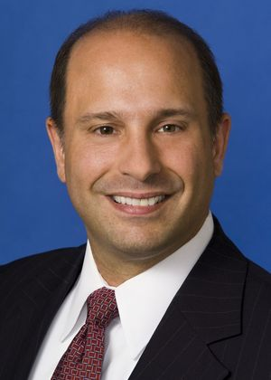
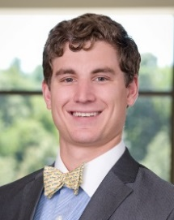
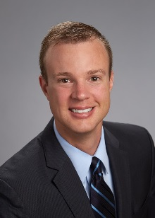
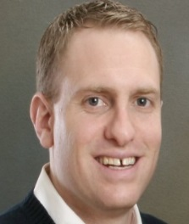
XXXXX’s Mayflower Team
Steve Dimitriou
Michael Barczak
Managing Partner
Portfolio Analyst
Steve has over 22 years of experience with retirement plans and is an unquestioned industry leader. He drives the vision of the firm and oversees our service structure. He works directly with clients on Plan Design and fiduciary oversight issues, including vendor negotiation, fund selection and regulatory compliance.
Michael manages the firm’s investment and market research efforts to ensure we provide the most informed recommendations to clients. He performs investment analysis, manager interviews, fund commentary and portfolio management.
Joe Kendall
Jeff Mehne
Registered Associate
Registered Associate
Joe is primarily responsible for day-to-day interactions with participants and HR staff. He expedites problem resolution and coordinates activity between vendors, the Plan Sponsor, Mayflower, and the participants. Together with Steve, Joe will be the face of Mayflower to participants.
Jeff has spent the past 13 years focusing on the corporate retirement plan market space. Prior to joining Mayflower Advisors, Jeff worked in a variety of roles at Fidelity Investments, ADP Retirement Services and most recently at Natixis Global Asset Management.

Slide 7






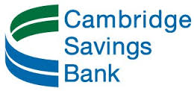










Broad Array of Clients

Slide 8
Service Beyond Traditional Investment Advisory
Plan Assessment
Review goals and objectives of plan and progress towards them.
Fee and Service Benchmarking
Conduct inventory of plan service and fees and judge satisfaction.
Evaluate Current Technology and Service
Take inventory of current technology and service options and present solutions
Full Disclosure Assistance
Assist committee and HR with review of all disclosures and filings
Plan Design Review
Ensure that the design of your plan is driving the outcomes you desire

Slide 9
Fiduciary Support
Regulatory Adherence
  Provide Routine Regulatory & Industry-Trend Updates
  Position as Industry Leader Gives us Unique Insight
    Position w/ ARA & NAPA gives access to DoL, Congress & regulators
    Member of several vendors’ Advisory Councils, so are aware of industry trends and coming technologies
Investment Advisory Services & Protection
  Customize a Quantitative & Qualitative Investment Review
    Do NOT rely on Vendor’s conflicted suggestions
    Provides practical Fiduciary protection vs flimsy vendor “guarantees”
  Recommend Fund Changes and/or Additions
  Identify and Negotiate all Fund Revenue Sharing
    Open Architecture = ability to change share classes to proactively lower costs and improve returns without interruption to participants

Slide 10
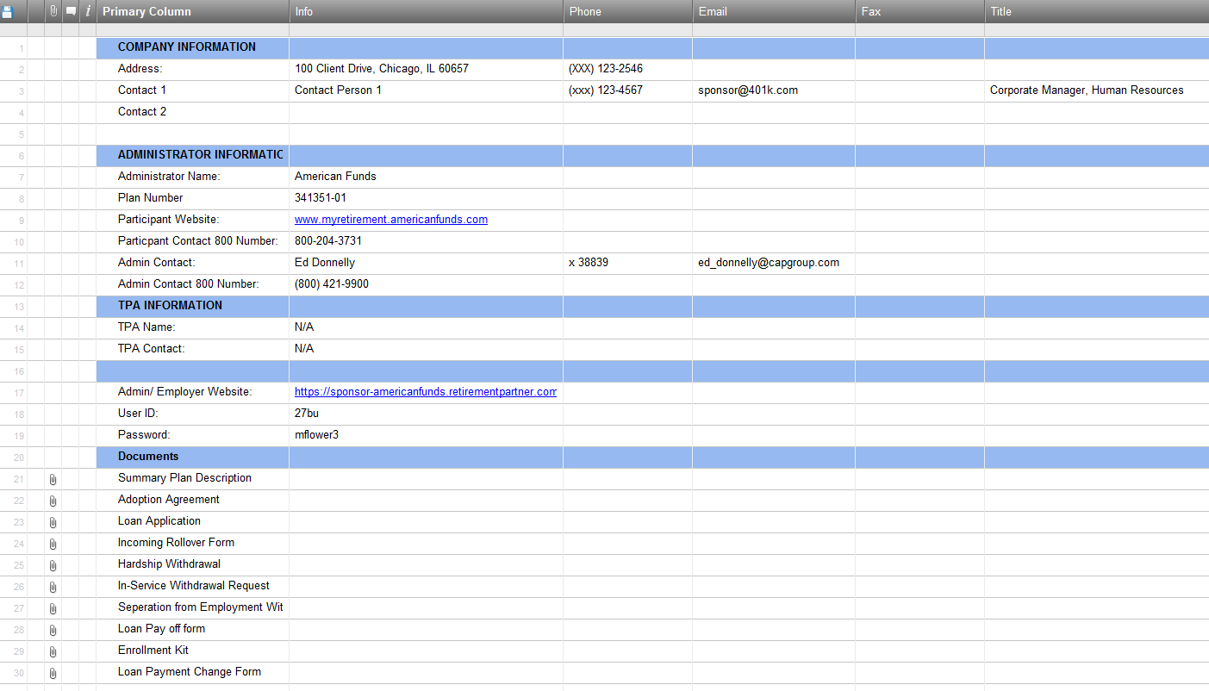
Fiduciary Support
Plan Sponsor Portal Keeps Important Documents and Contacts Organized and Accessible
  Can provide plan sponsor / HR contact access
All administrative contacts kept for sponsor’s reference
Mayflower keeps all plan & participant documents up-to-date

Slide 11
Plan Design & Testing Issues
Periodically Review Plan Provisions for Efficacy
  Eligibility periods
    Improper eligibility actually discourages participation
  Entry Dates
    Want to encourage participation, but weigh benefit vs administrative burden
  Vesting
  Variable provisions between employee & employer contributions
  Attack & resolve potential testing issues with a combination of targeted communication and Plan Design features
    Auto-x, Safe Harbor, utilization of QMAC, etc.
Mayflower Advisors can obtain industry Benchmarking of Plan Design so XXXXXX can assure its competitiveness for labor

Slide 12
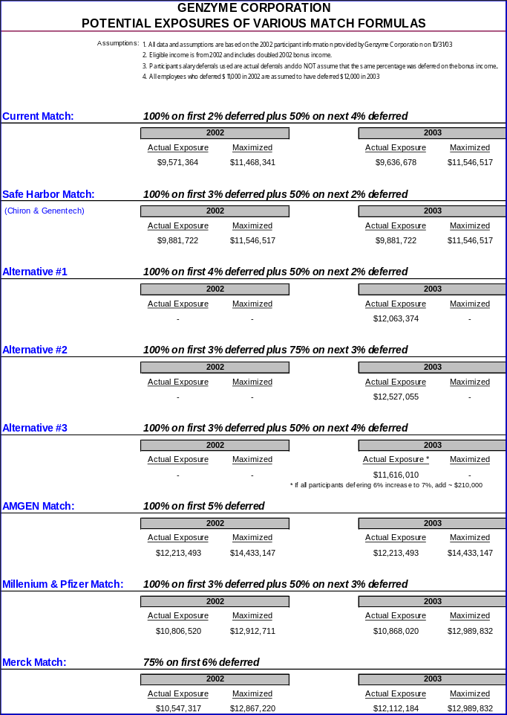
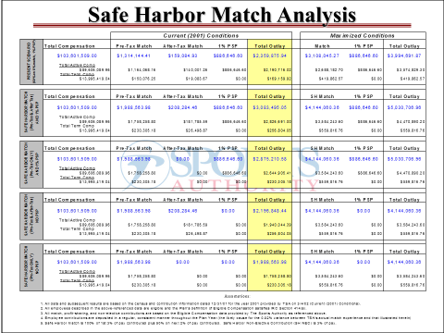
Plan Design Analytics
Mayflower Can Provide Cost Analyses
  Vendors & Recordkeepers will charge, we won’t

Slide 13
Vendor Benchmarking & Search
We Routinely Benchmark Vendor Pricing & Services Every Three Years
If Needed, We will Customize an RFP
  Identify XXXXXX’s “Wish List” and “Can Live With” List
    Rank/Weight Items by Level of Importance
    Suggested Specifics:
      Loan & Distribution Approval − Payroll Bridge
      Mobile app capabilities − In-Person annual review
      Enrollment Support – local offices / enrollers, languages, mobile apps
      Mailings / notifications included in pricing
      Fee guarantee for at least 3 years
      Revenue Recapture and ERISA Budget a must
      Open architecture on funds, including Index options
  We work with ALL vendors
    Prefer to be a fee-based advisor
      Provides much more flexibility with revenue recapture and fund selection

Slide 14
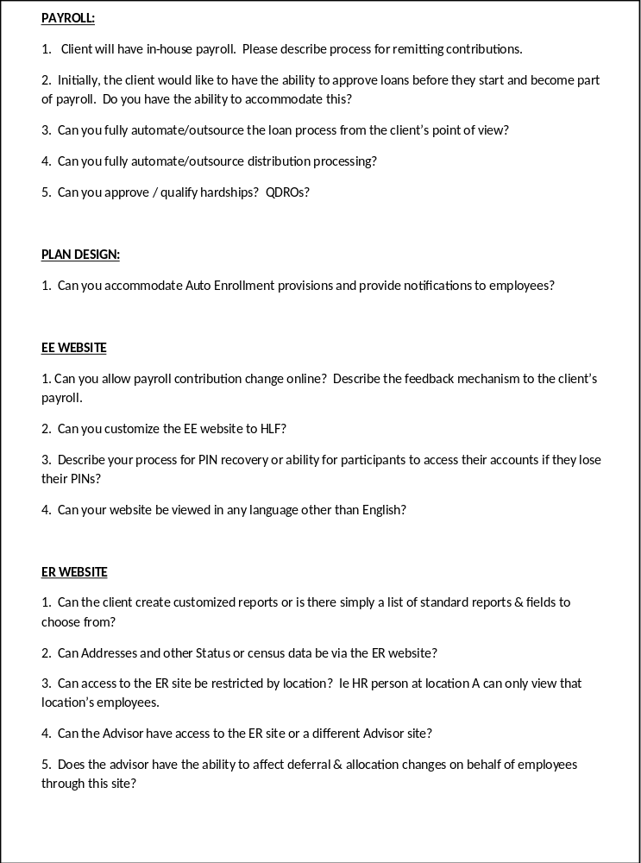
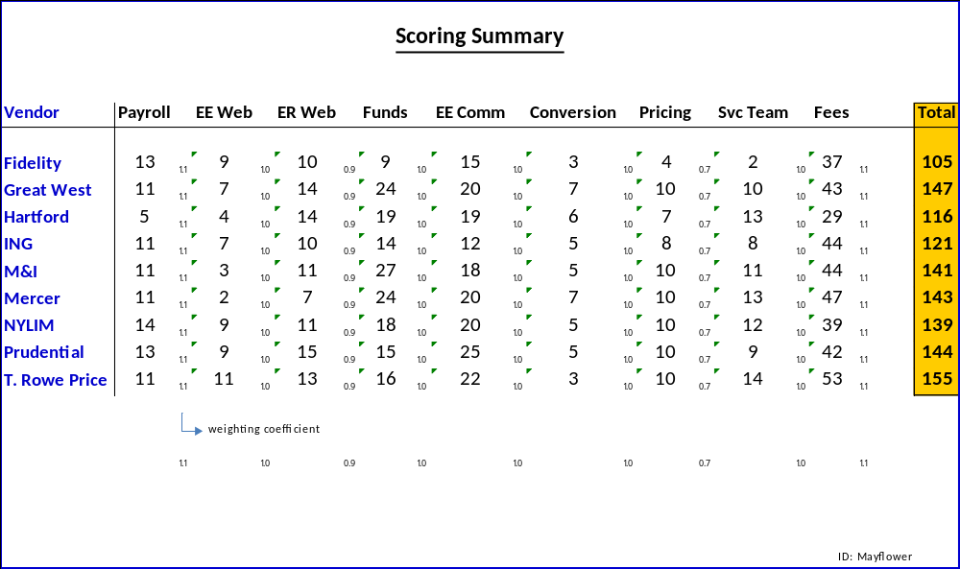
Vendor Search & Negotiation
Process:
  Create Customized RFP with XXXXXX’s Input
    Specific questions & specified weightings
  Obtain, Organize & Score Vendor Responses
  Review Findings & Schedule Finalist Meetings
  Initial Negotiations Pre-Finalist Meetings
  Identify Finalist and Negotiate Services & Fees

Slide 15
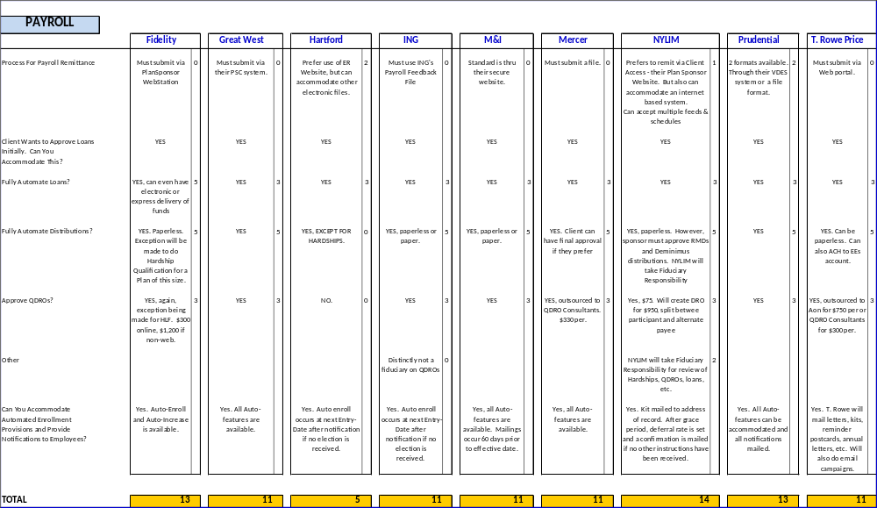
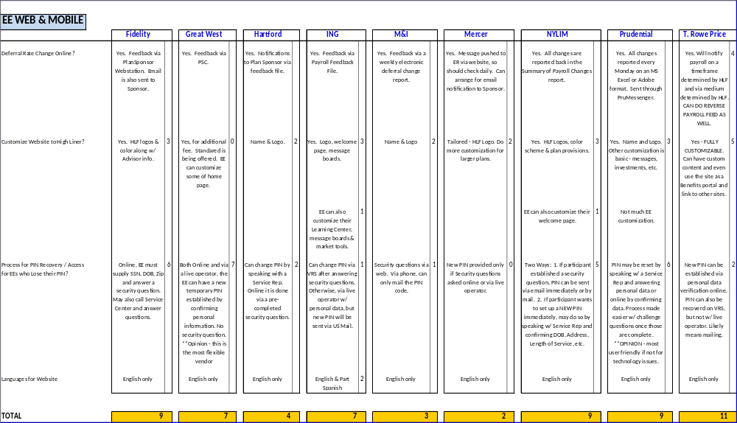
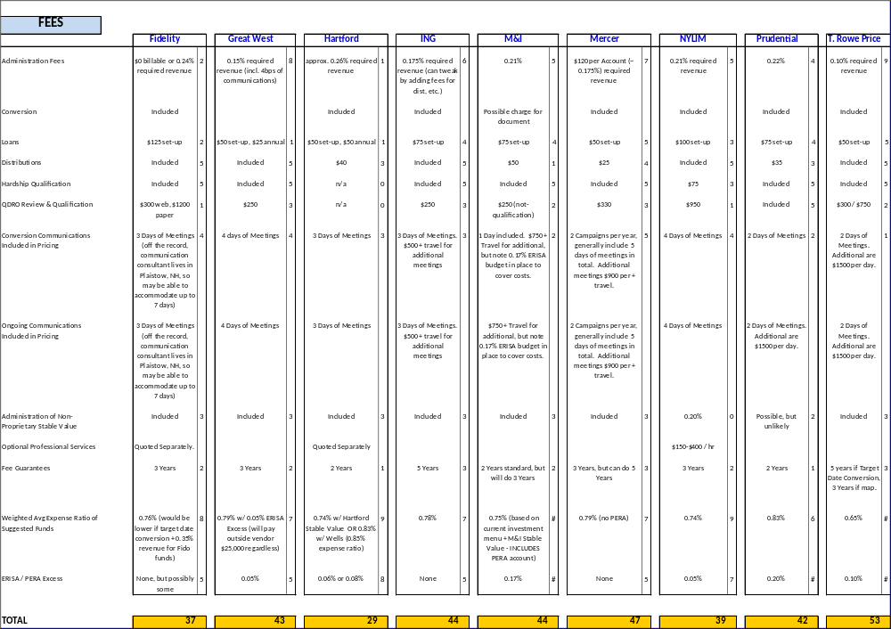
Vendor Search & Negotiation
Provide Side by Side Detail on all Identified Items
  Better identification of capabilities & XXXXXX preferences
  Enables better negotiation
  Allows XXXXXX to simply Re-order priorities and weightings
  Tremendous Fiduciary Protection

Slide 16
Vendor Benchmarking & Search
Will Aggressively Negotiate Vendor Fees and Revenue Sharing/Recapture
  XXXXXX’s size will be an advantage
    As Plan grows, size should be leveraged for better overall pricing, particularly with communication services
  Will have opportunity to use vendor proprietary funds for pricing advantages
    Wells, Fidelity, JPM, American Funds, Putnam & some others give additional revenue credits for funds used on their recordkeeping platforms
      As long as fund passes IPS screens, may provide enormous pricing advantage
      If QDIA option, can also solve issue of poor participant allocation and liability that comes with it
We Track Revenue Sharing Independently of Vendor to Ensure Plan is Receiving What it Should

Slide 17
Vendor Benchmarking & Search
Our Reputation in the Industry and Scale of Business Provides Advantages
  Gives Leverage to Our Clients in Negotiating with Vendors
    Intimate Knowledge of Industry Costs & Practices
    Examples:
      Negotiated the first in nation flexible advisory fee structure on American Funds Plan Premier Platform (FasCorp)
      Identified out-of-date revenue sharing agreement on Mercer platform that allowed GoldenSource to double revenue sharing/fee offset from Fund
      Negotiated Sub-T/A rebates for Genzyme Corporation resulting in $30,000+ recapture of fees as early as 2002
      Saved High Liner Foods > $100,000 of Advisory & Recordkeeping fees
      Recaptured nearly $200,000 of Recordkeeping Fees from Fidelity for Vertex Pharmaceuticals and its Participants
    Established relationship with most vendors

Slide 18
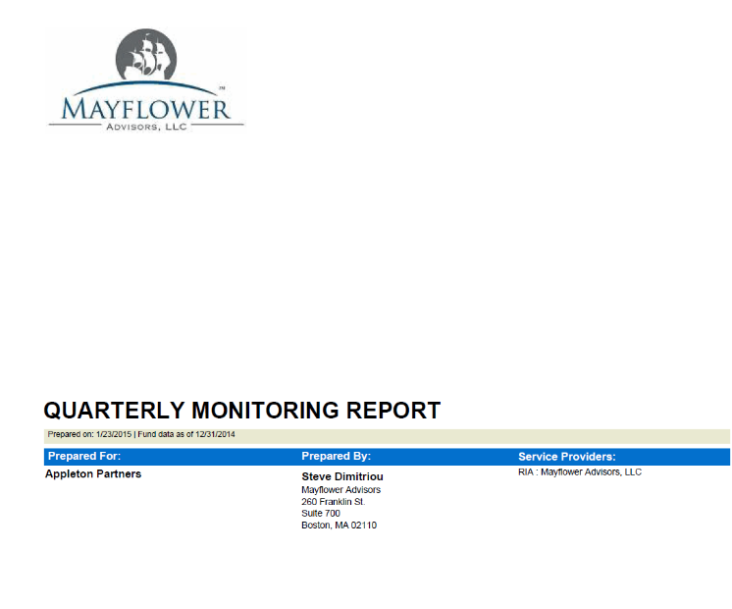
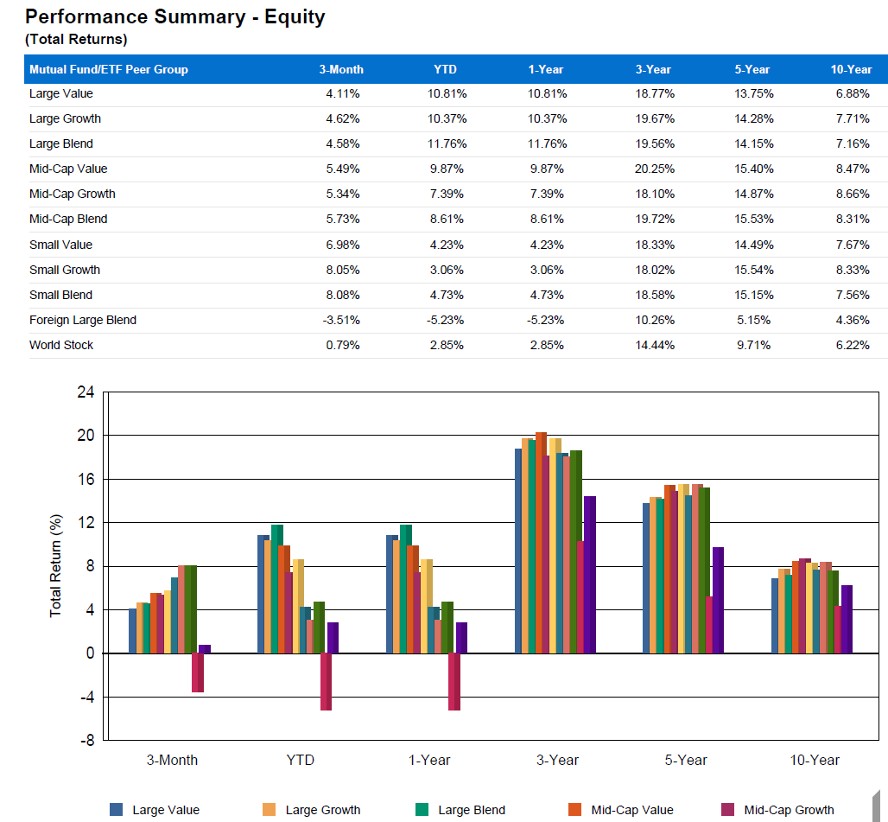
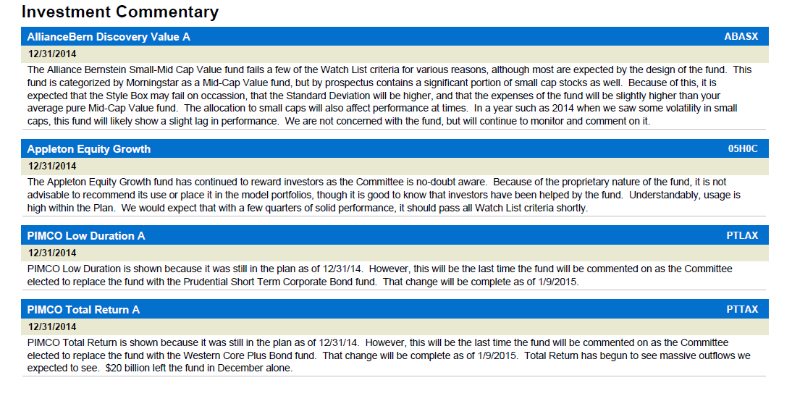
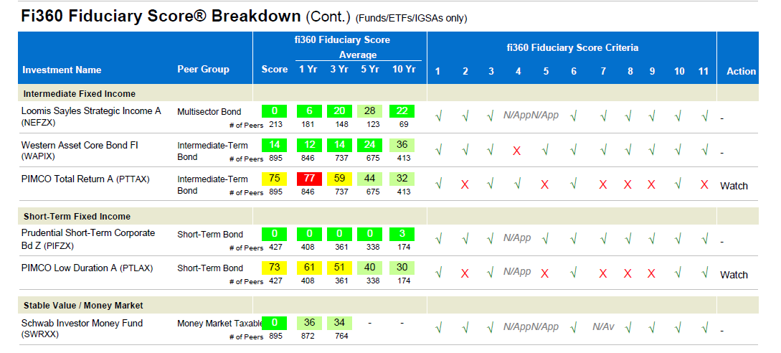
Investment Monitoring & Reporting

Slide 19
Investment Monitoring & Reporting
Provide Quarterly Quantitative & Qualitative Reviews
  Can deliver in-person or electronically
  Incorporates Investment Policy Criteria to evaluate dozens of analytical factors, comparing them to peer group and industry benchmarks
    Performance, Style Drift, Volatility, Risk Related Returns, Expenses, Sector Concentration, etc.
  Tracks performance of Model Portfolios to ensure proper spread of volatility & returns
  Provides summary of expenses, vendor costs and revenue recapture
  Clear and concise Watch List identification and fund-by-fund commentary

Slide 20
Investment Monitoring & Reporting
Investment Advisory Services
  Size and Reputation Provides Routine and Proactive Access to Investment Managers
    Meet regularly with PMs and liaisons in our offices
    Ability to conduct extensive interviews directly with PMs and fund company management during Search process
    Often informed in advance of Fund closings & mergers, management changes, etc.
    Back-channel access to platform revenue sharing agreements and fund availability
  Do Not Simply Regurgitate a Home Office Report with “Shelf-Space” Biases
    We are truly independent and have the ability and scale to conduct our own research in combination with other industry standard resources

Slide 21
Importance of Employee Education
Most employees are not able to obtain financial advice on their own
  Too expensive
  Financial markets can be intimidating
  Not sure whom to trust
The scale of a 401(k) gives each employee access to an unbiased advisor to whom they may not otherwise have access
People save more when they are educated!
* | Advisor | No Advisor
Have a Savings Goal for Retirement | 74% | 54%
Savings Rate | 9.5% | 7.8%
More Confident in your Financial Decisions | 70% | 39%
*“People Who Get 401(k) Advice are Better Savers. Too Bad Many People Don’t Get Advice.”, Washington Post, August 25, 2014
People with a financial advisor accumulate an average of 58% more in assets over a 4-6 year time period, and as much as 99% more in 7-10 years.
*CIRANO (2012) http://www.cirano.qc.ca

Slide 22
Employee Education Services
Group Education Meetings
  Customized 401(k) education
    Use examples specific to your employee demographics
  Financial literacy series
1-on-1 Education Sessions
  Chance for an employee to gain advice they may not attain on their own
  Personalized attention gives employee confidence moving forward
  Ability to affect 401(k) changes in the meeting
Provide Direct Email & Toll-Free Phone to Licensed Advisor
  Scheduling never need limit your employees’ access to advice
Create Model Portfolios
  Hard code into recordkeeping system if possible
  Eases the investment selection process for participants

Slide 23
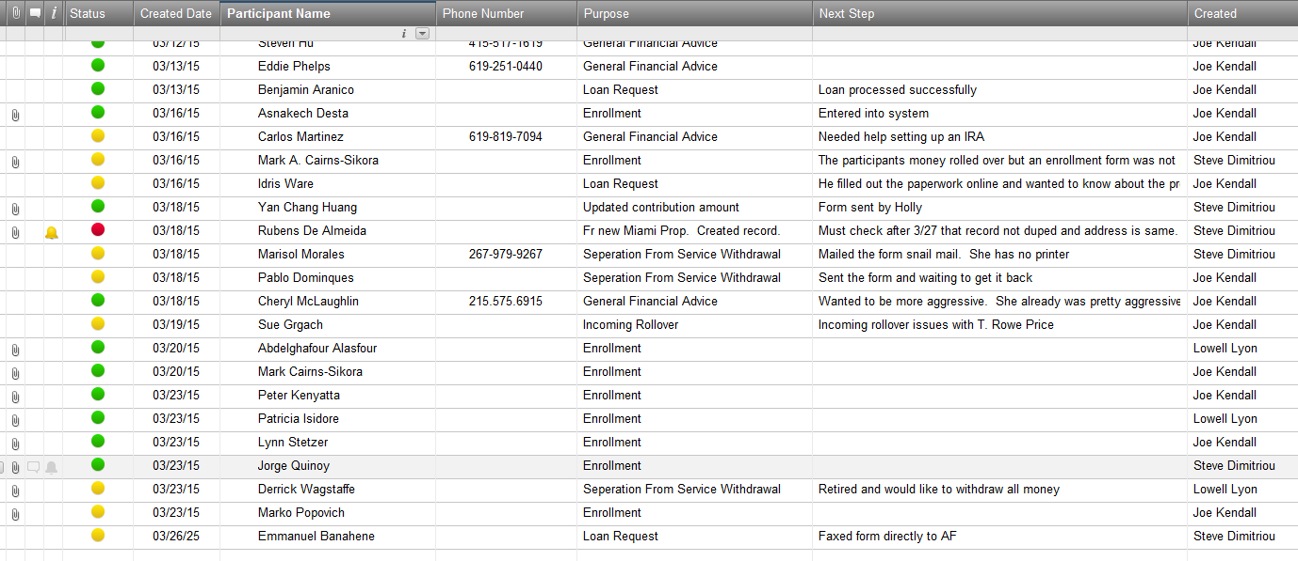
Pro-Active Approach with Your Employees
Extensive experience with Large, Multiple Location Populations
  Our scales gives us the ability to handle large volume of inquiries
Unique Contact Management System for Participants
  Track virtually all contacts and follow up with our Plan Management Portal
  Can provide plan sponsor access
Color coding indicates status
Relevant documents stored in system
Next steps keeps continuity between associates

Slide 24
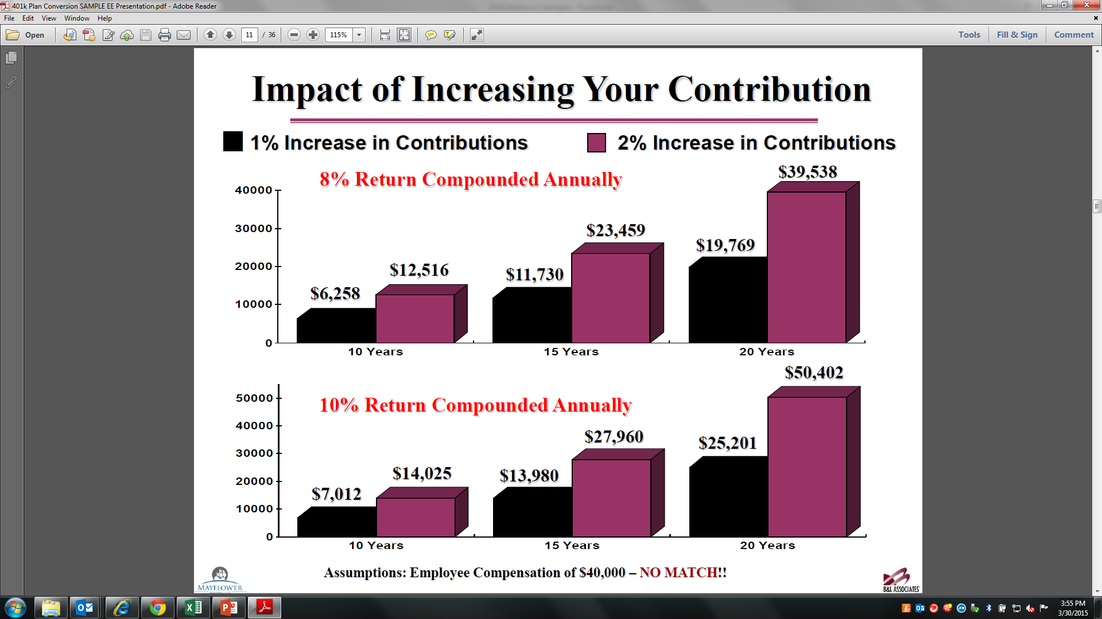
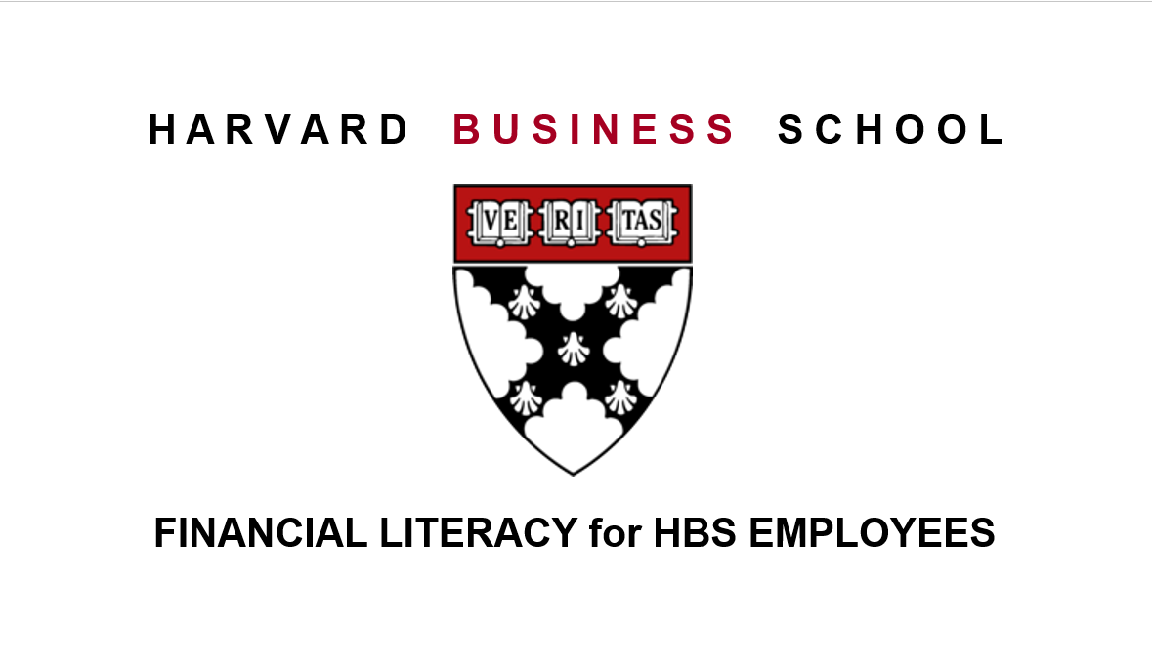
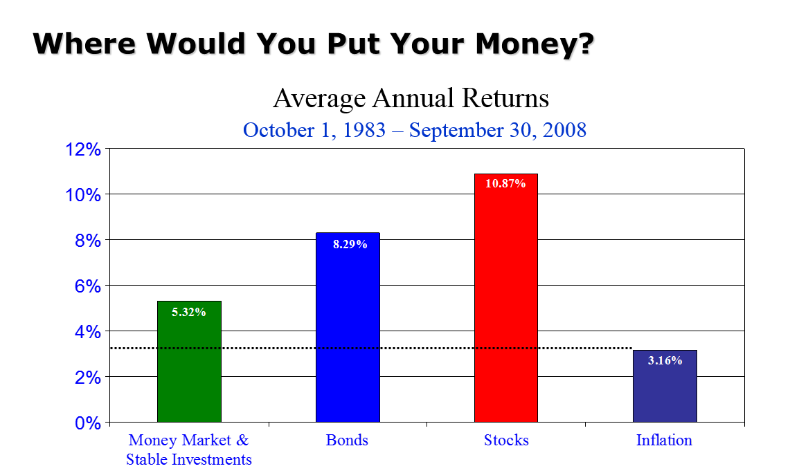
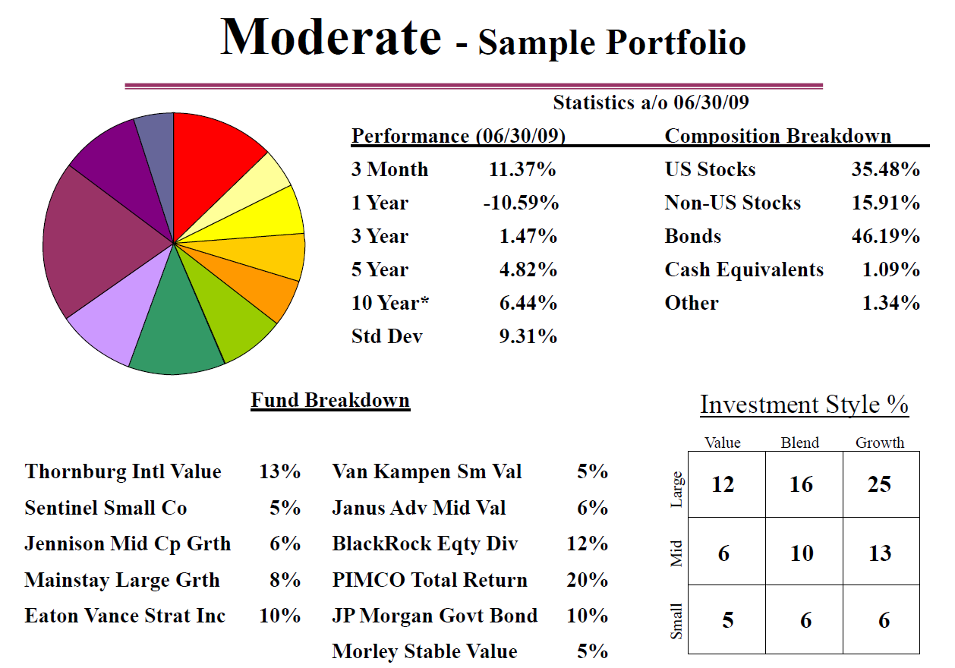
Employee Education Services

Slide 25
July 2, 2015 by:
Presentation of
Advisory Services
for
XXXXXX

