Slide 1


Energent
Enabling the Intelligent Use of Energy

Slide 2

Who We Are
EXPERT
ADVICE

Slide 3
Benefits of Energy Management
EXPERT
ADVICE

Slide 4


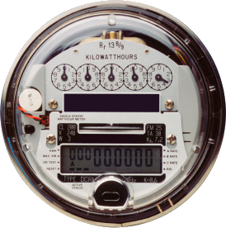





EMIS
Analytics Engine

Slide 5
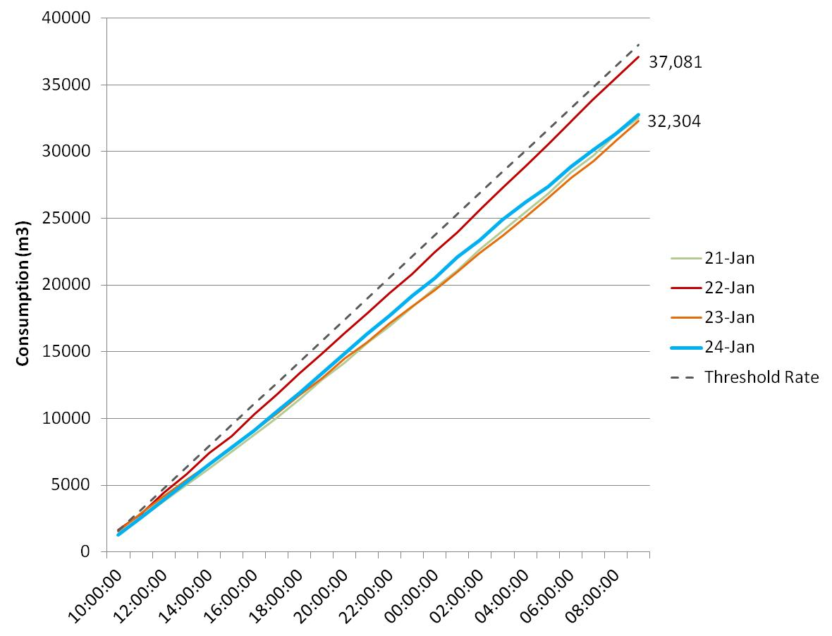
Threshold Management
Real-time monitoring to ensures the natural gas daily threshold is not attained, or additional fees are incurred.
January 22nd 2013, warned of a potential crossing of this threshold and set points were adjusted. The threshold was successfully avoided.
Now have a better understanding of these events and can better prepare/warn staff.

Slide 6
Case Study 2

Slide 7
Case Study 3

Slide 8
Case Study 4

Slide 9
Energy Hub Management System
“Enabling customers to participate in creating a smarter grid”
Partners
Results

Slide 10
MicroHub
Image/ Description

Slide 11
MacroHub
Image/ Description

