Slide 1
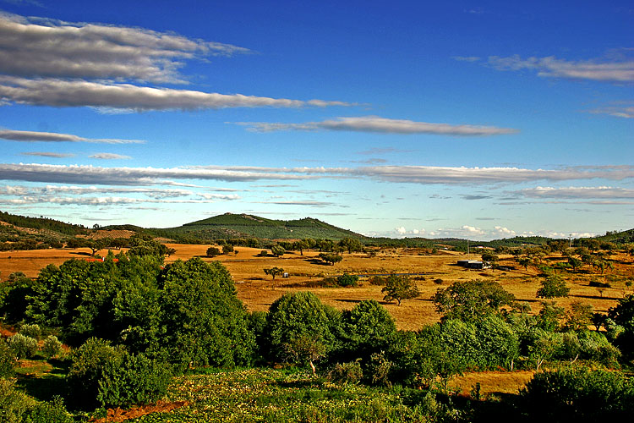
Photo 1

Slide 2
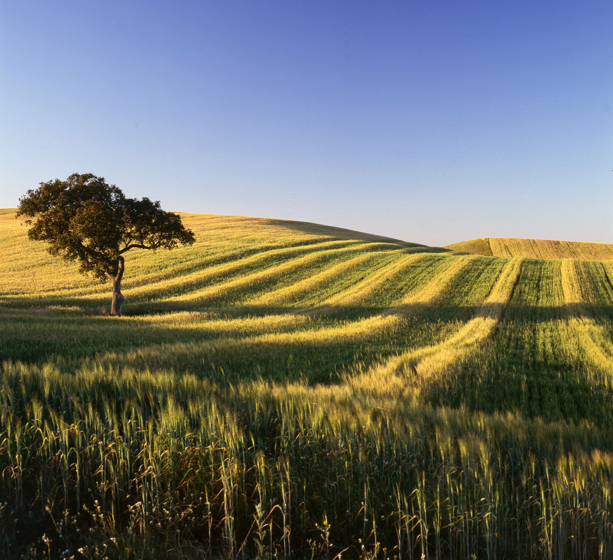
Photo 2

Slide 3
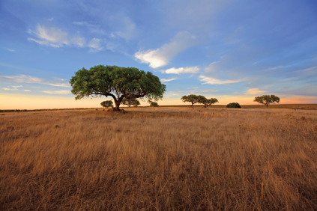
add Photo 2

Slide 4
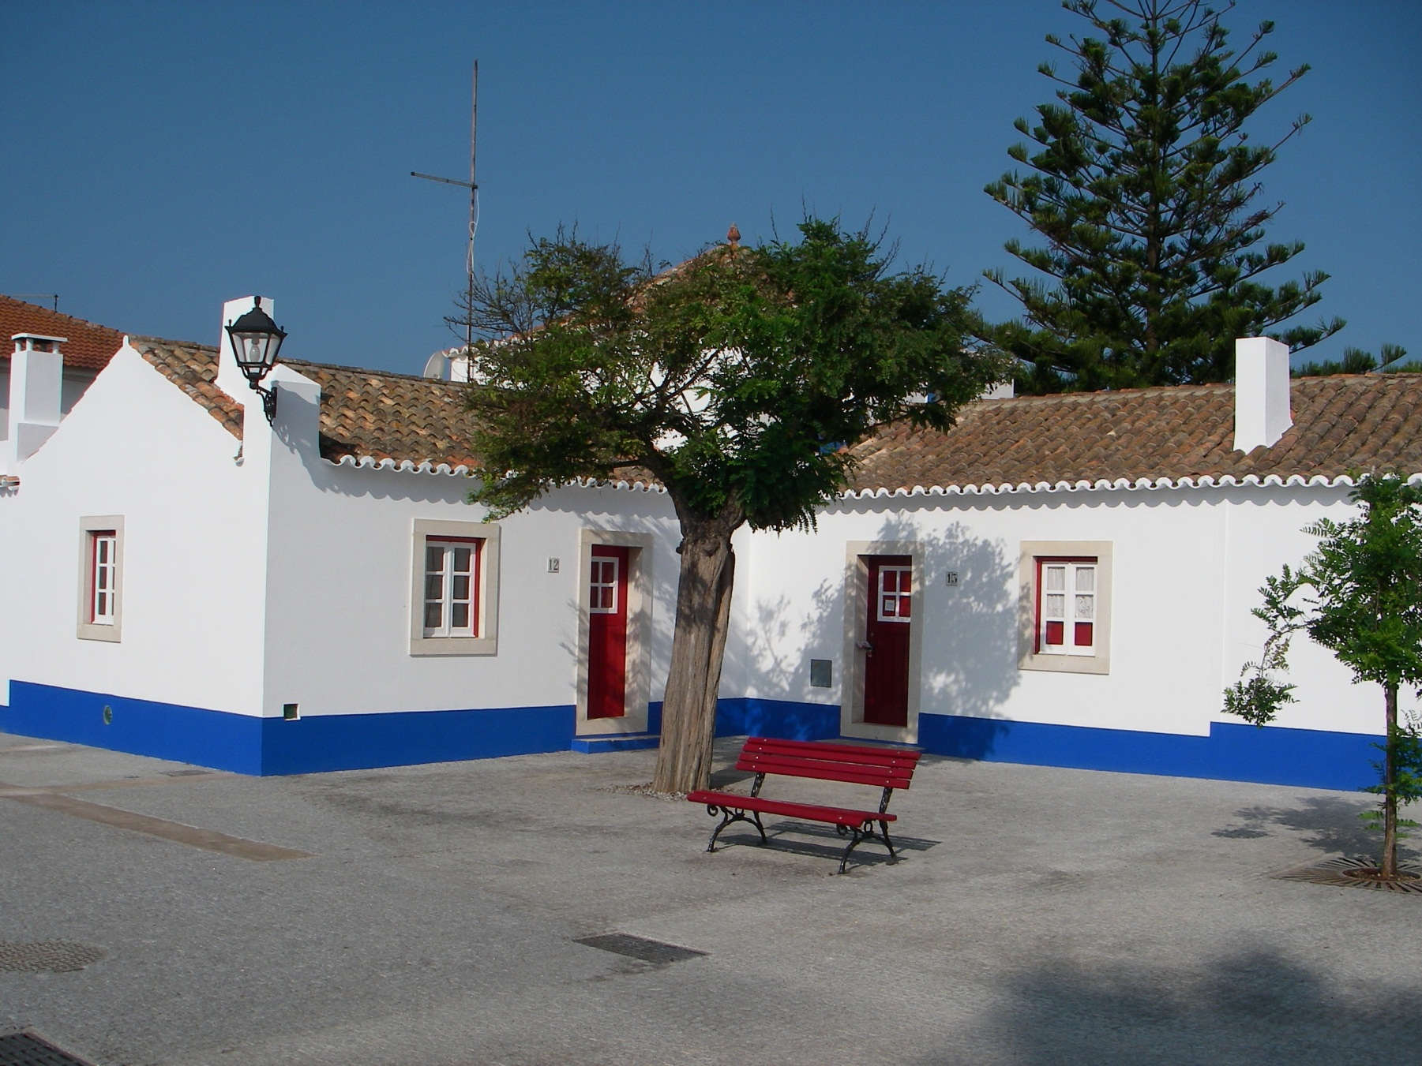
Photo 3

Slide 5



Sample logos nearby hotels

Slide 6
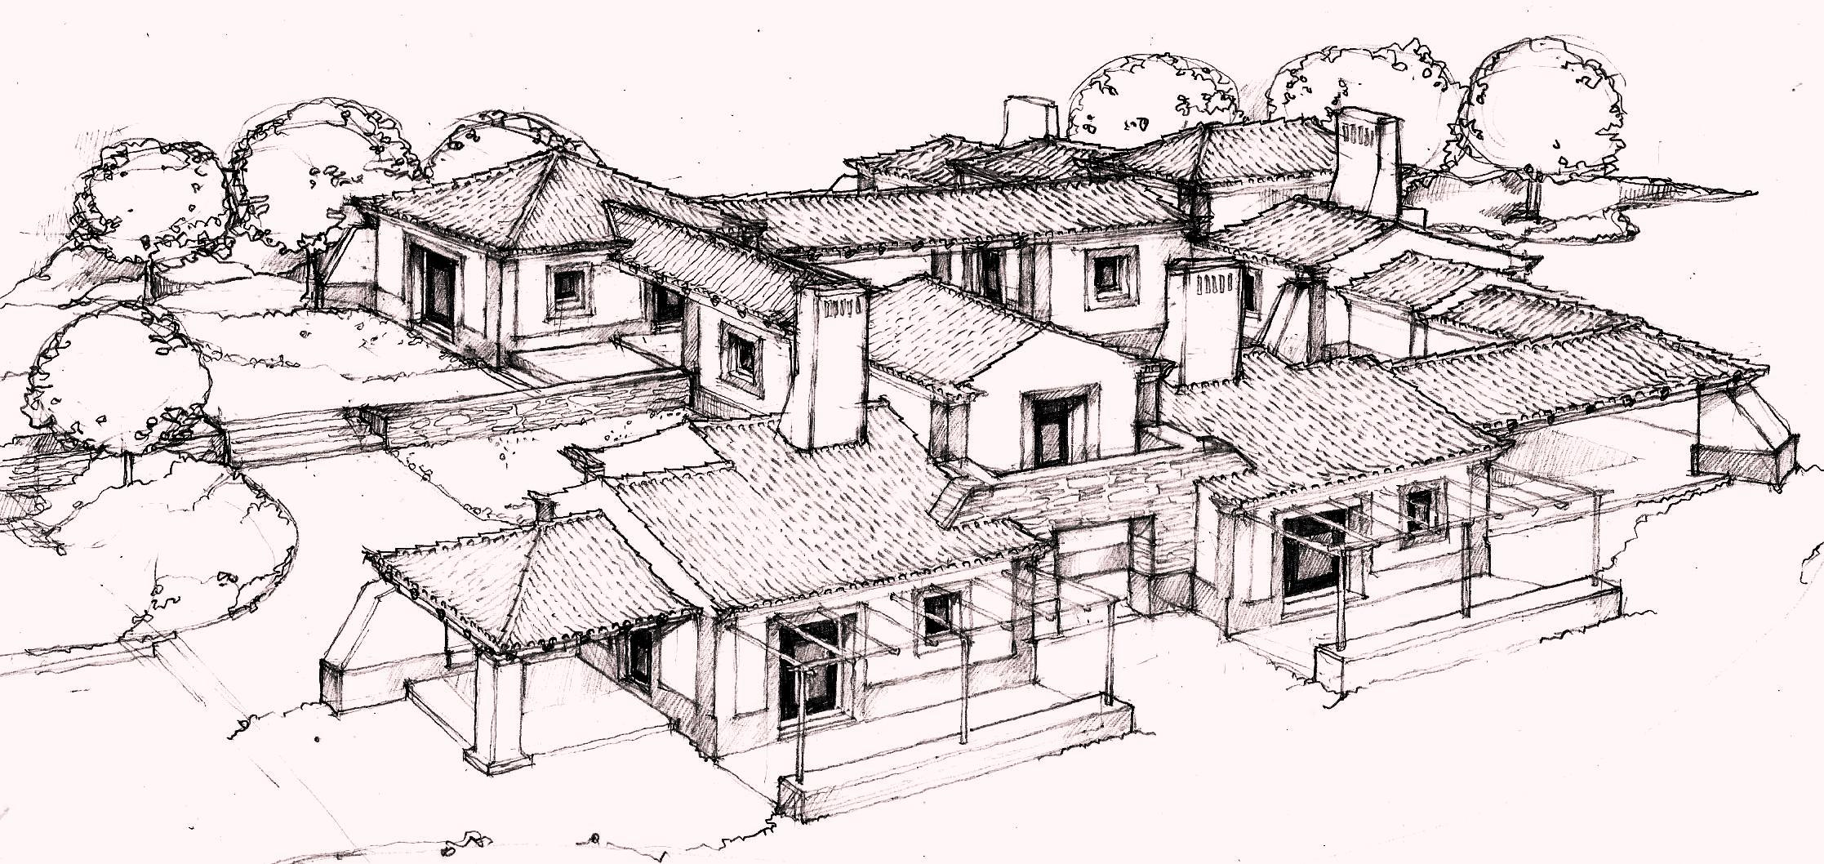
My Project Charcoal

