Slide 1
Thoughts for Vadym …
… and all of you!

Slide 2
General comments

Slide 3
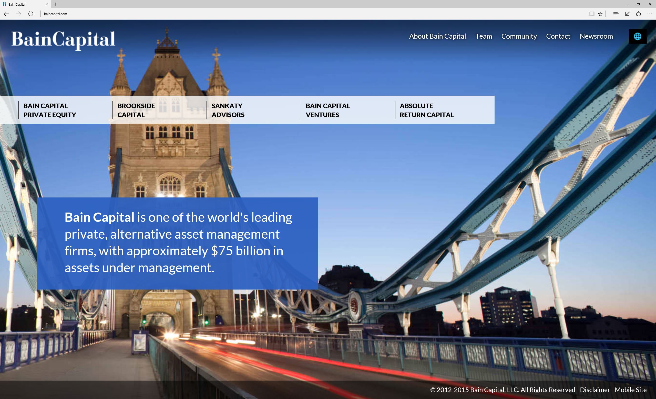
Our logo is colourful and does not look good on all backgrounds
Two menus:
NO!
But the menu is cool

Slide 4

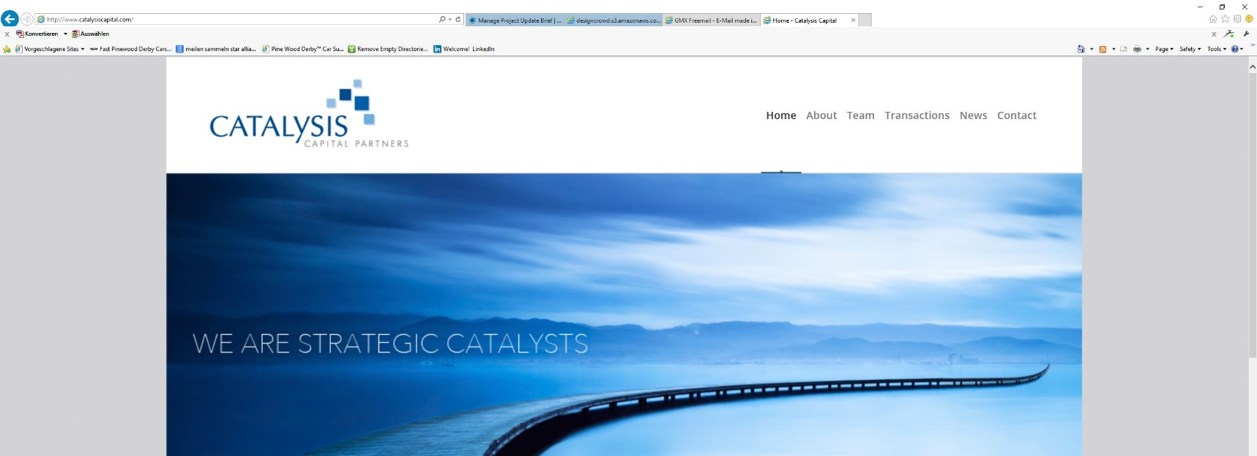
A white or black or grey (might be best) top navigation area
with room for the logo and no color problems would work for us.
I like that you can see where in the
menu you are. We can use the star for this.

Slide 5
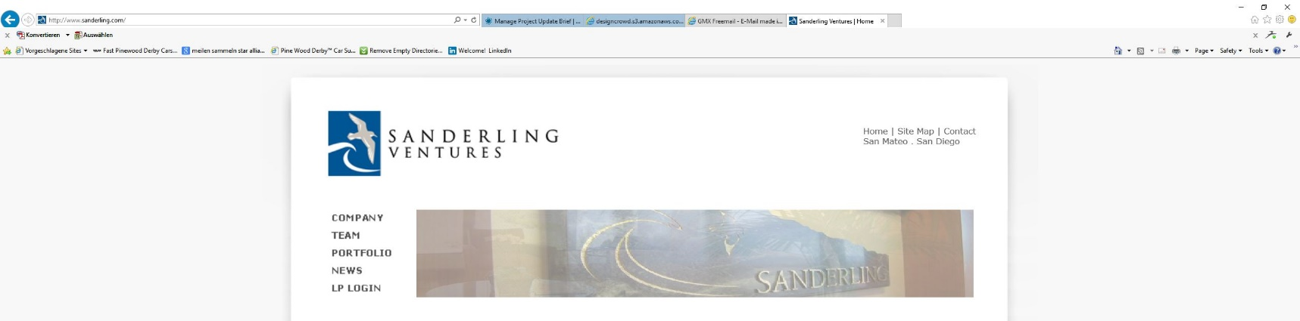
This is a big waste of space BUT we can the logo room and can
show the Swiss address which may be important
Here we can show the Swiss address
– but we don’t need two navigations

Slide 6
Comments for Vadym

Slide 7
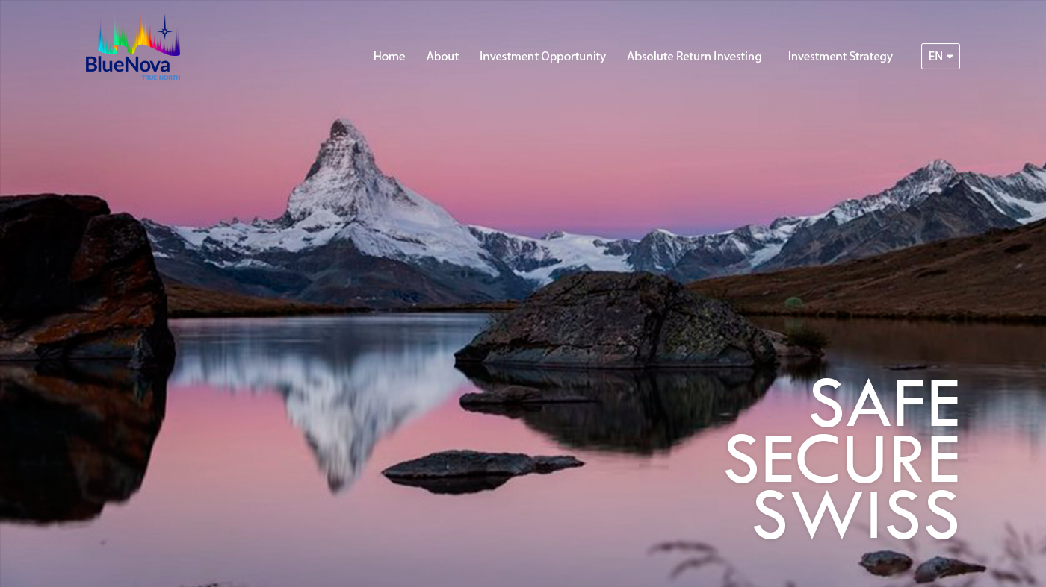
This is great!
But please let me tell you the little things?
Too much color, we need to have a neutral background under the logo and the menu items. And the logo should be a bit (maybe 20%?) bigger) .
Let’s keep these in blue according to color schedule and “Swiss” in white.
Horizon is
in the middle but this will change overall of a menu bar is added.
Take out this dirt

