Slide 1

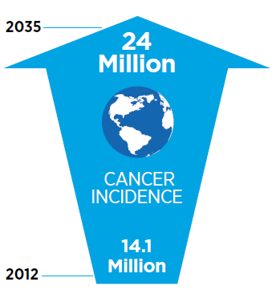

Cancer Outlook
Growing cancer incidence has
severe impact:
        On the patient
        On family and friends
        In the work place
        On increasing health care cost
        On the economy
Source: AACR Cancer Progress Report 2014

Slide 2

Aglaia Bridges the Gap
Availability
of
Break-through technologies
Demand
for
Innovative Products
Aglaia
Invests in discovery and early development
Know-how, experience and network to translate technology into products
Hands-on involvement
Universities & start-ups
Missing:
Drug development and business expertise
Capital
Pharma
Missing:
Access to early stage technologies
R&D collaborations with universities

Slide 3
Best Practices and lessons learned
Best practices
Lessons learned
Hands-on approach
Focus on what you know: oncology
Active role (strategy, studies, IP)
Obtain substantial stake
No direct shareholding by the
research institute
Build investment consortia as
early as possible
Reserve larger portion for
follow-on investments
Start business development
process asap
Attract management earlier
Install SAB at day one

Slide 4

Aglaia pursues impact
Improve Quality of Life of cancer patients
Improve life expectancy of cancer patients
Early access to experimental medicine
Impact large patient population
Ensure long term economic sustainability

