Slide 1
Aglaia Biomedical Ventures
February, 2015

Slide 2


Aglaia Fund Overview
100% Focus on early stage oncology
Innovative Science with impact on future cancer treatment
Funds under management
    Aglaia Oncology Fund I
    Aglaia Oncology Seed Fund
    Aglaia Oncology Fund II
Preference for platform technologies but single assets possible
Majority investments in therapeutics, limited investments in diagnostics
Commitment of scientists and research institutes
Hands-on approach to company building

Slide 3





Portfolio Companies
Antibody Drug Conjugates (exit 2011)
Merus
Human Biclonics™ and Oligoclonics® Antibodies
Rationally designed, fully synthetic therapeutic vaccines against cancer and persistent viral infections
Innovative development of miRNA-based therapeutics for cancer
Oncolytic Replication Competent Agents (Rec. Adenoviruses)
New angiogenesis inhibitors for the treatment of solid cancers through targeting of tumor blood vessels

Slide 4
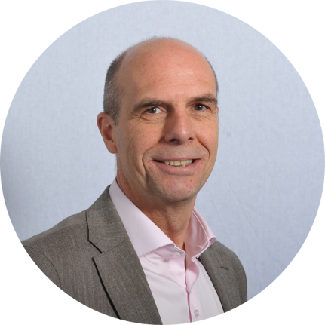
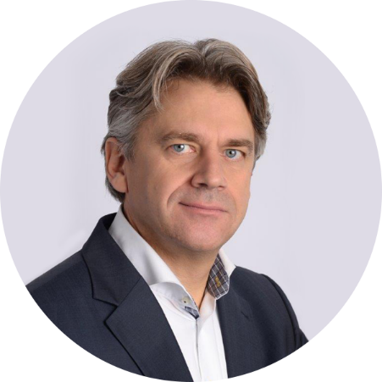
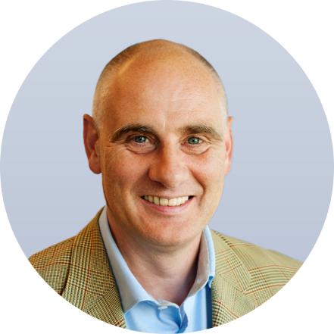

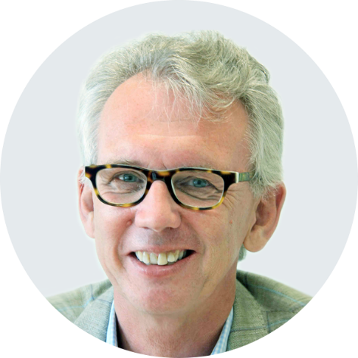
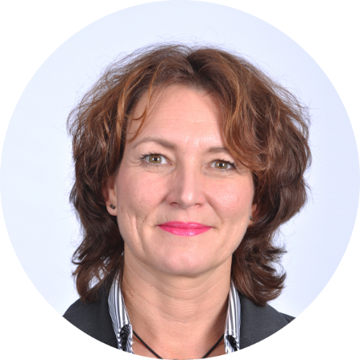
Team Fund Manager
Mark Krul
PhD, Partner
Karl Rothweiler
MBA, Partner
Eric van der Putten, BSc,
Senior Investment Manager
Ernst Geutjes, PhD, Business Analyst
Winald Gerritsen, MD,PhD, Venture Partner
Angelique Hermeling
Office Manager

Slide 5
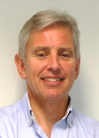

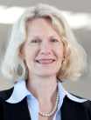

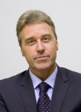

Strategy Board Aglaia
 | Alan Barge, CMO at ASLAN Pharmaceuticals. Oncology drug development experience. |  | David Kerr, Prof. of Cancer Medicine, Univ. of Oxford. Medical Oncology.
 | Gabriele Dallman, CEO of Pharmatching. Drug development and Regulatory Affairs. |  | Herman Spolders, Chairman and CEO of Pluriomics. Biotech and diagnostics entrepeneur
 | Stef van Doesburg, Managing Partner Greenfield Capital Partners. M&A, private equity. |  | Jan van de Winkel, CEO of Genmab. Biotech entrepreneur and immunologist.

Slide 6
Contact
Mark Krul, Partner
    krul@aglaia-biomedical.com
Karl Rothweiler, Partner
    kr@aglaia-biomedical.com
Eric van der Putten, Senior Investment Manager
    evdp@aglaia-biomedical.com
    www.aglaia-biomedical.com
    Bilthoven, Netherlands

Slide 7

Aglaia Oncology Fund
Improving the life of cancer patients

