Slide 1
TCSA’s Charter School Business Officer Certification (CSBOC)
www.csboc.org

Slide 2
What is TCSA’s CSBOC?
Charter Specific Training and Certification Program
Objective: Provide training to produce Texas knowledgeable Charter School Business Officers and Business Office staff.
Certifier: TCSA is the governing body that commences the designation of all Charter School Business Officer Certification.
Goal: All Charter School Business Officers obtain the status of efficient, stable, and fiscally sound business practices and well managed business functions of the Charter School.

Slide 3
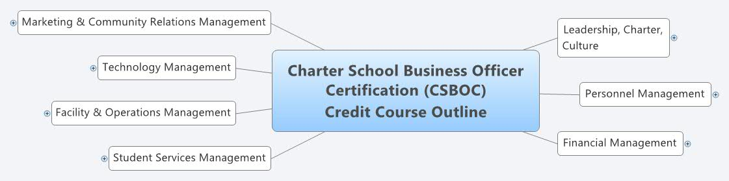
CSBOC Course Outline/Trainings
Focuses on 7 main areas of business officer responsibility
  Finance
  Facility
  Personnel
  Technology
  Leadership
  Marketing
  Student Services

Slide 4
Membership
Two Types of Membership Offered
  Individual- one member per charter
  Organizational- unlimited members per charter
Members Receive
  Opportunity to pursue a Charter School Busienss Officer Certification
  Reduced Pricing on Training
  Weekly Newsletter “Tuesday Tip” with compliance reminders, tips, tricks and how-to’s

Slide 5
Training
Open to everyone: member, non-member, business officer, superintendent, board member, etc.
Types of Courses
  Live Webinars
  Live Training Days- once a month throughout the state
  Documentation Workshops- opportunity to develop or review policies and procedures for your charter with expert advice and peer communication
  Online Courses- live trainings converted to online courses after the fact
Continuing Education for TEA, CPA and TASBO

Slide 6
For More Information
Visit our website: www.csboc.org
Email us! support@csboc.org
Looking forward to seeing you soon at one of our upcoming trainings

