Slide 1
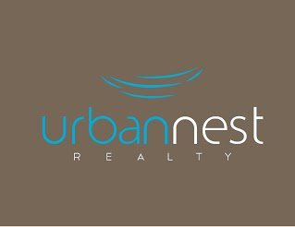
Nice stylised nest, not too complex.

Slide 2
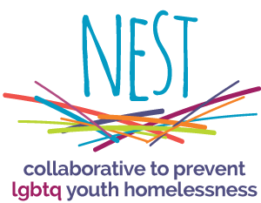
Font is not right, but having the ‘nest’ text IN the nest graphic and then the ‘Architectural Design’ beneath that might work. Nice stylised nest too. Don’t like that many colours though.

Slide 3
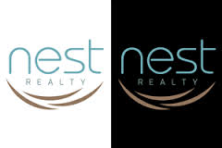
Nice and simple font, nice and simple stylised nest.

Slide 4
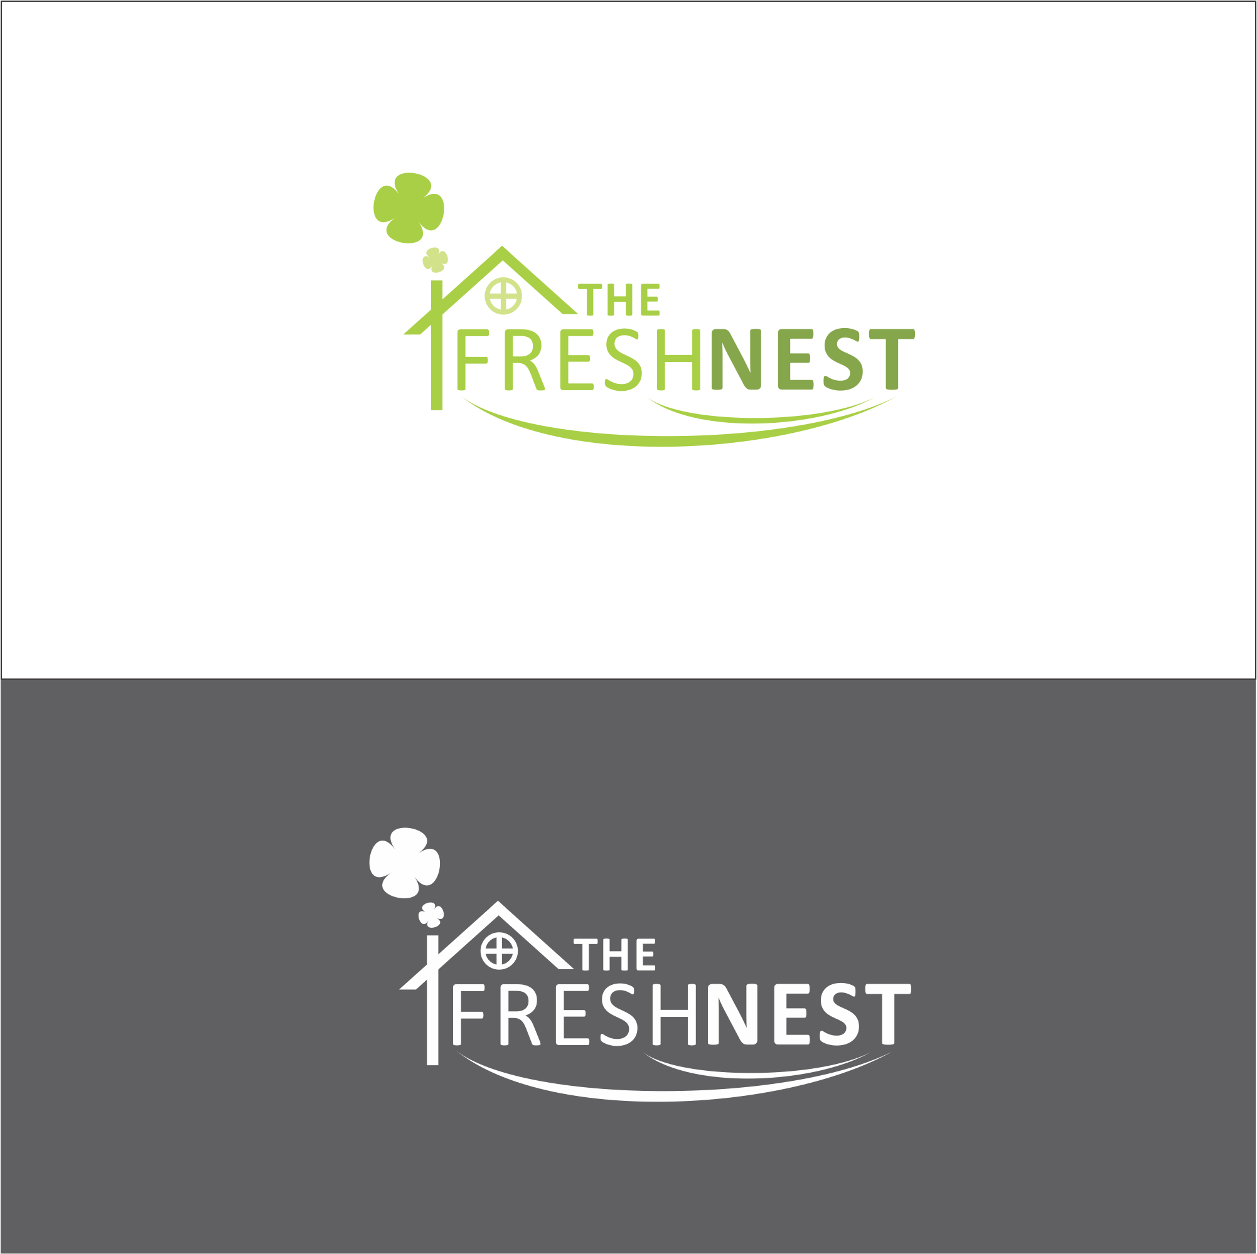
Nice idea, would need to be simplified (think the smoke coming from the chimney and the window are a bit unnecessary).

Slide 5

Having a bird with a twig (building it’s own nest) might work, rather than necessarily having a nest graphic.

Slide 6
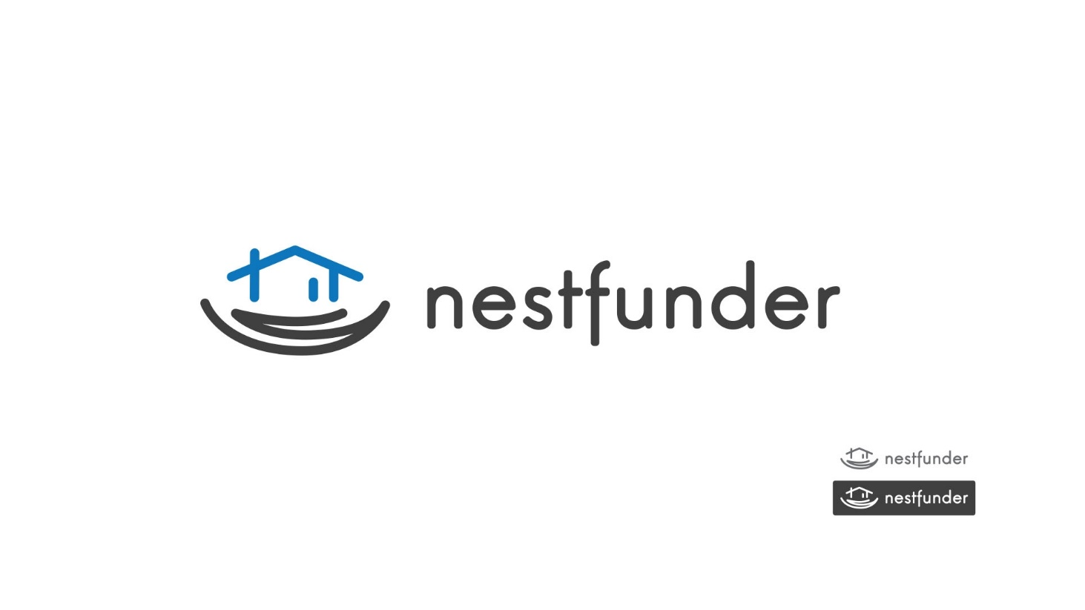
Nice and simple, not 100% right, but has appeal.

Slide 7
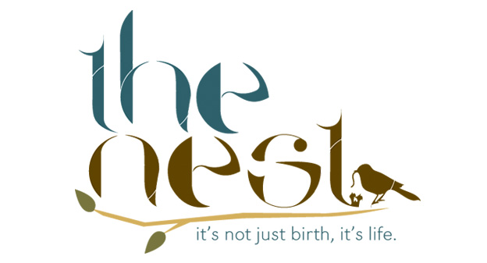
Font is not right, but the idea of having a branch under the ‘Nest’ with the ‘Architectural Design’ beneath the branch might work. Don’t necessarily need the bird and worm though as might be too complex?

Slide 8
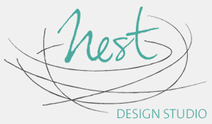
Nice stylised nest, not too complex. Font for ‘Nest’ is probably too ‘messy’. Does make me think of a design homeware store though, rather than a home designer.

