Slide 1

Your brand and your colours
1

Slide 2
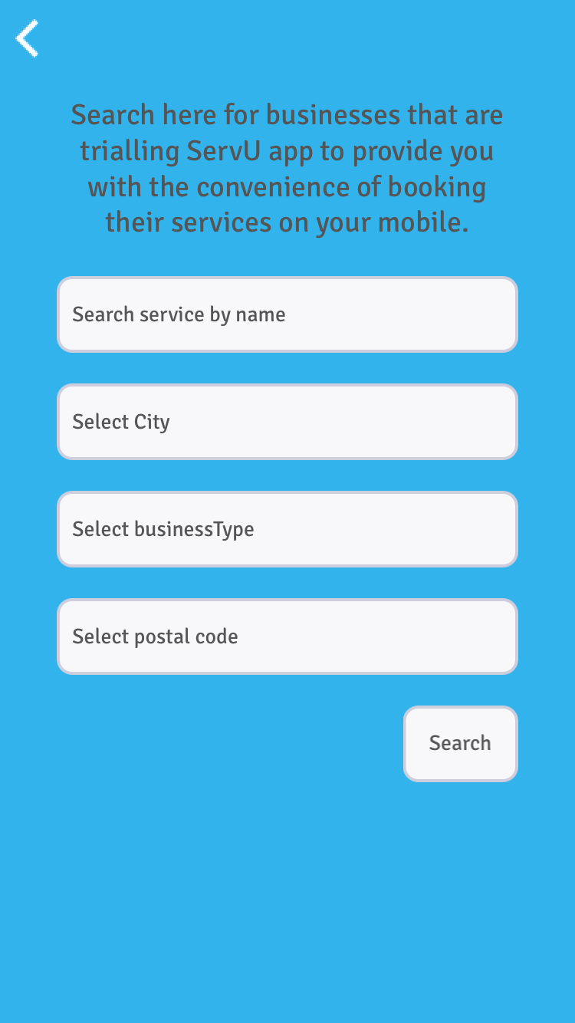
On Generic App, this selector will appear to enable users to select a vendor, who is currently trialing or is using a servU branded version of the app
2

Slide 3
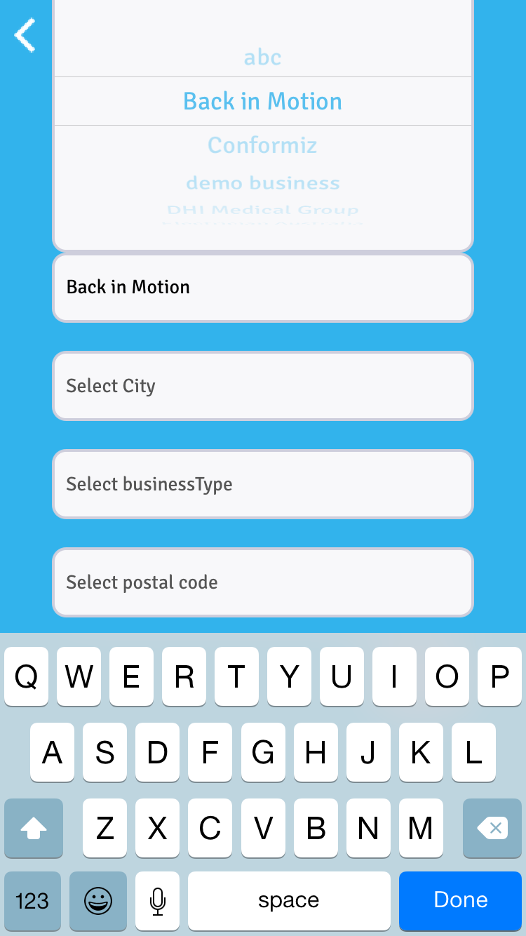
List of businesses can be searched here
3

Slide 4
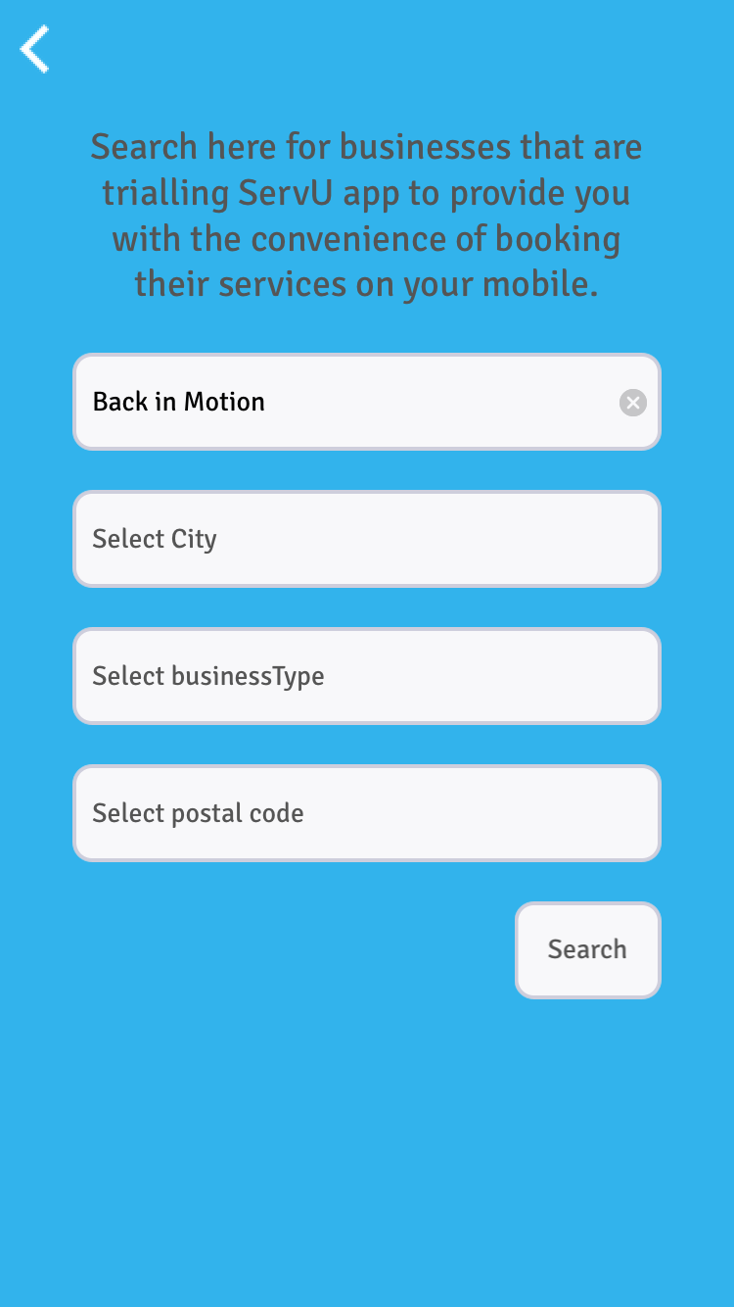
End user can also search for businesses based avaialble criteria
4

Slide 5
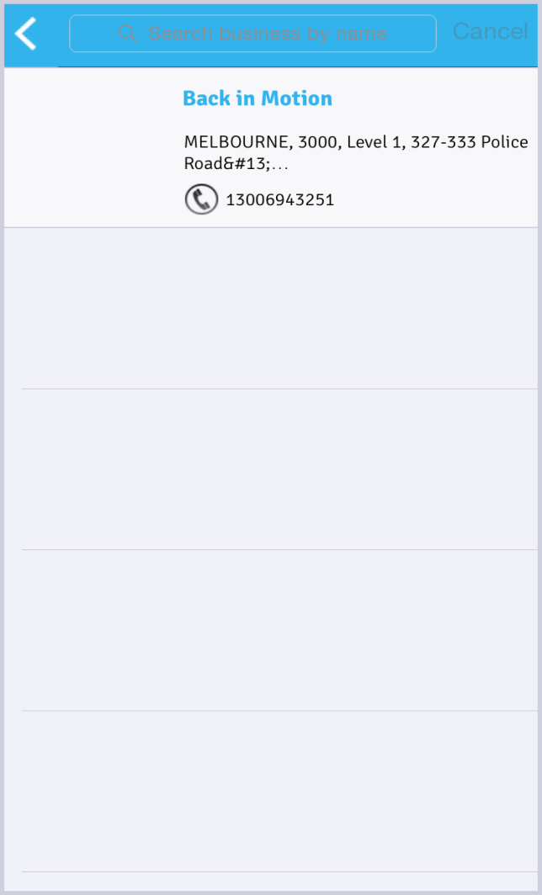
Search results for business appear here.
Selecting this business will provide details of the business
5

Slide 6
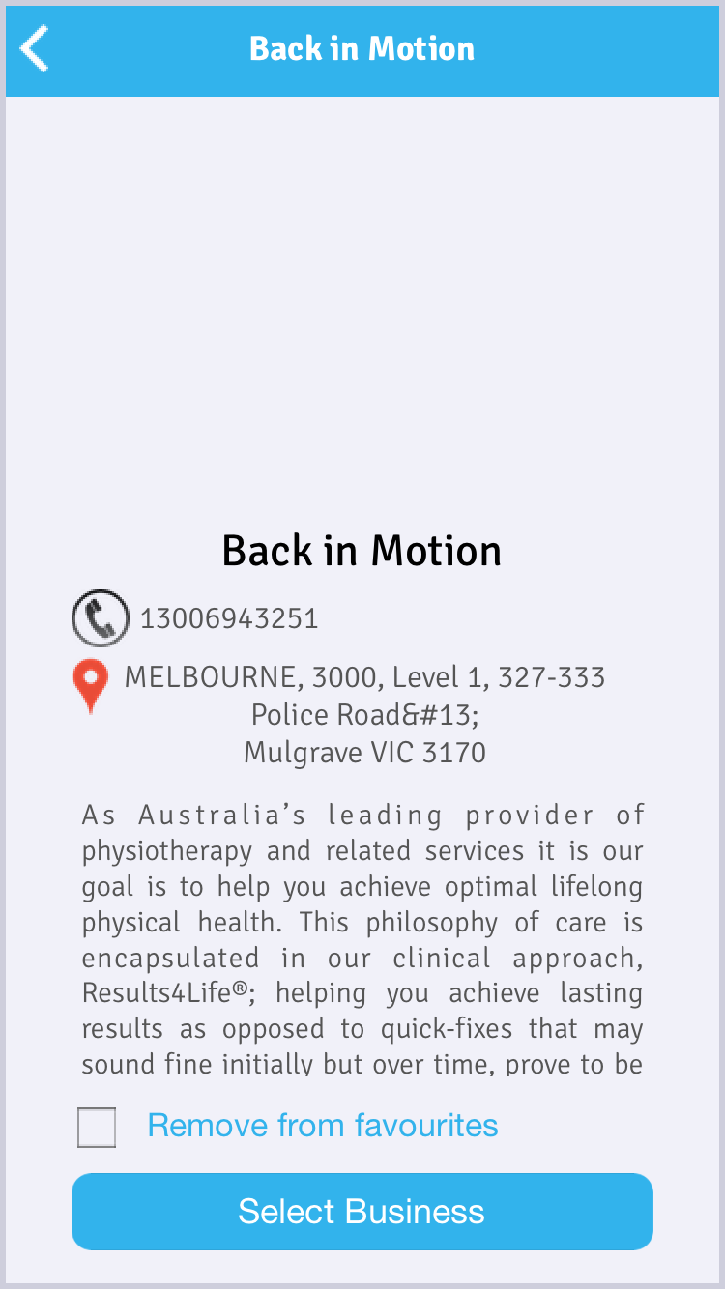
Users can save the business in their favourites
6

Slide 7
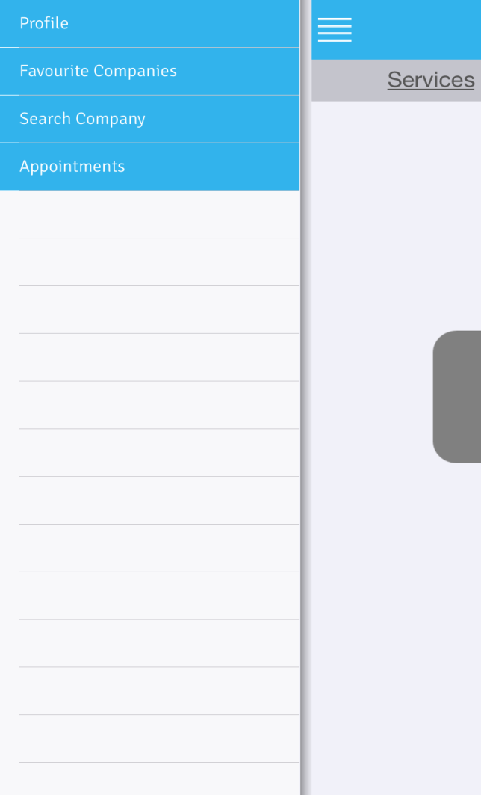
Menu bar options
7

Slide 8
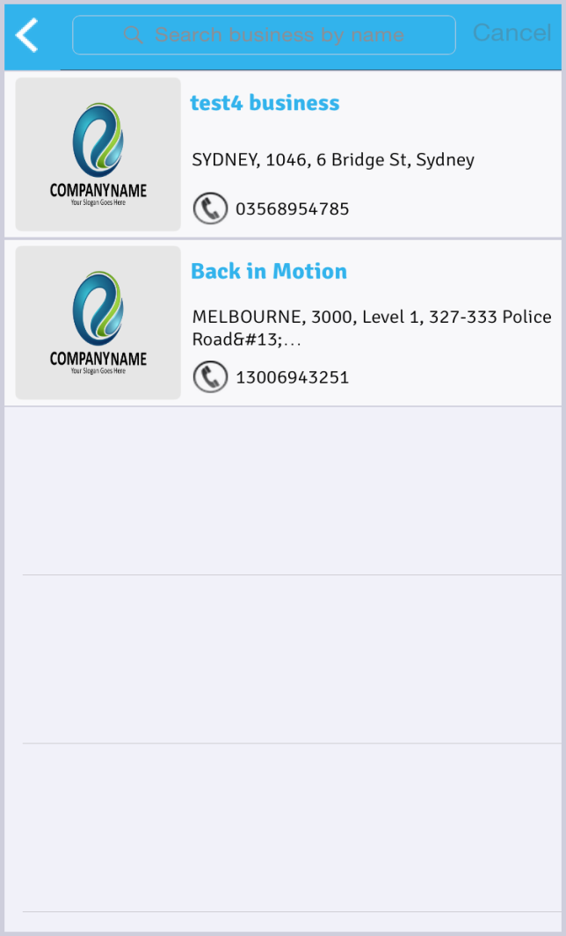
If there are other businesses (servu app subscribers) that the user uses, they can save them in their favourites.
Here are the businesses saved as favourites.
8

Slide 9
View My appointments on the app
9

Slide 10
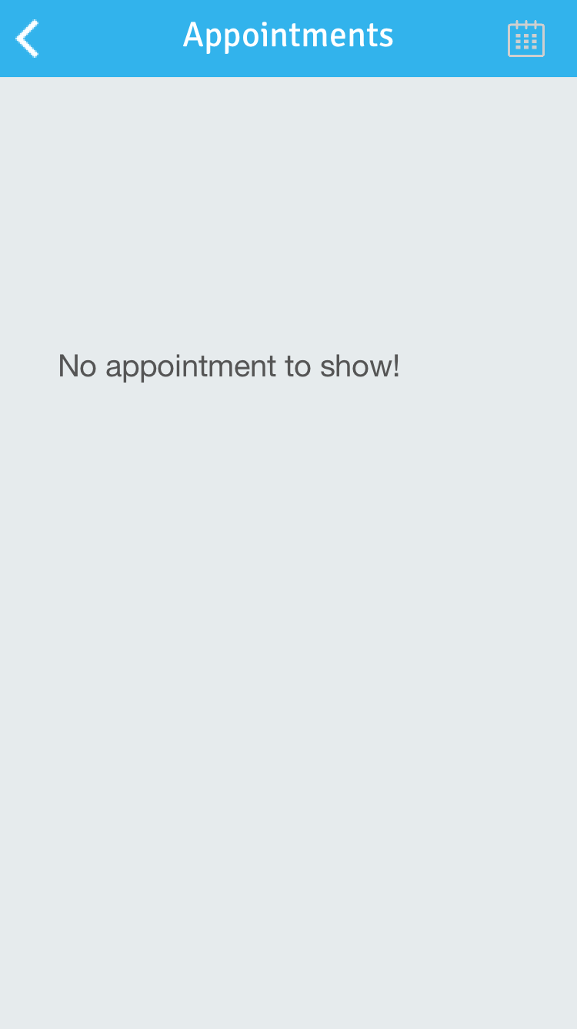
Appointments booked with businesses are listed here.
10

Slide 11
My Profile – created with my details.
These details are used to identify me to the businesses.
11

Slide 12
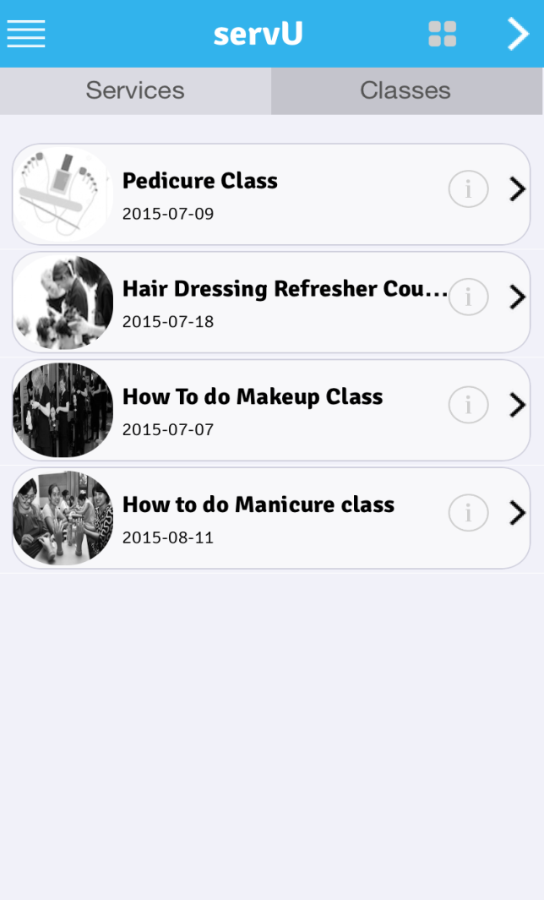
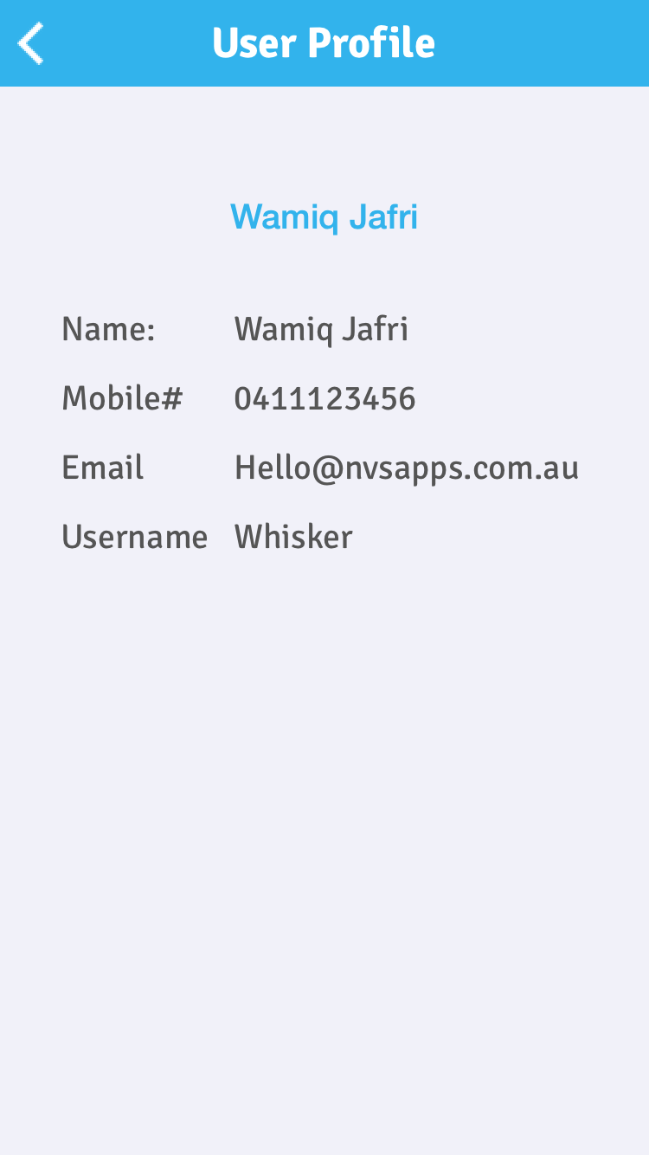
Your classes or sessions
12

Slide 13
Your classes or sessions
13

Slide 14
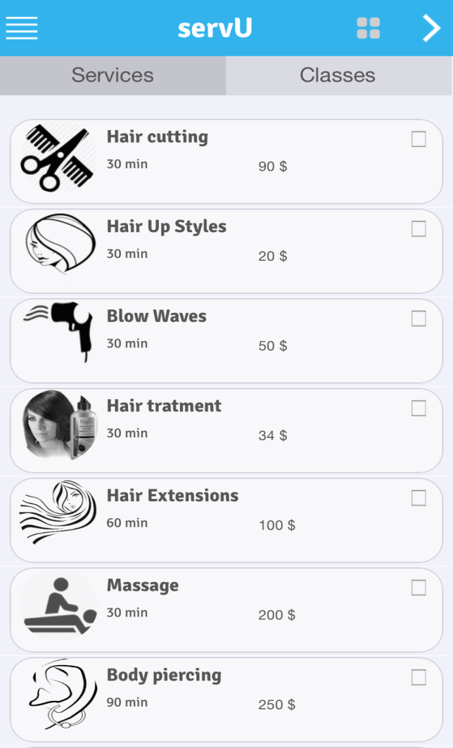
Your services
14

Slide 15
Booking is Easy on real-time calendar
15

Slide 16
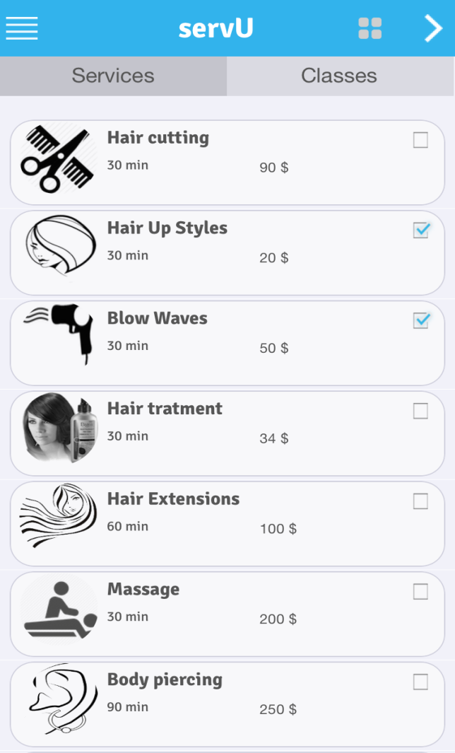
Select your services

Slide 17
Hit Next

Slide 18
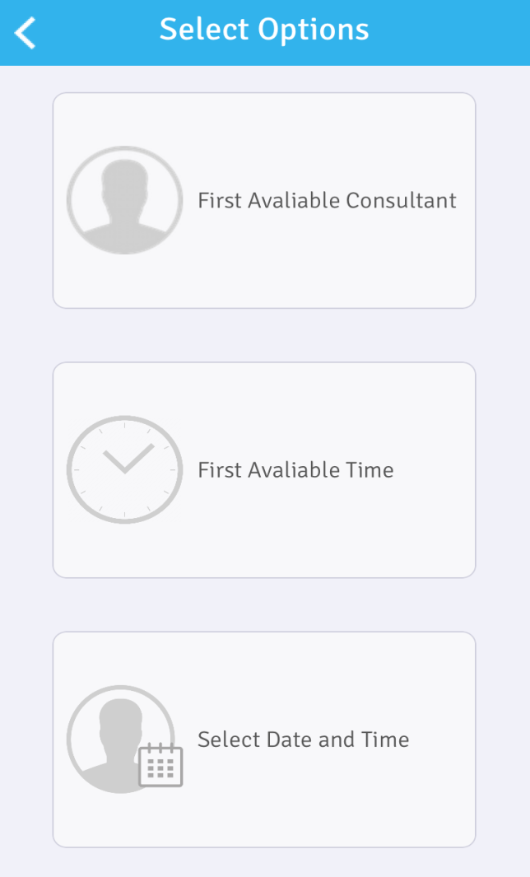
Select your preferred time
based on
  first available consultant
  first available consultant
  select a particular date,
  time and consultant

Slide 20
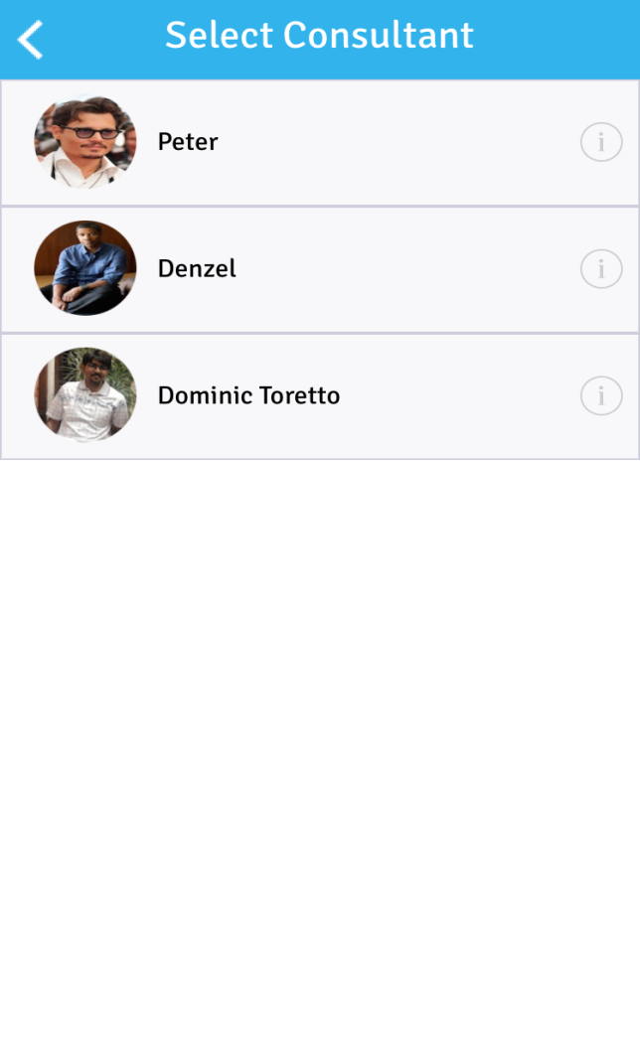
Based on your selected services, here are the available consultant

Slide 21
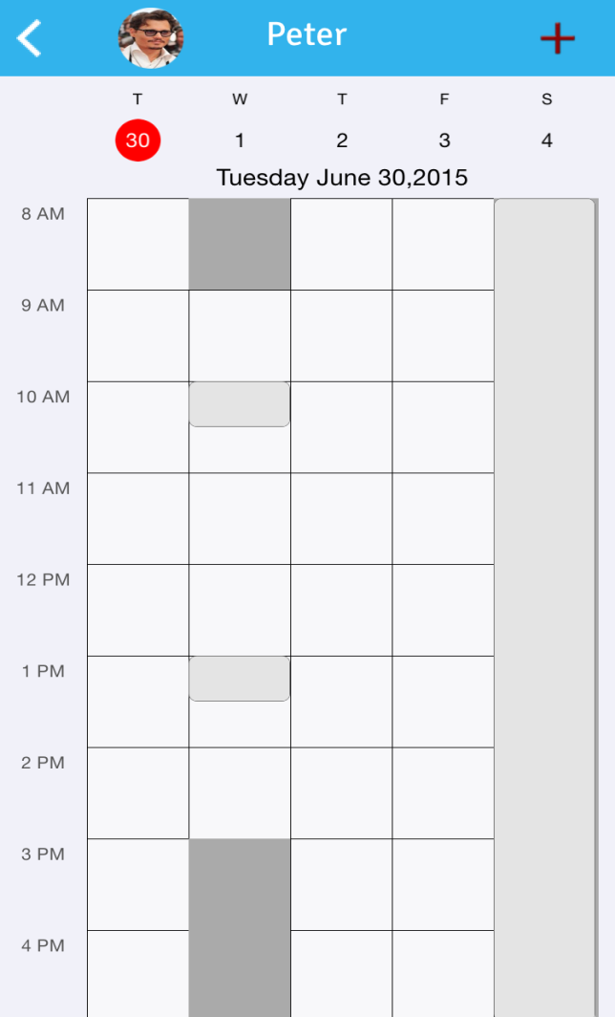
Click on the
light coloured area to book that time

Slide 22
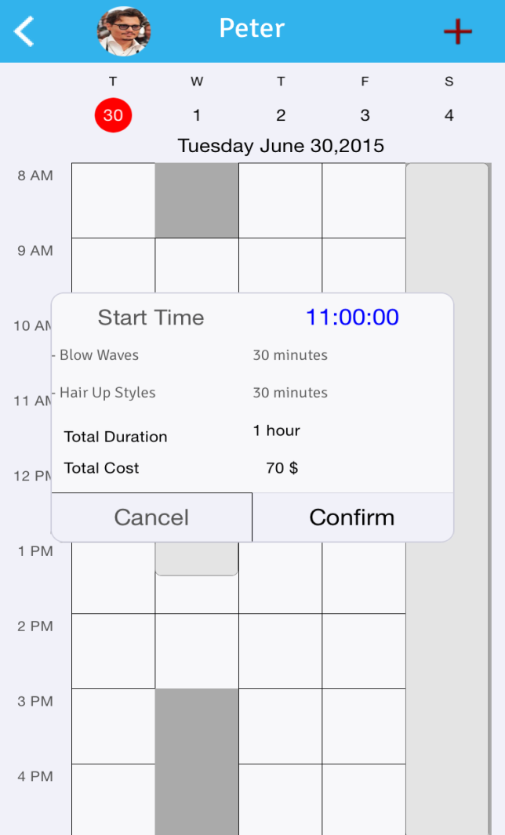
Time of the booking is based on the total length of services selected

Slide 23
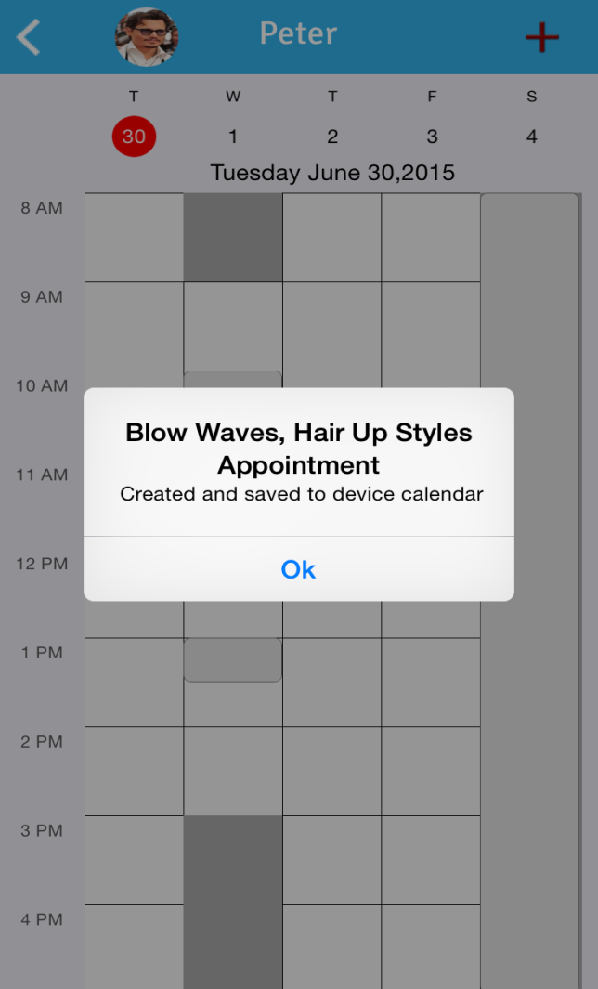

Slide 24
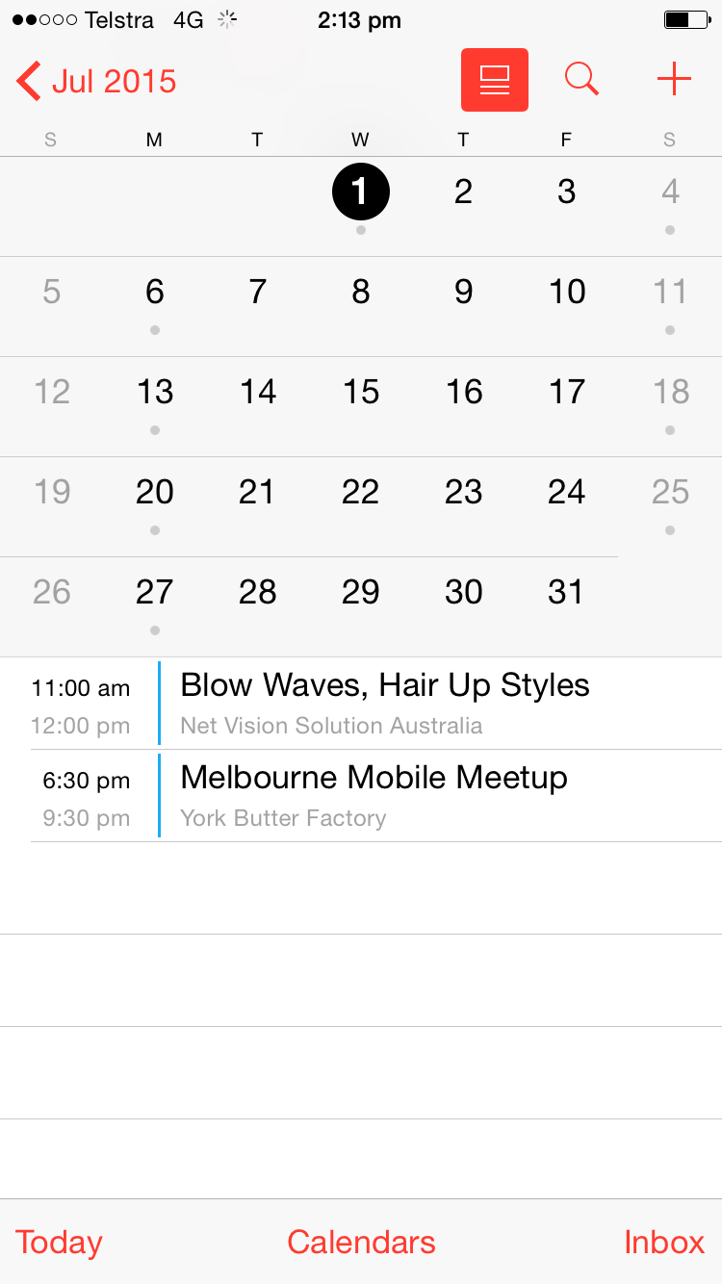
appointment is also booked on your device calendar

Slide 25
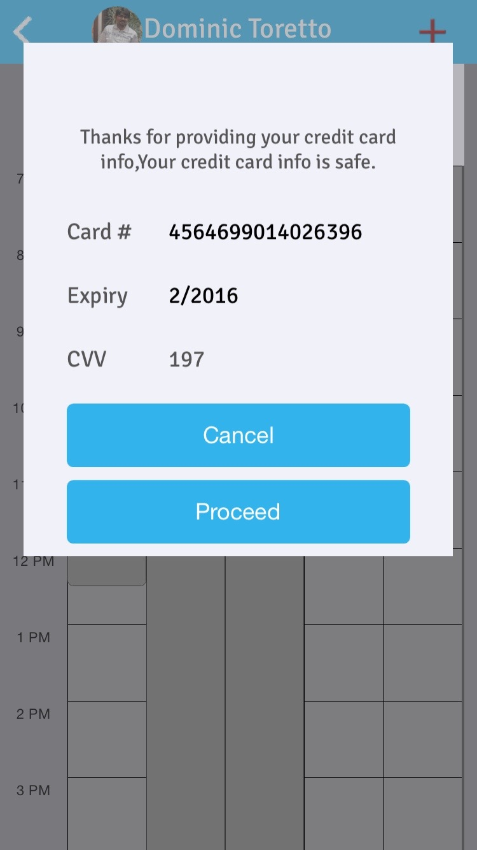
25

