Slide 1
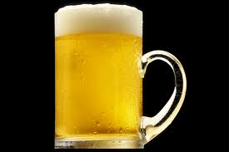
TRADIE THURSDAY
Kicks off June 2nd
Front bar prices
Live entertainment
Bar snacks
Boardroom bar access 3-9pm
Entry to main showroom after 9pm (Dress code applies)
LUCKY DRAW
3-9pm
@ Bar 20
*Every Hour*
Win...
VIP Memberships, Entertainment Vouchers
and more!
46 King St, Melbourne  9629 6484  www.bar20.com.au  Sexually explicit material may offend. 18+ only.

Slide 2


46 King St, Melbourne

