Slide 1
Logo Design Moodboard
Rocking Horse Photography

Slide 2
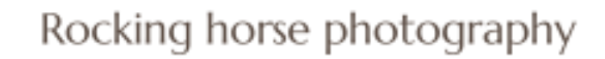
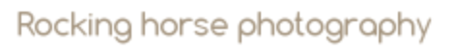
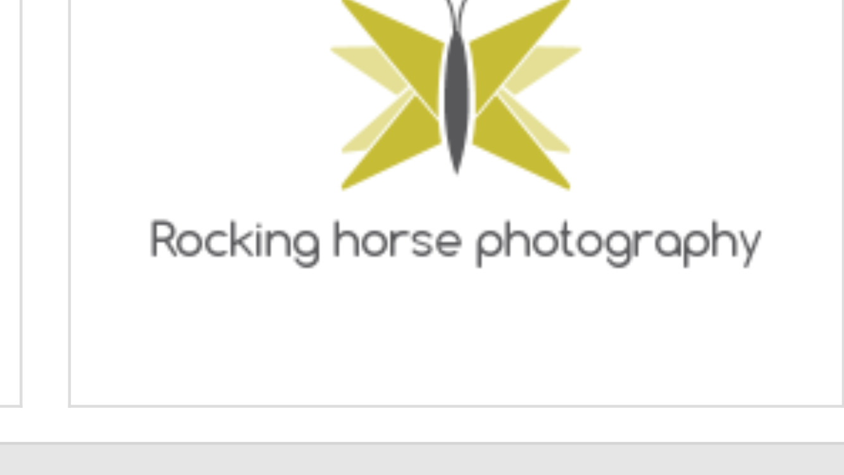
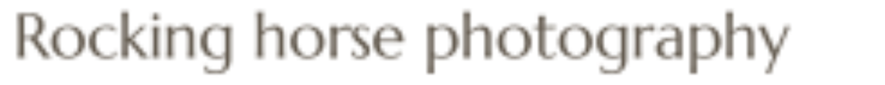
Typographic Styles
I like sans serif fonts.
I would like a font that is friendly and approachable, even slightly childish to communicate that the company takes photos of families, babies, children etc, but it still needs an air of professionalism. The font needs to be unisex in appeal.
I would like a font that I can load into Word / Powerpoint / in web editors etc, as well as being able to create a png / jpg of the words I need
The font needs to be legible in both upper and lower case (although I will keep most branding and use in sentence case).
Examples of plainer sans serif fonts I like the look of:

Slide 3
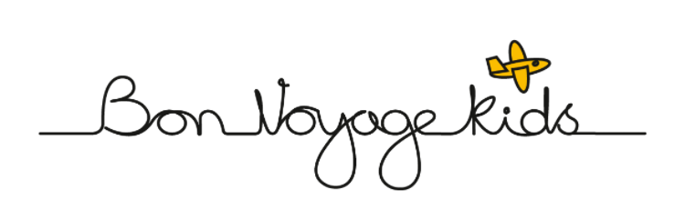
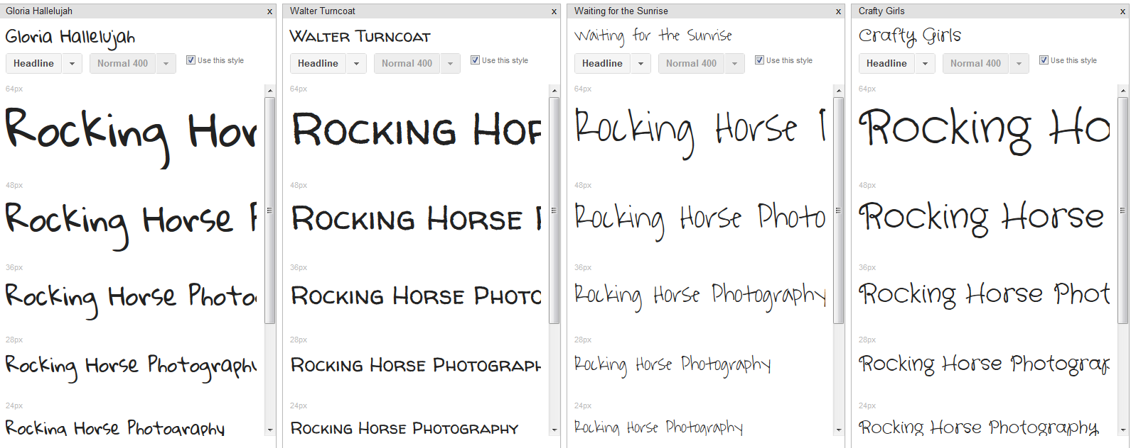
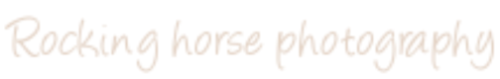
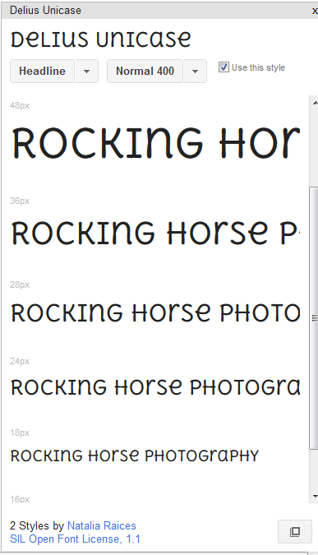
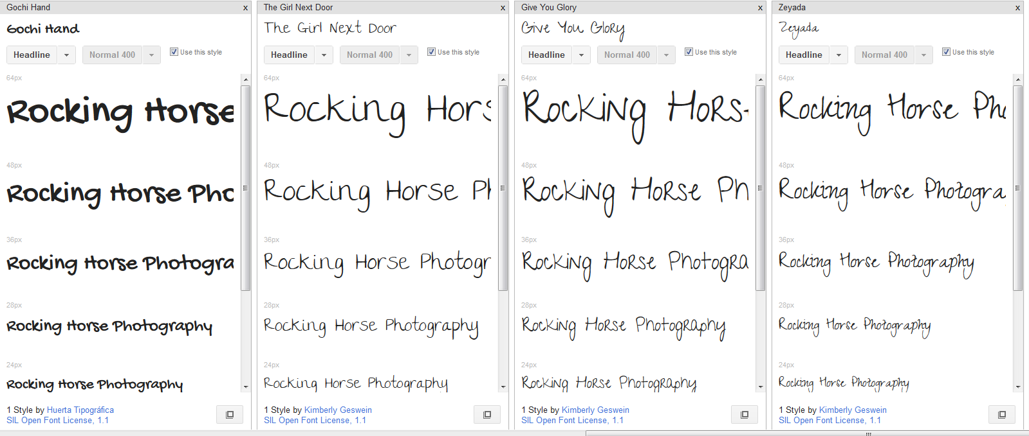


Typographic Styles Cont.
I particularly like the font used for “Bon Voyage Kids” above. I like that the straight line could be extended to act as a divider / header on letter head, business cards etc, but need to see whether that style would work when overlaid onto a photo
Examples of handwriting style fonts I like the look of:

Slide 4
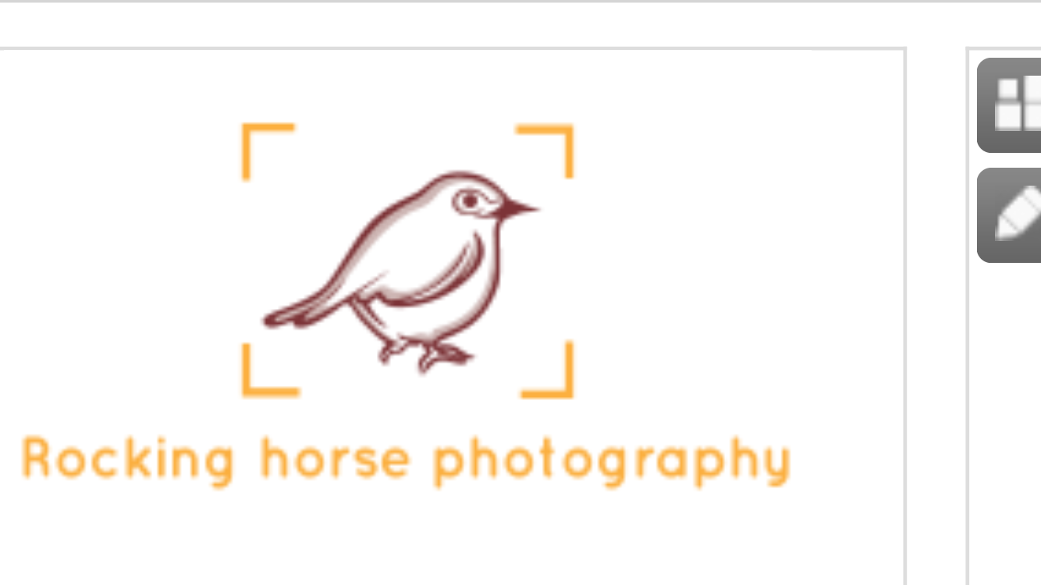
Photography Visual References
I like the photo corners effect – gives a nod to photography without being overt, could help create an outline for the logo so it has distinct edges and can be more easily placed on a photographic background e.g. see right…

Slide 5
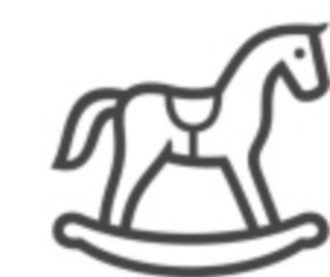
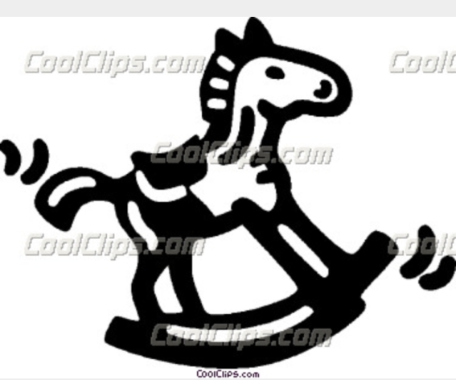
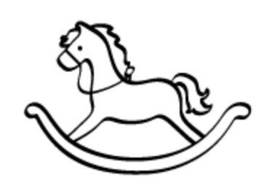
Illustrative Style – too simple

Slide 6
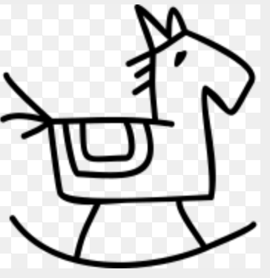
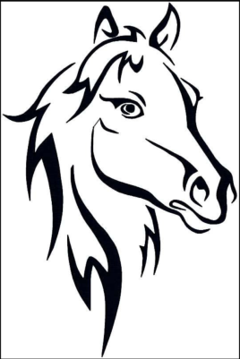
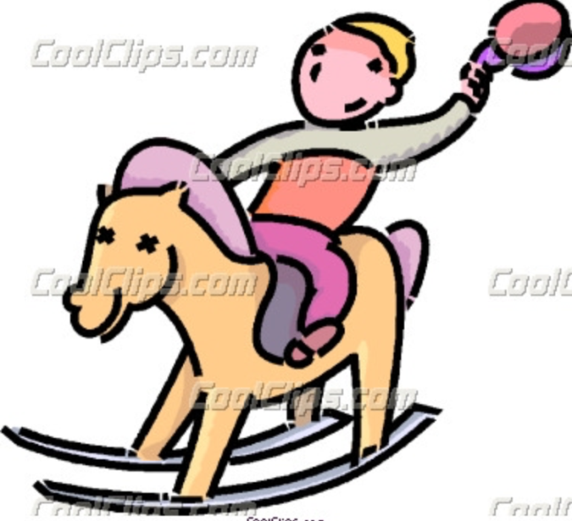
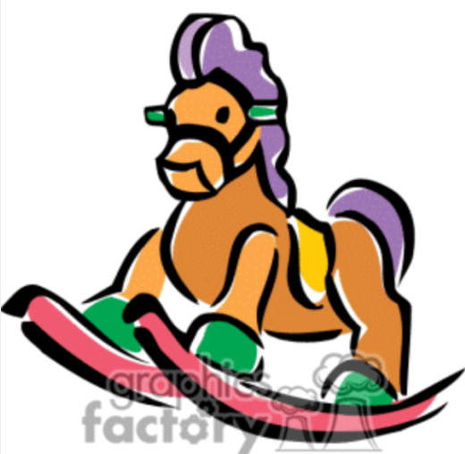
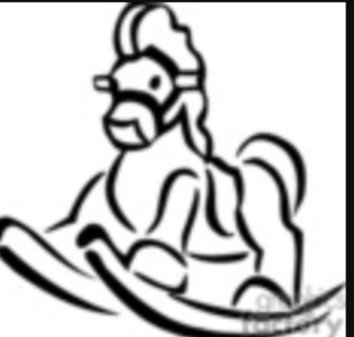
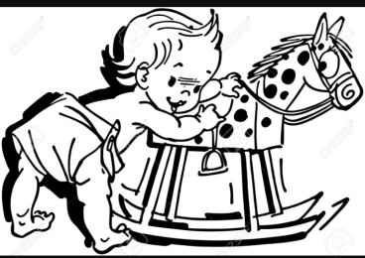
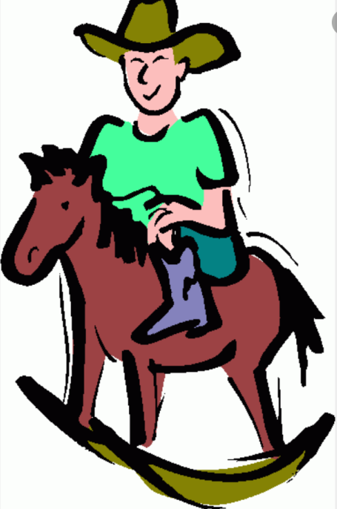
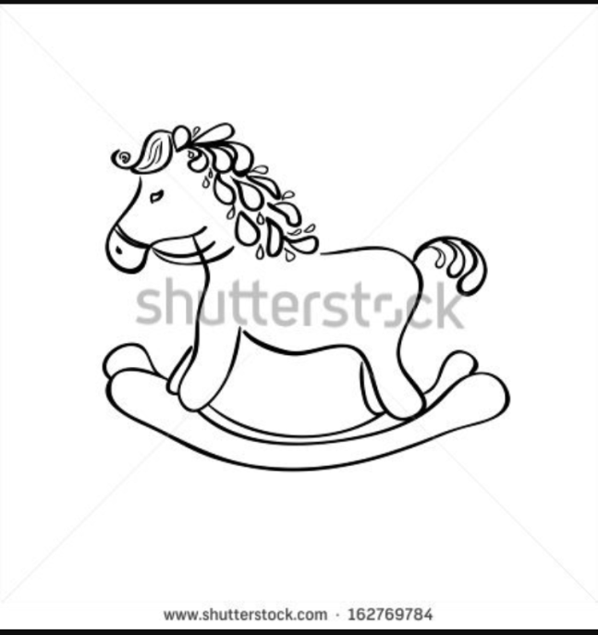
Illustrative Style - Good
I like the idea of a hand-drawn rocking horse, but ideally the side profile (so not twisted to the side as some of these are, though I am open to suggestions on this topic)
Colour ways need to be simple, unisex and work as single colour and black and white graphic too

Slide 7
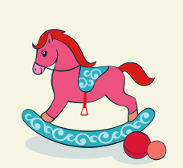



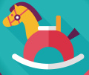


Graphic Style - Good
Like the simple block design of these three, particularly the blue version. Some specifics – would like the tail up more (happier look) and head not down in a regal way, but more facing forwards, - more approachable looking
Like the design of al four of these, albeit all are slightly too complex:
Top left – too much detail in pattern, stirrup eyes, nose/mouth area
Top right – would be better without stirrup
Bottom left – don’t like seat and perhaps a little too angular in places, may need offsetting with type
Bottom right – too much pattern and detail but otherwise OK

Slide 8
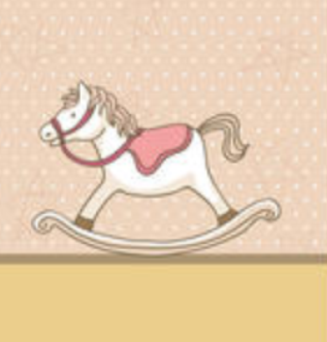
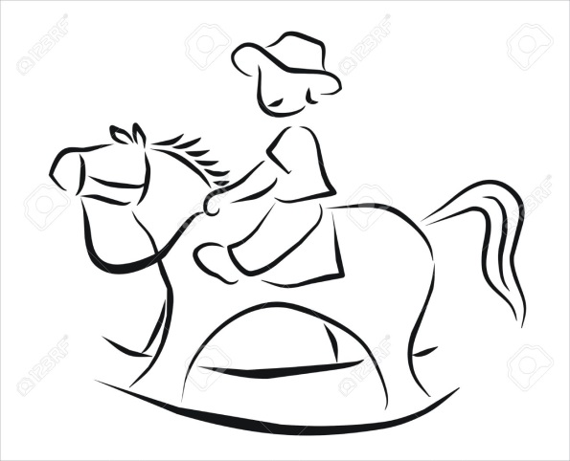
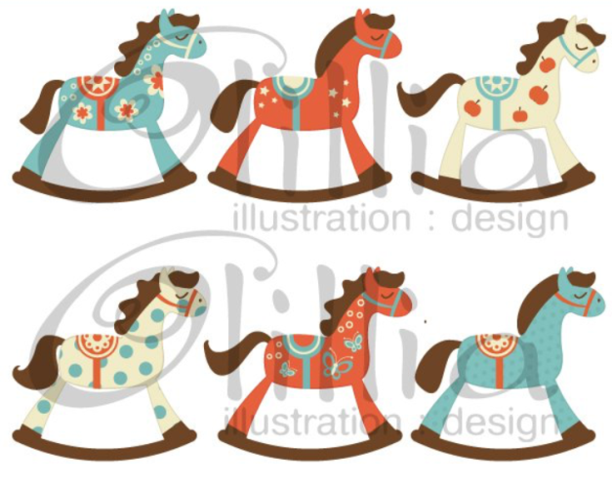
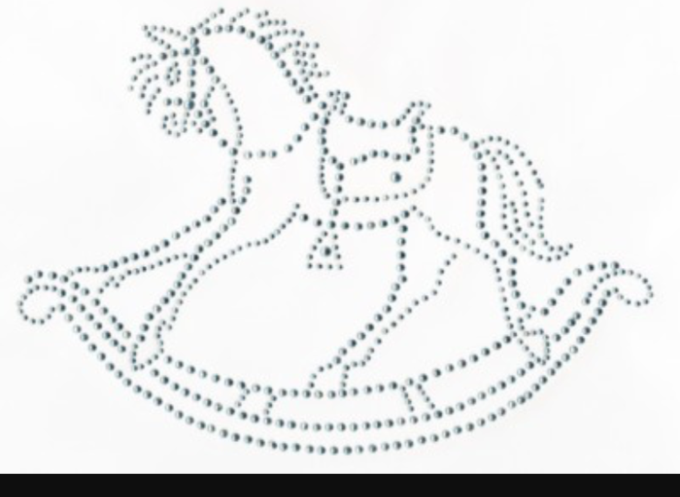
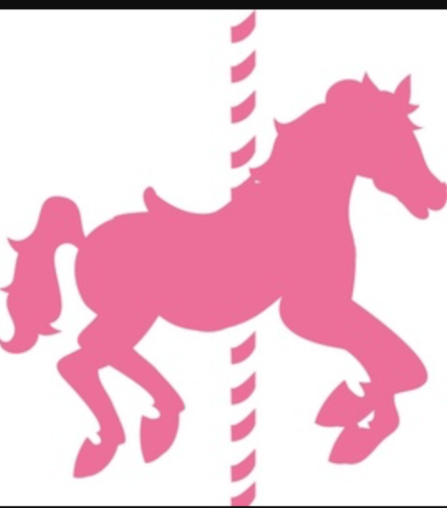
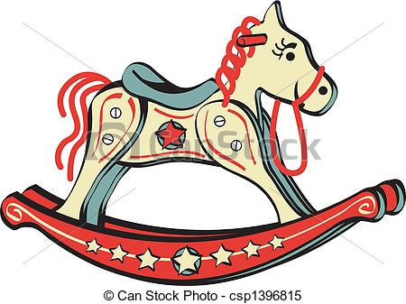
Style – unsure
(There’s something I like, but can’t see how to make them work)
Like the shape/outline – but might be too complex as a logo especially when small, don’t like the hair, too detailed
Too freehand – how would we colour it in?
Like the simplicity of colour / patter on the more simple ones (bottom right, top middle) but don’t like how cartoony the horses are – too “curved” on all the edges
Like the shape/outline – but might be a tad too complex as a logo especially when small
Like it, but it is not quite a rocking horse, like the introduction of pattern without too much colour or it being too busy
Like the shape/outline – but might be too complex as a logo especially when small

Slide 9
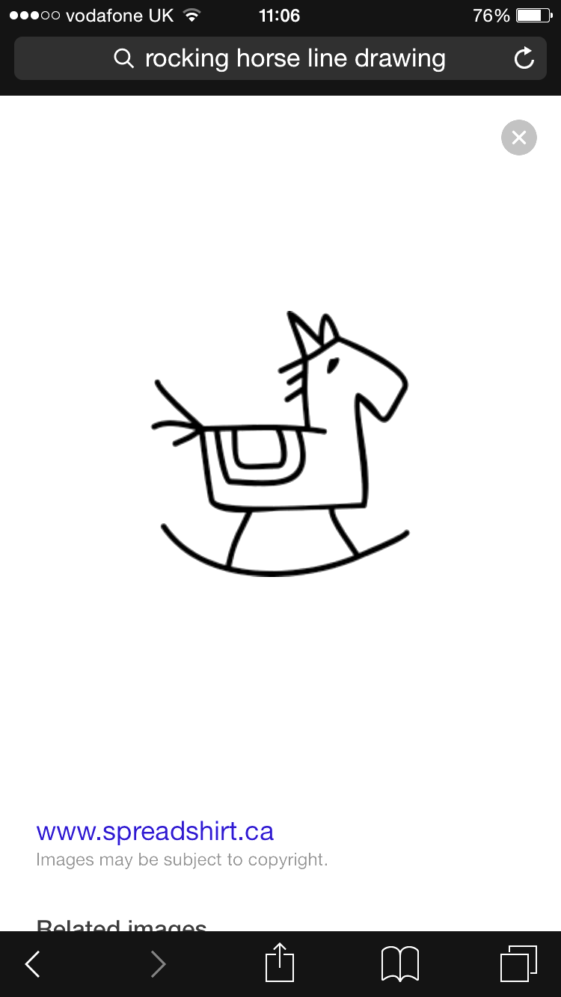
The kind of things I had in mind (without colour) (1)
This was just the kind of thing I had envisaged, but coloured and with some sort of boundary frame which means it could work on any background / photo.
I’m open to other approaches too, but thought it best to share what I had in mind if it helps the creative process.

Slide 10


The kind of things I had in mind (without colour) (2)
I like this rocking horse a lot (albeit I would change the tail a little, give it an eye and perhaps remove the nostril).
Would need to understand how to lock it up with the type (which I have not considered here)
Feel that a more contemporary type vs handwritten type would suit this style horse better

