Slide 1

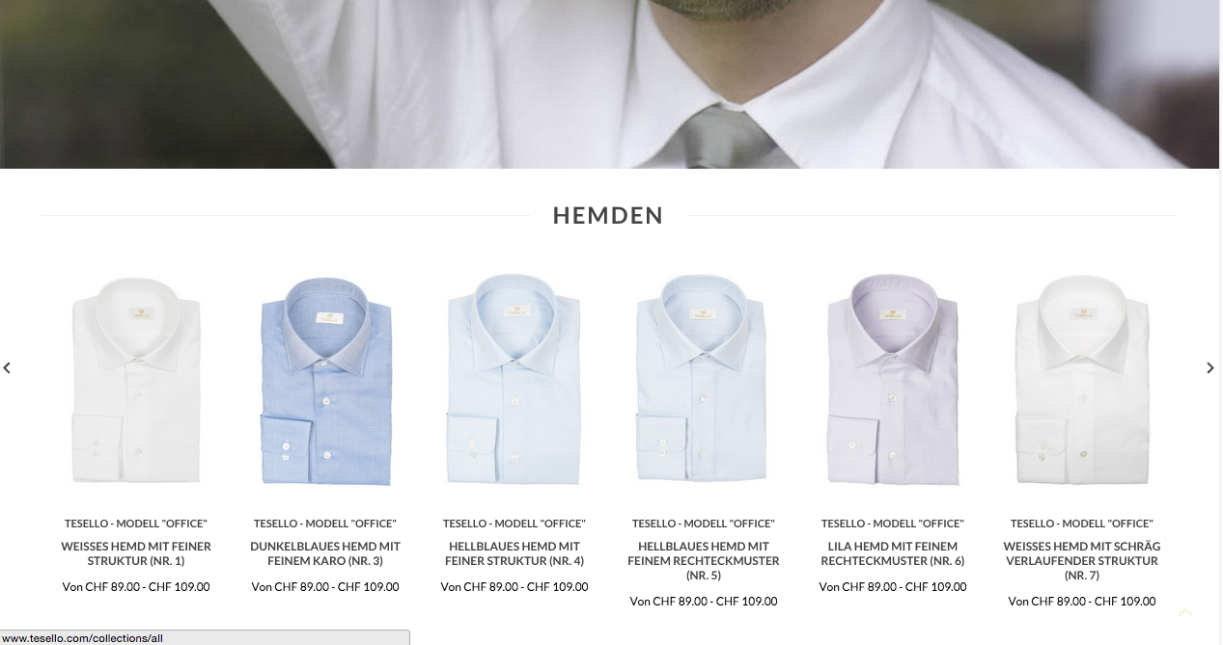
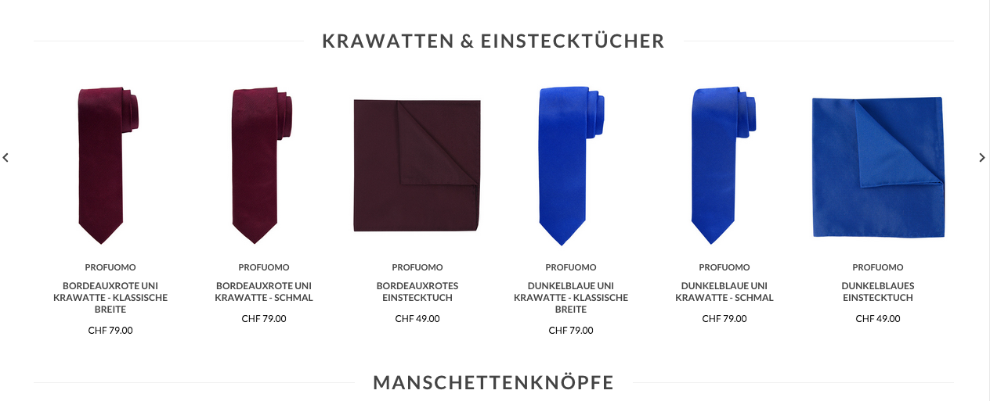
www.tesello.com
The area that need to be redesigned
with the 4 screens/views outlined
on the next pages

Slide 2
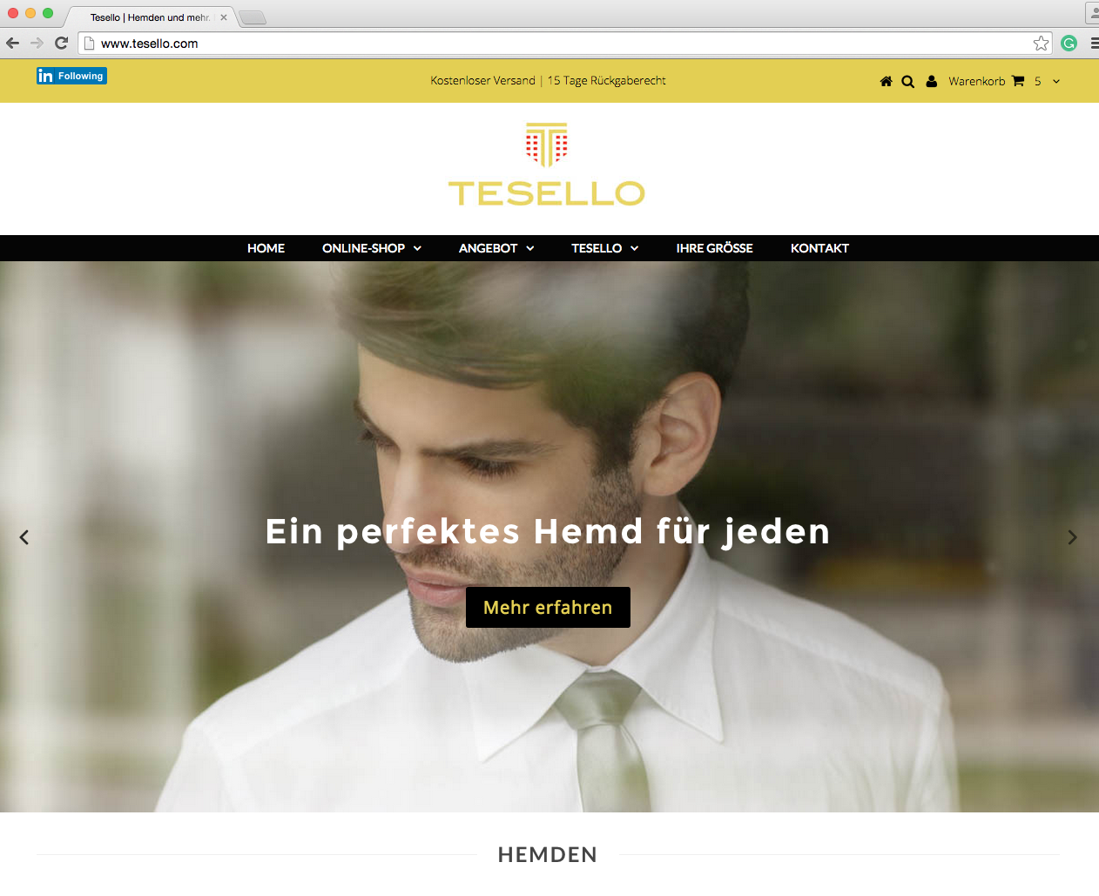
4 different screens/views are needed (1/2)
1
Das perfekte Hemd für jeden
Passend | Einfach | Garantierte Qualität
The perfect shirt for everybody
Fitting | Simple | Guaranteed quality
These texts need to be on the screens/ views
Englisch translation for your beter understanding only. On the screen we need the German terms on the left.
Passend:
114 Grössen: 4 Breiten, 3 Längen, viele Kragenweiten
Alle Modelle in allen Grössen verfügbar
Der stilvoller Business-Look für erfolgreiche Tage im Büro
Fitting:
114 Sizes, 4 widths, 3 lengths, many collar sizes
All models in all sizes available
Always properly dressed for the office
2

Slide 3
4 different screens/views are needed (2/2)
Einfach:
Ohne mühsames Ausmessen
Ohne zeitraubende Shoppingtouren
Jederzeit nachbestellen
Simple:
No need to take measures
No need to go shopping
Can be reordered anytime
3
These texts need to be on the screens/ views
Englisch translation for your beter understanding only. On the screen we need the German terms on the left.
Garantierte Qualität
100% Zufriedenheitsgaratie
15 Tage Rückgaberecht
5 Jahre Knopfhaltegarantie
Guaranteed quality:
15 days right to return
2 years guaranteed quality
5 years guarantee that buttons don‘t fall off
4

