Slide 1

Space between circled links is not the same as the rest. Please make spacing uniform

Slide 2

Greyscale – one of the deliverables (along with multicolored and white-on-black)

Slide 3
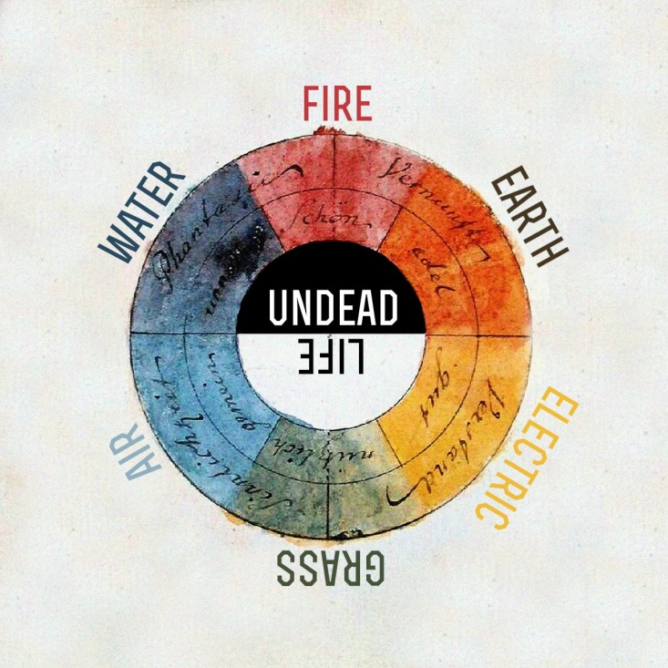
Goethe’s color wheel – this was the inspiration for the colors.
Trying to improve/get approximation that works for logo

Slide 4


Too dull/drab
Too bright

Slide 5
Use these for proof 1

Slide 6
Use these for proof 2

Slide 7
Use these for proof 3

Slide 8
Use these for proof 4

Slide 9
Use these for proof 5

Slide 10
Please propose your own color schemes

