Slide 1








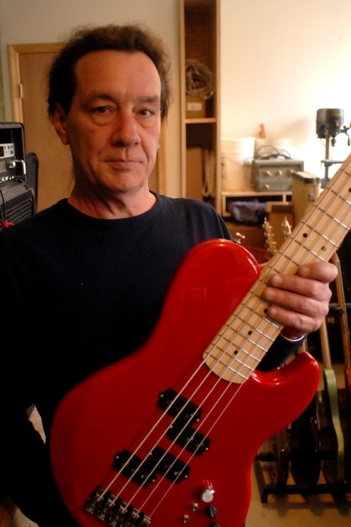
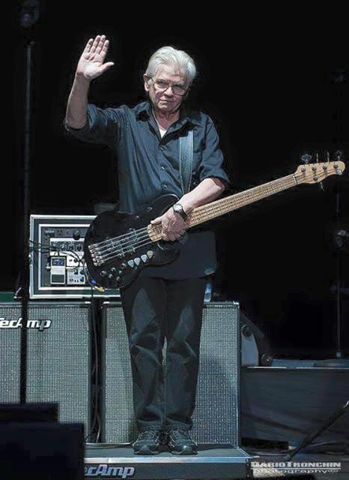
Alien Audio
Premiere instruments and electronics used by professional musicians around the world
Home
Basses
Pre Amps
Artists
Where to Buy
About Us
Contact Us
Designed by Charles “Chopper” Anderson with 40 plus years of playing in almost every conceivable environment; from arenas to small clubs to recording studios around the world
David Hungate with Toto: “The best instrument I have ever played” Bass Player Magazine Oct, 2015
Facebook
Google Plus
???

Slide 2
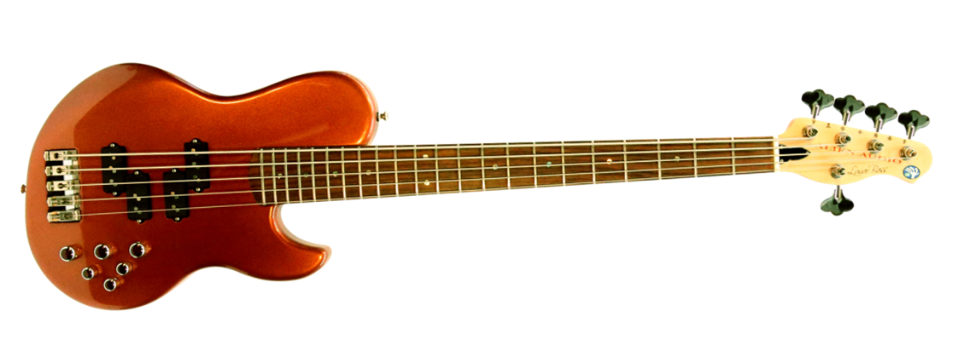
Alien Audio, LLC
Home
Basses
Pre Amps
Artists
Where to Buy
About Us
Contact
Alien Audio Basses
Each bass is handcrafted and built in our shop in Nashville, Tennessee.
Manufactured from premium hardwoods and hand finished in Nashville by, Southbound Custom, a leader in the field of musical instrument finishing and restoration.
Graphite reinforced necks
Nordstrand Pickups, designed to Alien Audio specifications and available in three configurations
Alien Audio BP2-FX Pre-Amp, with 3 band EQ and overdrive, co designed by Chopper and the legendary Mo West.
Hipshot Ultralight Tuners
Precision installed frets, optimized using state of the art Plek machinery
Pro Series
Pro Custom
Downloads

Slide 3
Alien Audio, LLC
Home
Basses
Pre Amps
Artists
Where to Buy
About Us
Contact
Pro-Series
Alien Audio Pro Series Bass
The Alien Audio Pro Series includes the features and performance that musicians around the world have grown to expect from Alien Audio. Comparable to instruments that are considerably more expensive.
Body Style: Constellation or Lunar
Configuration: 4 String or 5 String
Neck Length: 34” or 35”
Body Materials: Alder, Swamp Ash or Walnut
Body Finish: 3-5 options
Neck Materials: Maple or Walnut
Fret Board: Maple or Rosewood
Pickups: Nordstrand Pickups
Pickup Configuration: Double P or PJ
Electronics: Alien Audio BP2-FX Pre amp
Tuners: Hipshot Ultralight Chrome Cloverleaf
Bridge: Hipshot

Slide 4
Alien Audio, LLC
Home
Basses
Pre Amps
Artists
Where to Buy
About Us
Contact
Pro Custom
Alien Audio Pro Custom
Interested in an instrument customized to your exact specification? An Alien Audio Pro-Custom is your ideal choice. Prices vary based on selected options.
Body Style: Constellation or Lunar
Configuration: 4 String or 5 String
Neck Length: 34” or 35”
Body Materials: Alder, Swamp Ash, Walnut, Maple, African mahogany, Bubinga, Wenge
Body Figured Top Woods: Quilted Maple, Flame Maple, Spalted Maple, Burl Maple,
Body Finish: 30 finish Options
Neck Materials: Maple, Walnut, Wenge
Fret Board: Maple, Rosewood, Pistachio, Ebony, Bloodwood, Cocobolo
Pickups: Nordstrand Pickups
Pickup Configuration: Double P, PJ, or Jazz
Electronics: Alien Audio BP2-FX Pre amp
Tuners: Hipshot- Multiple options
Bridge: 2-Teck or Hipshot

