Slide 1




Carma
“Envison the profitability of your future”
CLOUD
ACCESSED
RESOURCE
MANAGEMENT
ASSISTANT

Slide 2
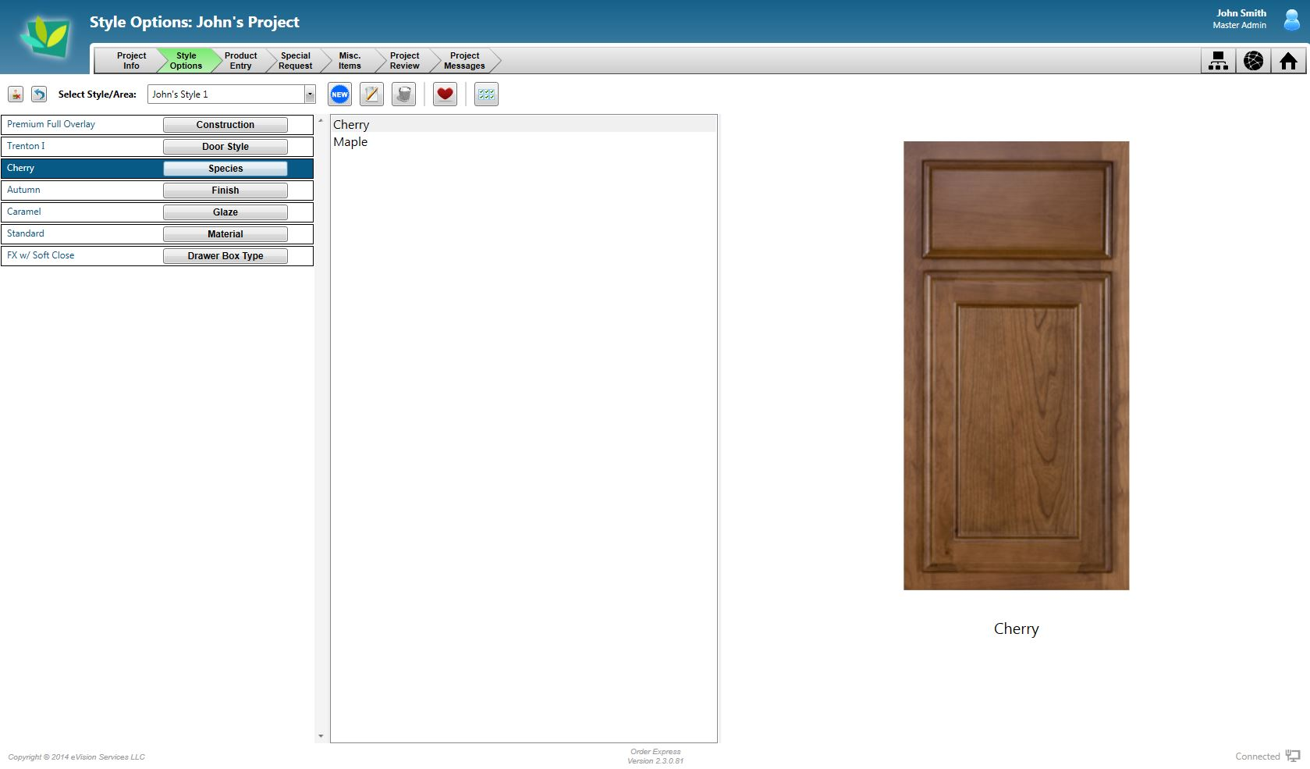

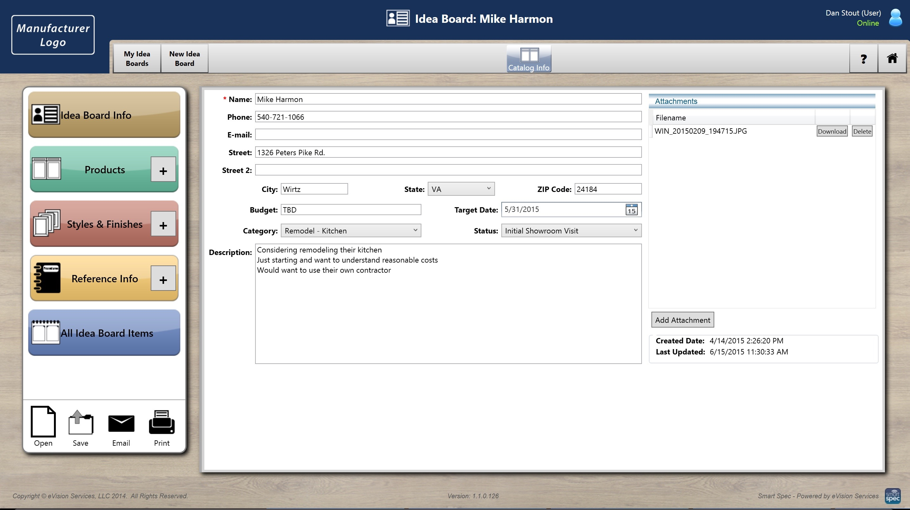
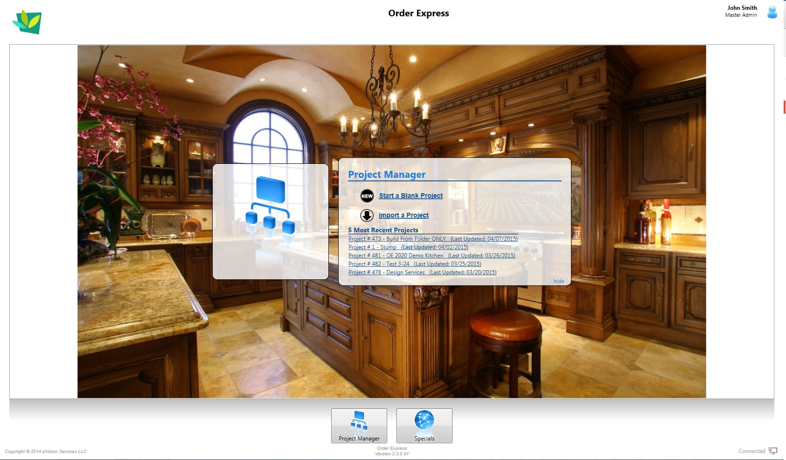

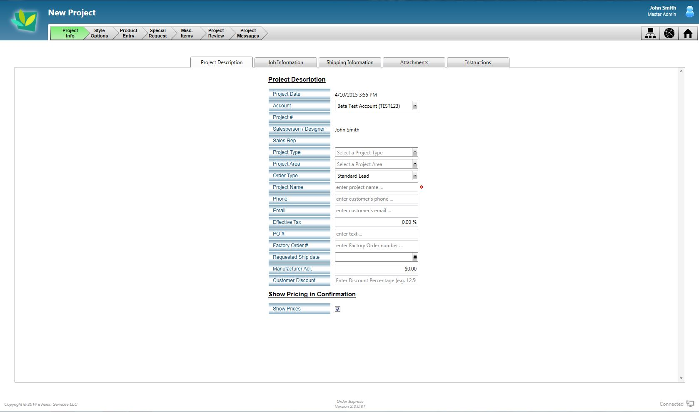
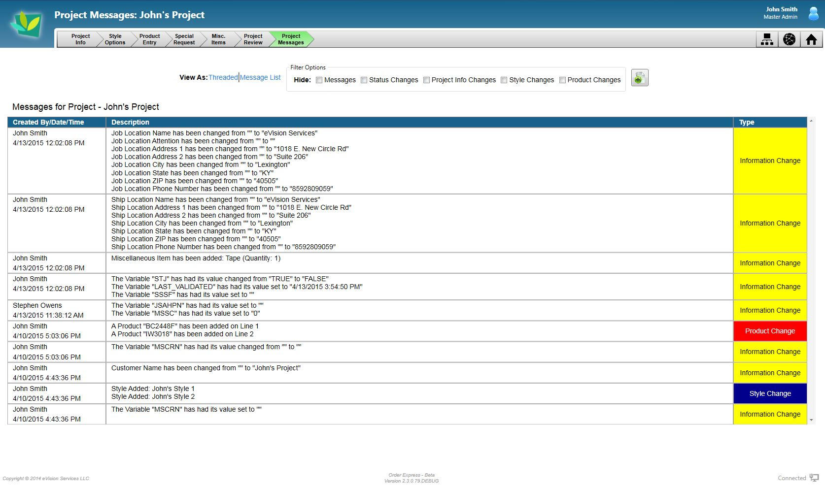
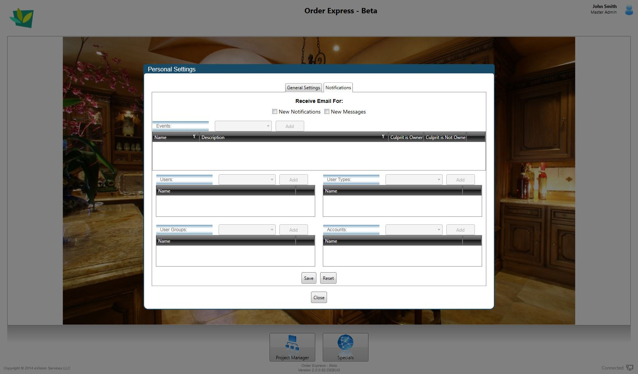
“Envison the profitability of your future”
Making your company easier to do business with !
From the first showroom visit to job completion – eVision has the solution
Order Express
Smart Spec
Carma
Your electronic catalog provider

Slide 3
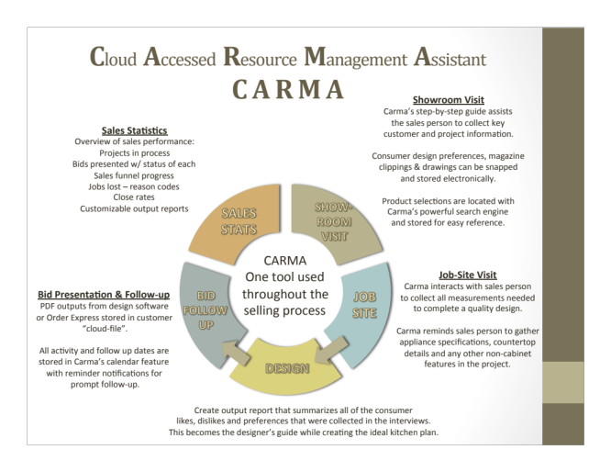

Slide 4


eCatalog Solutions

Slide 5
eCatalog Solutions

