Slide 1
Change the way you invest
Notes:
Hello and welcome to the Wixifi – we are here to reduce the complexity and therefore the time it takes to manage your wealth.

Slide 2
We solve the overwhelming complexity in wealth management by providing an automated app to help people manage their money as well (or even better) than the super rich do.
We make money by charging 0.25% of assets as fees & another ~0.25% from brokering & custody.
Notes:
We solve the overwhelming complexity in wealth management by providing an automated app to help people manage their money as well (or even better) than the super rich do. We make money by charging 0.25% of assets as fees & another ~0.25% from brokering & custody.
Notes:
What is the opportunity?
The problem is that wealth management is too complex and time consuming. Decent solutions are expensive.
The solution is to provide an automated investment advisory service that seamlessly invests the money as per the advice in minutes.
Single sentence – on the slide
Current status
MVP on its way – recommendation engine ready, mock screens ready
SEBI approvals applied and queries resolved. 7 objections reduced to 2 and those 2 are under review.
Analogy: Wealthfront of India.

Slide 3
The Problem
Wealth management is too complex
Complexity comes from excessive choice of products & features
Excessive choice drives up confusion & takes up time
Confusion leads to inaction & low returns*
*We personally have suffered through this cycle
Notes:
The problem is, that, wealth management is too complex for the average person. This complexity emanates from the fact that financial products are made by financial institutions who assume that everyone thinks like an institution. This leads to an explosion of offerings which are highly configurable, leading to excessive choice. For the average person this excessive choice more often than not leads to confusion and eventually inaction. Even those aware of financial products sometimes find it difficult to find time to manage their money. I have personally been a victim of this cycle.

Slide 4
Solution
A mobile & web app that enables customers to:
Simplify
Decision making automated => lesser choice + time
Keep more
Fee is 1/8th of mutual fund => better returns
Act on time
Automated reminders => timely + rational action
Replaces funds, financial advisors, fund distributors, research firms & brokers.
Notes:
The solution lies in a mobile and web app that decides what to do and even does it for you. That too at a fraction of the cost of the traditional alternatives. The app also reminds you on time to take the right action. The fact that rebalancing a portfolio is good for eventual returns is agreed upon by most, but, practically very few people do it – primarily due to the lack of time.
This mobile and web app replaces mutual funds, financial advisors, fund distributors, research firms and brokers.

Slide 5
Why now?
Two
Zero
Well funded online mutual fund distributors in India
Fully automated low cost fee only robo advisors
30
5th
Average age of the Indian mobile banking customer – lowest in the world
India’s rank in mobile banking – ahead of G7. Behind China, South Africa, South Korea & Singapore
Ripe for low cost fee only robo advisors
Notes:
The problem we are trying to solve has been around for ages. The solution has been possible to build for at least half a decade if not longer which begs the question – why now? Well for one India is rapidly growing on the mobile banking front, and is ahead of all the G7 countries. This tells us that there are enough people in the market willing to manage their finances online. Further validation of this is the fact that there are 2 (or maybe 3) well funded online start-ups distributing mutual funds online. The average age of the mobile banking customer in India is 30 which is the lowest in the world. This tells us that the target customer is fairly young and has several years of saving ahead – which will continue to grow our addressable market size.
And despite all this, there is NO fully automated low cost fee only robo advisor available. Which leads us to believe that the time is ripe for this product in the market today.

Slide 6
Customer need
5 Trillion USD
7% vs 37%
Expected assets of US Robo advisors in 2020 growing at 166% CAGR
India’s mutual fund AUM as % of GDP at 7% vs 37% world average and over 100% in the US
150~200 mil USD
> 375 mil USD
Approximate acquisition value of FutureAdvisor by BlackRock
Capital raised by the top 6 robo advisors overseas
Notes:
Whether you are an entrepreneur or investor, everyone looks for validation of a business model from the market. Fortunately for us there is a fair bit of validation out there. For starters Citigroup believes that robo advisors will manage 5 Trillion USD by 2020 – which implies a staggering growth number of 166% CAGR from the current approximately 20 Billion number. This is probably why Wealthfront and Betterment in the US, and, Nutmeg in the UK along with their competitors have cumulatively raised over 375 million US Dollars and all 3 (and maybe more) are expected to become unicorns. It also explains why Blackrock has bought a robo advisor for over 150 mil USD and traditional investment managers like Vanguard and Charles Schwab have setup their own robo advisors.
Over and above that, India’s mutual fund AUM as a % of GDP is at 7% versus the world average at 37% and over 100% in the US. When you put these 2 facts together, you get a market where the growth is 2x per year and a long growth runway ahead which could span several decades.

Slide 7
Market size
400 Bil USD
Direct Equity
200 Bil USD
Mutual fund AUM
Today
+
=
3 Bil USD
Robo advisor Revenue @ 0.3% Fee + 0.2% brokerage & DP fees
2020
8.5 Bil USD
Robo advisor market size in 2020 @ 23% growth
Notes:
Moving on to market size estimation, there is about 200 Billion US Dollars invested in mutual funds in India and about 400 Bil US Dollars in direct equity investments owned by Indian households. Our fee is 0.3% of asset and an addition 0.12% from brokerage and 0.08% from DP fees gets our revenue cap today at about 3 Billion US Dollars. The total market cap of listed companies in India between 2001 and 2015 has grown at 23% CAGR. If we extrapolate this growth we should get a total revenue potential for robo advisors in 2020 at 8.5 Bil USD.

Slide 8
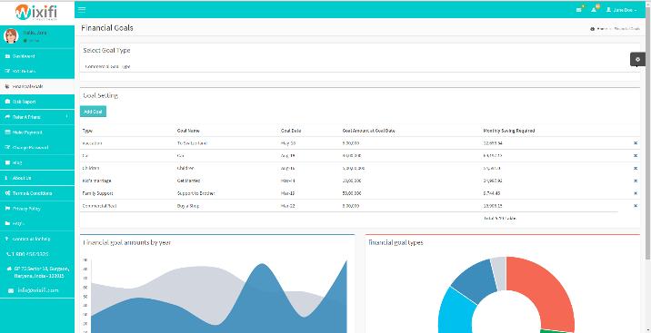
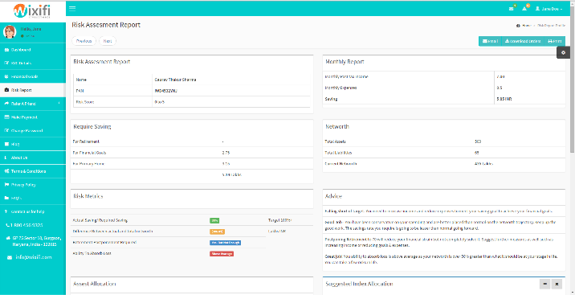
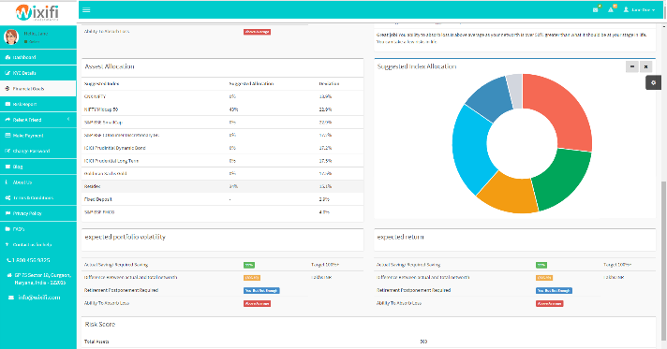
The Product
MVP Feature
MVP Feature
To be built
Tell us about your finances & goals
Review risk profile & investment plan
Invest it!
Notes:
You are probably wondering by now how the advice is going to be delivered and executed. Broadly the system will ask some basic questions about the client such as annual income, expenses, assets and liabilities – questions that the average person understands. Based on this input the app shows you a risk report and a suggested investment plan based . Both these features are a part of the MVP.
Based on this investment plan the user will be able to transfer money into the account and invest as per the investment plan into the various indices. The auto investment system will also rebalance automatically once the client approves.
Overall we expect that a user will be required to spend less than 5 minutes a month on the investing process.

Slide 9
Product architecture
3 tier + secure
Direct stocks
3 tier + secure architecture hosted on AWS
Instead of index ETFs to avoid ETF fees
IP
All in one
Risk profiler, recommendation engine, tax optimizer, basket execution & sign up process
Replaces funds, distributors, brokers & research analysts
Notes:
The product is being hosted on Amazon Web Services (AWS) with a 3 tier, SSL based highly secure architecture. It will invest in direct stocks that form a part of the index rather than ETFs to even save on the 50 bps ETF fee and provide access to a greater number of indicies. Our intellectual property will be in the risk profiling algorithm, recommendation engine based on modern portfolio theory, tax optimization, basket execution of indices and the sign up process. The signup process for traditional DEMAT account providers takes over 2 weeks – we intend to bring this time down to less than an hour through technology.
The product is an all in one solution where the advice, monitoring and execution are all bundled in one simple app.

Slide 10
Business model
We make 0.5% per year on the capital managed through our system
0.3%
Advisory fee
0.12%
Brokerage
0.08%
DP fees
=
+
+
0.5%
Total Fee
>
LTV: 350 USD*
CAC: 175 USD*
0.5%/year * 2 years = 1% of 35K USD is life time value (LTV)
HDFC: 0.19% on promotions + incentives. Wixifi: 0.5% with zero broker incentives as 100% online
* Estimate based on assumptions
Notes:
Our business model dates all the way back to the 1700s when the Rothschild family established their banking business. We simply charge 0.3 percent of assets managed as advisory fees. Over and above this we will have 2 revenue streams – one is from the revenue from brokerage – which will be 12 basis points as this is the same fee that mutual funds typically charge. The DP fees for most accounts works out to well over 8 basis points but we will charge just that.
There is data out there to suggest that the average size of an investors account is about 35K USD and the average holding period in a mutual fund is 2 years, which gives us a life time value of 350 USD per customer. Our goal will be to keep customer acquisition cost at less than 50% of that using growth hacks and online marketing.

Slide 11
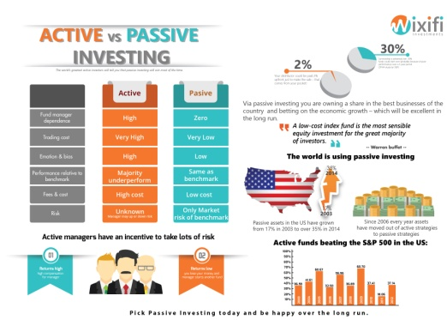

Sales model
INFORM
MARKET
FREE FEATURES
Spread passive investing
Build trust & traffic
Competitor traffic
Wixifi
PR via Infographics
Driving traffic
Google ads
Social media
Brand & trust
TV, newspaper, magazine Roadside, ads
Focussed targeting
Example: Specific real estate project buyers who lost money
Fundamental tools
Stock screeners, P/E graphs
Unbiased visual news
MFs, Prop & FD investors
Real estate news, Price charts, Fixed deposit screeners, Fund screeners
Goal
Get traffic from competition
Convert to passive investing
Sell Wixifi as best passive option
Videos
Notes:
We will have to innovate on the traditional mutual fund sales model in order to succeed. The sales model is based on 3 pillars – Inform, Market and Free features. In the Inform pillar of our model, we will run campaigns around investment themes such as passive versus active investing, or mutual funds vs wixifi or real estate versus wixifi, etc. We will create videos to spread awareness in the market.
Our marketing pillar is based on the usual channels of online and offline advertising. In addition to this we will run focussed campaigns in specific segments of the market such as real estate investors who have lost out by investing in the real estate bubble.
The free features pillar is required to get traffic that is currently going to other sources for these tools or information. The features that will be offered will be those that can directly feed off our database or can be built with little effort. We believe providing tools and information via ad free clean interfaces should drive traffic. The idea is to get traffic from investment realted sites such as moneycontrol.com or 99acres.com.

Slide 12













Competition
Cheap => Better returns
Direct Stocks
ETFs
Excessive Time => Complex
Minimal Time => Simple
Mutual Funds
Real Estate
Fixed Deposits
MF sales online
Expensive => Lower returns
Notes:
Given that it is a centuries old business model the competition is through many sources. Broadly mutual funds and real estate are highly expensive options in terms of transaction costs and advisory fee. Fixed deposits typically give you lower than inflation returns after tax. Mutual fund online sales websites like fundsindia or scripbox are compensated by the mutual fund houses and thus pose a massive principal agent problem. Direct stocks are cheap, especially if you use online discount brokerages, but take up lots of time – so much so that sometimes people do it as a full time job. ETFs are a decent option but still more expensive than Wixifi due to multiple layers of brokerage and higher advisory fee and their breadth of asset types is low. In addition for ETFs you typically have to hire an advisor to tell you which ones to buy which costs even more.
In short robo advisory beats all other options on both cost and time factors.

Slide 13
Competitive Advantage
1st to Market
Simple
Lower Fees
More time to establish brand – once established will have a moat
Transfer money and click invest.
5 minutes per month.
No long reports or stock analysis.
0.3% fee vs
2% for mutual funds
2%+20% for hedge funds
Technology
Service
Regulations
Fully automated.
User does not have to think about the details.
Tax optimized.
Timely rebalancing.
24x7 chat + phone service – No one has time to invest during market hours
Lots of regulations that need to be complied with – We are ahead on this curve
2.5x over 20 years
4.4% / year compounded
Lower fees + Tax + Timely & rational action
Notes:
I could go on and on about Wixifi’s competitive advantages but the top few are early to market, its simplicity – requires just 5 minutes per month, lower fees, technological solutions to the entire stack of wealth management, 24x7 service and last but not the least regulation complexity. The regulation complexity makes it harder for us to setup – but once achieved it is likely to act as a moat.
Overall we believe you could make 2.5x the returns over 20 years if you stick to Wixifi rather than the traditional options.

Slide 14







Team
Ishaan Gupta
Founder, took the idea to MVP in 2 months, Masters in ECE
Wall Street + Technology + Management

Slide 15
Capital raise
For 1.25 years expenses need to raise 7.8 Crores or 1.2mil USD

