Slide 1
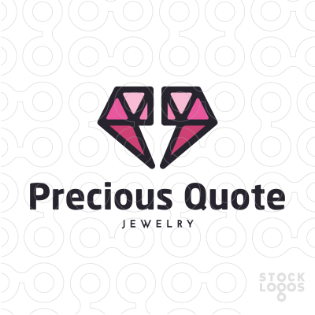

I am open to all creative ideas, but a couple of logos that I’ve seen that got me thinking are below. One idea would be for the logo “object” to be two alpaca heads / necks facing each other and have them form a gem. Below is an example of a logo attempt to make two alpacas a heart as well as an example of two quotes that make a gem. It is interesting to me as the head / neck of an alpaca could be well shaped structurally to pull it off. Just a thought…

Slide 2
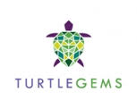
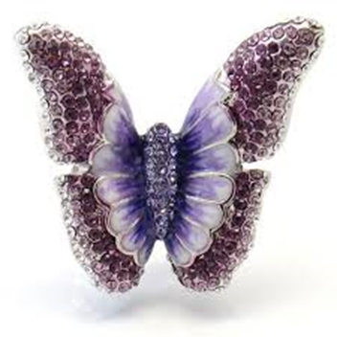
Some examples of gemstone / crystal figures
Here are a couple of examples of objects with a “gem” fill… Could be an alpaca figure or head with a gem fill ??????????????

Slide 3
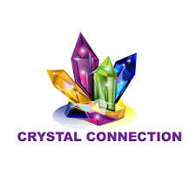
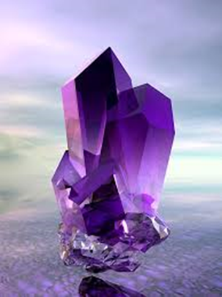
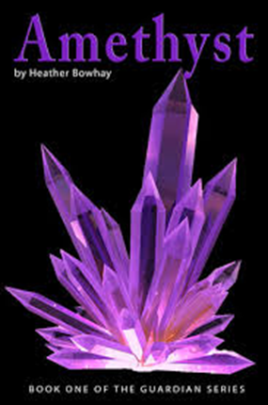
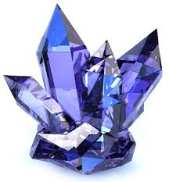
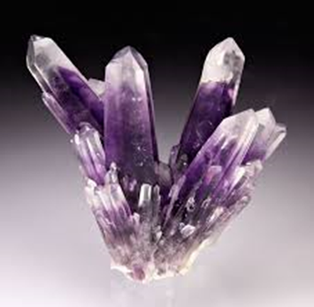
Here are a few examples of the type of crystals I like.

