Slide 1


MEASURE THE SUCCESS OF PR
WWW.CURVEUP.CO
Notes:
I am Rojand From CrveUp , at CurveUp we measure the success of PR

Slide 2
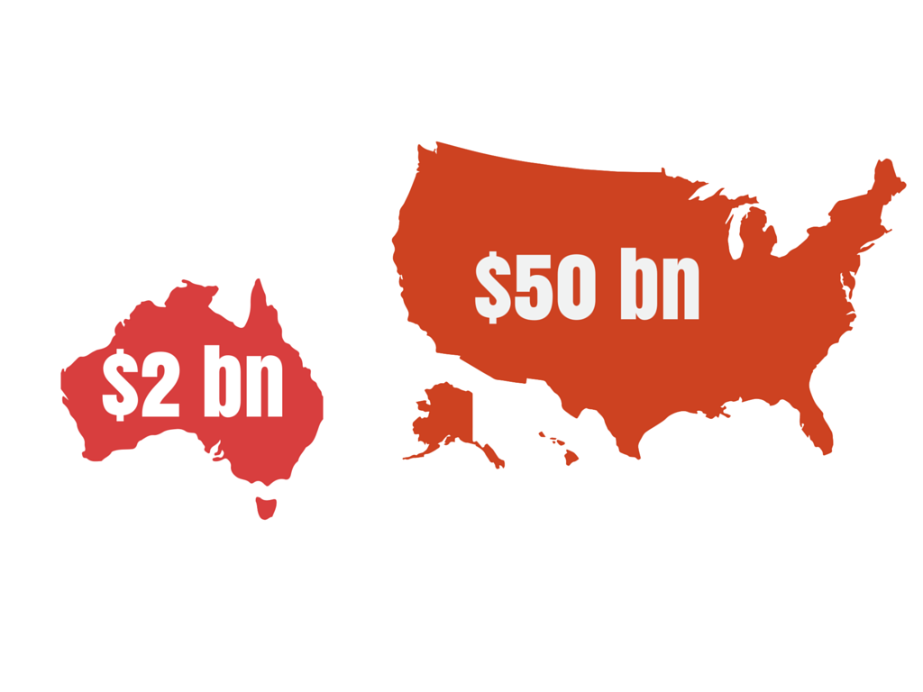
Notes:
In US alone companies spend 14bn directly on PR last year. Plase not that here need to have US map with $14bn

Slide 3

Notes:
They spent on the PR without knowing actually it work or not , you add photos here that describe . For example this photo people spent money on spiritual healing without knowing the result

Slide 4

Notes:
Companies have all the tools available to them to measure their return on he investment in digital marketing or social medica

Slide 5

PR MEASUREMENT
Notes:
But when comes to PR , PR measurements is old school. There are not enough tools and metrics to evaluate directly the result of online PR.

Slide 6
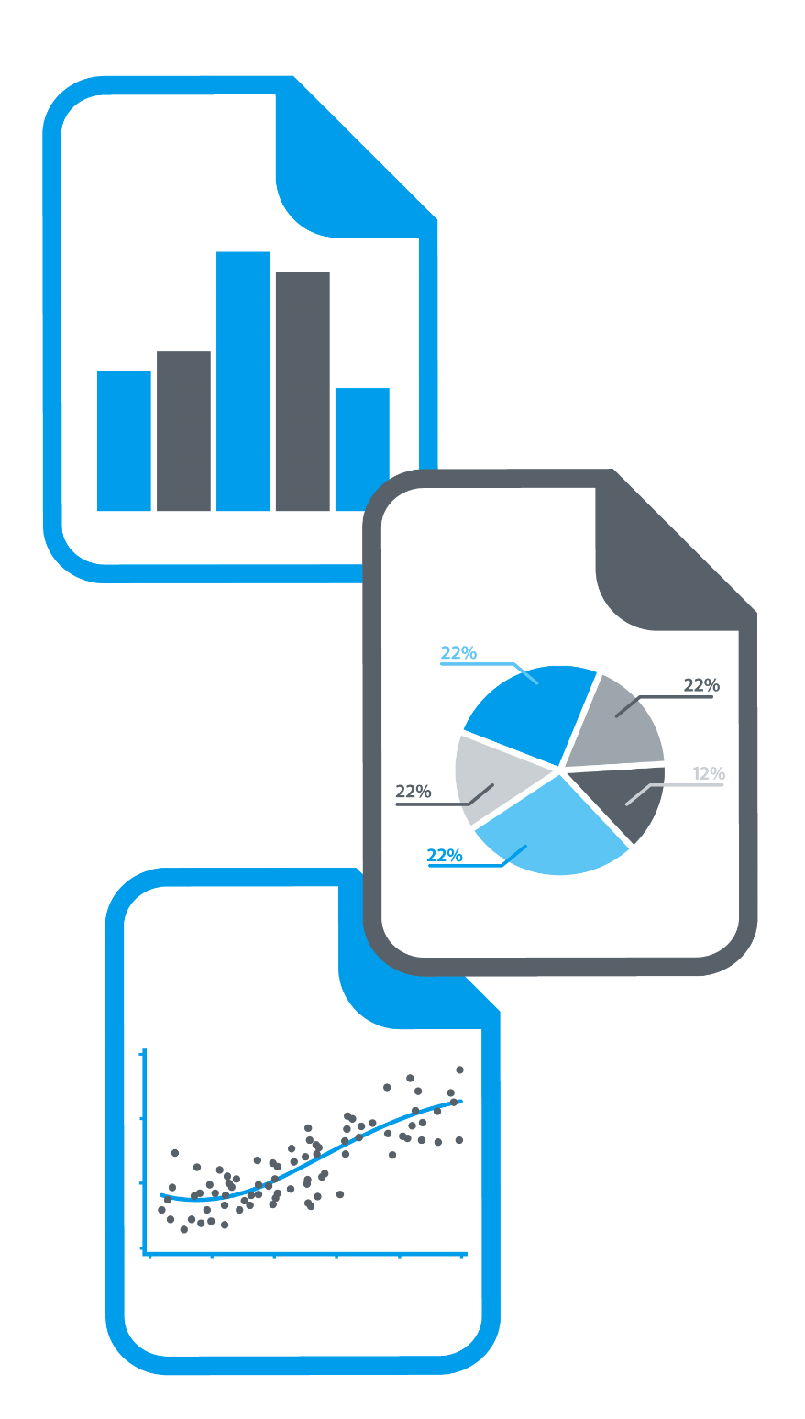


Notes:
CurveUp is the soloution. How ? With curveUp we bring accountability and transparency to PR. CurveUp will collect all digital footprint of client and merge those data with clinest goals and budget. Then it will create a tailored base report for client.

Slide 7
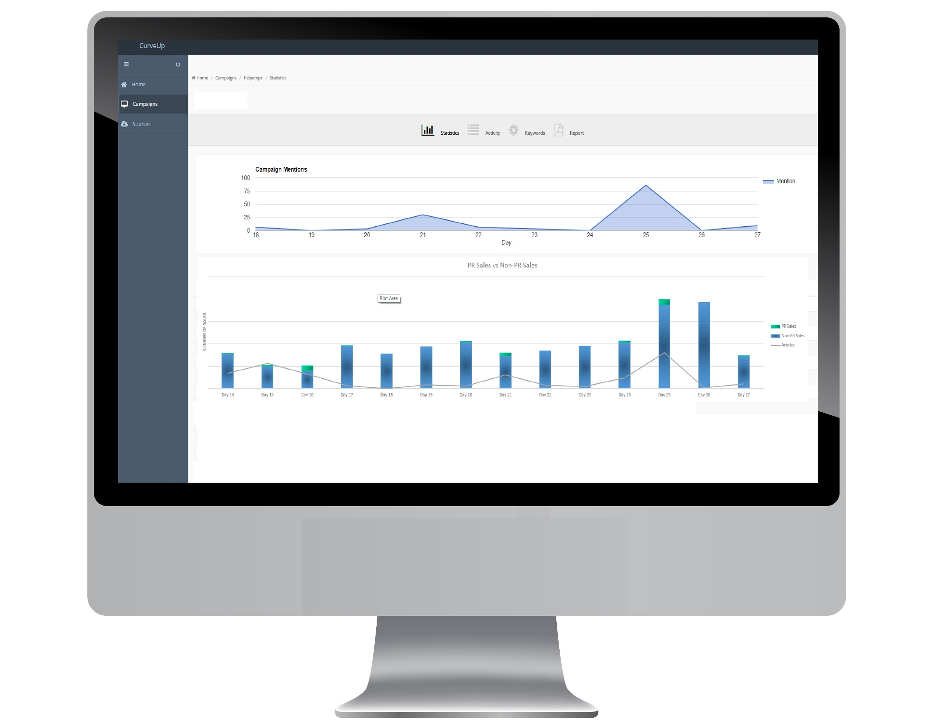
Notes:
With crveup report clients not only can measure the succsees of their current activity but they would have a bench mark for their future PR efforts. They would no for example which blog or articles generate more revenue or impression for their brands. They would know how much and where their should spend their PR budget.

Slide 8

Notes:
We launched our MVP 7 weeks ago and now we are in Bete.
So far we have 25 users.
Etsy Australia they are one of our happy customers
They are in love with CurveUp and they are going to introduce us to their international offices

Slide 9
Notes:
I want to show how big is the industry in Australia UK , Eorupe ad Asia , may be the map of word with numbers in asutralia europ US and UK, I will put correct number later

Slide 10



ROI
No ROI
Notes:
Who are our competitor?
There are lots of player out there. But first of all they do not measure the success they just provided limited metrics with out tie that back to the actual result for the clients
At curveup we measure the direct success of PR activites

Slide 11
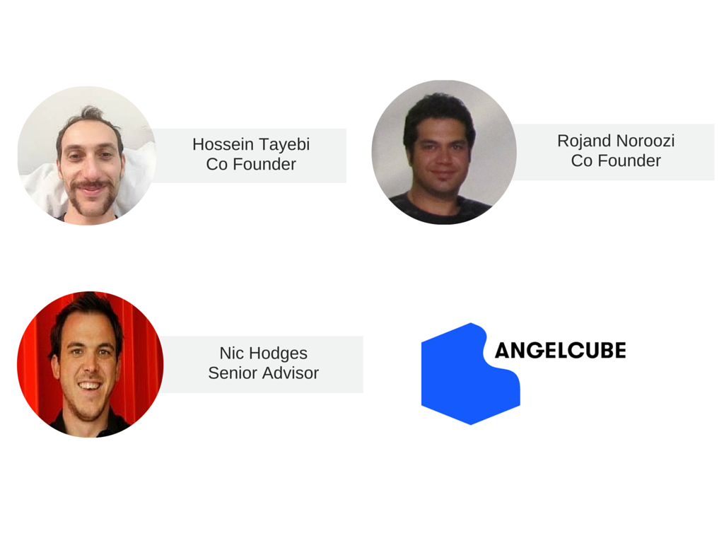

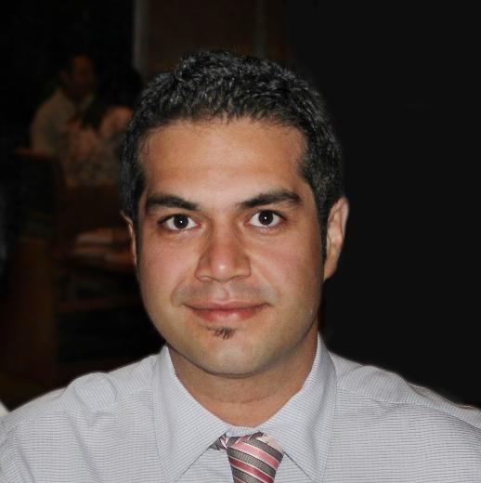
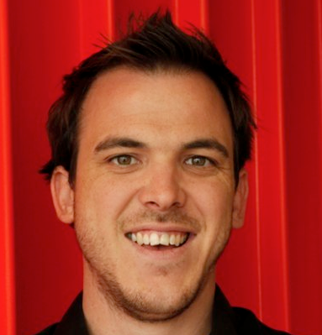
Team
Advisors

Slide 12
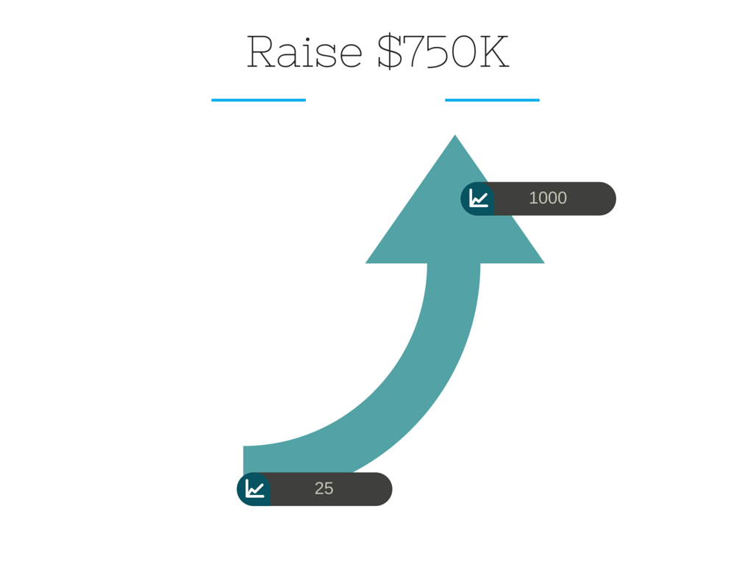
Notes:
We our raising 750k.
We that money we gonna grow our sales and development team and spend on the marketing
Our goals is to get to 1000 customers in q8 month with that money
For this slide I don’t want graph but want some infographic to represent what I am saying

Slide 13
MEASURE THE SUCCESS OF PR
WWW.CURVEUP.CO

Slide 14
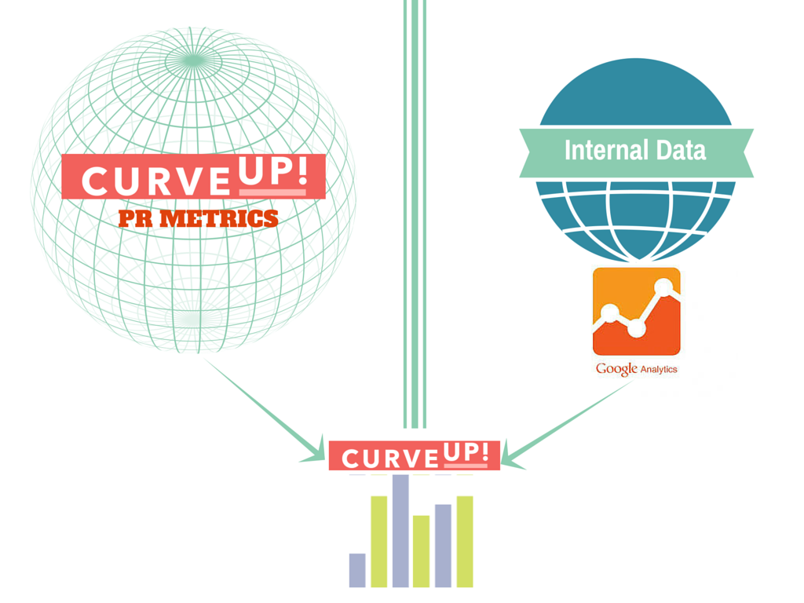
Notes:
This slide is a additional , it shows CurveUp gather all the data from the web and then merge it with internal customer website information then generate revenue

