Slide 1
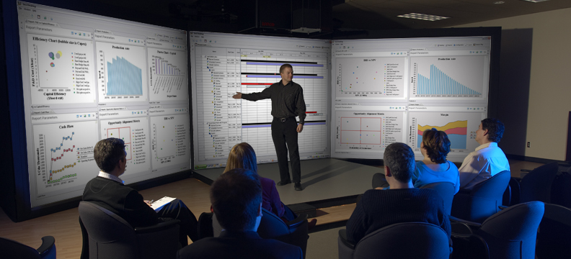
Integrated Business Planning

Slide 2
3esi – enabling shared intelligence
Started operations in 2006
HQ in Calgary; Offices in USA, Europe, Latin America & Australia
Combines a history of successful commercial software (Hyprotech) development with solid Oil & Gas industry expertise
More than 50 installations world-wide
      2 of the top 10 largest Integrated Oil & Gas Companies
      4 of the top 10 largest USA Independent Oil & Gas Companies
FOCUS: Helping upstream Oil & Gas companies to maximize Value with an Integrated Business Planning process.

Slide 3






















Customer Sample

Slide 4
Proven Results
Notes:
Although we have been referring to the esi.schedule application as a New Module, 3esi has been working with a number of customers to prove out the capabilities with some relevant industry challenges.
In this slide we highlight two recent examples:
Example #1
In the 1st example the customer was able to develop a Long Term Plan that delivered a significant improvement in capital efficiency, over the initial plan.
The Asset consisted of ~150 type wells, to model all the different areas of their portfolio.
Using the Type well Scheduling capabilities that we have been discussing, the Business Unit was able to develop its 5 year plan consisting of thousands of wells wells.
And through Analysis and Optimization, the Business Unit was able to consider alternative development programs
They ultimately selected the Plan that maximized Capital Efficiency (or Production for Capital Investment) that best met the Corporate Goals
Example #2
The second example that we highlight here, was recently presented by Sproule and 3esi at the Oil Sands Heavy Oil Technologies Conference in Calgary earlier this month
The use case for the system was the development of an Unconventional Play in Alberta.
The field was already producing;
8 PADs were developed with a capacity of 10-50 wells per PAD
And up to 30 New PADs could be developed within the Field
Considerations that were incorporated into the Development Plan model included the following
- Complex Geological & Reservoir models
- Different PAD configurations based on geography
- Energy requirements to power steam generation and electricity, as part of development
Facility capacities, constraints & schedules including downtimes and contingencies
Dense well spacing over a Large land holding
- Short, mid and long range cash flows with changing economic conditions
- And The procurement of long-lead time Infrastructure, equipment & materials
In Summary
Through the use of esi.manage and esi.schedlue the previous spreadsheet method to develop the Business Plan was minimized
More time was spent on value-added analysis vs spreadsheet model building
A technically robust model was created to visualize results, identify problem areas and make adjustments to optimize the plan.
Quicker more informed decisions were made

Slide 5
Testimonials
“

Slide 6
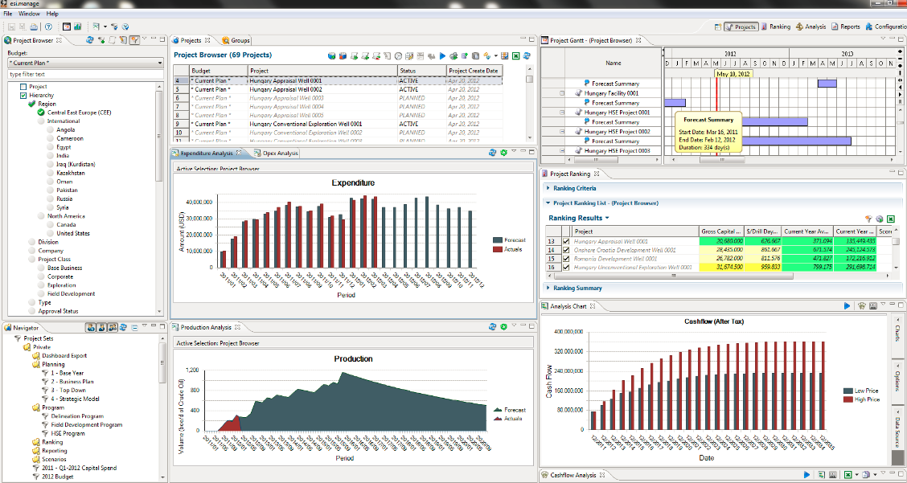
Our Product

